Slide 1
CAPSTONE PROJECT Data analysis using python
Mentor name : Shruti Gode
Student name : Manju Thomas

Slide 2
INTRODUCTION
TMDB provides an api(application programming interface) and downloadable datasets that contain information on thousands of movies and TV shows. Analysts and data scientists can access this data to perform various types of analyses.
The TMDB movie data analysis can vary widely. Common goals include understanding audience preferences, predicting box office success, assessing the impact of genres, analyzing actor/director influence, and evaluating the relationship between ratings and revenue.
Before diving into analysis, it's essential to explore the dataset. This involves checking for missing data, understanding data types, and gaining a general overview of the dataset's structure.
Basic statistics can help provide insights into key metrics like movie budgets, revenue, ratings, and popularity. Common statistics include mean, median, standard deviation, and quartiles.

Slide 3
OBJECTIVE
Analyse movie genres and their popularity, determine which genres are most produced and which are the most profitable.
Analyse the relation of budget and revenue of movies to identify that whether it is a success or failure
Analyse the budget is really a matters of the popularity of a successful movie.
Analyse the top production company ,which produced number of films that comes in success or failure category.
Analyse the runtime of the movie encourage the enthusiasm of movie lovers.

Slide 4
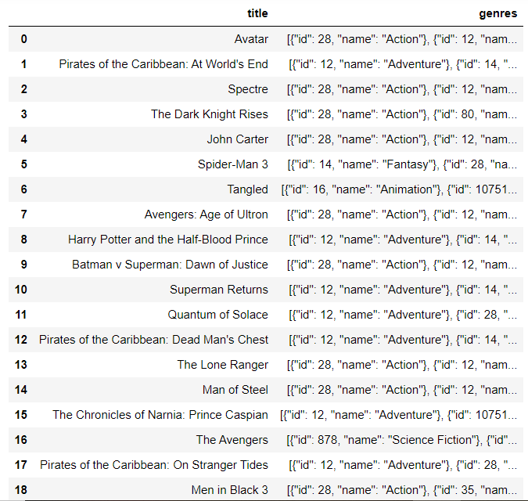

Task1
INTERPRETATION:
Loading the dataset and displaying the number of rows and columns helps understand the dataset's size and complexity.
Displaying the titles and genres of the first 50 movies provides an initial glimpse into the movie categories and themes present in the dataset, giving a brief overview of the diversity of movies included.

Slide 5
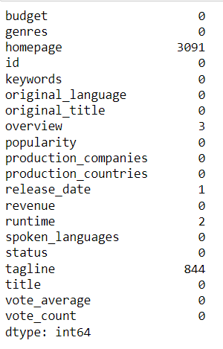
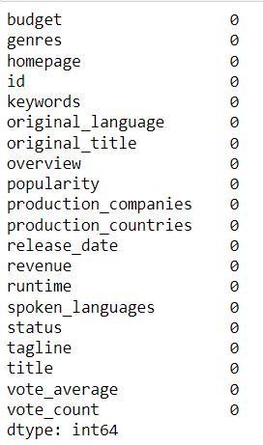
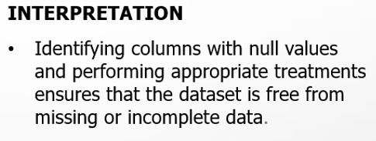
Task2

Slide 6
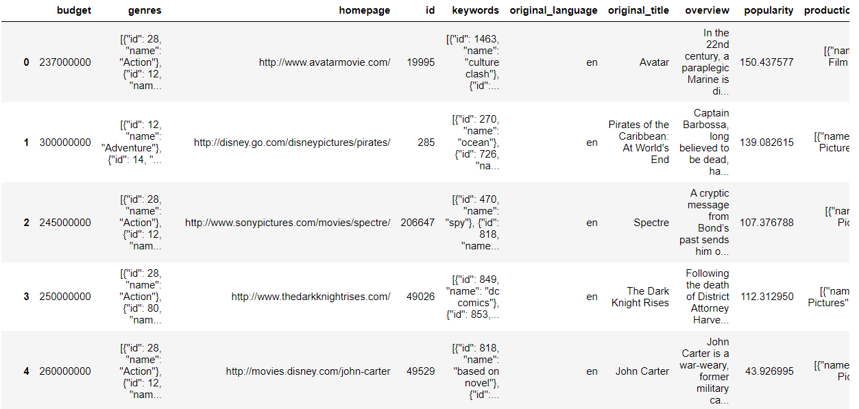

Task3
INTERPRETATION
Displaying movie categories with budgets exceeding $220,000 highlights the investment trends within different genres.
We see that most of the movies belong to the Action, Adventure, Animation, Fantasy and Science Fictions genres.

Slide 7
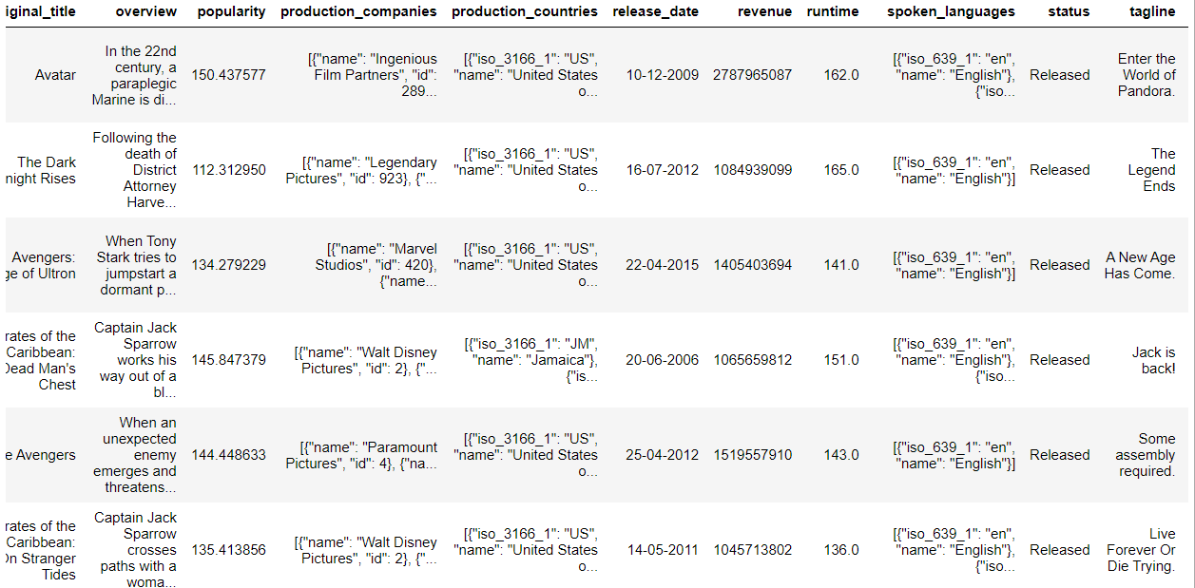

Task4
INTERPRETATION
Display movie categories with revenues greater than $961,000,000 offers insights into the most commercially successful genres.
The genre of movies with high budget is Action and Adventure. Majority of the movie have made revenue more than its budget.

Slide 8
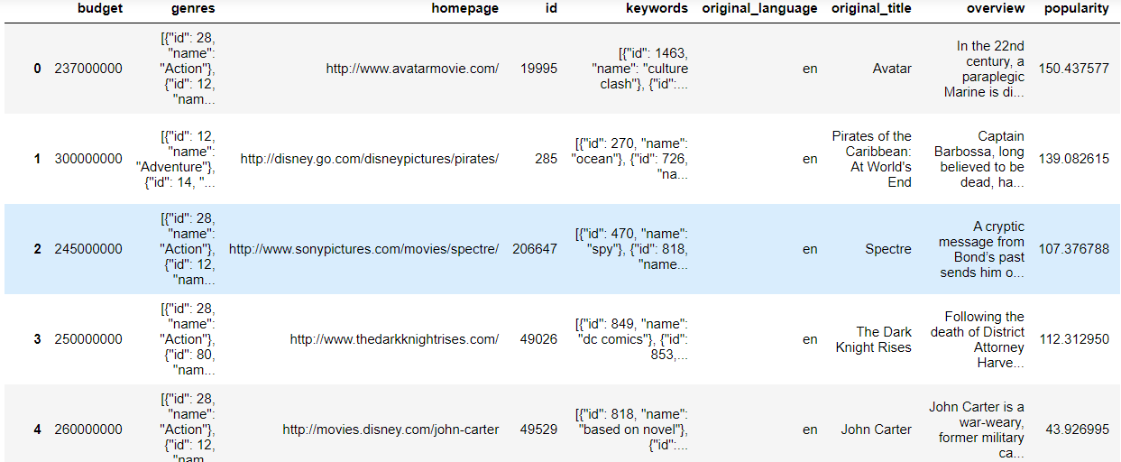

Task5
INTERPRETATION
Removing rows with zero budget and revenue values ensures that the subsequent analysis is based on reliable and meaningful information, as these values indicate missing data.

Slide 9
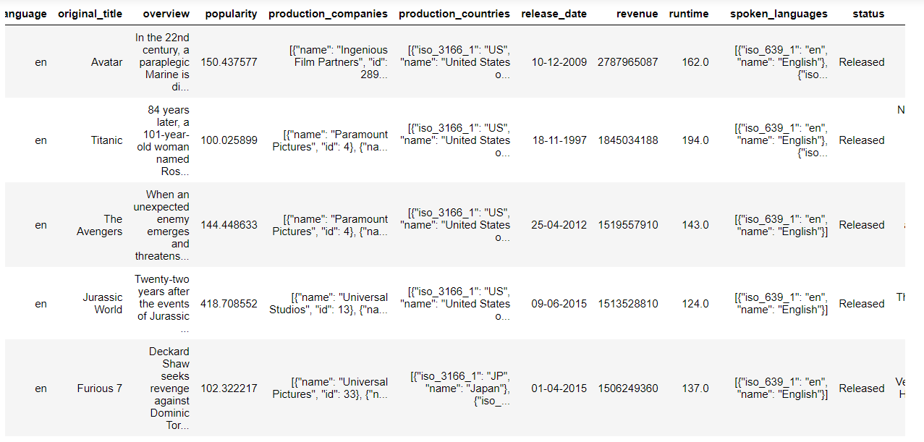
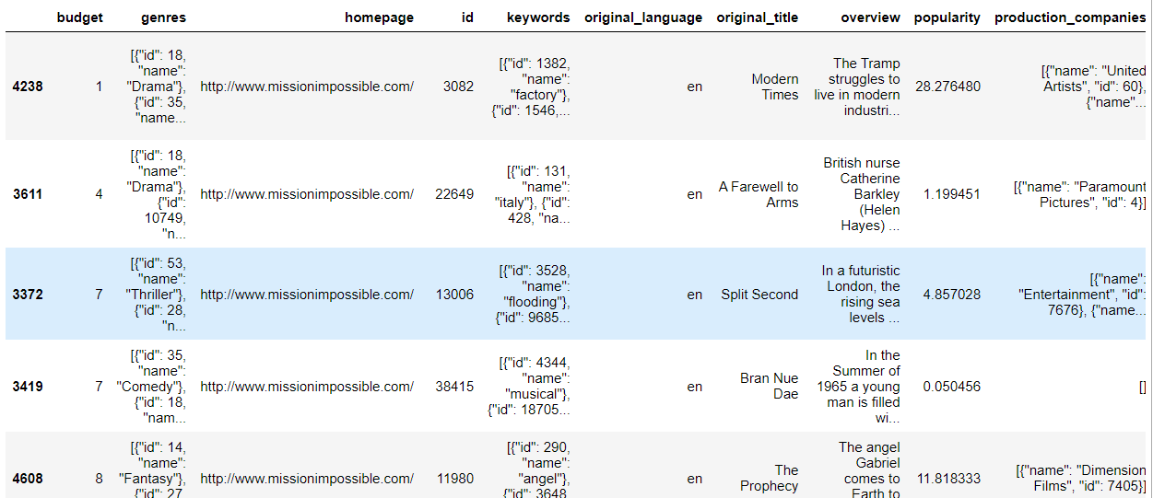
Task6
INTERPRETATION
The movies of Action, Adventure ,Family, Science Fiction, Animation and Drama genres comes in highest revenue making movies, these are highly budgeted movies.
The movies that have low budget belongs to Drama, Thriller, Comedy and Horror, those kind of movies are comparatively low revenue.

Slide 10
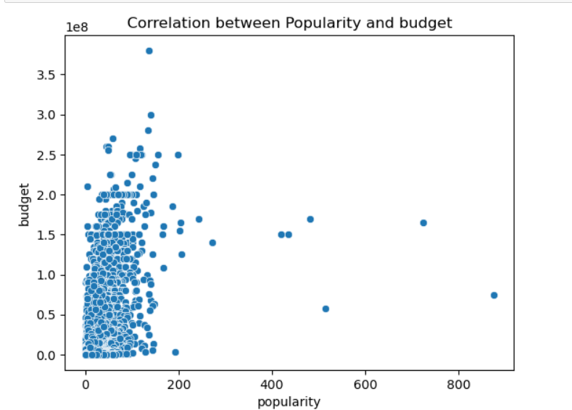
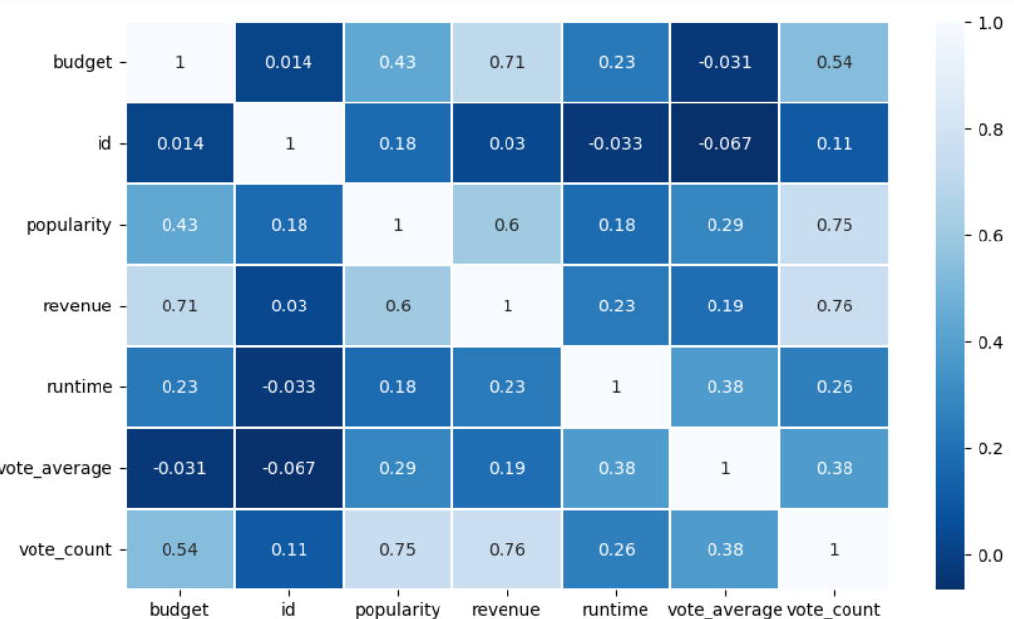
Task7
INTERPRETATION
The scatter plot is use to depict the relation of variables.The haetmap shows more accurate numeric value of correlation. The popularity of movies and its budget is having moderate positive correlation. Only budget cannot decide the success of any movies.

Slide 11
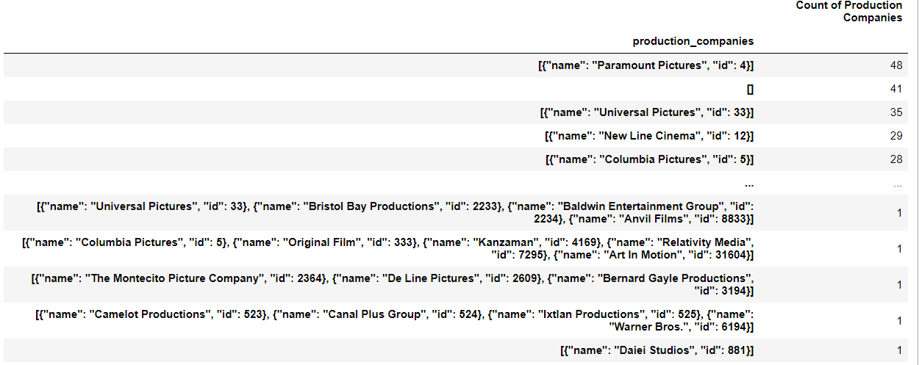

Task8
INTERPRETATION:
Identifying and displaying the names of all production companies along with the number of times they appear in the dataset provides valuable insights into the diversity and distribution of production companies involved in the movies included in the dataset.

Slide 12
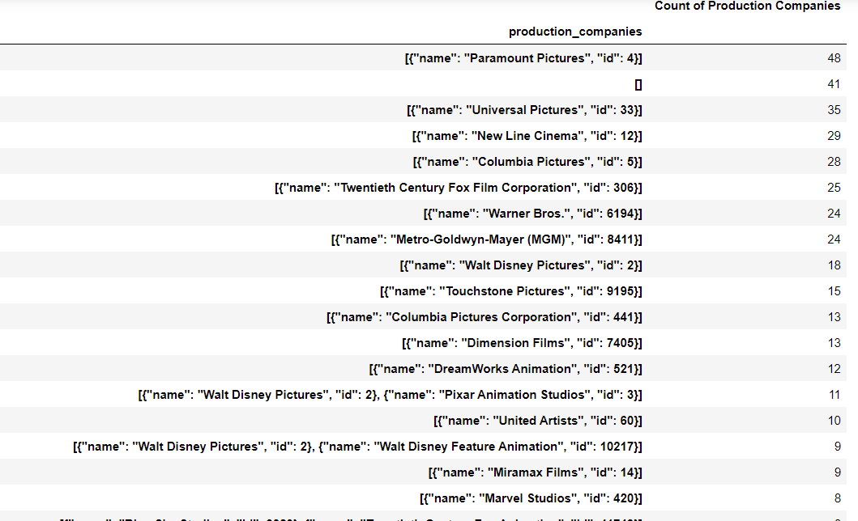
Task9
INTERPRETATION:
Displaying the names of the top 25 production companies based on the number of movies they have produced in descending order helps identify the most prolific production companies within the dataset.

Slide 13
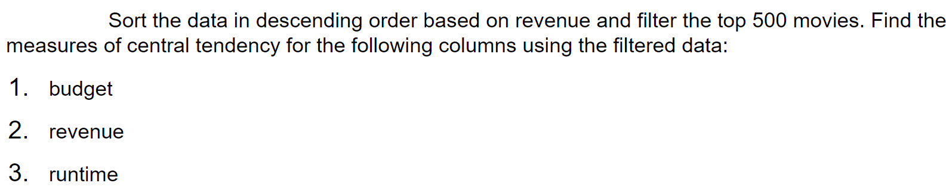
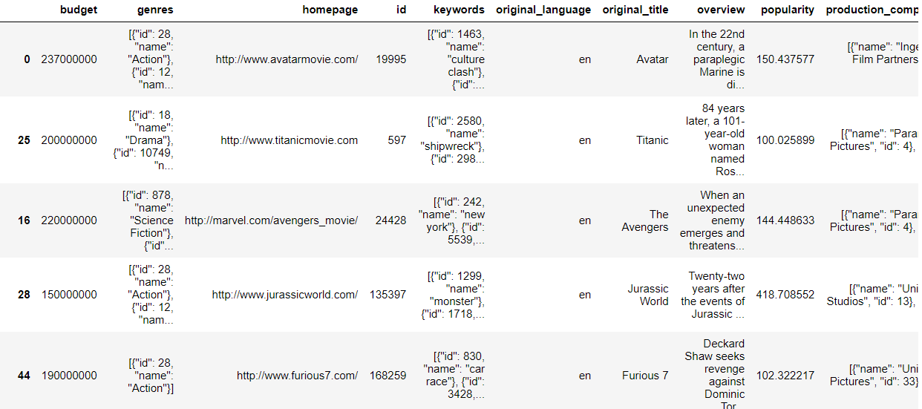

Task10

Slide 14
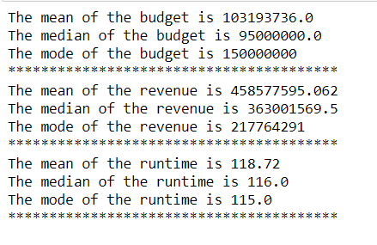
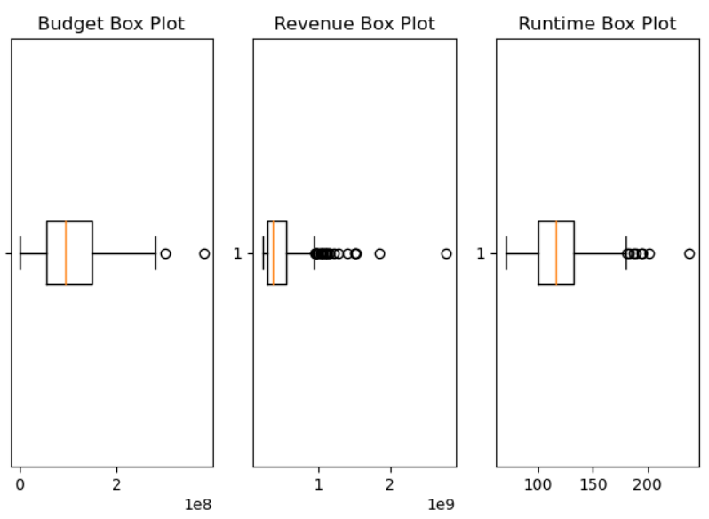
Task10
INTERPRETATION
Mean
Budget: Observations for the mean budget indicate the typical amount invested in producing successful movies.
Revenue: Observations for the mean revenue indicate the typical financial success achieved by these movies.
Runtime:Observations for the mean runtime indicate the typical movie length for successful films.
Median
The median of columns represents the middle value when all values are sorted in ascending order. It is less affected by extreme values and provides insight into values that divides the top 500 movies into two equal halves.
Mode
Budget:Observations for the mode budget show the most common budget range.
Revenue:Observations for the mode revenue show the revenue level that is most prevalent among successful movies.
Runtime:Observations for the mode runtime indicate the prevalent movie length among successful films.
Outliers (Budget Box Plot): Outliers are observations that deviate substantially from the typical budget range and can be seen as exceptionally high or low-budget movies among the top 500.
Outliers (Revenue Box Plot):Outliers in revenue indicate movies with exceptionally high or low earnings compared to the majority of the top 500 movies.
Outliers (Runtime Box Plot):Outliers in runtime represent movies with exceptionally long or short durations compared to the majority of the top 500 movies.

Slide 15
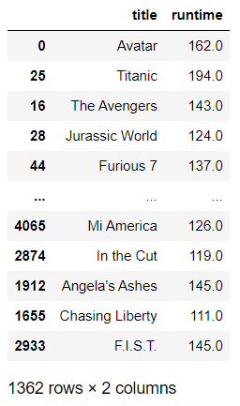
Task11
INTERPRETATION:
By identifying and displaying the names of movies with runtimes above the average, stakeholders in the film industry can gain an understanding of the characteristics of movies that typically have longer durations.
This analysis can help identify patterns or genres that often require more extended storytelling or elaborate plot development.
Understanding the movies with above-average runtimes can assist filmmakers, producers, and distributors in making informed decisions regarding content planning, scheduling, and audience engagement strategies.

Slide 16
INTERPRETATION
We see that most of the movies belong to the Action, Adventure, Animation, Fantasy and Science Fictions genres.
The genre of movies with high budget is Action and Adventure. Majority of the movie have made revenue more than its budget.
The movies of Action, Adventure ,Family, Science Fiction, Animation and Drama genres comes in highest revenue making movies, these are highly budgeted movies.
The movies that have low budget belongs to Drama, Thriller, Comedy and Horror, those kind of movies are comparatively low revenue.
The popularity of movies and its budget is having moderate positive correlation. Only budget cannot decide the success of any movies.
We observe that the production companies Paramount Pictures, Warner Bros, New Line Cinema ,Walt Disney Twelth Century Fox Film Corporation and Columbia Pictures are most frequently appearing film makers. Their movies are in low or high budgeted and revenue as well.
Most of the box office success movies have runtime is between 110 and 200.

Slide 17
CONCLUSION
I observed a positive correlation between a movie's budget and its revenue, indicating that a higher budget often leads to increased financial success. However, this relationship is not linear, and other factors play significant roles in a movie's financial performance.
Certain genres, such as action, adventure, and science fiction, dominate both in terms of production and profitability. It's essential for stakeholders to consider genre popularity when planning movie projects.
The time series analysis revealed that the movie industry has experienced steady growth over time, with peaks in different months or years. Understanding seasonal trends can help with strategic release scheduling.
Some directors and actors exhibit a strong influence on a movie's financial performance and ratings.
Recognizing these influential figures can guide casting choices and directorial appointments.
The development of a movie recommendation system has the potential to enhance user engagement and satisfaction, contributing to a better user experience on movie platforms.
The analysis highlighted the influence of external factors, such as economic conditions and cultural events, on the performance of movies.
Staying attuned to these market dynamics is crucial for adapting to evolving industry trends

Slide 18

INTERPRETATION
Identifying columns with null values and performing appropriate treatments ensures that the dataset is free from missing or incomplete data.

