Slide 1
System Design
Session 2

Slide 2
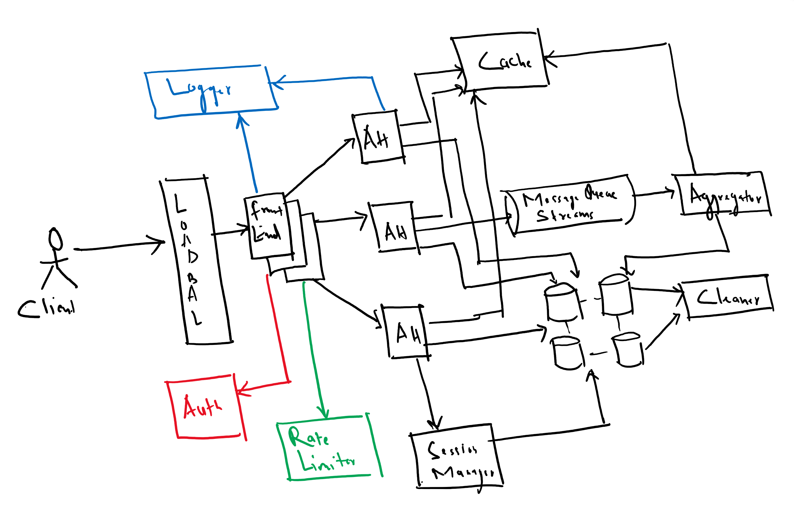





Slide 3
Performance
When we talk about performance it is generally the speed/response time.
If we see high latency, then we say it is poorly performant.
It is a quality metric.
Performance can be poor because of multiple reasons.
Badly written code.
Low performing machines.
Too many network calls.
Slow db queries.
Too much data passing over the network.

Slide 4
Scalability
A service is said to be scalable if when we increase the resources in a system, it results in increased performance in a manner proportional to resources added.
Werner Vogels CTO - Amazon.com
A Word on Scalability - All Things Distributed

Slide 5
Performance Vs Scalability
Performance may improve with scaling but depends upon the system.
Performance depends on Software as well as the scalability and other factors.
When see a dip in performance then scalability comes to our help provided our system is well written to scale.
Performance can also improve by adding caching but reducing network calls etc.

Slide 6

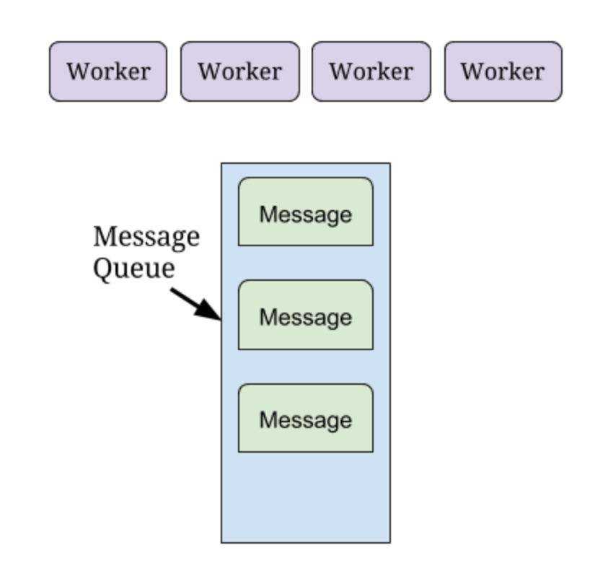

Slide 7
Horizontal vs Vertical Scaling
Adding more power to same machine is vertical scaling.
Adding more machine is horizontal scaling.
Vertical scaling has limits
Horizontal scaling can go unlimited but again depends on the system.
Vertical scaling is easy but has limits.
Horizontal scaling is hard to achieve as it depends hardly on the type of system designed. All systems may not be easily horizontally scaled.

Slide 8
Scaling layers
Load balancers/Reverse Proxy
Application layer
Data layer
Cache layer
Network layer

Slide 9
Latency Vs Throughput
Measuring the level of throughput or latency can help to identify performance issues.
Latency is the time between making a request and beginning to see a result. Some define latency as the time between making a request and the completion of the response
Throughput is the number of items processed per unit time, such as bits transmitted per second, HTTP operations per day, or millions of instructions per second

Slide 10
Break Time for 10 mins

Slide 11
Consistency, Availability and Partition tolerance
Consistency – that reads are always up to date, which means any client making a request to the database will get the same view of data.
Availability – database requests always receive a response (when valid).
Partition tolerance – that a network fault doesn’t prevent messaging between nodes.

Slide 12
CAP Theorem

Slide 13
CAP Theorem Misconceptions
Misconception: CAP is frequently misunderstood as if one has to choose to abandon one of the three guarantees at all times.
Fact: In fact, the choice is really between consistency and availability only when a network partition or failure happens; at all other times, no trade-off has to be made.

Slide 14
Design Twitter
Requirements
Estimations
HLD/Architecture Diagram

Slide 15
Functional Requirements Room1
Posting a tweet
Following another user
Profile update

Slide 16
NF
Low latency

Slide 17
Room 2
2.Post Tweets
3.See the posted Tweets (Home)
4. Follow User
6.Like/Comment/Retweet/Share
6. User’s Timeline

Slide 18
Room 4
2. Follow people
3. Tweet -> text, images
4. Retweet(likes, comments)
5. User Timeline
6. Streaming Analysis of the content-> remove unwanted content, trending
7. Notification service(extended)
8. Search posts/hashtags(extended)
9. Profile of another user and tweet history(extended)
10. Interaction with other apps(extended)

Slide 19
Room 3
Web or mobile?
2.login?
3.can we retweet a tweet?
4.types of input we are considering?
5. should we support multimedia

Slide 20
NF
Low latency
Highly available
Reliable and durable

Slide 21
Requirements
3. Post/Retweet a tweet
4. Like a tweet
5. Follow/unfollow
6. Comment posts
8. Trending hashtags based on geo locations/world
9. User followers feed
10. Searching feeds or based on hashtags
Tweet can have maximum 120 characters, also it can have media files I.e. photo, video etc.

Slide 22
ROOM=01
Fun#:
User should be able to Tweet
User should be able to follow other users
User Timeline Generation
User should be able to Re-Tweet
# tag tranding
NFR (Nonfunctional requirements)
Performance takes priority over Consistency
System should be Scalble and Highly available
Response time for each task ( login, tweet, retweet etc)
Security - Authorization
Cyber Security: How to handle DOS attack
Reliable and durable

Slide 23
1. User can post a tweet.
2. Tweet can have maximum 120 characters, also it can have media files I.e. photo, video etc.
3. User can follow other users
4. User can see tweets from users he is following
5. See Followers and followed users

Slide 24
graph of followers and followee
what user will see time lines
search for hashTags
Tweeter post/ReTweet mechanism
Follow unfollow
-----------------------
Saving static files+ scalable api
authentication
streaming mechanism for posting tweets
caching 10 new tweets for each user
nosql for saving tweets and load on user timeline

Slide 25
Requirements
User Management
Functional
1. Post Message /Re-tweet
1. Image
2. Text
3. Blob etc
2. Comment, Like
3. Reply
4. Follow/Unfollow

Slide 26
Non-Functional
1. Availability, Consistency
2. Security

Slide 27
Requirements
Making a tweet. Limit of 140 chars
Loading the timeline
Following a user
Retweet
Like a tweet
Notification
Handle celebrity

Slide 28
NF
Highly available
Low latency for timeline load
Reliable
Eventual consistency

Slide 29
Estimations
Users – 1 lakh
Write request = 30k And each post has 120char
1 post size = 120 * 1byte = 120bytes * 30000 = 36M bytes * 365 * 5 => 657M bytes
50K active users and each user avg 20 followers. Each followee has 10 posts.
Read requests = 10M per day
Each app server can handle 10k rps
We need 1000 servers
App servers to handle rps.

Slide 30
Room-1
Assuming 1million users tweet and 10 million users read
QPS for read = 50million qps
QPS for writing. = 1million qps
Users, tweets, once a tweet is stored always stored
1 tweet = 5 MB
5 TB/s inbound tweets posted
4,32,000 TB in a day
Roughly 157 million TB in a year
0.1 billion TB in a year
1 billion TB in 10 years

Slide 31
Room-2
Room 2 :Database/Inbound
Posting Write
1m users * 60 * 60 * 24 * 30 *12 *5 years
Posting read
1m users * 60 * 60 * 24 * 30 *12 *5 years * 10
QPS
Posting Write
100,000 users
Posting read
1m users * 60 * 60 * 24 * 30 *12 * 100,000 *10

Slide 32
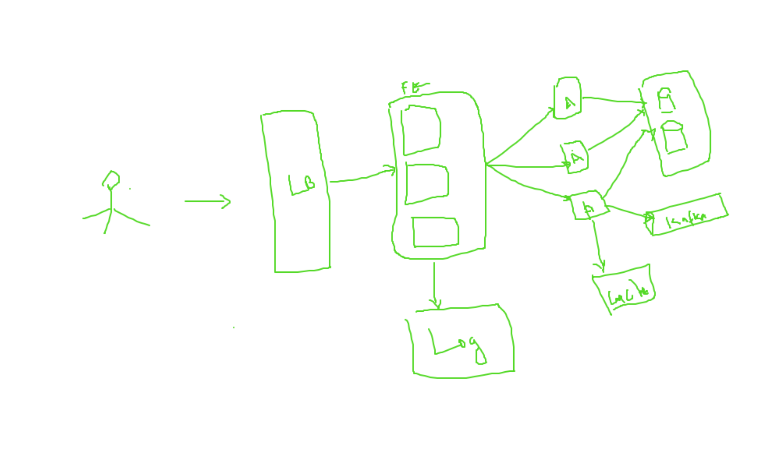

Slide 33
