Slide 1




Slide 2
TITLE :-ESPORTS MANAGEMENT SYSTEM
Presented by:- Manjeet Govind Gupta

Slide 3
INTRODUCTION
Definition:
E-Sports Tournament Management System designed using SQL databases. It stores and manages data related to tournaments, games, teams, matches, and players. The system ensures efficient tracking of tournament schedules, match results, team statistics, and player information.
Key Features:
Centralized storage for all tournament-related data
Easy tracking of matches, scores, and winners
Management of teams, players, and their performance
Reports for analyzing team and player statistics
Importance:
Helps tournament organizers to manage events efficiently
Reduces manual errors and saves time
Provides insights on team performance and player statistics
Visual Suggestion:
Use a diagram showing relationships between Tables: Players → Teams → Matches → Tournaments → Games

Slide 4
OBJECTIVES
Efficient Data Management:
  To organize all tournament-related data in a structured database.
Automated Match Tracking:
  To automatically track match results, scores, and winners using SQL queries.
Team & Player Insights:
  To provide detailed statistics about teams and players for performance analysis.
Integration with Games:
  To manage multiple games and tournaments simultaneously within a single system.
Data Consistency & Integrity:
  To maintain accurate relationships between teams, players, and tournaments using proper database constraints like primary keys and foreign keys.
Scalable System:
  To allow future addition of more tournaments, teams, matches, and players without affecting existing data.

Slide 5
Database Design / Database Schema
Database Name: Esports
DATABASE create Syntax:- CREATE DATABASE Esports;
SELECT database syntax:-USE ESPORTS;
Purpose: To store and manage all data related to Players, Teams, Tournaments, Matches, and Games
Tables Created:-
Players Table → Stores player details (name, age, nationality, role, join date, etc.)
Teams Table → Stores team details (team name, country, coach, founded year, total wins, etc.)
Games Table → Stores esports game details (game name, genre, release year, rating, etc.)
Tournaments Table → Stores tournament details (tournament name, location, prize pool, dates, etc.)
Matches Table → Stores match details (tournament, teams, scores, winner, date, etc.)

Slide 6
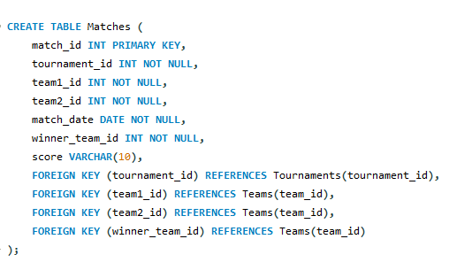
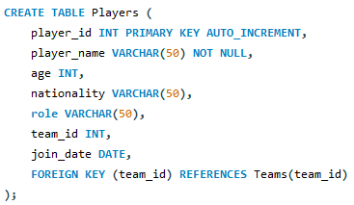
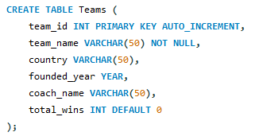
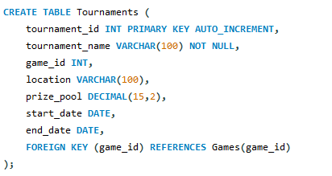
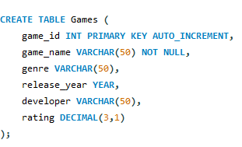
TABLE CREEATION SQL QUERY OF ALL 5 TABLES SYNTAX:-

Slide 7

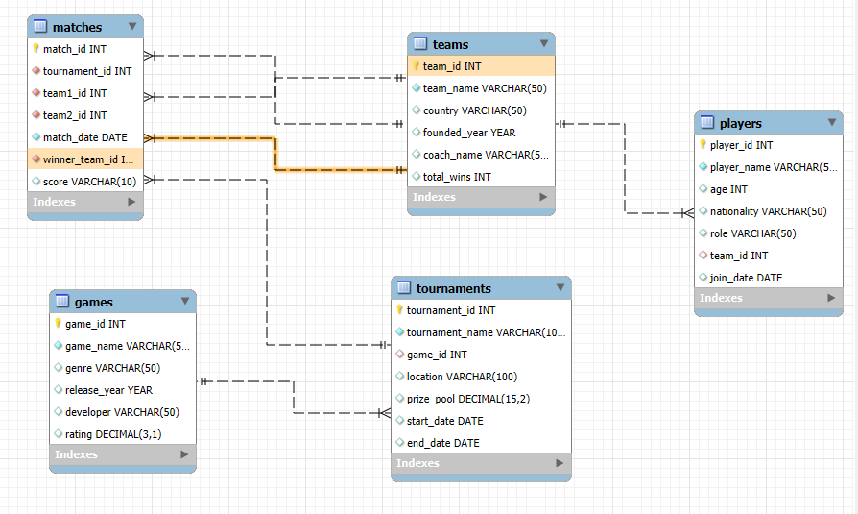
ER DIAGRAM

Slide 8


Insert Data into Columns of Table Using This Syntax

Slide 9


Insert Data into Columns of Table Using This Syntax

Slide 10


Insert Data into Columns of Table Using This Syntax

Slide 11


Insert Data into Columns of Table Using This Syntax

Slide 12


Insert Data into Columns of Table Using This Syntax

Slide 13
To add entries (such as new columns) to the players table using the ALTER function in SQL, the correct approach is to use the ALTER TABLE statement. Note that ALTER TABLE is used for changing the structure of the table (for example, adding/removing columns), not for inserting records. To insert data (entries), use the INSERT INTO statement.
ALTER TABLE players ADD COLUMN column_name datatype;
USE this syntax for drop database or table;
DROP database databse_name; --use for drop database
DROP TABLE table_name; --use for drop table

Slide 14

Q1. Find the average age of players, and also the youngest and oldest player.
Syntax:-
Output:-
SELECT
AVG(age),
MIN(age),
MAX(age)
FROM Players;

Slide 15
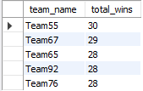
Q2. Write a query of the top 5 teams with the highest total wins.
Syntax:-
Output:-
SELECT team_name, total_wins
FROM Teams
ORDER BY total_wins DESC
LIMIT 5;

Slide 16
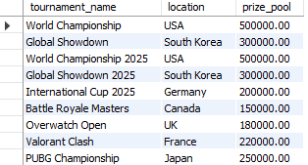
Q3. Find the tournaments whose prize pool is greater than the average prize pool of all tournaments. Display the tournament name, location, and prize pool.
Query:
SELECT tournament_name, location, prize_pool
FROM Tournaments
WHERE prize_pool > (
SELECT AVG(prize_pool)
FROM Tournaments
);

Slide 17
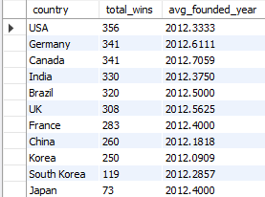
Q4. Write a query to find the total wins of teams for each country and also show the average founding year of the teams. Sort the results by total wins from highest to lowest.
Syntax:-
Output:-
SELECT country,
SUM(total_wins)
AVG(founded_year)
FROM Teams
GROUP BY country
ORDER BY total_wins DESC;

Slide 18


Q5. Find the locations where the total prize pool of all tournaments held there is greater than 1000000. Display the location and the total prize pool.
Output:-
SELECT location, SUM(prize_pool)
FROM Tournaments
GROUP BY location
HAVING SUM(prize_pool) > 1000000;

Slide 19
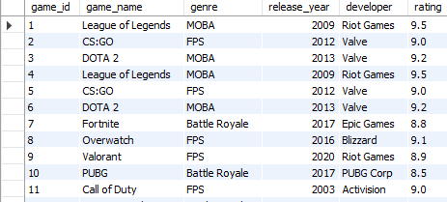
Q6. Find players whose role does NOT contain 'Captain' using NOT LIKE.
SELECT game_name
FROM games
WHERE game_name LIKE '%Battle%';

Slide 20
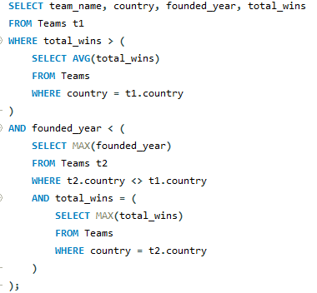
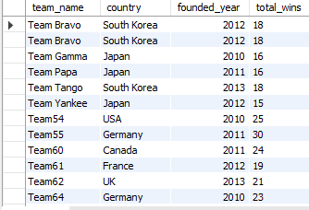
Q7.Find the teams that have more total wins than the average wins of their country and were founded before the newest team with maximum wins from another country. Display the team name, country, founding year, and total wins.

Slide 21
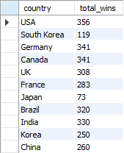
Q8. Find the countries where the total wins of teams is greater than the average total wins of all teams across all countries. Display country name and total wins.
SELECT country, SUM(total_wins
FROM teams
GROUP BY country
HAVING SUM(total_wins) > (
SELECT AVG(total_wins)
FROM teams
);

Slide 22
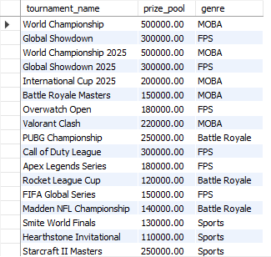
Q9. Write a query to display tournament name, game name, and location where the prize pool is greater than 1,00,000 and the game genre is 'FPS’.
SELECT tr.tournament_name, tr.prize_pool, g.genre FROM tournaments tr, games g where tr.game_id = g.game_id AND prize_pool > 100000;

Slide 23
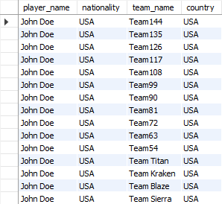
Q10. List all possible combinations of players and teams, but only show those where the player’s nationality matches the team’s country. Display player name, nationality, team name, and country. Cross join:-
SELECT p.player_name, p.nationality, t.team_name, t.country FROM Players p, Teams t WHERE p.nationality = t.country;

Slide 24
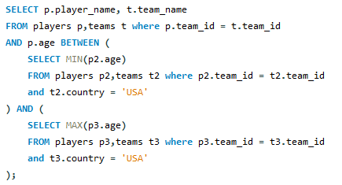
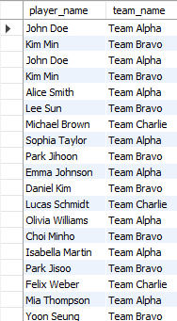
Q11. Write a query to display the player's name and team name of all players whose age is between the minimum and maximum ages of players in the USA team.

Slide 25
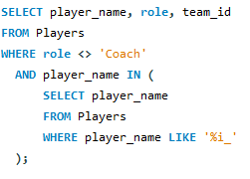
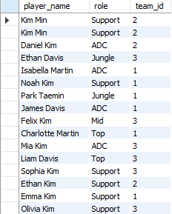
Q12. Write a query to display all players whose role does not include “Coach” and whose player name has the letter ‘i’ as the second last character.

Slide 26
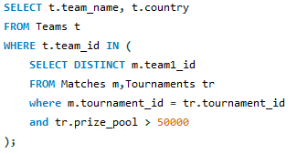
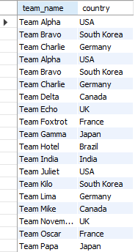
Q13. Write a query to display the team name along with country for all teams that are participating in tournaments with a prize pool greater than 50000.

Slide 27
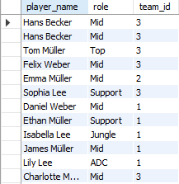
Q14. Display all players whose player_name has the letter ‘2’ as the last character and who are not Coaches.
SELECT player_name, role, team_id
FROM Players
WHERE role <> 'Coach'
AND SUBSTRING(player_name, -2, 1) = 'e';

Slide 28
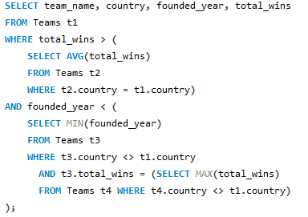
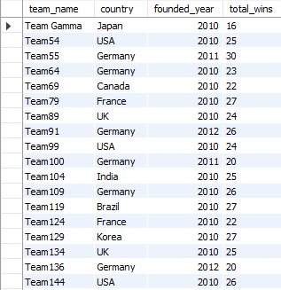

Q15. Find the team(s) that have total wins greater than the average wins of teams from the same country, and whose founding year is earlier than the youngest team from a different country with maximum wins. Display the teams name, country, founded year, and total wins.

Slide 29

THANK YOU

