Slide 1
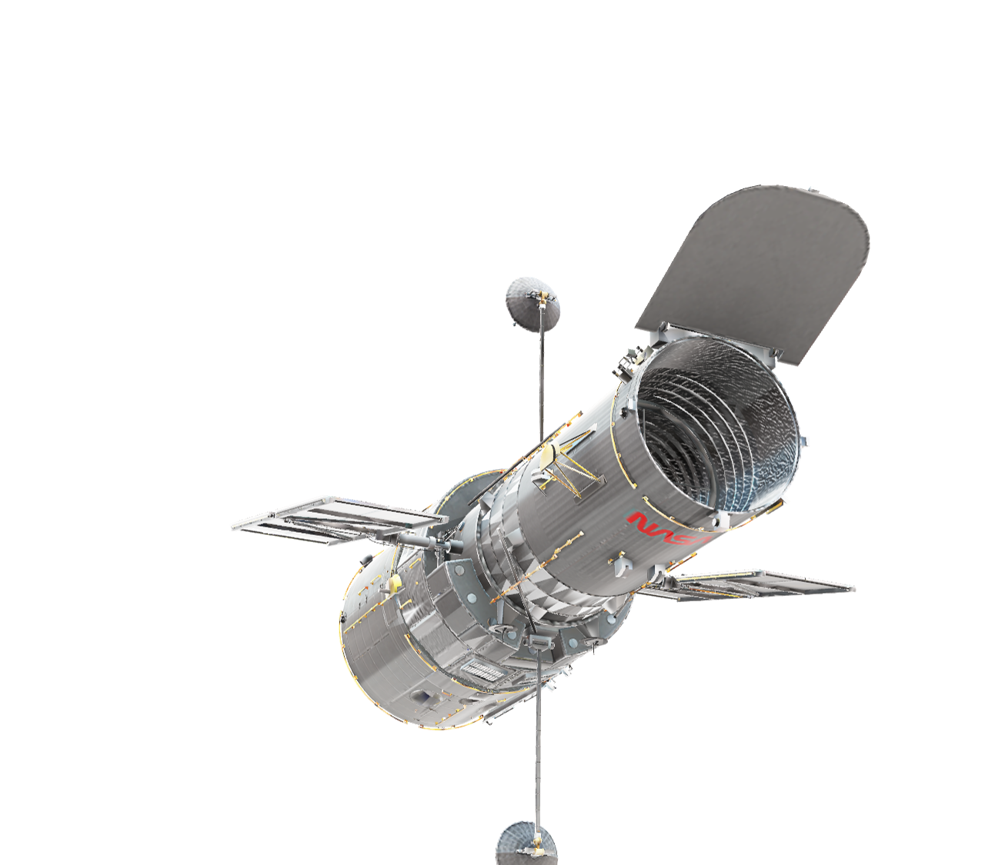
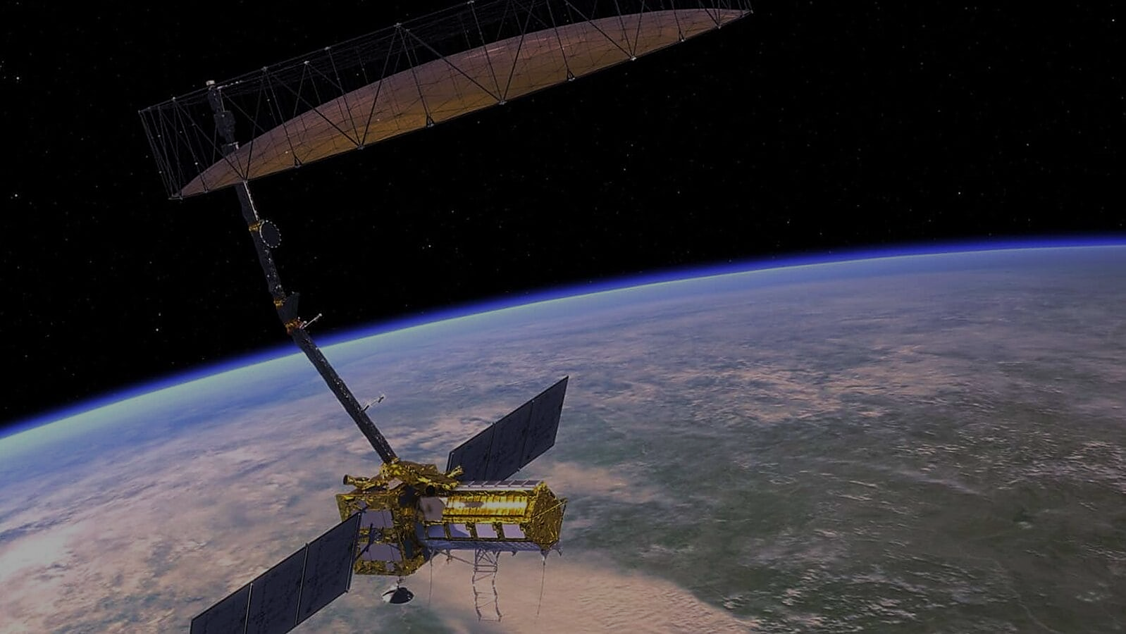
Team name: XDevs
MOSDAC AI CHAT-BOT
Team Leader Name : Manjeet
Problem Statement: AI-based Help bot for information retrieval out of a knowledge graph created based on static/dynamic content at a web portal.

Slide 2
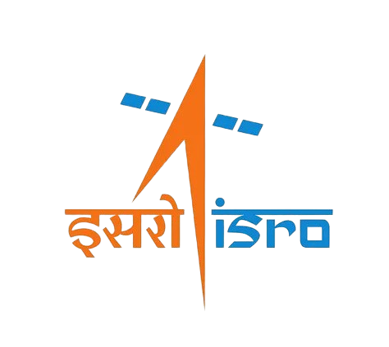
Team Member Details:
- Team Leader:
Name: Manjeet
College: IIMT University, Meerut
- Team Member 2:
Name: Punit Pal
College: IIMT University, Meerut
- Team Member 3:
Name: Arpit Govil
College: IIMT University, Meerut
- Team Member 4:
Name: Priyanshu Sonkar
College: IIMT University, Meerut

Slide 3
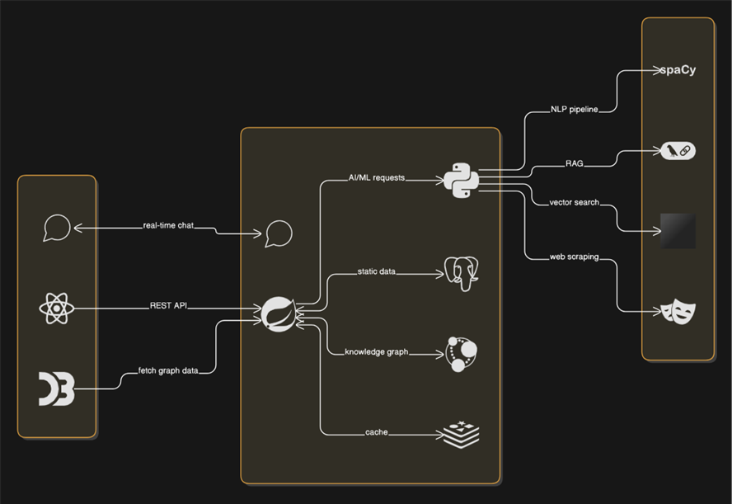
Project Idea Overview
🚀 The Big Idea:
Navigating satellite data shouldn't feel like rocket science. Our solution transforms complex, layered information into simple, human-like conversations—powered by AI, natural language understanding, and smart data extraction.
🌟 Our Vision:
Imagine asking a chatbot: “Show me rainfall data from INSAT-3D for the past week”—and getting a direct, accurate response in seconds.
We’re building an intelligent assistant that understands natural questions about satellite missions, data products, and services—and responds instantly using a knowledge graph and NLP.

Slide 4
Uniqueness & Problem Solving
Different from Existing Ideas:
  Combines static and dynamic data handling—most bots handle only one.
  Builds an evolving knowledge graph in real time.
  Uses intent-aware routing to deliver precise answers fast.
How It Solves the Problem
  Translates complex site navigation into natural conversation.
  Provides contextual responses using both historical and live data.
  Supports semantic understanding—not just keyword matching.
Our USP
  A modular, reusable AI assistant for scientific portals.
  Smart caching for real-time queries boosts performance over time.
  Designed for scalability across ISRO’s entire data ecosystem.

Slide 5
Core Capabilities:
1️⃣ Understands Natural Language in a Smart, Human-Like Way
The assistant can interpret everyday language, allowing users to ask questions in simple terms—like “Show me rainfall data from last week for Kerala”—without needing technical knowledge or exact keywords.
2️⃣ Retrieves Both Static Information and Live Satellite Data
Whether the answer lies in a user manual, product catalog, or needs real-time satellite imagery, the bot knows where to look. It intelligently decides when to search pre-existing data or fetch fresh information from the live MOSDAC portal.
3️⃣ Keeps Track of the Conversation for Contextual Responses
The bot remembers what the user said earlier, making follow-up questions feel natural. For example, if you ask about a satellite and then say “show rainfall from it,” it understands what "it" refers to—just like a human would.
4️⃣ Gets Smarter Over Time by Learning from Users
Every interaction helps improve the system. The bot adapts to new types of queries, identifies gaps in knowledge, and expands its responses based on feedback—ensuring that it becomes more accurate and helpful with use.

Slide 6
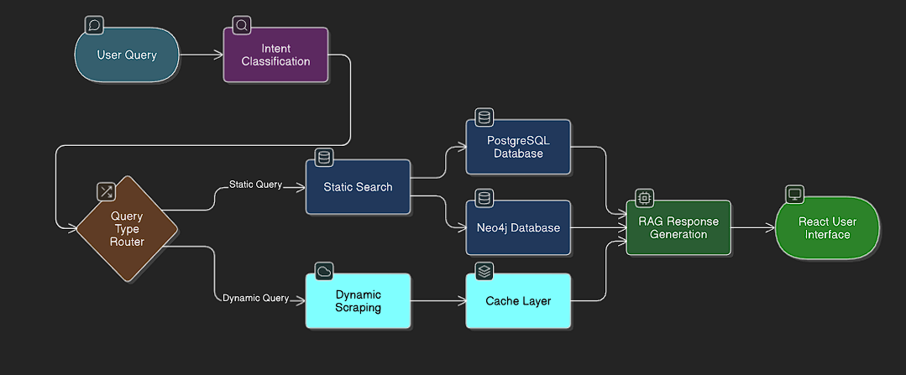
System flow diagram:

Slide 7
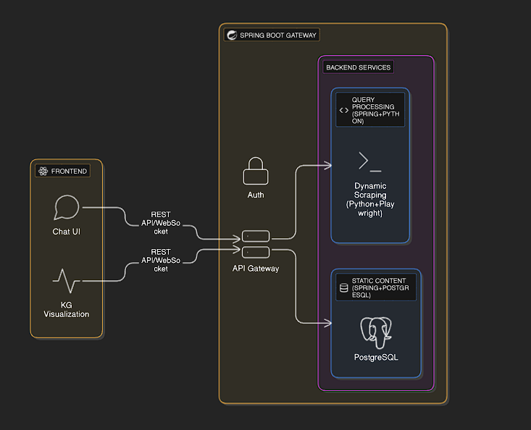
Architecture diagram:
🖥️ Frontend (React.js):
At the top, users interact with a sleek chatbot interface built using React.js. This isn’t just a chat box—it also shows visualizations from the knowledge graph so users can explore data relationships in a more intuitive way.
🚪 Spring Boot Gateway:
Every request goes through a central Spring Boot API Gateway. Think of this as the system’s traffic controller. It handles authentication, routing, and ensures the right services are triggered at the right time.
🔍 Query Processing Service :
Once the user's query is received, the Query Processing Service—powered by a mix of Spring Boot and Python—analyzes it using AI models. It detects the intent behind the query and figures out whether it can be answered from static content or needs dynamic data.
📚 Static Content Service:
If the answer is something that’s already available—like an FAQ, documentation, or metadata—it’s retrieved from a well-organized PostgreSQL database through the Static Content Service. This service quickly fetches and formats answers using pre-indexed data.
🌐 Dynamic Scraping Service:
If the query demands up-to-the-minute information (like the latest satellite imagery), the system calls in the Dynamic Scraping Service. This module, built in Python with Playwright, browses the MOSDAC portal live—just like a human would—and pulls the latest data instantly.

Slide 8
Technology Stack:
Frontend
Backend
AI / ML

Slide 9
Thank You

