Slide 1



SMART INDIA HACKATHON 2025
  Problem Statement ID – SIH25013
  Theme- Transportation & Logistics
  Problem Statement - Real-Time Public Transport Tracking for Small Cities
  PS Category- Software/Hardware
  Team Name : xDevs

Slide 2
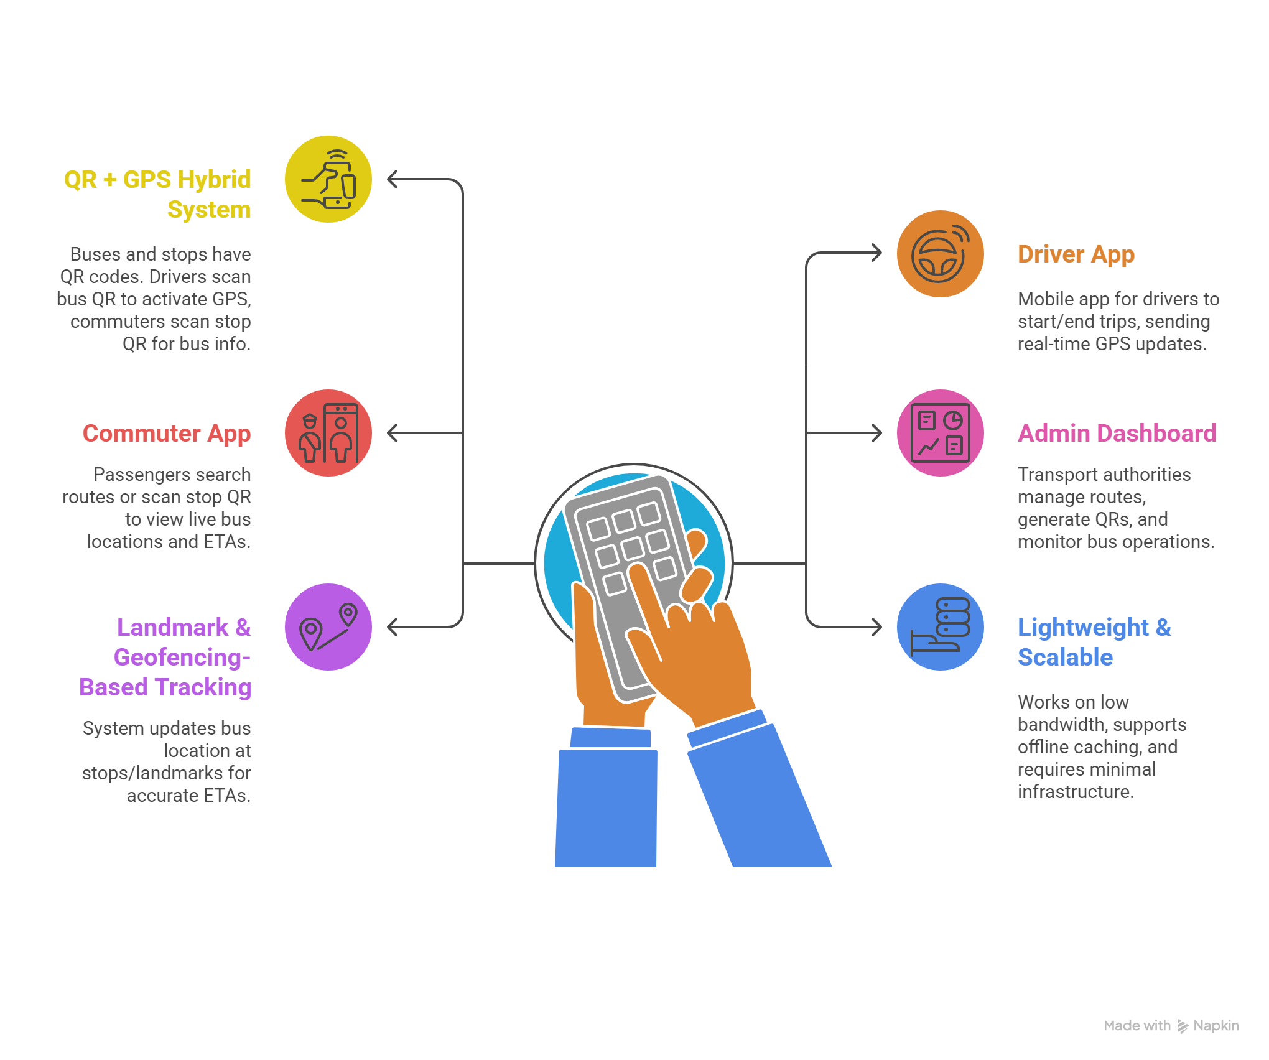
Real-Time Public Transport Tracking for Small Cities
Proposed Solution - BusGo
QR + GPS Hybrid System – Each bus and stop has a QR code; drivers scan bus QR to activate GPS tracking, commuters scan stop QR to view upcoming buses.
Driver App – Simple mobile app for drivers to start/end trips, automatically sending real-time GPS updates to the server.
Commuter App – Passengers can search routes or scan stop QR to view live bus locations, ETAs, and next departure times.
Admin Dashboard – Transport authorities create/manage routes, generate QRs, and monitor bus operations through a clean web interface.
Landmark & Geofencing-Based Tracking – System updates bus location at stops/landmarks to provide accurate ETAs, even in low-internet areas.
Lightweight & Scalable – Works on low bandwidth, supports offline caching, and requires minimal infrastructure (only smartphones + QR stickers).

Slide 3
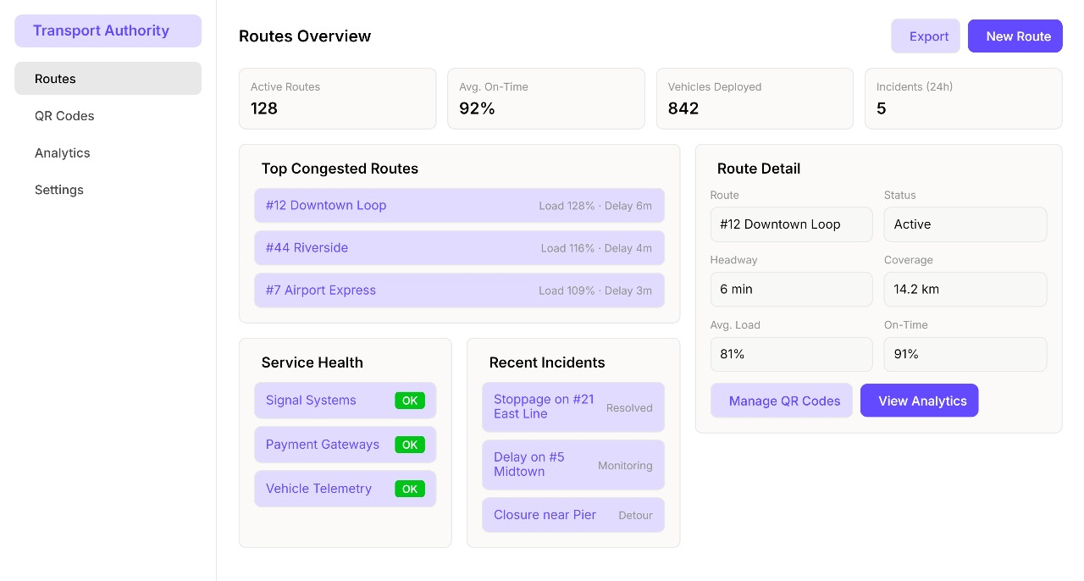
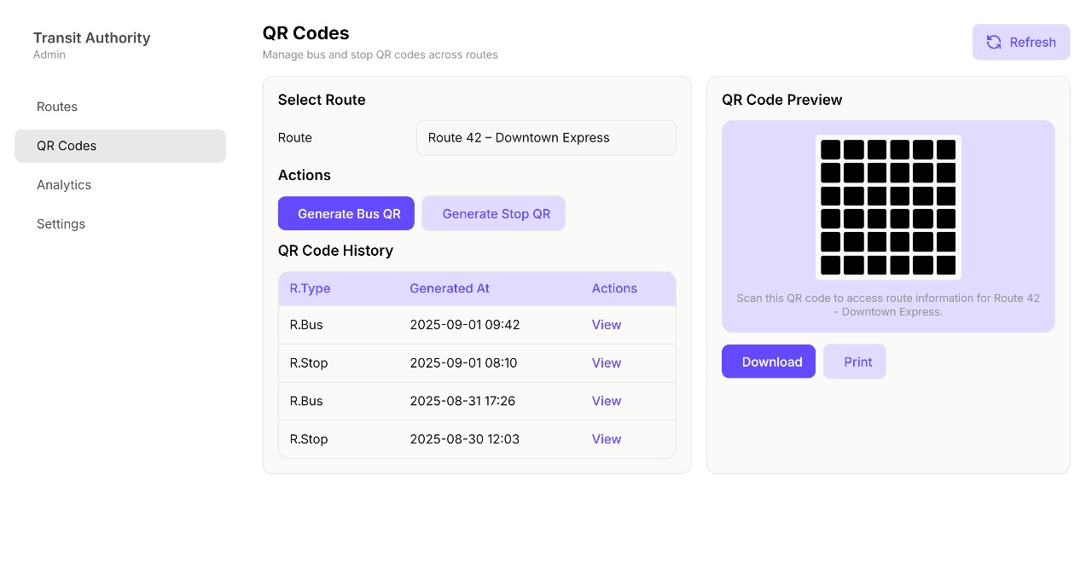
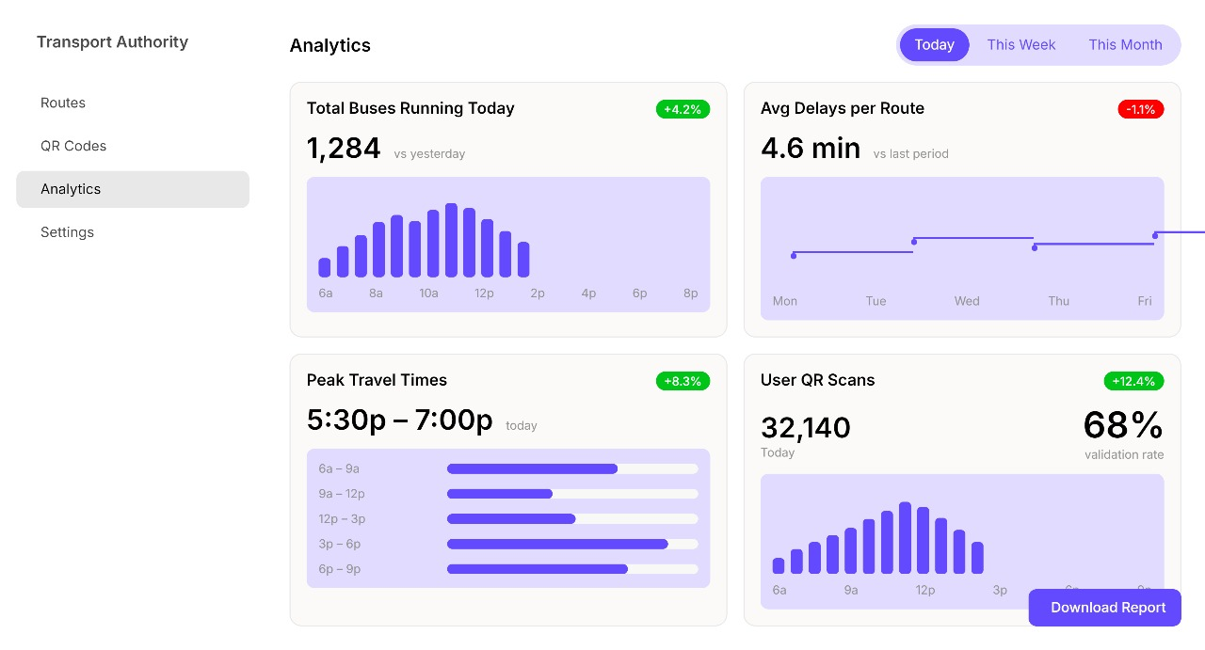
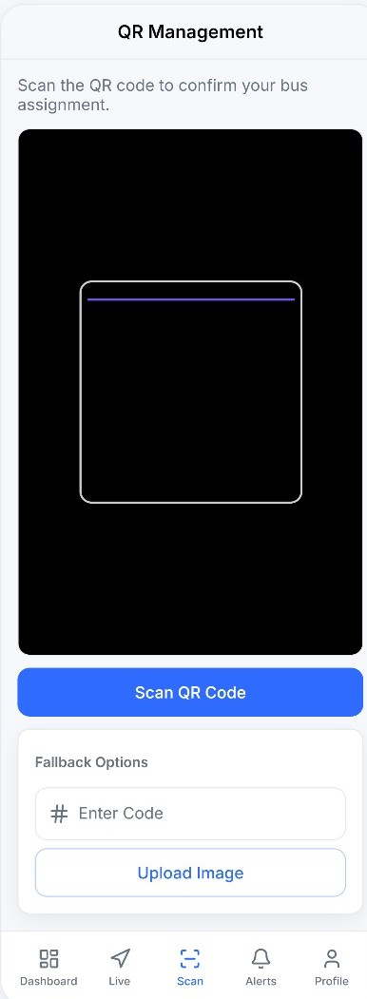
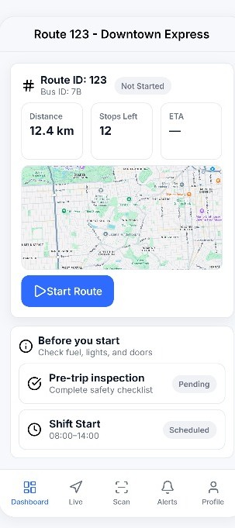
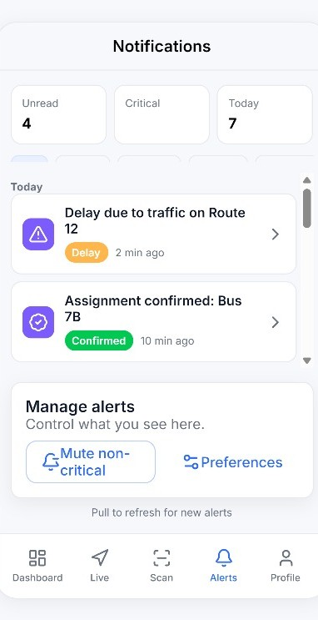
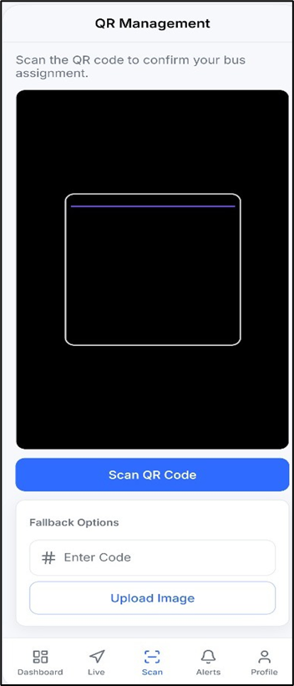
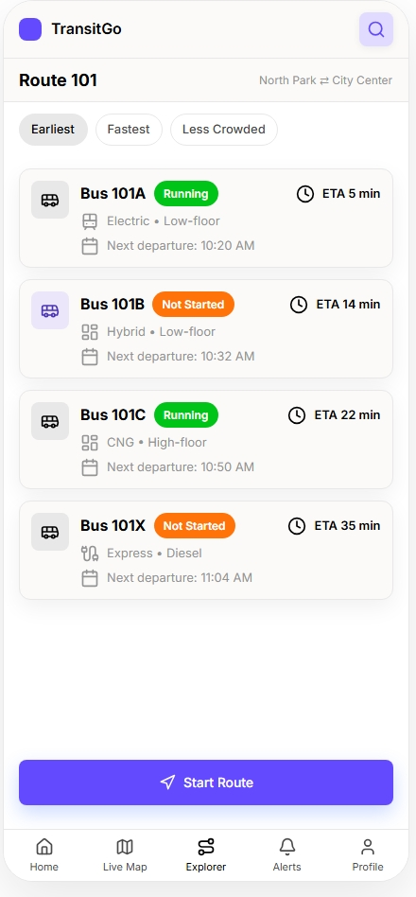
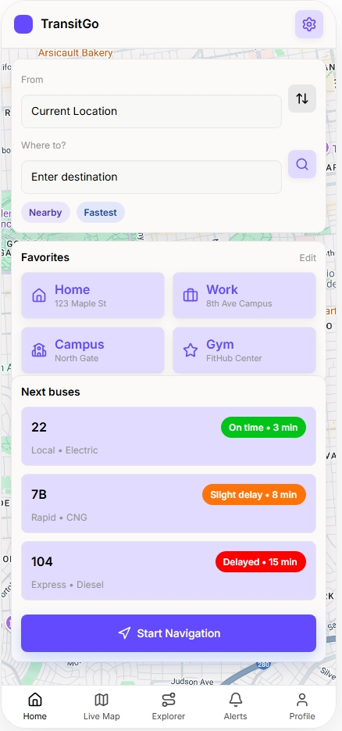
User Interfaces
Admin Screens
Driver’s Screens
Commuter’s Screens
2

Slide 4
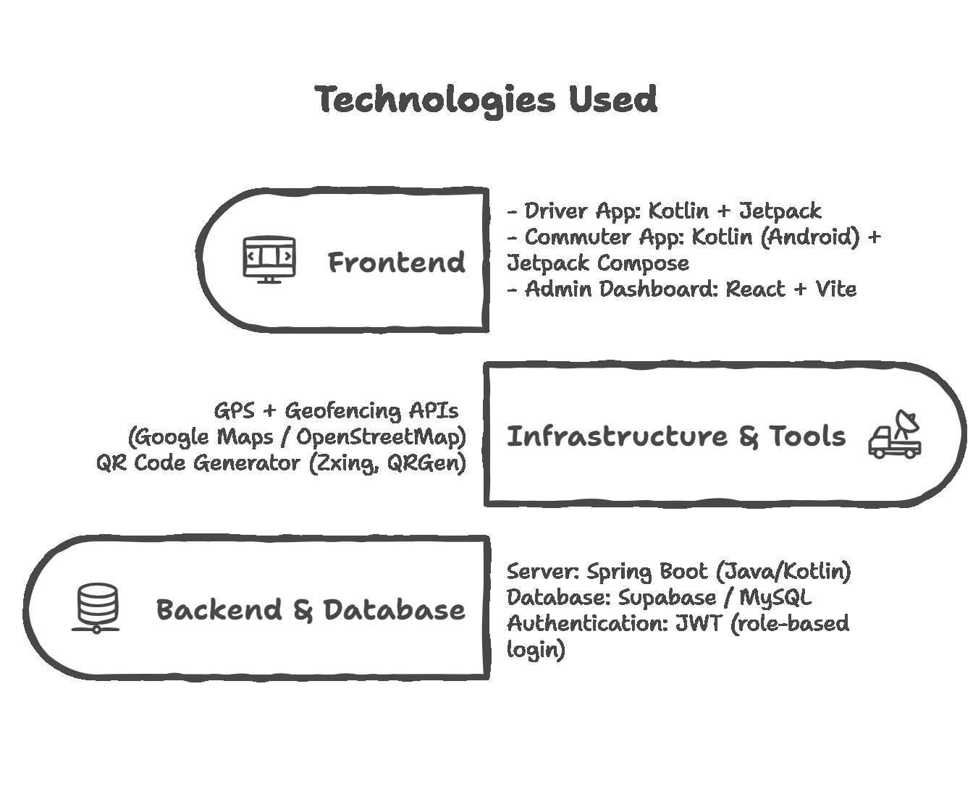
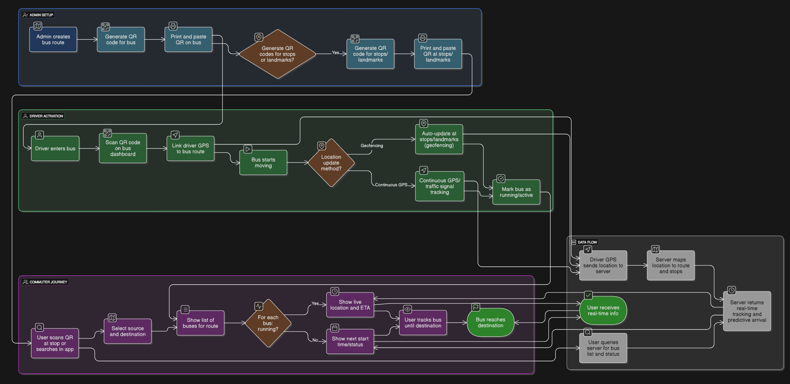
TECHNICAL APPROACH
3

Slide 5





FEASIBILITY AND VIABILITY
Feasibility Analysis
Navigating Challenges & Risks
Driver Adoption
Technological Readiness
Risk: Some drivers may resist using the smartphone app.
Strategy: Implement driver incentives (e.g., fuel cards, bonuses) for consistent usage.
Leverages readily available smartphones, GPS, and QR technology, avoiding complex hardware.
GPS Accuracy
Risk: Poor GPS signals in densely congested urban areas.
Strategy: Employ hybrid tracking, combining GPS with geofencing and traffic landmark checks.
Economic Efficiency
Low deployment cost, requiring only QR code stickers and basic smartphone access.
Admin Coordination
Risk: Requires strong cooperation from local transport authorities.
Strategy: Provide comprehensive training and onboarding with easy-to-use UI and local language support.
Scalable Infrastructure
Designed for easy and uniform rollout across multiple cities using the same underlying infrastructure.
Network Coverage
Risk: Patchy internet connectivity common in some Tier-2 towns.
Strategy: Incorporate an offline mode, providing last known bus data even during internet drops.

Slide 6




IMPACT AND BENEFITS
Target Audience Impact
Commuters
Drivers
Experience reduced waiting times and more reliable, stress-free travel for an enhanced daily experience.
Benefit from simplified technology (QR scan + GPS), requiring minimal effort for efficient operations.
Authorities
Cities
Gain real-time fleet visibility, enabling better planning and improved operational efficiency.
Foster higher trust in public transport, leading to reduced reliance on private vehicles and less congestion.
Holistic Benefits of BusGo
1
2
3
Social Benefits
Economic Benefits
Environmental Benefits
  Saves 20–40 minutes daily for commuters.
  Reduces fuel wastage from unnecessary travel and waiting.
  Encourages greater public transport adoption.
  Ensures safer, more predictable journeys.
  Contributes to a reduction in private vehicle dependency.
  Enhances public transport accessibility in smaller towns.
  Boosts overall productivity by saving commuter time.
  Offers cost-effective deployment using existing infrastructure.
  Helps cut CO₂ emissions and alleviate urban congestion.

Slide 7
RESEARCH AND REFERENCES
Urban Mobility India (UMI) Report 2024 – Ministry of Housing & Urban Affairs Highlights inefficiencies in Tier-2/3 public transport.
🔗 https://urbanmobilityindia.in
NITI Aayog – Transforming Mobility for India - Focus on sustainable mobility and reducing congestion costs.
🔗 https://www.niti.gov.in
Government of India – Census & City Classification (Tier-1/2/3)Defines Tier-2 cities officially.
🔗 https://mohua.gov.in
IEEE Paper: “Real-Time Transit Tracking System in Mexico” (2022)Verified feasibility of low-cost GPS + mobile-based bus tracking.
🔗 https://www.mdpi.com/2079-9292/11/5/834
Trans-Sense: Crowd-sourced Transit Tracking Model (Arxiv, 2019) Achieved >90% ETA accuracy using smartphone data in developing countries.
🔗 https://arxiv.org/abs/1906.07575
Existing Apps Studied
  Chalo App – Bus tracking in metros & large cities.
  Google Maps Transit – Limited coverage in Tier-2 towns.
6

