Slide 1
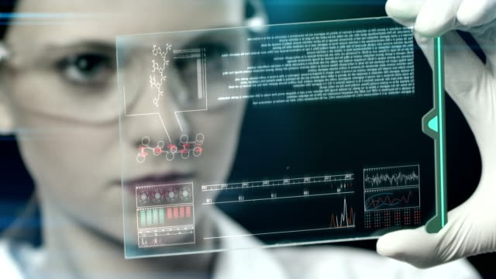
Technology in Biology
SyedUbaid Imran

Slide 2
Introduction
What is the study of Biology?
What makes up biotechnology?
How does it impact our lives?
Technology helps us improve our lives and allows us to progress in life.

Slide 3
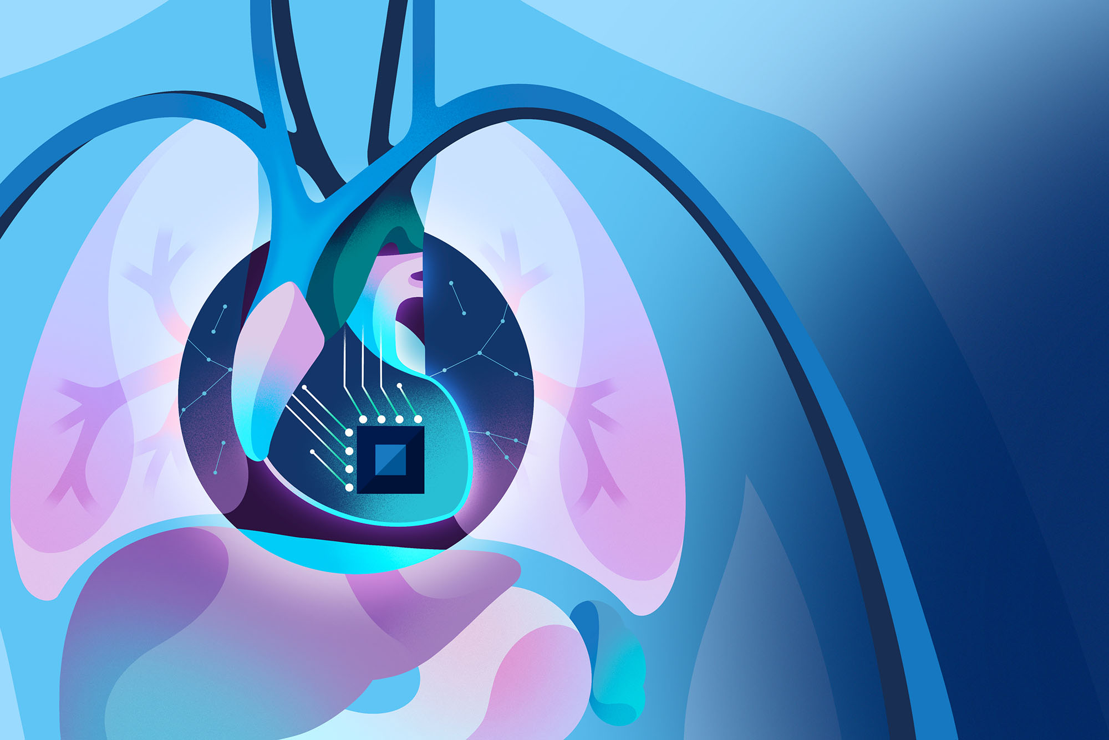
Why Technology is an important component in biology
Technology helps us speed up research in this study
It improves accuracy while implementing
Lastly, it helps us solace real world problems, some examples are disease treatment, food production, and environmental protection.

Slide 4
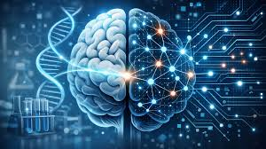
Artificial intelligence in Biology
What exactly is AI?
Ai are computers that can learn and make decisions similar to humans
How is AI used in biology?
It is used to analyze large amounts of biological dara and can predict protein structure. It can detect disease from medical images. FOr and example it helps doctors find cancer early, and can discover new medicines faster.
Why is it important?
It saves time for the researchers, improving accuracy and it can solve complex biological problems.

Slide 5
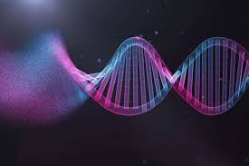
DNA Technology
A fundamental component of DNA technology is DNA sequencing. What is DNA sequencing? Def. DNA sequencing is the laboratory process of determining the precise order of the four chemical building blocks—nucleotides (Adenine, Thymine, Cytosine, Guanine)—that make up a DNA molecule.
Another component is PCR also known as Polymerase Chain Reaction. It is used for identifying disease,forensics, and genetic research

Slide 6
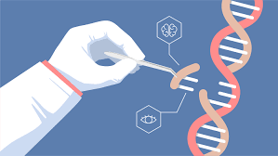
Genetic Engineering
Genetic engineering is modifying DNA in an organism
Some examples of this process are GMO also known as genetically modified crops and insulin production
Genetic engineering controversy is a real concern in the industry. Many have concerns of the safety of mutations with in the products. Another concern some have is the adea of “playing God” as there are concerns of catering human germlines

Slide 7
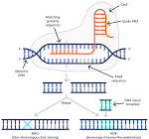
CRISPR Gene Editing
This tool is such a powerful tool for gene editing
It allows scientist to cut and edit through DNA
Through this “cut and edit” researcher could treat genetic disease and search through the DNA
It also has other features of targeting, binding, and repairing, these features is such a revolutionary technology.

Slide 8
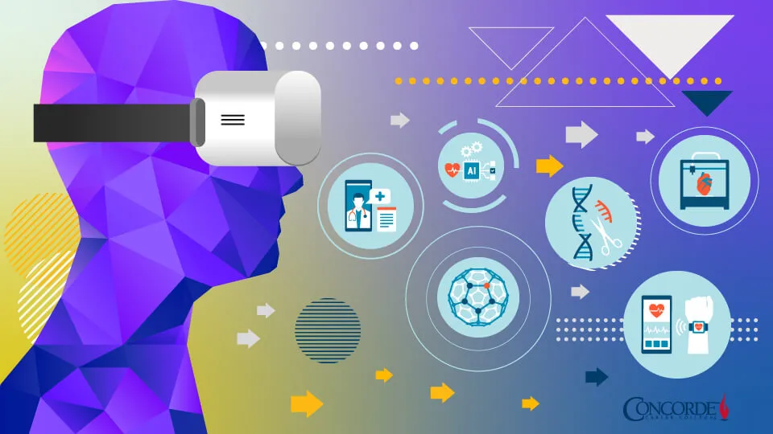
Medical Technology
Medical technology also known as technology in healthcare
Some examples of this technology are MRI,CT scans and lastly robotic surgery
Through this technology researchers could early dianos and develop better treatments

Slide 9
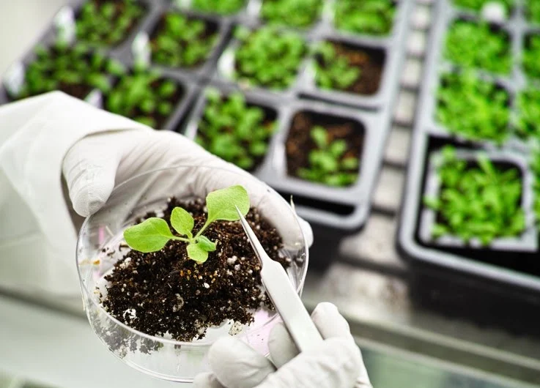
Biotechnology in Agriculture
Biotechnology in agriculture helps genetically modify crops
It helps develop Pest-resistant crops
Increase food production with the help of this technology
An example is drought resistant crops

Slide 10
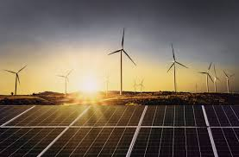
Environmental Technology
What exactly is environmental technology? It is( innovative tools, methods, and systems designed to monitor, model, and conserve the natural environment while curbing the negative impacts of human activity) def
Some examples are bioremediation, through this process, organisms to clean pollution, conservation tech, and renewable biofuels

Slide 11
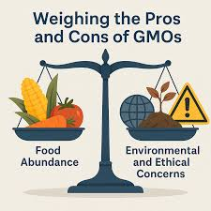
Ethical Issue
Is genetic modifications safe?
As I mentioned earlier many have concerns if it safe for us and if this action is considered “playing God”
It is seen that GMO foods currently on the market are considered safe and nutritious. There is no evidence of it causing cancer, allergies, or chronic disease

Slide 12

Conclusion
In conclusion technology is transforming biology for the good
It helps improve health,food, and the environment as it has potential to be big in the future
As seen biotechnology will have a great impact on the earth and it will shape the future

