Slide 1

School Management System
A web-based, dynamic system designed to organize and computerize academic and administrative tasks in educational institutions.

Slide 2
Addressing Key Challenges
Inefficiency of Traditional Methods
Fragmented Communication
Paper-based systems are slow, error-prone, and difficult to scale for student records and exams.
Limited interaction between students, parents, and teachers affects transparency.
Lack of Centralized Data
Manual Workload & Errors
Disconnected data leads to poor accessibility and inefficient decision-making.
Tasks like report generation and fee calculations increase burden and vulnerability to human error.

Slide 3
Core Objectives
Automate Tasks
1
Minimize human error and staff workload.
Centralize Data
2
Real-time accessibility for all stakeholders.
Enhance Communication
3
Transparent interaction via intuitive web interface.
Generate Insights
4
Improve educational quality with data analytics.
Ensure Security
5
Secure data handling with authentication and backups.

Slide 4
System Scope
Student Information Management
Leave and Notification Management
Enrollment and admission tracking.
Leave request submission and approval workflows.
Student profile creation and management.
In-platform announcements and updates.
Attendance Management
Timetable Scheduling
Automated recording for students and teachers.
Automated creation and modification.
Real-time monitoring and reporting.
Conflict-free scheduling.
Examination & Report Card Management
Exam scheduling, grading, and result processing.
Comprehensive report card generation.

Slide 5
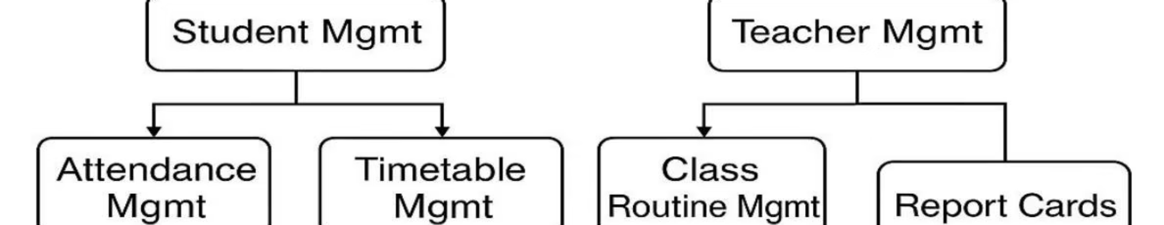
System Design Overview
The School Management System is designed as a responsive web application, structured with an Administrator as the central operational point.
The Administrator manages Student Management (registration, editing, class assignment) and Teacher Management (registration, salaries, class routine scheduling).

Slide 6
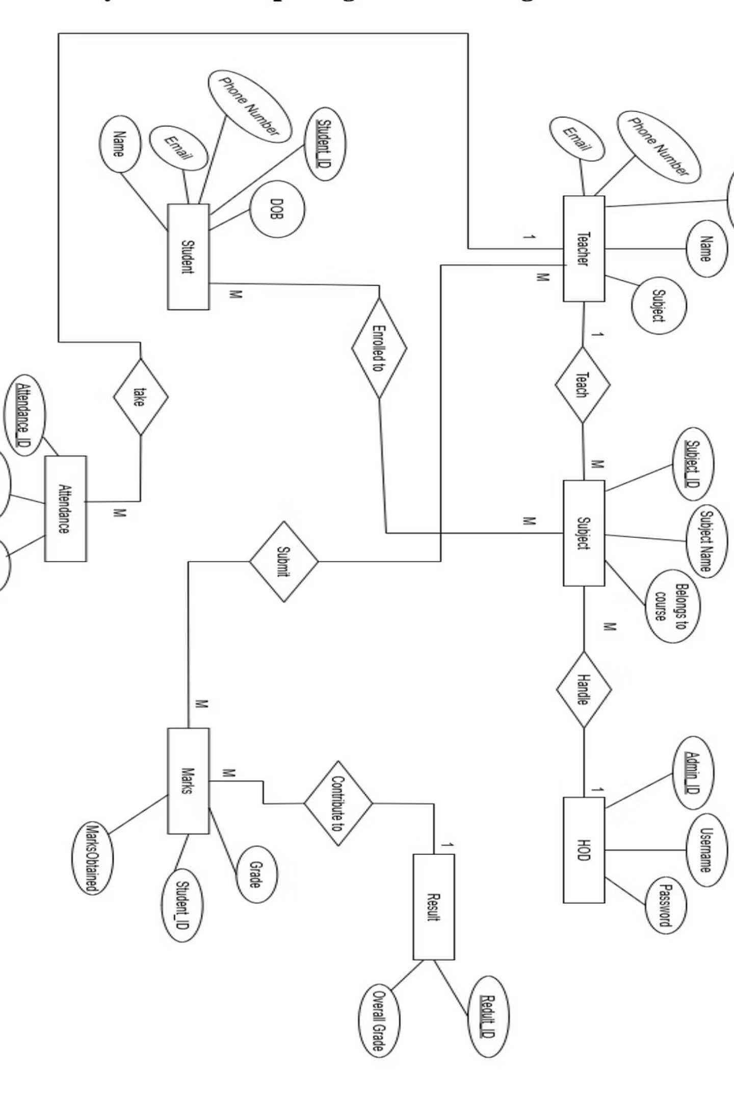
Entity-Relationship Diagram
This ER diagram highlights key entities and their relationships within the SMS, ensuring seamless academic and administrative operations.
Entities include Teacher, Administrator, Class, Student, Subject, Attendance, Marks, and Result, all interconnected to manage school data efficiently.

Slide 7

Use Case Diagram
The use case diagram illustrates interactions between HOD, Staff, and Students with the School Management System, ensuring role-based access and secure operations.
HODs manage admin functions, staff handle student info and records, and students view results and timetables.

Slide 8




Implementation & Key Features
Developed using Django, HTML, CSS, JavaScript, and SQLite, the SMS follows an agile methodology.
User Role-Based Login
Admin Dashboard
Separate logins for Admin, Staff, and Students with role-specific redirection.
View statistics, manage courses, staff, students, and subjects.
Attendance & Result Management
Notifications & Feedback
Staff record attendance and grades; students view reports.
Simple messaging system for communication and leave management.

Slide 9
Analysis & Evaluation
The SMS successfully addresses project objectives, enhancing efficiency and data accuracy.
Achievements
Challenges
Successful local deployment.
Limited accessibility due to local hosting.
Automation of core tasks.
Data sharing restrictions.
Role-based interfaces.
Timetable scheduling complexity.
Successful testing and validation.
Basic security practices.

Slide 10



Future Scope
Mobile App Expansion
AI-based Grading
RFID/Biometrics Integration
On-the-go access for teachers, students, and parents with push notifications.
Machine learning models to assist with grading and predict student performance.
Automatic attendance logging for enhanced accuracy and security.

