Slide 1
Usability Testing and Verification
Under the guidance of:
Dr. -Ing. Swati Chandna
Mr. Sandesh Athreya B. D.
1

Slide 2
Musicians Connect
Group members:
Manjiri Rane (10113623)
Yash Pandey (10113381)
2

Slide 3

Agenda for the presentation
Introduction to Use Case
Motivation
Competitive websites
Design Process
Usability Testing
Analysis of the results
3

Slide 4
Introduction
4

Slide 5
Motivation
5

Slide 6
Competitive Websites
Lastminutemusicians
Musicians Connect
Search for an Artist
Book an Artist
Search for an Artist
Search for Gigs
Create a Community
6

Slide 7
Design Process
7

Slide 8
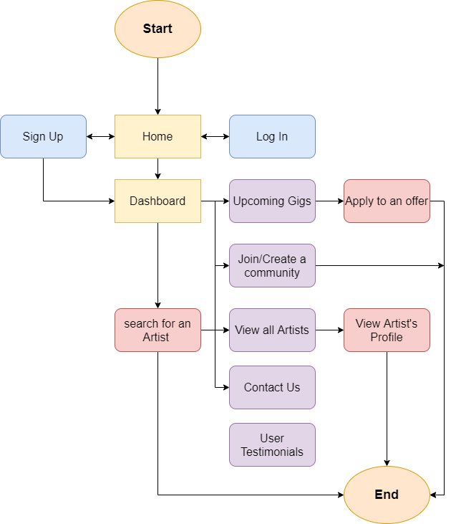
User Workflow
8

Slide 9
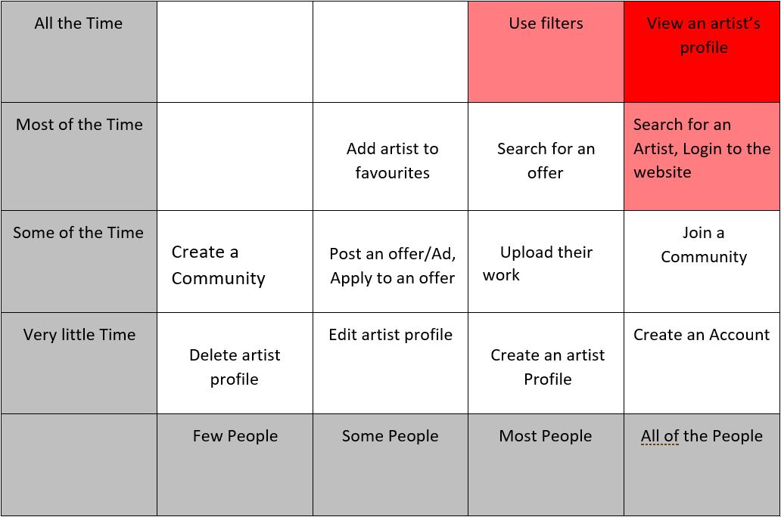
Red Routes
9

Slide 10
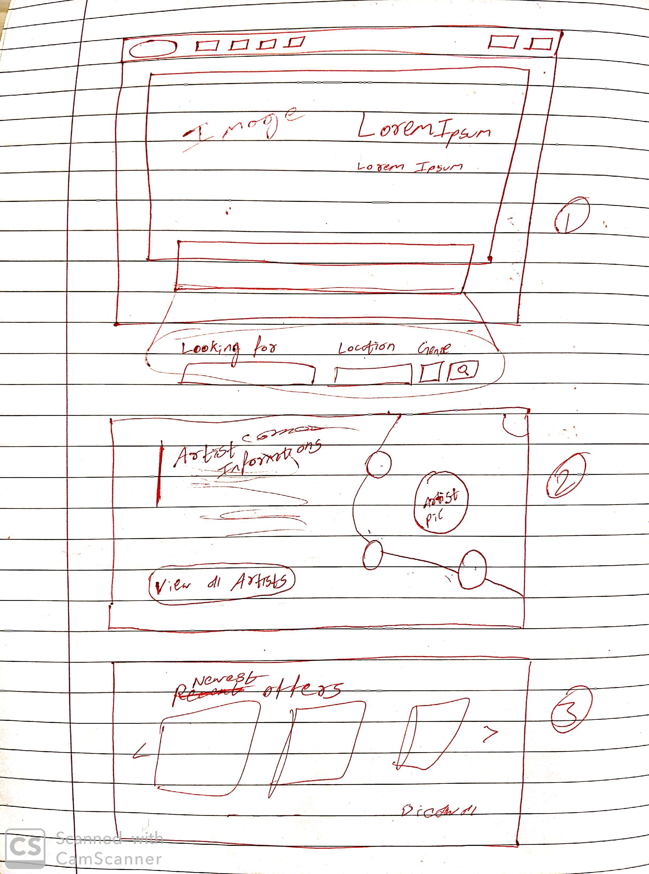
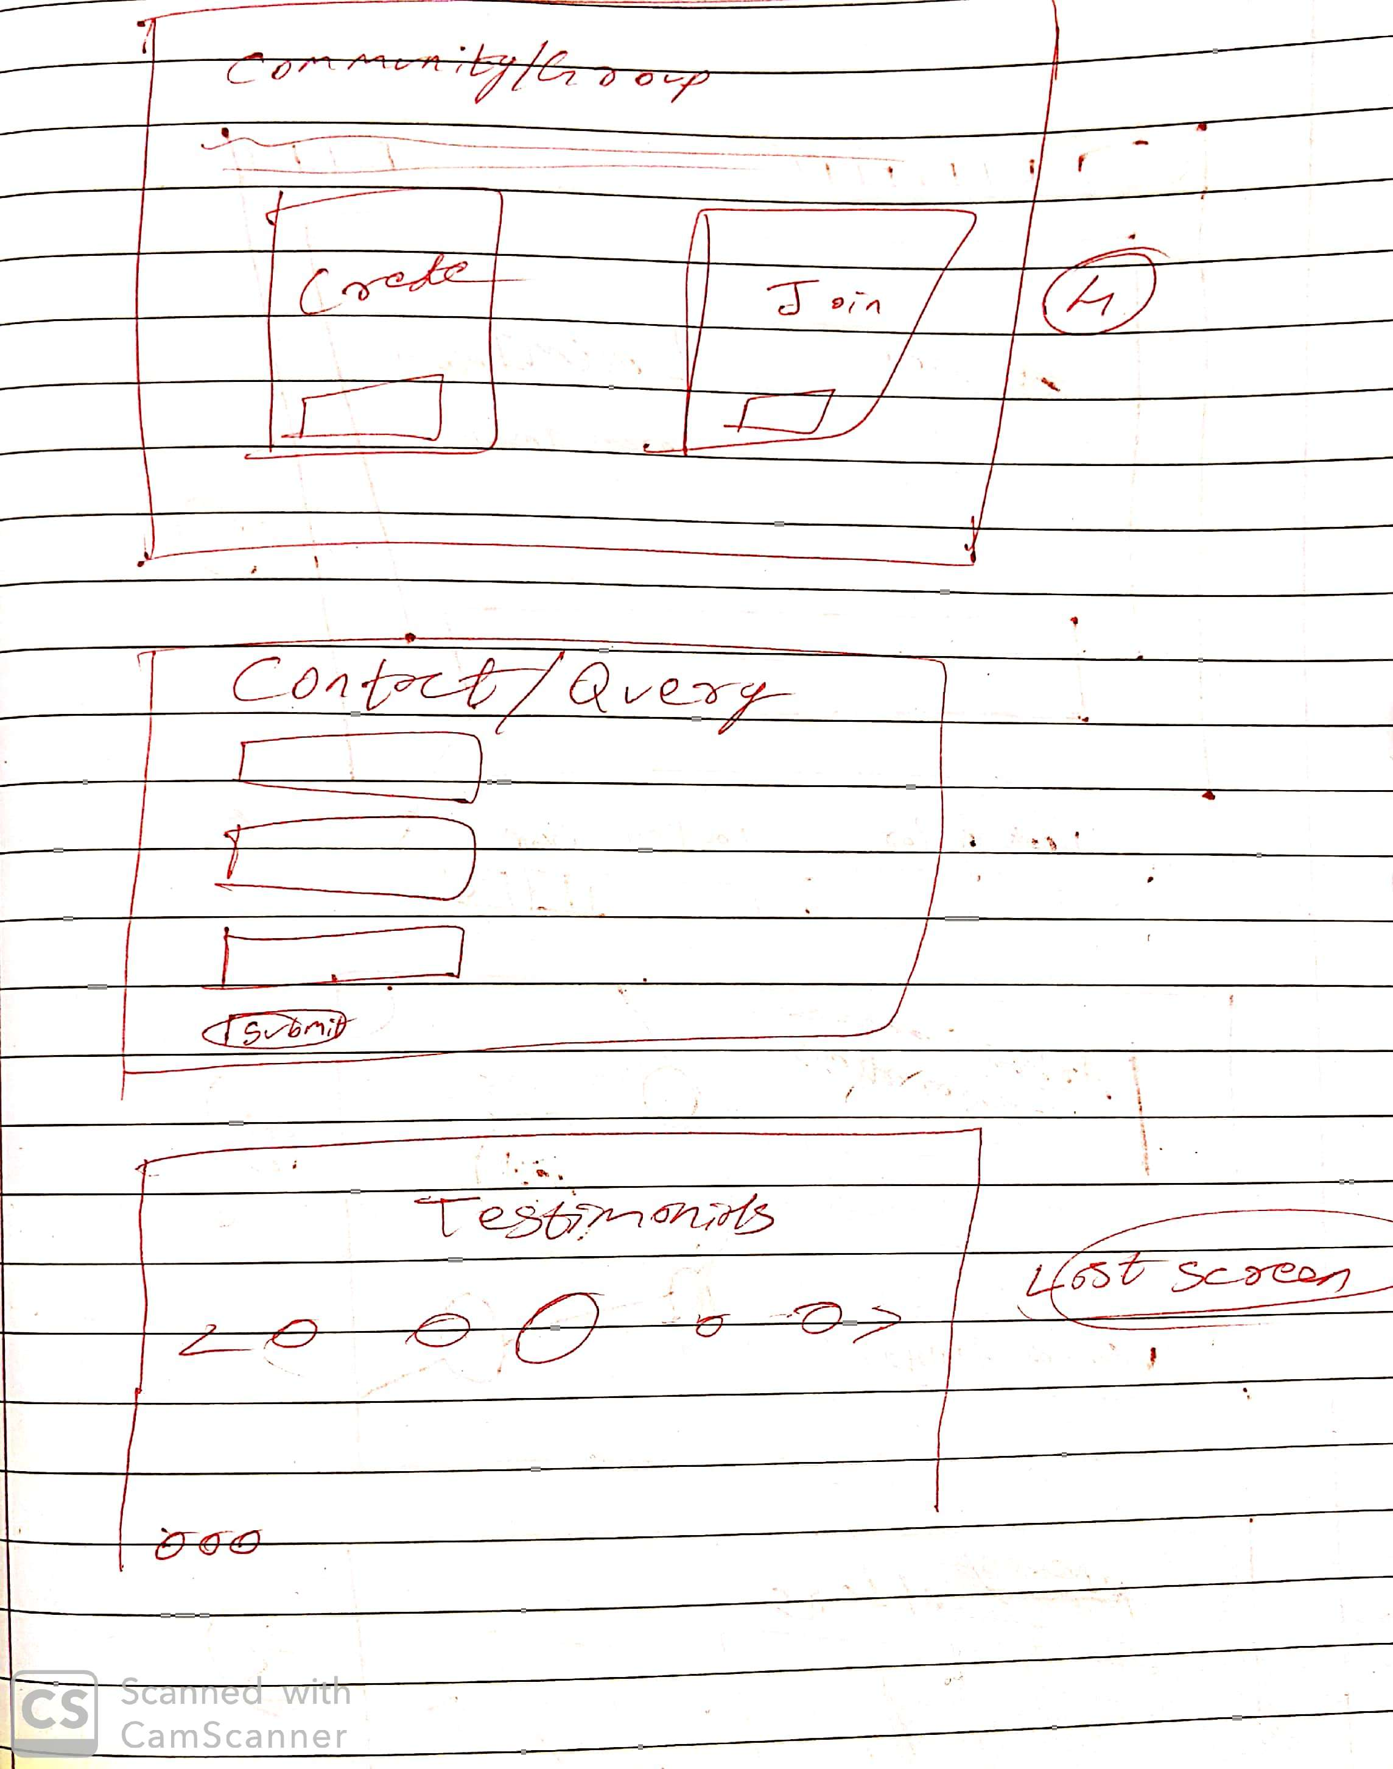
Paper Prototype
10

Slide 11
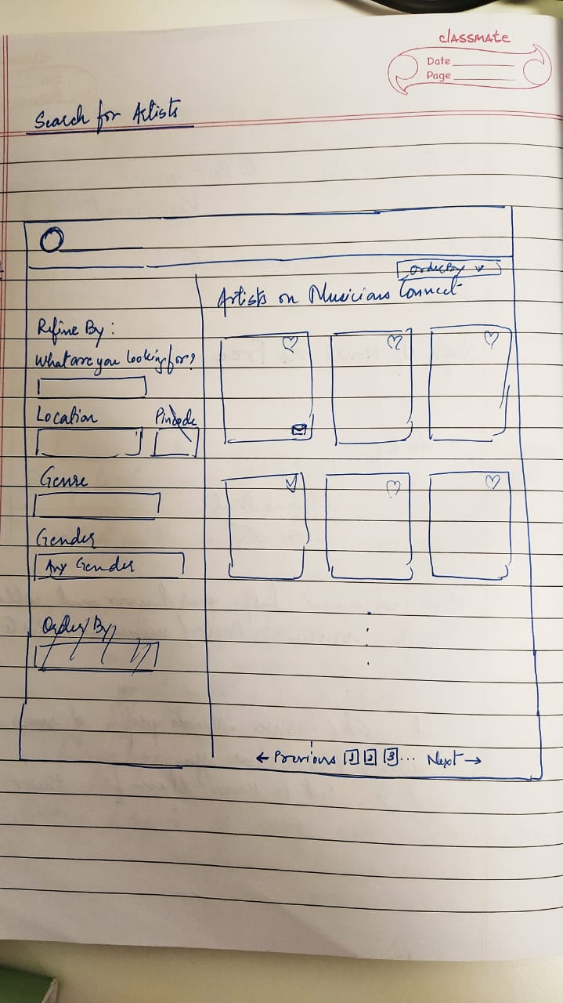
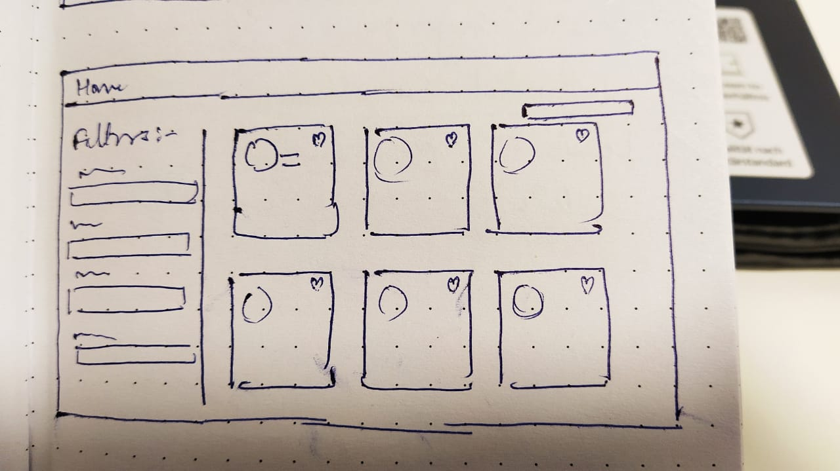
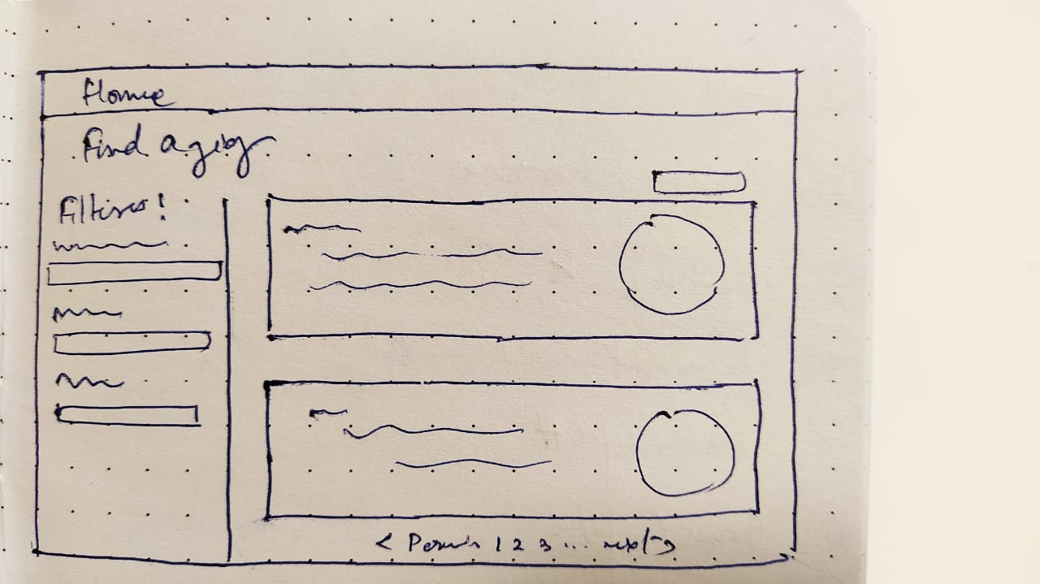
11

Slide 12
Usability Testing
12

Slide 13
Think Aloud Process
13

Slide 14
Participants
Akshay K.
Nathaniel C.
Louis
Zeba G.
Varun S.
14

Slide 15
Tasks
Signup and Login
Search for an Artist using filters
View an Artist’s profile
Look for an option for creating a Community
View the complete information of a Gig
15

Slide 16
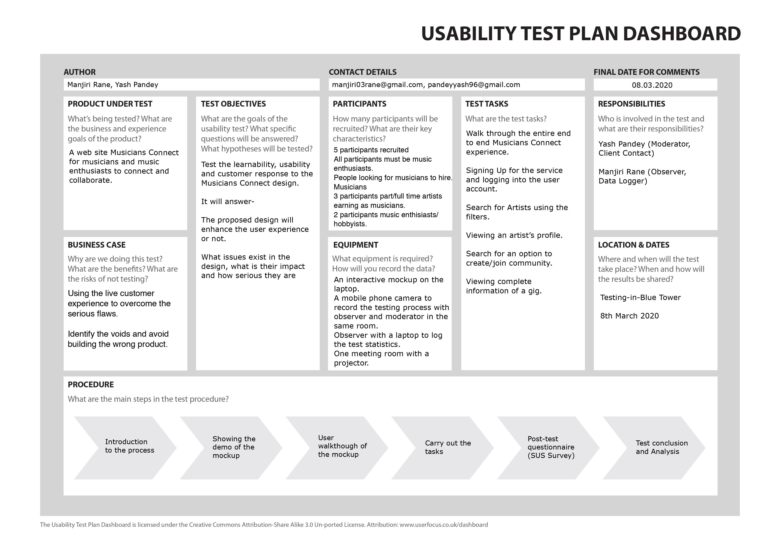
16

Slide 17
Analysis of the results
17

Slide 18
Effectiveness
Participants | Task 1 | Task 2 | Task 3 | Task 4 | Task 5
1 | 100% | 100% | 100% | 100% | 100%
2 | 100% | 100% | 100% | 100% | 100%
3 | 100% | 100% | 100% | 0% | 100%
4 | 100% | 100% | 100% | 0% | 100%
5 | 100% | 100% | 100% | 100% | 0%
AVG | 100% | 100% | 100% | 60% | 80%
18

Slide 19
Efficiency
Participant | Task 1 | Task 2 | Task 3 | Task 4 | Task 5
1 | 20 | 7 | 10 | 15 | 13
2 | 19 | 7 | 8 | 10 | 11
3 | 20 | 9 | 11 | 0 | 15
4 | 21 | 11 | 13 | 0 | 18
5 | 18 | 10 | 12 | 17 | 0
SD | 1.140 | 1.789 | 1.924 | 8.081 | 6.877
AVG | 19.600 | 8.800 | 10.800 | 8.400 | 11.400
RT(+) | 24.58 | 19.25 | 24.54 | 83.72 | 91.88
RT(-) | 20.11 | 12.24 | 17.00 | 52.04 | 64.92
19

Slide 20
System Usability Scale (SUS)
 | P1 | P2 | P3 | P4 | P5
Q1 | 4 | 3 | 3 | 3 | 4
Q2 | 4 | 1 | 3 | 3 | 3
Q3 | 4 | 3 | 3 | 2 | 4
Q4 | 4 | 4 | 4 | 1 | 4
Q5 | 4 | 4 | 2 | 2 | 3
Q6 | 4 | 4 | 3 | 3 | 3
Q7 | 4 | 4 | 4 | 3 | 4
Q8 | 4 | 4 | 4 | 3 | 4
Q9 | 4 | 3 | 3 | 2 | 2
Q10 | 4 | 4 | 3 | 3 | 4
Total | 40 | 34 | 32 | 25 | 35
SUS Score | 100 | 85 | 80 | 62.5 | 87.5
20

Slide 21
SUS Graph
30 to 40 | 2
40 to 50 | 0
50 to 60 | 3
21

Slide 22

Word Cloud
Attractive
Fun
Expected
Friendly
Exciting
Clear
Sophisticated
Complex
Bore
22

Slide 23
Thank You
23

