Slide 1
PROJECT REPORT (ECS1002)
PROJECT TITLE – ALCOHOL DETECTION IGNITION LOCK
Submitted by :
Satwika Malla (23BCE8932)
B. Varsha(23BEC7068)
M. Jaya Sree (23BCE9335)
J.Manjiswari (23BCE9340)
S.N. Swetha Sree (23BCE8922)
Pothireddy Guna Tejaswi(23BCE8937)
Under the Guidance of Prof. Satyendra Singh Chauhan

Slide 2
Summary
In the Modern Era, the number of traffic accidents caused by drunken driver's increased rapidly . More and more people are realizing that drunk driving is a public safety hazard on the road. It's time to develop a system that can effectively deter drunk driving. Since this type of system is not widespread, we are trying to develop this system to be available in all cars. This system costs less but is more effective in keeping people safe. This system has the preventive effect of preventing accidents.
In this engineering clinics project, we are making an alcohol detecting and ignition disable system with a Arduino Uno using python. In this, the alcohol will be detected in breathe and then alerts if you’re capable to drive the car safely or not . If not, then the ignition of the car will be disabled automatically by the device and alerts to not drive while drinking .

Slide 3
Index
Introduction of the project,
Objectives
Component Illustration
The description of the electrical parts used in the project
Alcohol Detection and Alert System Design
Implementation of the working design, operation, hardware, operating scenarios.
Software Design
Conclusion

Slide 4
Objective
The primary objective of this project is to design and implement an alcohol detection system that automatically prevents drunk driving by detecting the alcohol concentration in the driver's breath. Drunk driving poses significant risks on the road, leading to accidents, injuries, and fatalities. Current methods of detecting drunk driving involve manual intervention, such as random checks and the use of breath analyzers by law enforcement, which can be inefficient and inconsistent. This system aims to address these challenges by providing an automated solution that detects alcohol levels directly in the vehicle, thereby enhancing road safety
This system utilizes an alcohol sensor integrated with an Arduino Uno microcontroller to monitor the driver's breath in real-time. When alcohol is detected above a predefined threshold, the system triggers an automatic response by stopping the vehicle’s engine, simulated through a DC motor. The use of a Liquid Crystal Display (LCD) allows for immediate feedback to the driver, displaying a warning message and notifying them that the engine will be locked for a set period due to the detected alcohol. This approach not only ensures immediate action but also serves as a deterrent to drivers attempting to operate a vehicle while under the influence of alcohol.

Slide 5
COMPONENTS
Motor
Arduino Uno
Lcd display
Mq3 Sensor
L293 module
L293 module

Slide 6
Arduino Uno
The Arduino UNO is a widely admired microcontroller board within the Arduino family. It features an ATmega328P microcontroller, combining an AVR RISC (Reduced Instruction Set Computer) architecture CPU and essential peripherals. The board includes a set of GPIO (General Purpose Input/Output) pins, allowing for the connection of various sensors and devices to support a wide range of applications.

Slide 7



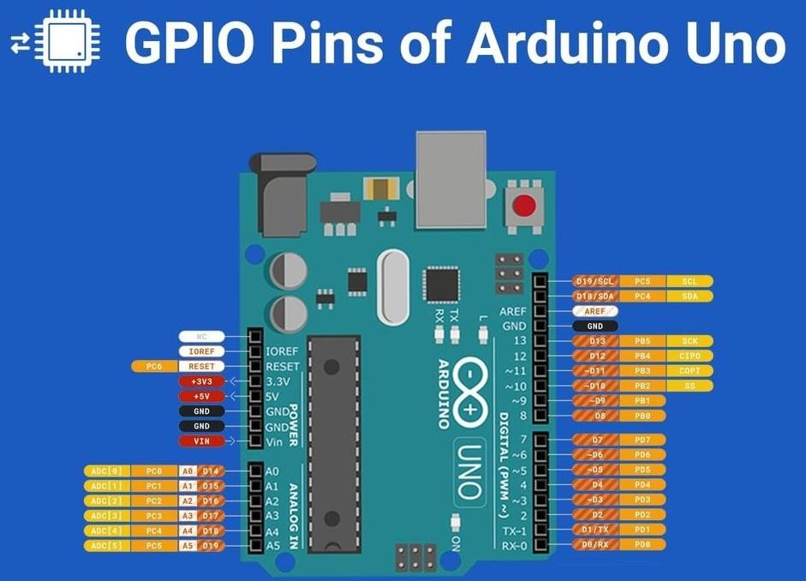
Gpio(General Purpose Input/Output):
One of the standout features of the Arduino UNO is its array of GPIO (General Purpose Input/Output) pins along the edges of the board. These pins provide a crucial interface between the Arduino and external components, enabling it to read inputs from sensors and control outputs like LEDs or motors. The board includes 14 digital I/O pins (6 with PWM capabilities), 6 analog input pins, and dedicated power supply pins for +5V, +3.3V, and ground. Additionally, it features a USB connection for programming and an ICSP header for direct programming. These
elements together make the Arduino UNO a powerful tool for a wide range of electronics projects.

Slide 8
The Drunk Driving Detection System consists of below
Components
Controller:
The Arduino Uno microcontroller manages the system, programmed to respond to inputs from connected sensors. It continuously monitors the driver's breath and executes actions based on the detected alcohol level. When the alcohol sensor exceeds the set threshold, the controller signals the output devices to take preventive measures, ensuring safety.
Input: The primary input device is the alcohol sensor, which detects the concentration of
alcohol in the driver’s breath and sends a signal to the Arduino Uno. This data is processed to determine whether the detected level is above the safety threshold. Additional inputs like buttons or other sensors can be used, but the main focus remains on reliable alcohol detection. Output:
If alcohol is detected, the system initiates an engine shutdown, simulated by stopping a DC motor, after a brief delay allowing the driver to pull over safely. The LCD displays warnings, notifying the driver of the engine lock. This automated action prevents further operation of the
vehicle under the influence, reducing accident risks.

Slide 9
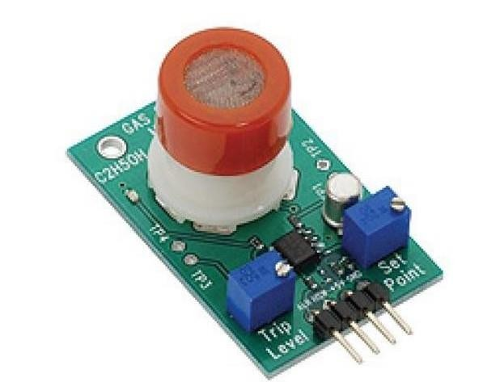
Alcohol Sensor
This alcohol sensor is suitable for detecting alcohol concentration on your breath, just like your common breath analyser. It has a high sensitivity and fast response time. Sensor provides an analog resistive output based on alcohol concentration. The drive circuit is very simple, all it needs is one resistor. A simple interface could be a 0-3.3VADC.

Slide 10
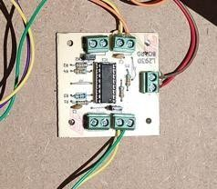
L293D Module
The L293D is designed to provide bidirectional drive currents of up to 600-mA at voltages from 4.5 V to 36 V. Both devices are designed to drive inductive loads such as relays, solenoids, DC and bipolar stepping motors, as well as other high- current/high-voltage loads in positive-supply applications.
The L293D is a dual-channel H-Bridge motor driver that can control two DC motors or a single stepper motor. Because the shield includes two such motor drivers, it can control up to four DC motors or two stepper motors.

Slide 11
Alcohol Detection system
DESIGN
To achieve this, an alcohol sensor is used to detect the alcohol.
Additional sensors can be used to modify the design. placement of components scaled to the model and peripherals connected to the controller.
The Arduino Uno controller is placed in such a way that it
accommodates space for the input and output components
The DC motor is connected as a prototype of the car engine

Slide 12
Conclusion
The utilization of liquor even in little amounts raises the risk of being engaged in an accident for drivers and people. In addition to the fact, alcohol decreases the ability to processes which are important for road safety operative solutions is provided to develop the smart system for vehicles that will perceive various parameters of the vehicle in between constant time period and this is done by using platforms like Arduino Uno, alcohol sensor, dc motor, and LCD display. The whole system has the advantage of small volume and high reliability. Future scope of this system is to control accidents and reduce the rate of accidents this system brings innovation to the existing technology in the vehicles and also improves the safety features, hence proving to be an effective development in the automobile industry.

Slide 13
Reference
Here are references for Arduino UNO in four concise points:
Michael McRoberts, " Getting Started with Arduino : The Open Source Electronics Prototyping Platform"( 2011 ) – An introductory guide to Arduino projects and programming.
Massimo Banzi and Michael Shiloh, "Getting Started with
Arduino" ( 2011) – Comprehensive insights from one of Arduino' s co- founders on using the platform.
Jeremy Blum ," Exploring Arduino : Tools and Techniques for
Engineering Wizardry" (2013) – Practical examples and techniques for
advanced Arduino projects.
4.. Simon Monk, "Arduino Cookbook: Recipes to Begin, Expand, and Enhance Your Projects" (2012 ) – A collection of practical solutions and recipes for common Arduino tasks.

