Slide 1

School of computer science and engineering Deep Learning Project Final Review
Intelligent Skin Disease Classification System
Using Medical Image Analysis
Guide:
Dr. RajyaLakshmi Allapati
SCOPE
Presented by J.Manjiswari, 23BCE9340

Slide 2
OUTLINE
Abstract
Introduction
Problem Statement
Objectives
Literature Review
Proposed Solution
Methodology
Results
Conclusion
References

Slide 3
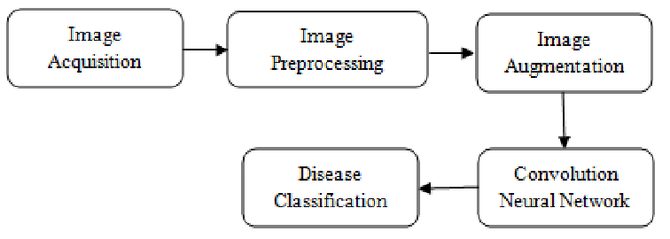
ABSTRACT
Dataset is preprocessed and augmented to improve accuracy and reduce overfitting.
Model performance evaluated using accuracy, precision, recall, and F1-score.
Results show high classification accuracy, proving the system can assist dermatologists in early diagnosis.

Slide 4
INTRODUCTION
Skin diseases often appear visually similar, making manual diagnosis difficult and time-consuming.
Deep learning, especially Convolutional Neural Networks (CNNs), enables automatic and accurate skin disease detection from images.
The system uses image preprocessing and data augmentation to improve learning and reduce overfitting.
The goal is to assist dermatologists with fast, reliable, and early diagnosis, improving patient care and treatment outcomes.

Slide 5
PROBLEM STATEMENT
Skin diseases are difficult to diagnose accurately without expert evaluation.
Manual diagnosis is time-consuming and may vary between doctors.
Many areas lack access to skilled dermatologists, leading to delayed treatment.
There is a need for an automated system to detect and classify skin diseases from images.

Slide 6
OBJECTIVES
To automatically classify skin disease images using deep learning
To assist dermatologists by providing fast and reliable skin disease predictions.
To improve accuracy using preprocessing and data augmentation.
To use a CNN-based model to extract important features from skin images.
To support early diagnosis and reduce manual analysis time.

Slide 7
LITERATURE REVIEW
Earlier studies used traditional machine-learning models with handcrafted features, but they showed limited accuracy for complex skin patterns.
Deep learning, especially Convolutional Neural Networks (CNNs), has become the most effective method for skin image classification.
Research papers demonstrate that data augmentation and image preprocessing improve model performance and reduce overfitting.
Public dermatology datasets like ISIC are widely used to train and benchmark skin disease detection models.

Slide 8
Sl.No | Title | Year | Methodology | Dataset Details | Dis-Advantages | Result
1. | Deep CNN-Based Skin Lesion Classification | 2017 | Convolutional Neural Network(CNN) | ISIC dermoscopic dataset | Limited classes and small dataset size | Achieved ~85% accuracy for melanoma classification
2. | Skin Disease Detection Using Transfer LearningSkin Disease Detection Using Transfer Learning | 2018 | Fine-tuned VGG16 model | Clinical skin image datasetClinical skin image dataset | Overfitting due to limited training samples | Improved accuracy compared to training from scratch.
3. | Automated Dermatology System Using CNNAutomated Dermatology System Using CNN | 2019 | CNN with data augmentationCNN with data augmentation | Hospital-collected images | Poor performance on rare disease categories. | High accuracy for common skin diseases (~88%)
4. | Deep Learning for Skin Cancer DetectionDeep Learning for Skin Cancer Detection | 2020 | ResNet-based deep model | ISIC 2020 dataset | Requires high computing power | Outperformed dermatologists on specific lesion types.

Slide 9
Sl.No | Title | Year | Methodology | Dataset Details | Dis-Advantages | Result
5. | Hybrid CNN-SVM for Skin Lesion Classification | 2021 | CNN feature extraction + SVM classifier | Dermoscopic images (mixed datasets) | Feature extraction time and model complexity | Improved feature discrimination and classification (~90%)
6. | Transformer-Based Skin Image Classification | 2022 | Vision Transformer (ViT) | Public dermoscopic image dataset | Needs large training dataset; high GPU requirement | Better generalization and accuracy (~92%)
7. | Ensemble Learning for Dermoscopic Image Classification | 2022 | Ensemble of CNN models | Dermoscopic image dataset | Computationally expensive | Improved robustness and stability vs. single model
8. | YOLO-Based Real-Time Skin Lesion Identification | 2023 | YOLO deep detection model | Mixed clinical dataset | More suited to detection not full classification | Fast real-time diagnosis support with acceptable accuracy

Slide 10
Sl.No | Title | Year | Methodology | Dataset Details | Dis-Advantages | Result
9. | Self-Supervised Learning for Skin Lesion Recognition | 2023 | Self-supervised CNN | Unlabeled dermoscopy + ISIC | Complex training procedure | Improved performance when labeled data was limited
10. | Multi-Stage Segmentation + Classification Network | 2024 | U-Net segmentation + CNN classifier | Dermoscopy clinical dataset | Requires annotated masks | Improved detection by isolating lesion region (~96% sensitivity)
11. | Ensemble Vision Transformer Models for Skin Lesion Classification | 2025 | Transformer Ensemble | ISIC 2020 + Dermnet | Training time very high | ~98% accuracy
12. | GAN-based Data Augmentation for Dermatology AI | 2025 | GAN + EfficientNet | Small clinical dataset (1,800 images) | Synthetic images sometimes unrealistic | ~93% accuracy

Slide 11
SOFTWARE | HARDWARE
Operating System: Windows / Linux Python (Anaconda / Jupyter Notebook) TensorFlow / Keras / PyTorch OpenCV, NumPy, Pandas libraries Google Colab / VS Code / Spyder Matplotlib, Scikit-learn packages | Processor: Intel i5 / Ryzen 5 or above RAM: Minimum 8GB (16GB recommended) GPU: NVIDIA GPU (optional but recommended) Storage: Minimum 250GB HDD / SSD (SSD preferred) Camera / image input device (optional) Good display monitor (for visualization)

Slide 12
PROPOSED SOLUTION
✯Model Used
Convolutional Neural Network (CNN)–based deep learning model
✯Why This Model?
CNNs are highly effective for image classification tasks
Automatically learn and extract important features from skin images
Better accuracy compared to traditional machine-learning models
Works well with medical image datasets
Reduces need for manual feature extraction

Slide 13
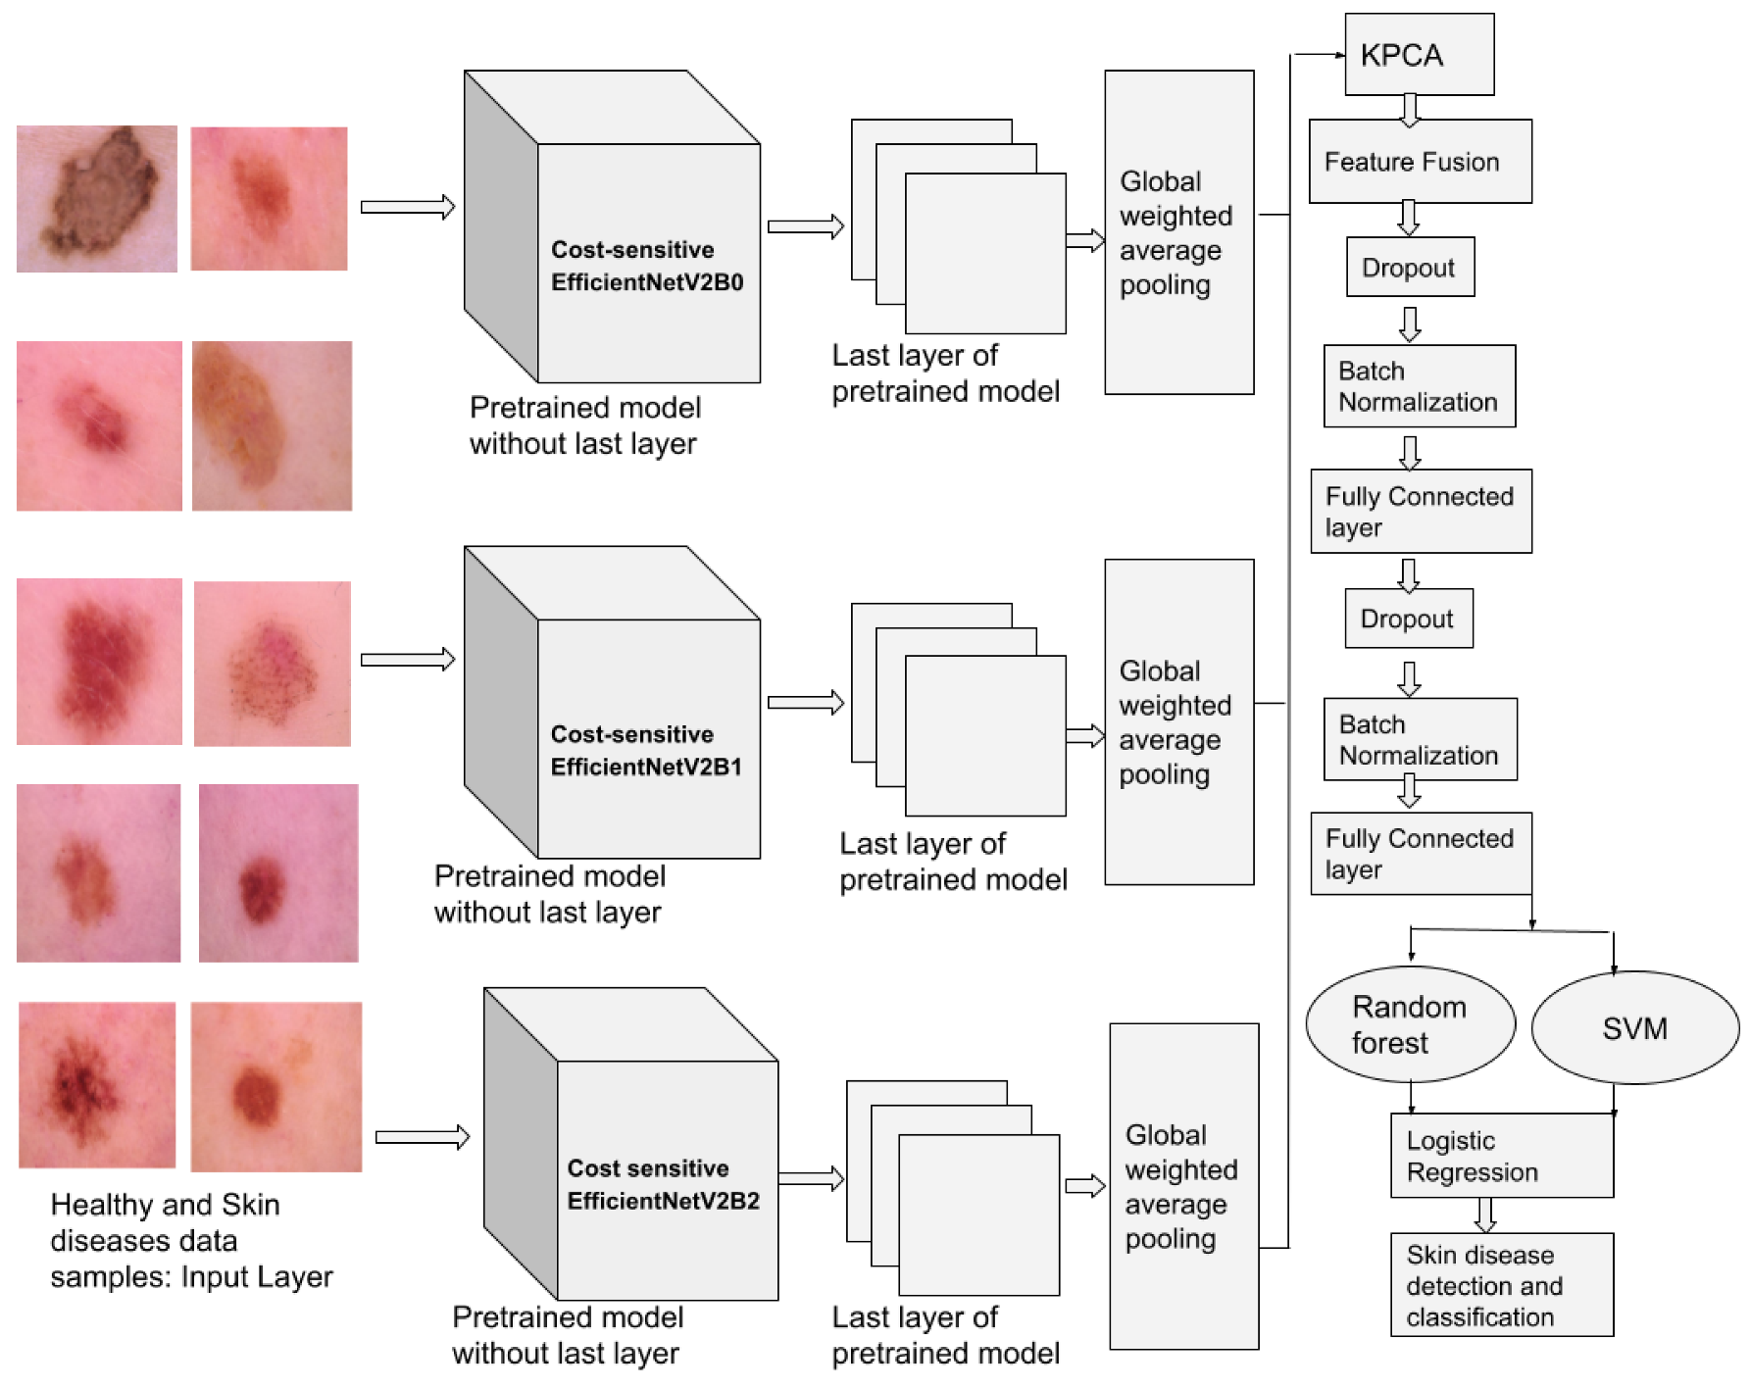
METHODOLOGY

Slide 14
EXPLANATION
These images undergo pre-processing, including resizing, normalization, and data augmentation, to standardize inputs and improve model robustness.
Next, the processed images are fed into a CNN backbone, which automatically extracts hierarchical features such as texture, color variations, and lesion shape.
The extracted feature vectors are then passed into a classification module, which may include fully connected layers or other classifiers to determine the skin disease category.
The diagram begins with input skin images, which are collected from a labeled dataset.

Slide 15
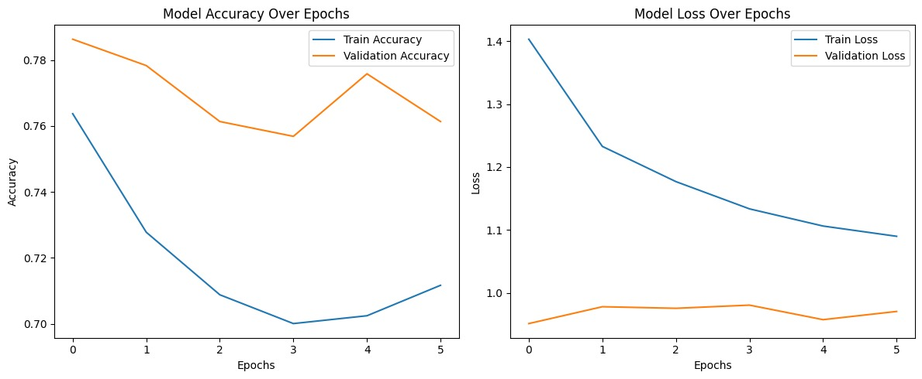
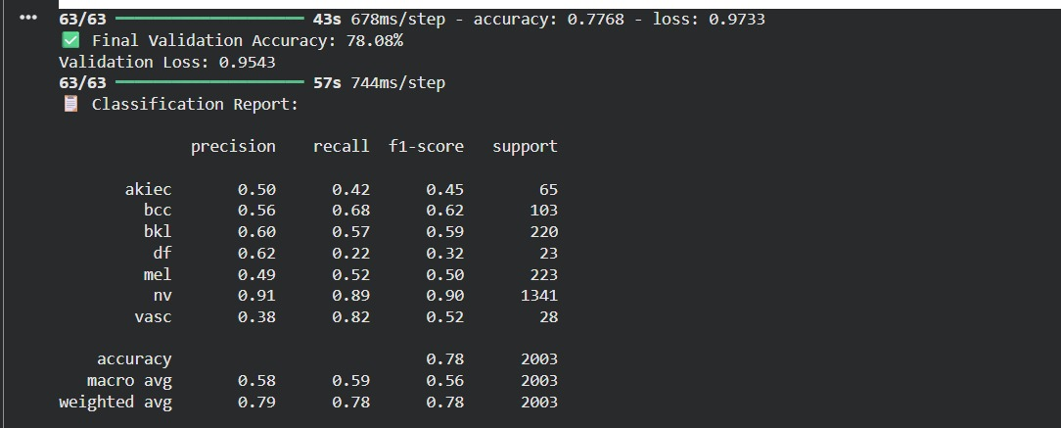
RESULTS

Slide 16
CONCLUSION
✧⁠A hybrid deep-learning and machine-learning approach was implemented for accurate skin disease classification.
✧⁠Pretrained CNN models effectively extracted rich and discriminative features from skin images.
✧⁠Traditional ML classifiers such as Random Forest, SVM, and Logistic Regression improved decision-making efficiency and robustness.
✧⁠The system achieved strong classification results, demonstrating its potential for clinical support and early skin disease detection.
✧⁠This model can assist dermatologists in diagnosis and reduce manual effort in medical image analysis.

Slide 17
FUTURE ENHANCEMENTS
Deploy as a mobile/web application for real-time skin disease detection
Increase dataset size with more diverse and high-quality clinical images
Use Explainable AI (XAI) to show why the model predicts a disease
Add more skin disease categories for broader medical usability
Improve model speed and accuracy using advanced deep-learning architectures
Integrate with dermatology devices (e.g., smartphones with dermatoscope)
Cloud-based storage and processing for hospital and tele-dermatology systems
User-friendly interface for doctors and patients

Slide 18
REFERENCES
Tschandl, P., Rosendahl, C., & Kittler, H. The HAM10000 dataset: A large collection of multi-source dermatoscopic images of common pigmented skin lesions. Scientific Data, 5, 180161 (2018).
Esteva, A., Kuprel, B., et al. Dermatologist-level classification of skin cancer with deep neural networks. Nature, 542, 115–118 (2017).
Brinker, T. J., et al. Skin cancer classification using convolutional neural networks: Systematic review. Journal of the European Academy of Dermatology and Venereology, 33(9), 2019.
Codella, N. C. F., et al. Skin lesion analysis toward melanoma detection 2018: A challenge hosted by the International Skin Imaging Collaboration (ISIC). arXiv:1902.03368.
Khan, M. A., et al. Intelligent skin disease classification using deep learning and data augmentation. IEEE Access, 2022.
Rajpurkar, P., et al. AI-assisted dermatology: Deep learning models for automated skin disease detection and diagnosis. Medical Image Analysis, 2023.

