Slide 1

Go Auto and Transmission Types: Demo 1
Data Dreamers: ​
Michaela Goud, Waryam Kaur, Manjot Kaur, and Sukhvir Kaur​
Norquest College​
CMPT 3830​
Md Mahbub Mishu

Slide 2
Problem statement: Vehicle Transmission Identifier (Classification)
Transmission Types
Automatic – Self-shifting, preferred for convenience.
Manual – Driver-controlled, popular in performance cars.
Challenges Faced by Go Auto
📌 Objective: Automate transmission classification to improve inventory management. 📌 Business Impact: Reduces manual errors, enhances customer experience, and streamlines dealership operations.
Data Source
📌 Collected from: Go Auto’s Business Intelligence Team 📌 Dataset Includes: Vehicle listings from Edmonton dealerships

Slide 3
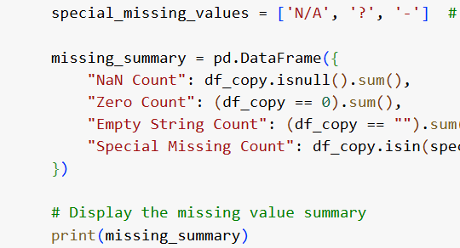
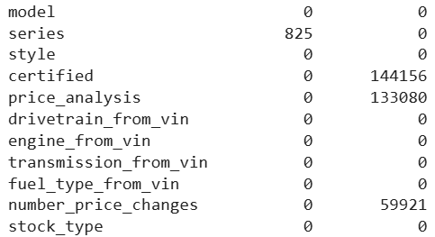
Key Features for Prediction
Identifying Missing Data
📌 Checked missing values in dataset using Pandas.
Selected Features
🔹 Mileage – Indicates wear & potential transmission impact. 🔹 Price – High-end cars often use automatic transmissions. 🔹 Model Year – Newer vehicles are predominantly automatic. 🔹 Make & Model – Certain brands favor specific transmission types. 🔹 Engine Type – Some engines are designed for specific transmissions. 🔹 Drivetrain – AWD, FWD, RWD influence transmission choice. 🔹 Fuel Type – Efficiency and performance affect transmission selection.
Notes:
Why These Features?
✅ Directly impact transmission classification. ✅ Improve model accuracy and efficiency. ✅ Business relevance for dealership optimization.

Slide 4
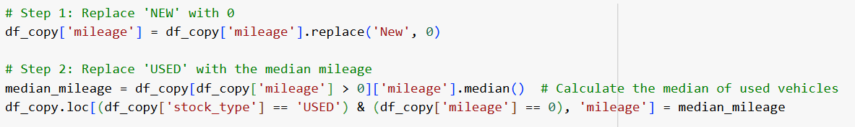
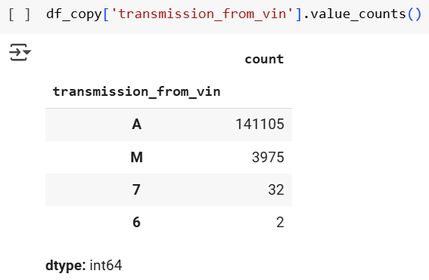
Handling Missing Values

Slide 5
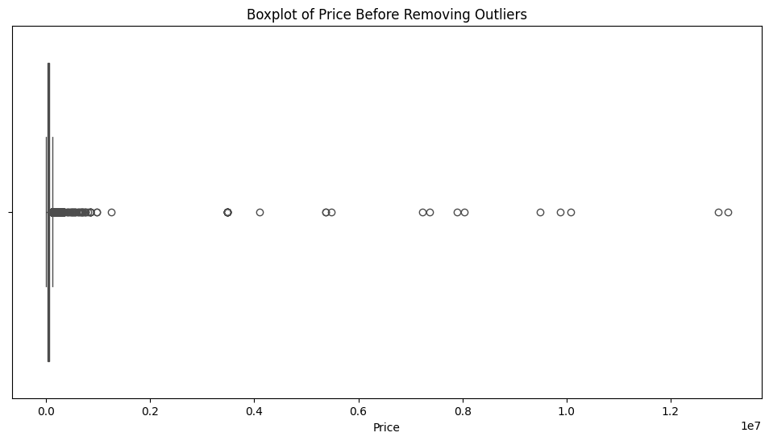
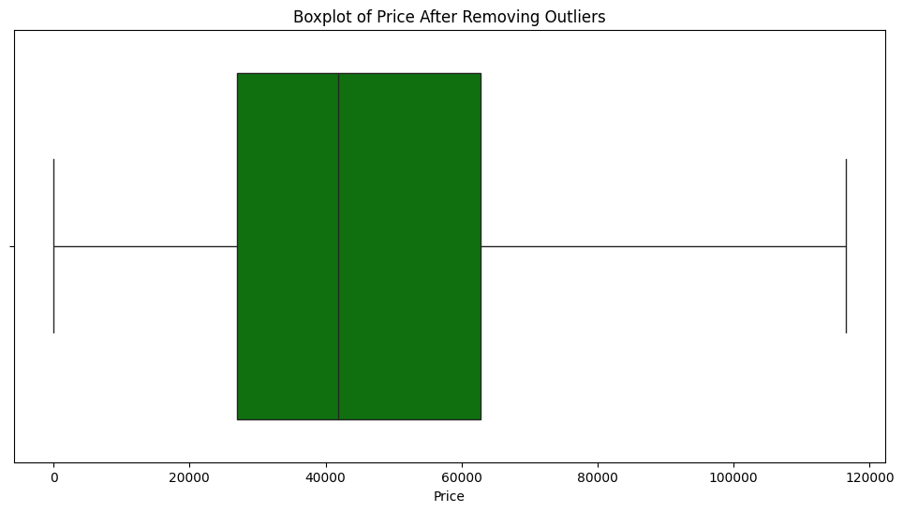
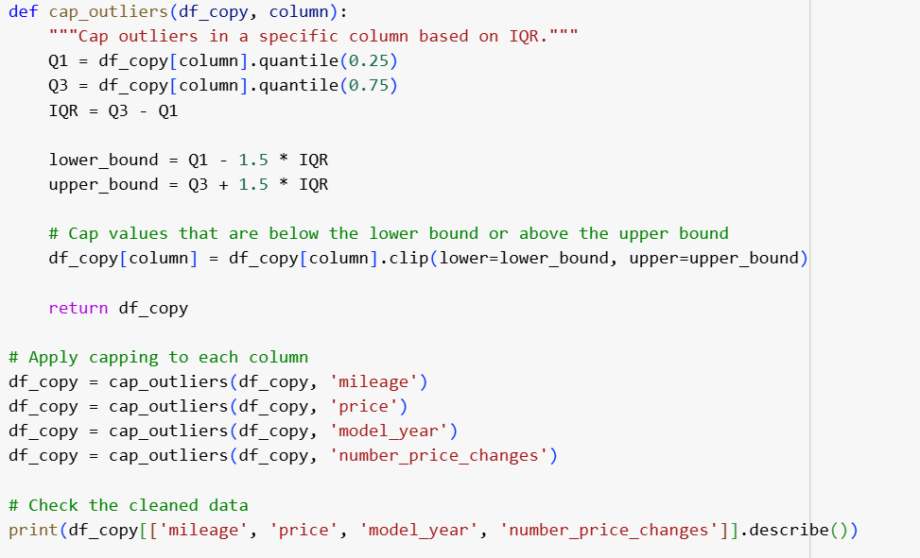
Removing outliers from price column

Slide 6
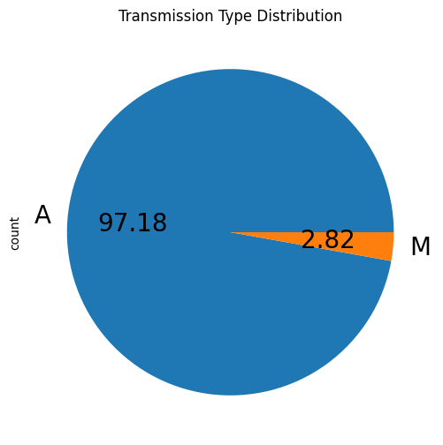
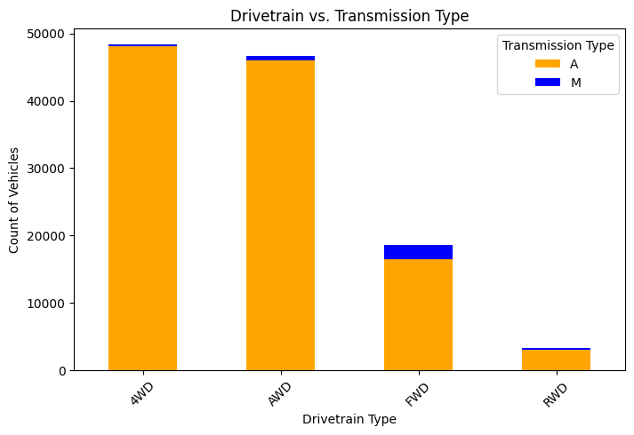

Slide 7
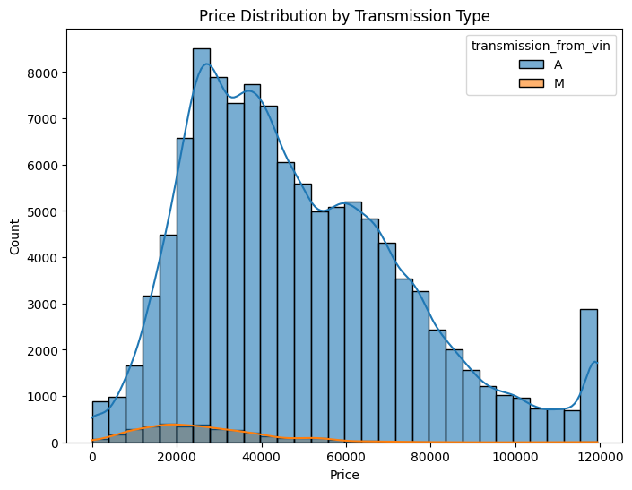
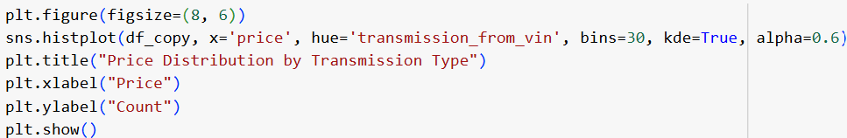
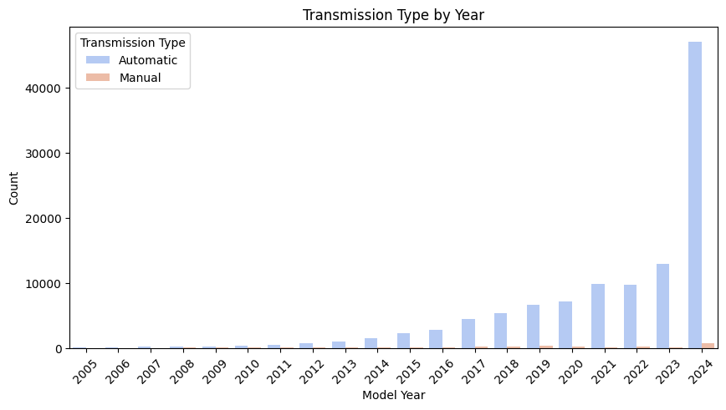
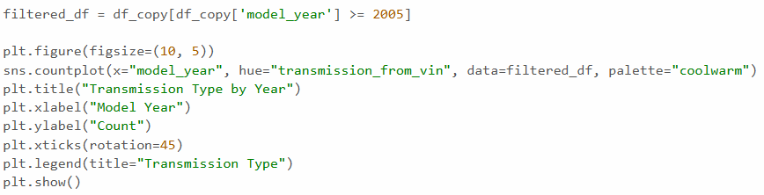

Slide 8
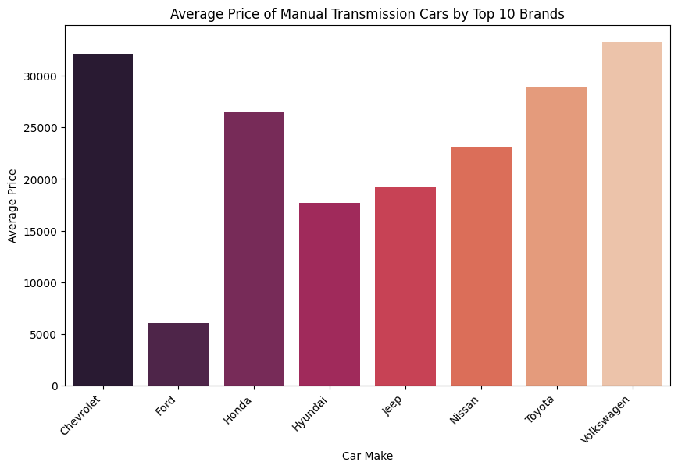
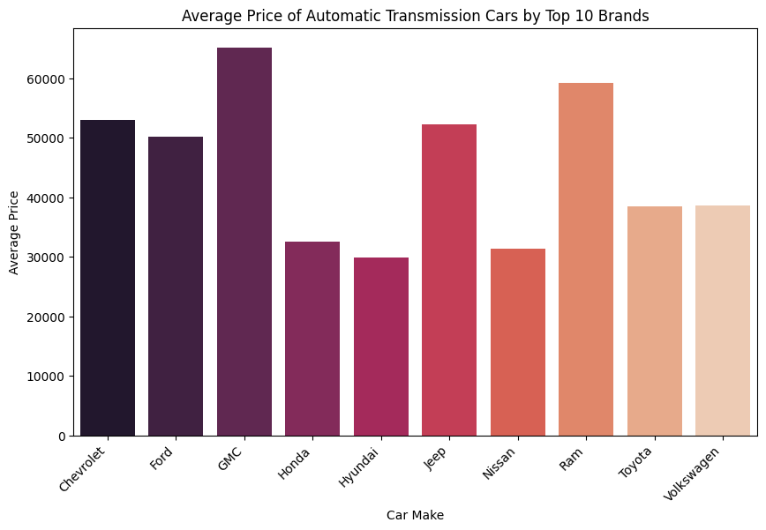

Slide 9
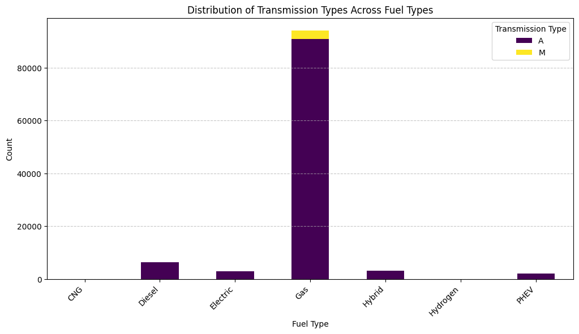
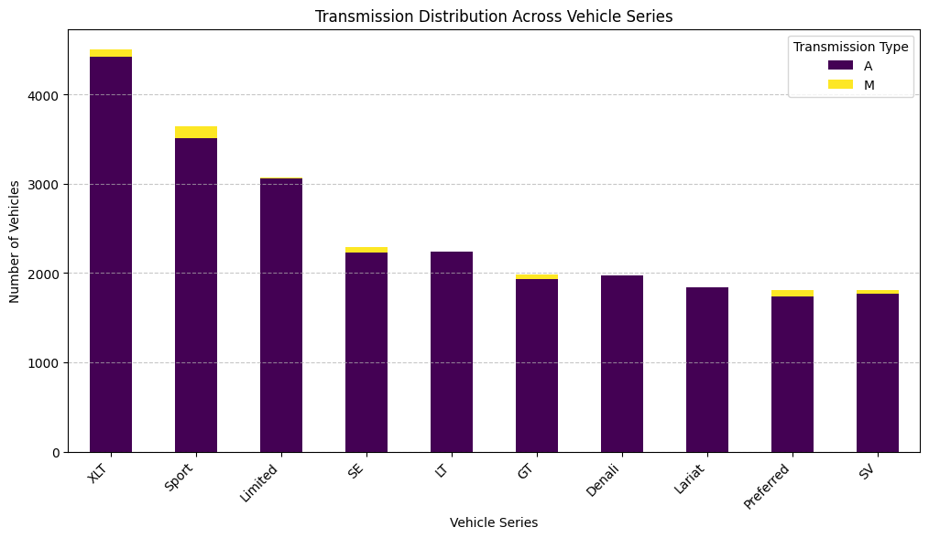
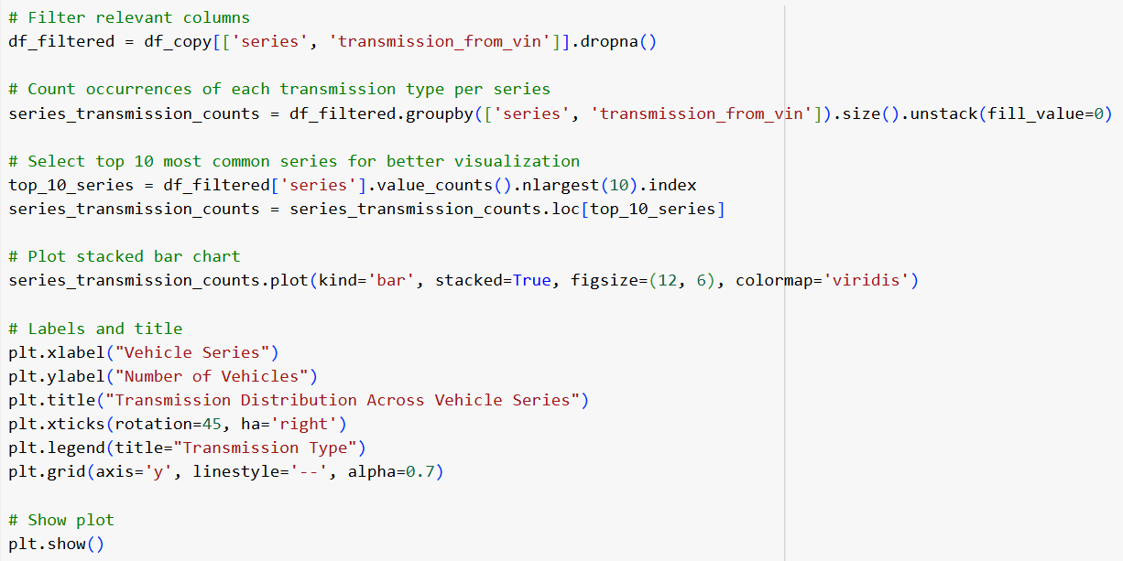
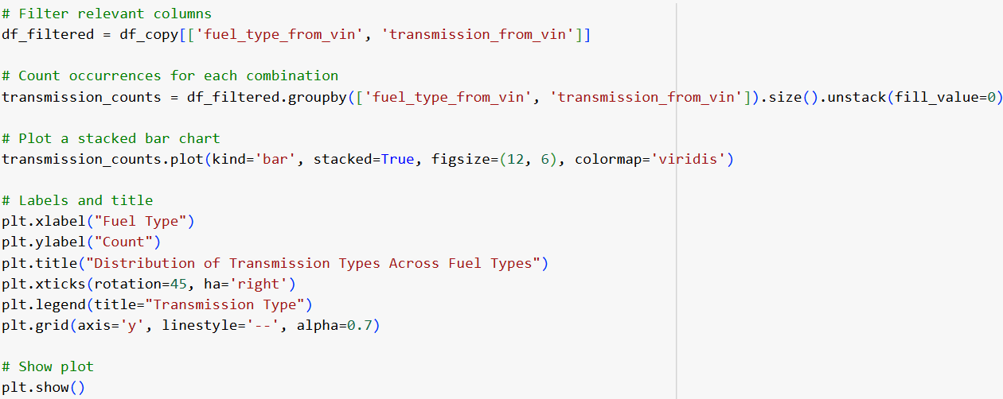

Slide 10
