Slide 1


PUNJAB VERSE
Group 35
Presented by : Jasmin Kaur Gahlot (2203470)
Jasvir Kaur (2203474)
Manjot Kaur (2203497)

Slide 2
Introduction
Objectives
Methodology
Technologies used
Flow diagram
Output Screen
Conclusion
TABLE OF CONTENTS

Slide 3

INTRODUCTION
Objective
Approach
This project aims to translate popular Punjabi idioms into their English meanings and find their closest English equivalent idioms. By doing so, we help preserve the essence of the Punjabi language while making its expressions accessible and relatable to a global audience.
We will explore common Punjabi idioms, providing their meanings and offering the most fitting English equivalent idioms. Special attention will be given to cultural nuances to ensure that both the meaning and the impact of the idiom are retained.

Slide 4

To compile a comprehensive dataset of Punjabi proverbs with their contextual English meanings.
OBJECTIVES
To create a user-friendly interface for translating Punjabi proverbs into English
To ensure language accuracy and interface functionality

Slide 5
METHODOLOGY
DATABASE CREATION
BACKEND DEVELOPMENT
FRONTEND DEVELOPMENT
TESTING AND DEBUGGING

Slide 6

TECHNOLOGIES USED
Frontend
HTML, CSS and JavaScript
Backend
Python
Database
Manually curated idiom mappings using SQLite

Slide 7
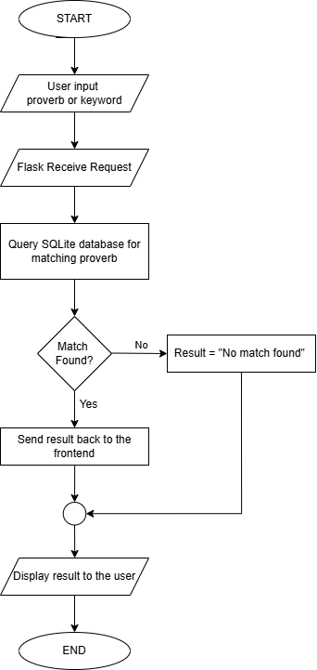

FLOW DIAGRAM

Slide 8
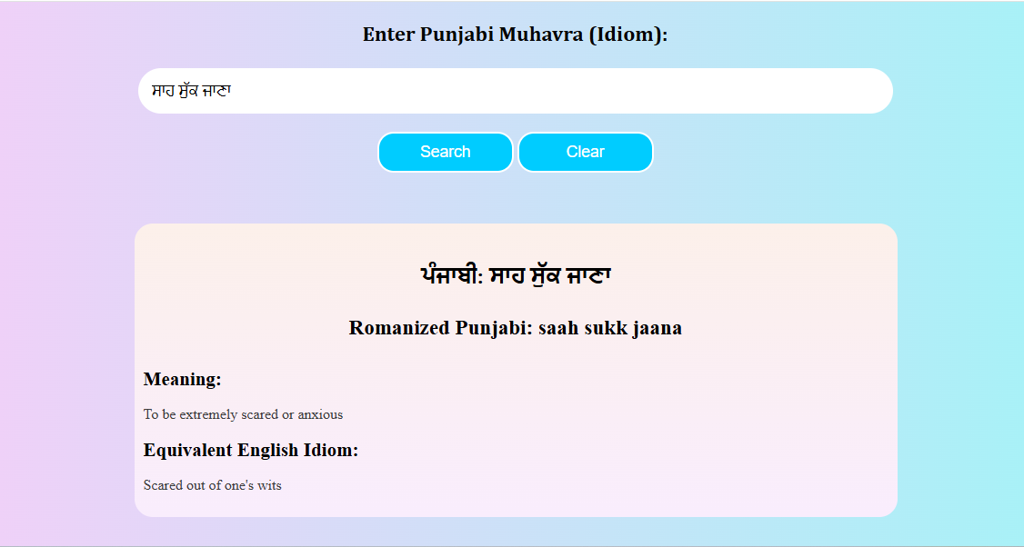
OUTPUT SCREEN

Slide 9
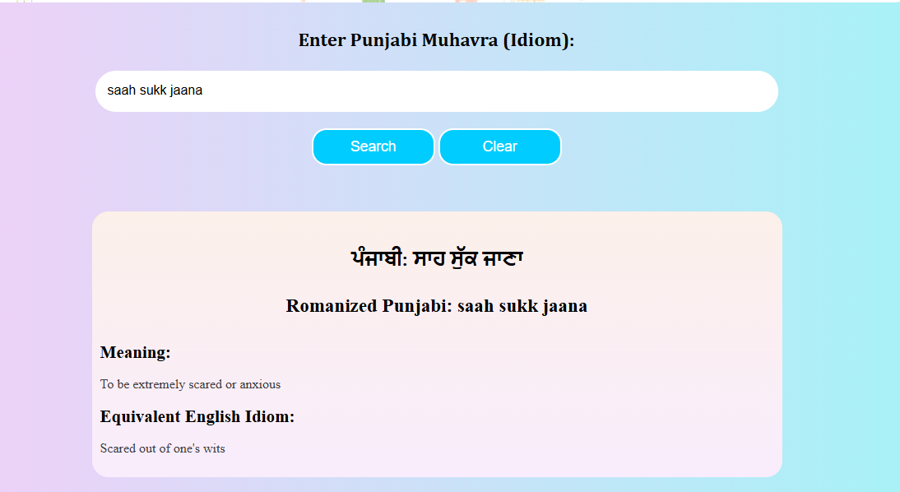
OUTPUT SCREEN

Slide 10


CONCLUSION
PunjabVerse seamlessly connects traditional Punjabi proverbs with modern technology. Supporting Gurmukhi and Romanized inputs using fuzzy matching and providing contextual English translations, it offers an accessible, user-friendly experience. Ideal for students, researchers, and enthusiasts, the platform promotes cultural preservation, cross-cultural understanding, and the continued relevance of Punjabi heritage in the digital age.

Slide 11
THANK YOU

