Slide 1
Service Version in Continuous Delivery
QA Activities
As of March 13 2019
Document Identity Card
UUID | Owner | Author | Version Major.Minor | Modification Date (YYYY/MM/DD)
3DS_D_SVDev_R_BP | ARL | ADD1 | V0.15 | 2020/03/30

Slide 2


Continuous Delivery
Test a Service in Continuous Delivery context
1. Prepare Validation Plan | QA | Service Version Define & Plan
2. Review PES | QA | Service Version Development
3. Define Scenario | QA | Service Version Development
4. Automate Scenario Replay | QA | Service Version Development
5. Prepare QA Environment | QA | Service Version Development
6. Replay Scenario | QA | Service Version Development
7. Assess Function Quality | QA | Service Version Development
8. Submit IR | QA | Service Version Development
9. Validate IR Closure | QA | Service Version Development
10. Assess Service Version Quality | QA | Service Version Development
WHAT
WHO
WHERE

Slide 3
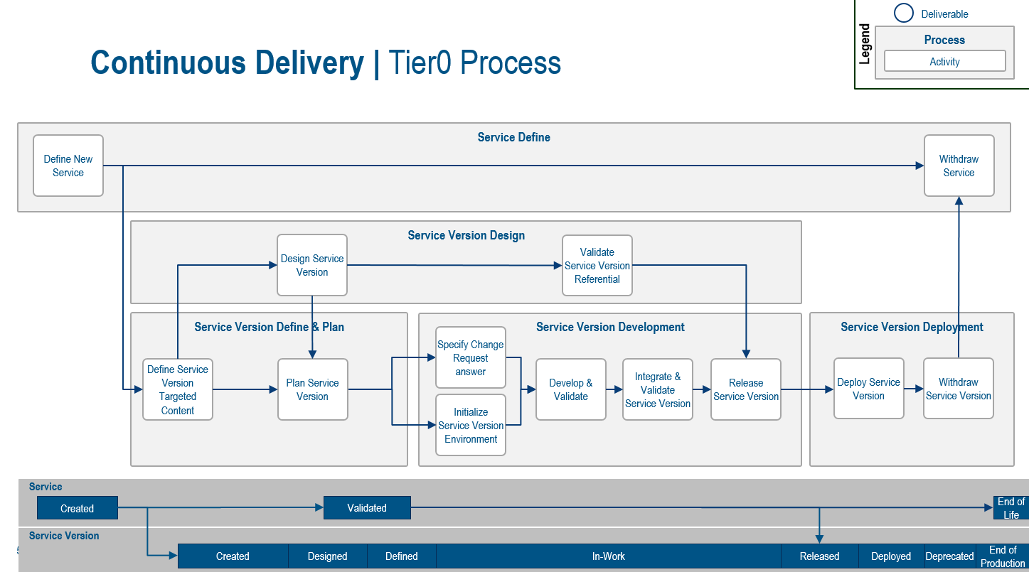
QA Activities in Service Version Process
1
Prepare Validation Plan
Review PES
Define Scenario
Automate Scenario Replay (to be defined)
Prepare QA Environment
Replay Scenario
Assess Function Quality
Submit IR
Validate IR Closure
Assess Service Version Quality
2
3
4
5
2
3
6
1
5
6
7
4
7
8
9
10
8
9
10

Slide 4
Prepare Validation Plan
What:
Define the best test strategy based on all factors that could influence the Service Version quality: such as functional content, available resources, previous Service Version tests, …
Identify list of QA scenario to be defined or updated
Identify list of QA scenario that will contribute to Service Version QA Assessment
Identify list of QA Automated Scenarii impacted (to be replayed / validated)
Estimate QA Affordability for the targeted content
Is it affordable to test / validate / converge the Service Version Content in the defined time-frame?
If not affordable,
Provide a risk assessment (list of scenario that will not be replayed while not putting at stake the Service Version)
re-work plan with Service Manager (move content to another Version, update Service Version schedule …)
Deliverables
List of scenarios …defined / updated / Automated / Not Replayed
Service Manager sign-off
QA Affordability and risk assessment

Slide 5
Review PES
Why:
Ensure that PES contains all the necessary information on « what » the function will do and not do with respect to a Customer Requirement.
Start scenario definition to integrate the new functionality in validation steps

Slide 6
Define Scenario
What:
Define or update the steps to perform in order to test a particular aspect of a Service in a particular scope
Different Type of Scenario: Redwire, Non regression tests scenarios, Smoke tests scenario, Function certification, Best Practice, Licensing, Packaging, PCS, Security, CAA, Customization, Migration, Documentation, Guided free tests, TVT/NLS
How:
Scenario Definition Detailed Process available here
Through DSxRD / Software Quality / Scenario Application. Detailed documentation available here

Slide 7
Automate Scenario Replay
Objective: Enable automatic replay of scenario when needed (and more frequently than possible manually) in order to increase service version quality, and team efficiency

Slide 8
Prepare QA Environment
What:
QA Environment for Service Version Validation is a Sandbox on a dedicated “Dev Stage for QA”, based on Reference Cluster that corresponds to
Production Level (LastDevOpsRef)
Or Global Factory switch Level (LastSwitchDevOpsRef or LastDevOpsRefLevel)

Slide 9
Environments to perform Service Version QA tests
Production Reference Cluster
Switch
Reference Cluster
Service C
Global Factory Service
Deployment
Service A
QAL
(Cloud)
E4ALL + Download (On-Premises)
BSF
Based On
Service Version Released
Deployment
INT Stage
PRJ 1
PRJ 2
Sandbox
Dev 1 Stage
Dev 2 Stage
QA Stage
Dev 1
Dev 2
Local Factory Service
Deployment
Legend
Local Factory
Global Factory
Service B
Reference Cluster
Service B
QA Environment

Slide 10
Prepare QA Environment
Recommendations
Establish Strategy for defining how many stages / Sandbox are required
Following aspects should be considered:
Different type of testing are needed? (with / without data, …)
Multiple QA members to test the Service version? (same team? Different team)
In order to ensure stability of the environment and that QA tests are efficient, it’s necessary to define precisely
how many stage / sandbox are needed ?
what will be the usage of each of those ?
What is the lifecycle of the sandbox (periodicity of the renewal) ?
Define what will be the different parameters of the sandbox, that will support with the defined strategy
Reference Cluster
List of Services to be added to the sandbox (Continuous Delivery and/or Global Factory Services)
Exact Version / Iteration / Package of each Service
This define should be done with the Service Manager, who can provide recommendations based on his knowledge of the Service Version Development plan
If QA tests requires some existing data, the Service must provide export/import capability
Service manager needs to provide support to QA to execute the batch that will perform Export / Import

Slide 11
Prepare QA Environment
Possible strategies, if an IR/Function Validation requires a change authored in Global Factory
Service A with fix
1.0.1
Service B With fix
R2020xFD1
Reference Cluster on Production Level (2020xGA)
Service A
1.0.0
Service B
R2020xGA
Service x
QA Sandbox
Service A with fix
1.0.1
Reference Cluster on Switch Level (2020xFD1)
Service A
1.0.0
Service B With fix
R2020xFD1
Service x
Legend
QA Sandbox
Local Factory
Global Factory
Reference Cluster
QA Environment

Slide 12
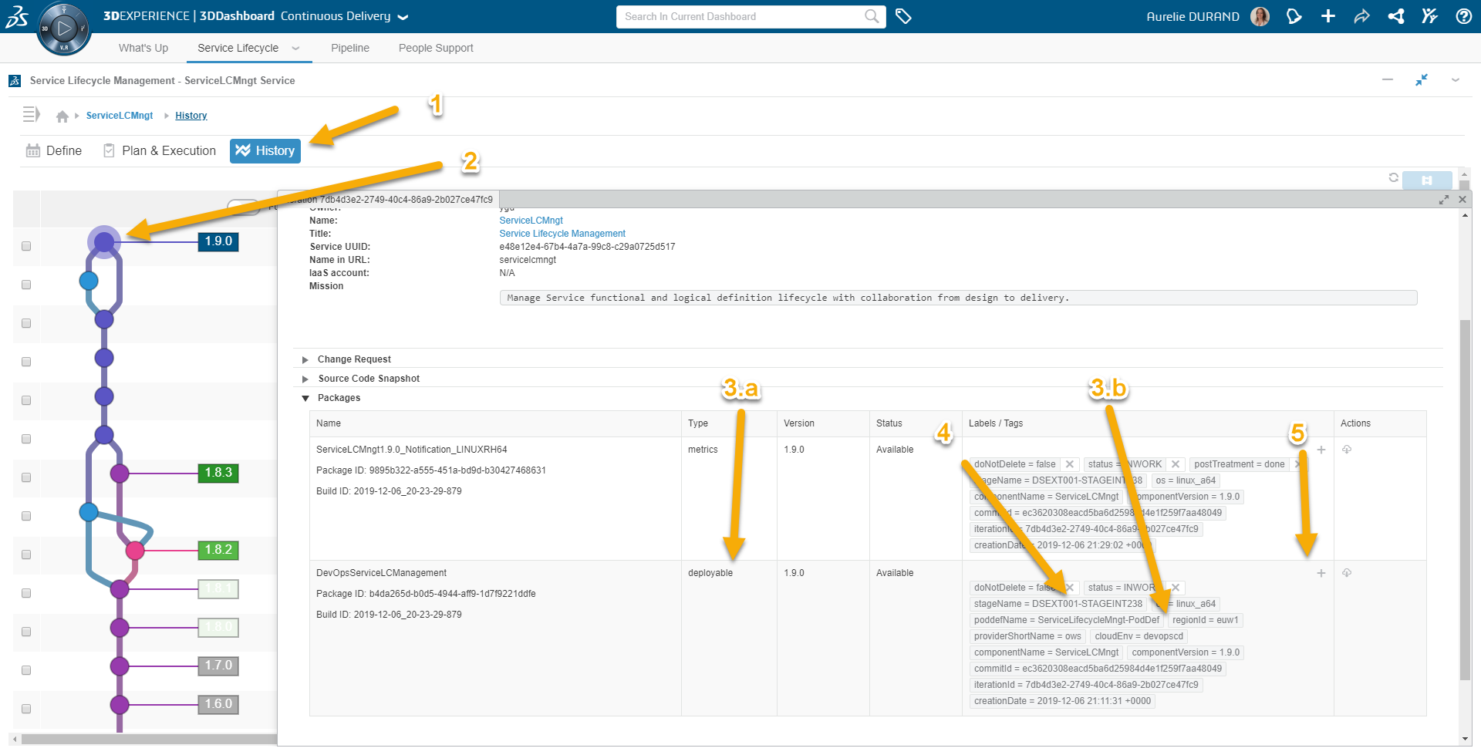
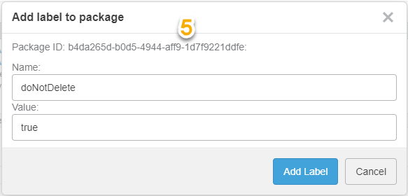
Prepare QA Environment
HOW TO
Service Manager preparation (1/2)
Protect the deployable package In order to ensure that the package to deploy won’t be deleted until the end of the QA Validation, the Service manager must protect the deployable package for each region to be deployed (based on regionId tag).
How:
In Continuous Delivery / Service Lifecycle,
On History Tab
Open an Iteration
In Packages Section, identify the right Package
Type=deployable,
regionId=region to be deployed
Delete existing doNotDelete tag with value set to false
Add doNotDelete tag and set its value to true
Warning: tag name and value are case sensitive

Slide 13
Prepare QA Environment
HOW TO
Service Manager preparation (2/2)
Unprotect previously protected package In order to avoid quota error, the service manager must check that no packages are uselessly protected (at least each time he wants to protect a new package).
Identify all the packages currently protected by the doNotDelete tag The following command enable to retrieve all the packages of the service (in this case ServiceLCMngt) which have a :
doNotDelete tag with value set to true
status=INWORK
dsslm list_package -TcomponentName=ServiceLCMngt -TdoNotDelete=true -Tstatus=INWORK
Change doNotDelete tag value to false for all the iteration that shouldn’t be protected anymore (following the same steps as previous slide for setting doNotDelete tag value to true)
Never remove or change the tag "doNotDelete = true" for a package which has the tag : "status = RELEASED"

Slide 14
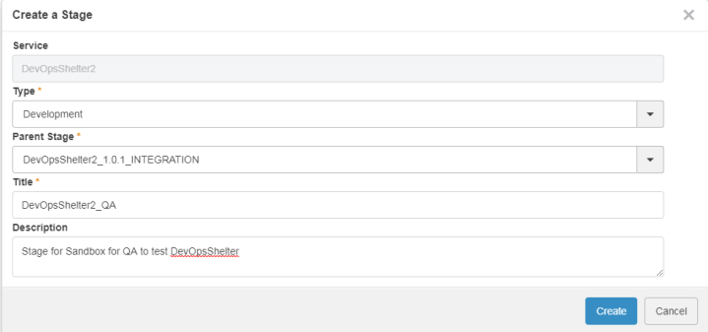
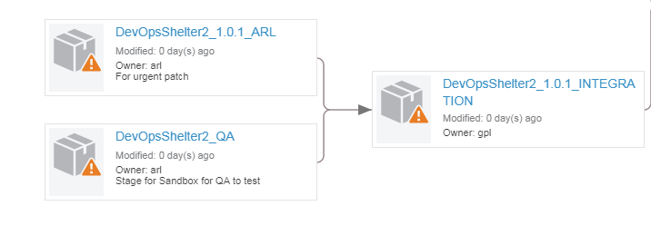
Prepare QA Environment
HOW TO
How to create a new stage
In Continuous Delivery / Pipeline :
Create a New Stage dedicated to QA tests
The Parent Stage is the Integration stage of the Service pipeline to be tested
The type for QA stage is similar to dev: Development
More information are available in the Pipeline Service documentation here
The factory associated to the stage should be deleted in order to avoid consuming resources uselessly, except if the stage is used to deliver automated test or to execute migration test,

Slide 15
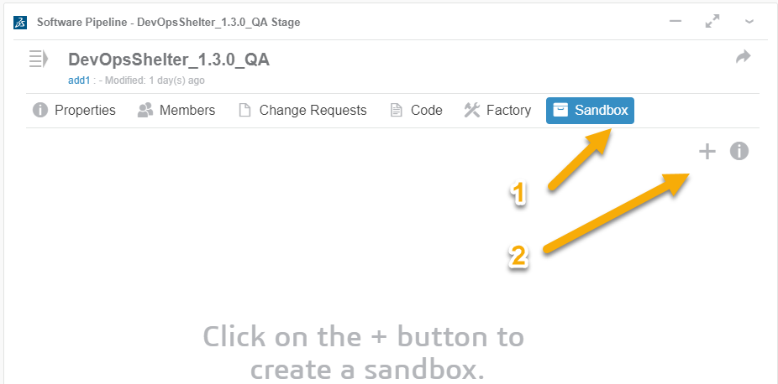
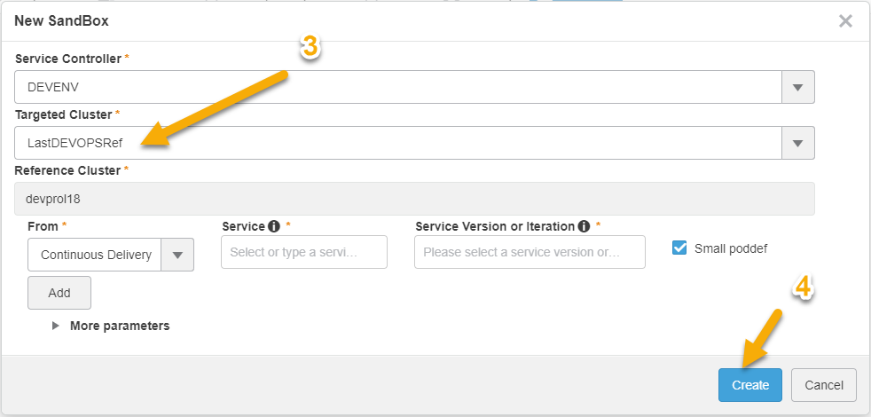
Prepare QA Environment
HOW TO
How to create a sandbox
In the newly created QA Stage:
Create a sandbox for QA Tests
Select Sandbox tab
Click on the “+” button to create a sandbox
Select Targeted Cluster
LastDEVOPSRef for the production
Create the sandbox
More information on Sandboxes can be found here
In order to avoid consuming resources, don’t forget to delete useless sandbox as soon as the test are finished.
When a ref Cluster is destroyed, all the sandbox based on it are destroyed.

Slide 16
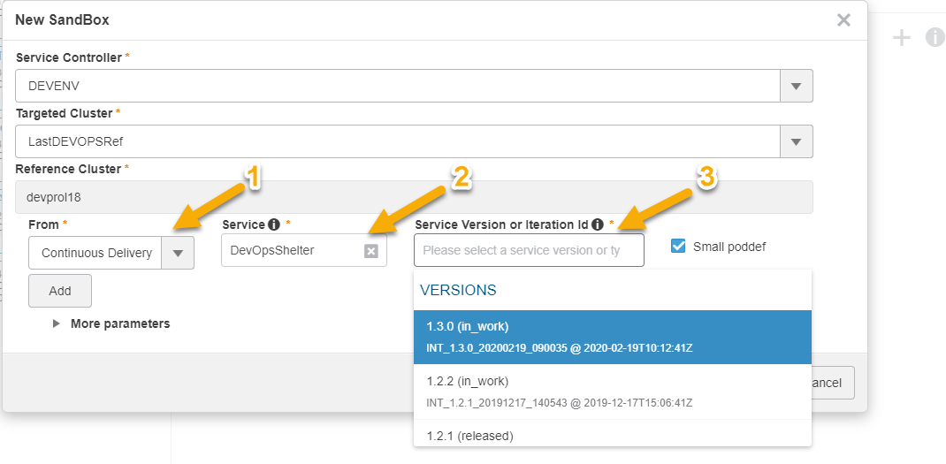
Prepare QA Environment
HOW TO
How to deploy a Continuous Delivery Service
In order to deploy a Continuous Delivery Service, when you create your sandbox, you need to :
Select Continuous Delivery in the From field
Select the right service in the Service Field
Select in the Service Version or Iteration field the build that you want to deploy

Slide 17
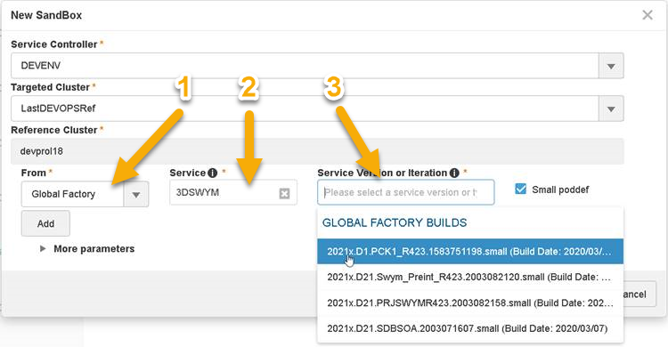
Prepare QA Environment
HOW TO
How to deploy a Global Factory Service
In order to deploy a specific Global Factory Service, when you create your sandbox, you need to :
Select Global Factory in the From field
Type in the Service field the name of the service name that identify the service in the the Service Controller (define in the PodDef)
Select in the Service Version or Iteration field the build that you want to deploy
As of February 2020 :
the service list doesn’t display the list of Global Factory Service, so you need to type the exact service name as known by the Service Controller
The service version list display all the build, for the service, known by the service controller. However, the package aren’t necessary still available in the cloud.

Slide 18
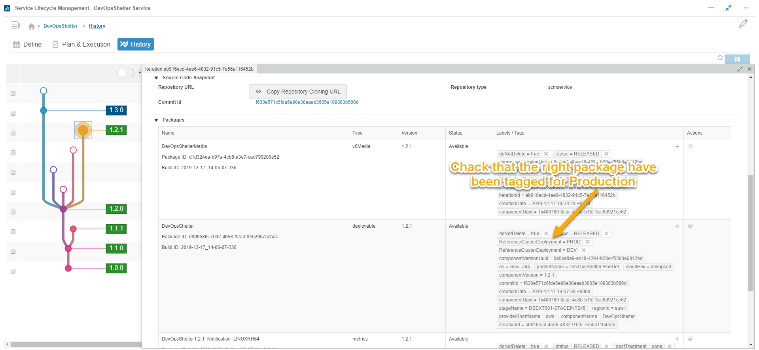
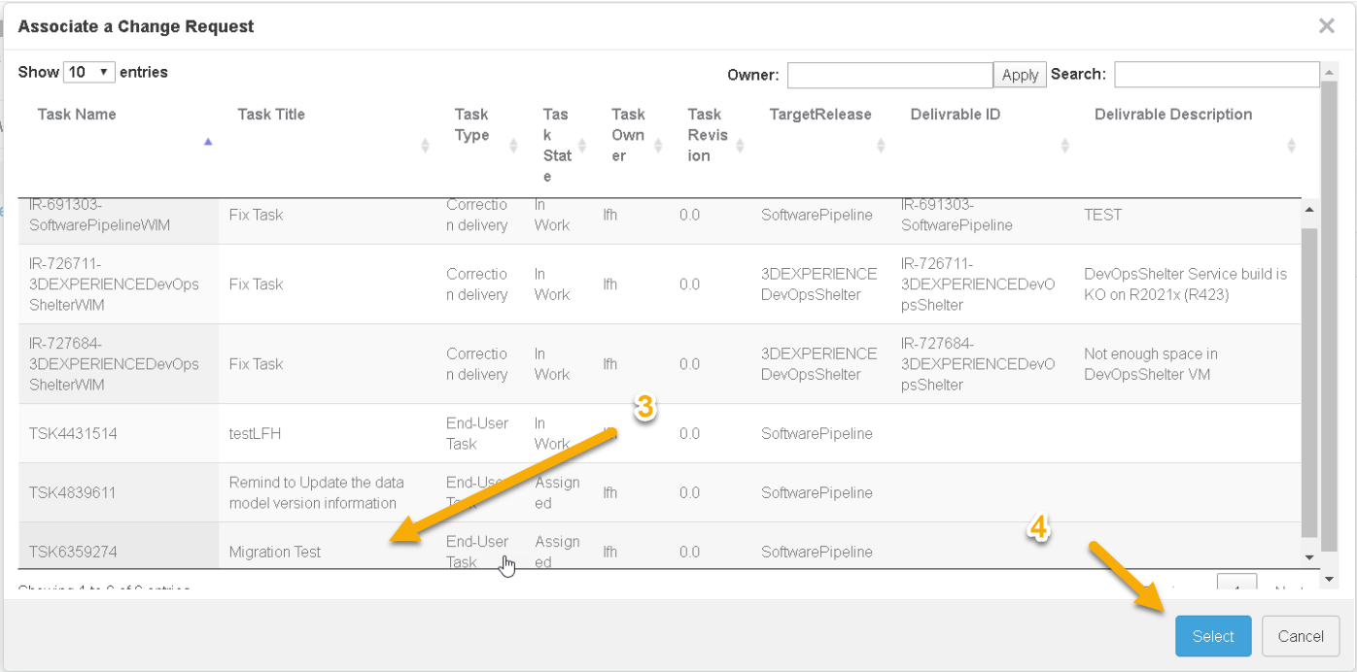
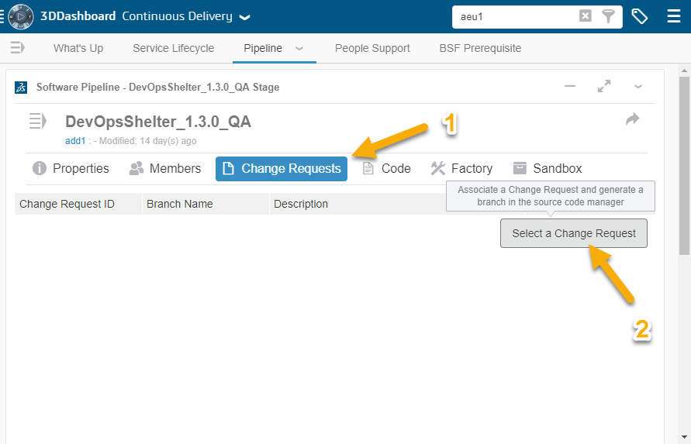
Prepare QA Environment
HOW TO
How to prepare QA Environment for service upgrade test 1/2
Service upgrade test on Cloud Environment consist in:
Use the factory to upgrade the service
Execute non-regression test
Prerequisite:
The Service manager has set the tag ReferenceClusterDeployment=PROD on the iteration that is related to the service version deployed in production
Optional: In Pipeline/Sandbox tab, create a sandbox based on the service version/iteration that you want to upgrade (automatically done by the factory if you want to test the upgrade from the service version in production: iteration tag ReferenceClusterDeployment=PROD)
Service Upgrade test need a factory and a branch in the QA Stage. If there is no branch associated to the stage:
In Pipeline, select Change Request tab
Click on “select” a change request
Select a change request tips: you can ask you service manager to add a task attached to the Service Version Project for “Upgrade Test”
Create the branch by clicking on “Select” button

Slide 19
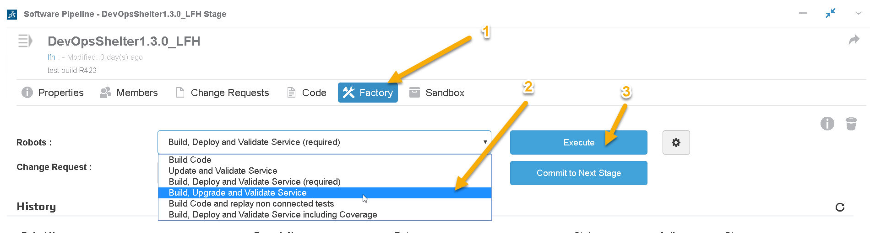
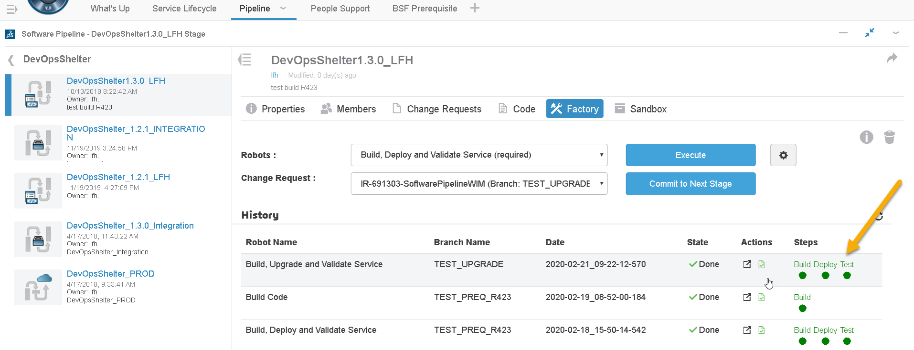
Prepare QA Environment
HOW TO
How to prepare QA Environment for service upgrade test 2/2
In Pipeline, select Factory tab
Select Build, Upgrade and Validate Service
Click on execute
The Factory will
create a Sandbox on production level (tag ReferenceClusterDeployment=PROD), if there is no Sandbox in the Stage
Upgrade the sandbox associated to the stage according to the level of code associated to the current stage.

Slide 20
Prepare QA Environment
HOW TO
How to prepare QA Environment for data migration test
Migration test on Cloud Environment consist in:
Populating a sandbox with data
Upgrading the sandbox
Checking migrated data
Execute non-regression test
The step-by-step is the same than for Service Upgrade Test (see previous slide) except that you must create your sandbox and populate data before executing the Buid, Upgrade and Validate Service graph in the Factory.

Slide 21
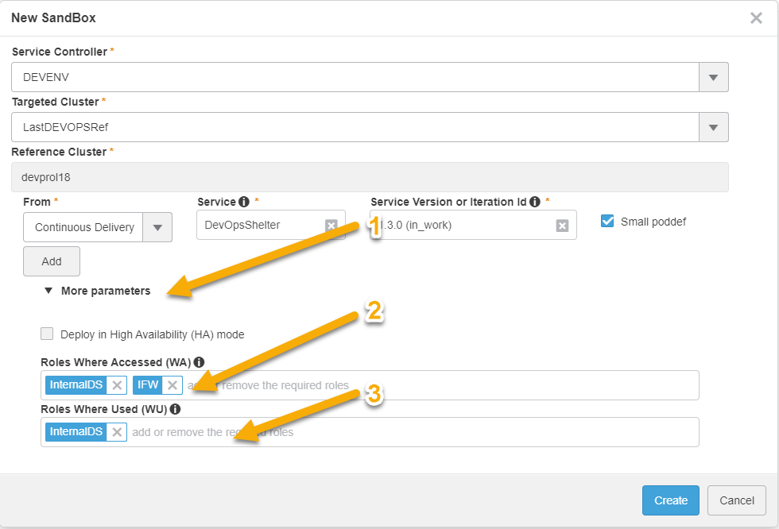
Prepare QA Environment
HOW TO
How to prepare QA Environment for Licensing test
In order to deploy a sandbox with specific licenses, when you create your sandbox, you need to :
Click on More Parameters
In the Roles Where Accessed (WA) field add:
InternalDS
IFW
Any additional license you need
In the Roles Where Used (WU) field add:
InternalDS
Any additional license you need
You can find here definition of WA and WU Roles
By default, there is 10 licenses assigned by roles that expire after 30 days.
If the added role have prerequisite roles, each prerequisite have to be added also.

Slide 22
Replay Scenario
What:
Plan, execute, assess result of one particular scenario replay in a particular context
How:
Scenario replay is to be performed on the sandbox created in the “Prepare QA Environment” Step.
In Continuous Delivery / Pipeline
select the QA Stage and go to the Sandbox tab
Launch 3DEXPERIENCE
Advices – specific cases, not testable in a sandbox as of February 2020:
Packaging, Documentation tests
Multi-tenant
Different environment type (VPC, Academia, etc.)

Slide 23
Assess Function Quality
What:
Provide a GO/NO-GO assessment of each function developed in the Service Version:
All Functions associated to the Service Version Project that have a QA task (similar to on-premises process)
GO/NO GO Criteria:
The function Quality Assessment must be set to « GO » if there is no Opened IR associated to the Function (no IR reported on the function, or all reported IR fixed and validated)
How:
List of Functions to validate is accessible
In Service Lifecycle Management / Plan & Execute tab => Validation task on Functions
In DSxRD through the Project of the Service Versions

Slide 24
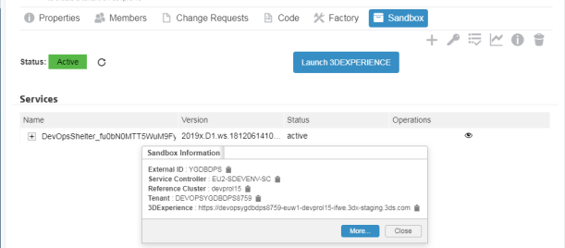
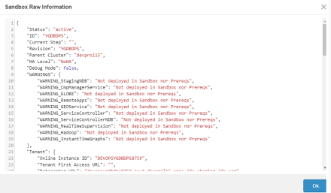
Submit IR
What:
Report an issue related to the service, during Service Version validation
How:
Create new Incident Report Family with
Detection information:
Detected Version: “3DEXPERIENCE”
Detected Release or Service: [Name of the tested service]
Detection Level: [service version tested]
Detected Environment: “Cloud”
Target Information:
Targeted Version: “3DEXPERIENCE”
Targeted Level or Service: [Name of the tested service]
Associated document:
To communicate information about the sandbox environment
On the Sandbox tab, select “I”, then “more”
Copy/paste the displayed information (Sandbox Raw Information) into a text file
Associate this file to the IR
For issues which are not related to new functions (Regression IR), associate the newly created IR to the Service Version Project;: this can be done either by Dev or QA

Slide 25
Validate IR Closure
What:
IR that I own (submitted by me)
IR in Final Validation
IR associated to the Service Version Project
Selected during the Service Version define
Found during the Service Version Scenario Replay
IR Associated to Functions of the Service Version
How:
List of IR to be validated can be retrieved from Service Lifecycle Management / Plan & Execute tab, or directly in the project in DSxRD
See detailed slides “IR In Continuous Delivery” for more information on IR Management

Slide 26
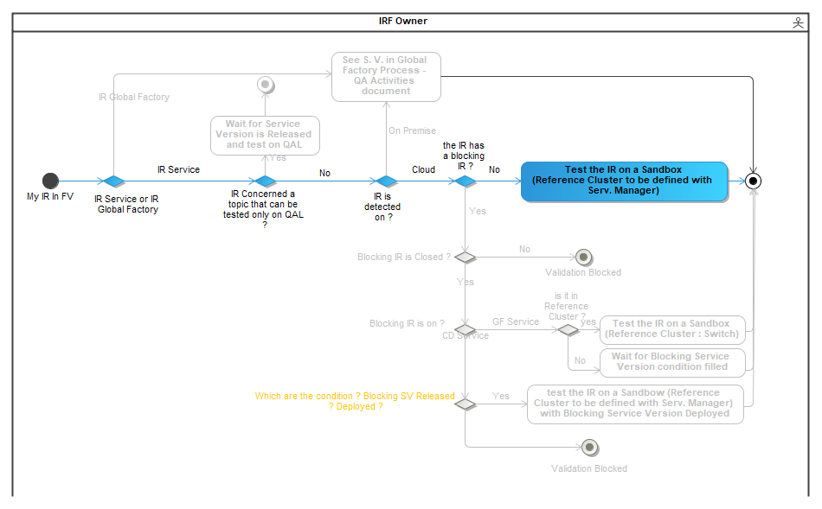
Validate IR – validation environment

Slide 27
IR in Continuous Delivery

Slide 28
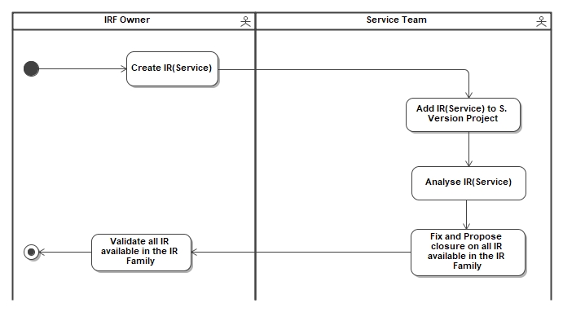
IR in Continuous Delivery
Nominal use case

Slide 29
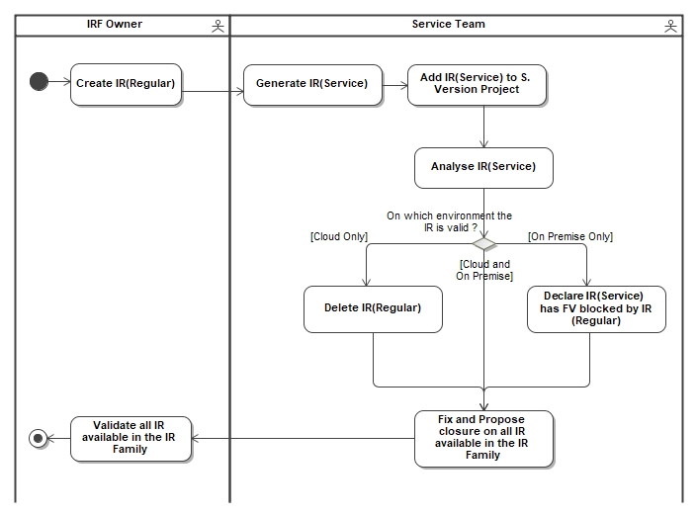
Analyze and Fix IR
External IRF or Internal IRF created on 3DEXPERIENCE Regular program (19x, 20x…)
The « Service » IR should be closed as UR, if the issue is only valid On Premises
“IR(Regular)” stands for IRs submitted on a regular program of 3DEXPERIENCE (18x, 19x, 20x …)
“IR(Service)” stands for IRs submitted on a Service that has its own Release Program (managed in Continuous Delivery Mode)

Slide 30
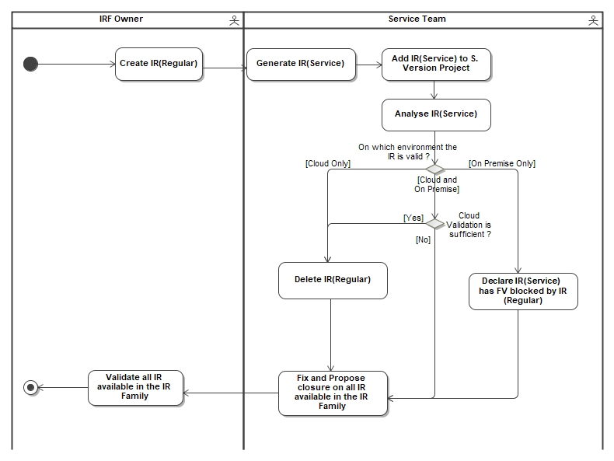
Analyze and Fix IR
IR Opened on a Service before migrating to Continuous Delivery
The « Service » IR should be closed as UR, if the issue is only valid On Premises
“IR(Regular)” stands for IRs submitted on a regular program of 3DEXPERIENCE (18x, 19x, 20x …)
“IR(Service)” stands for IRs submitted on a Service that has its own Release Program (managed in Continuous Delivery Mode)

Slide 31
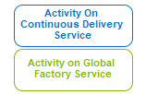
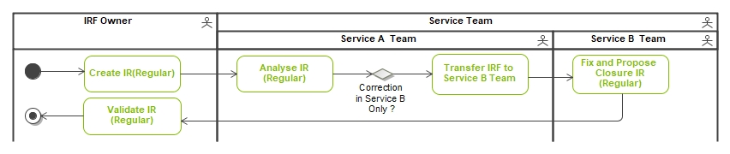
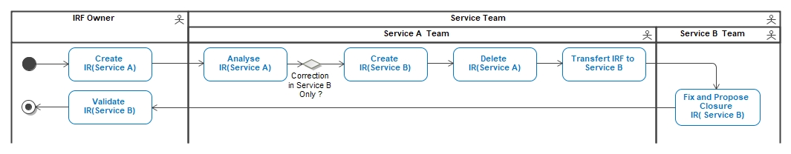
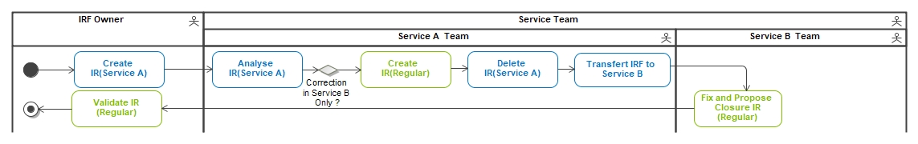
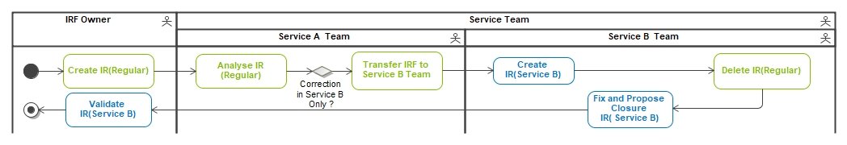
Analyze and Fix IR
Legend
Issue detected on Service A that requires a correction only in Service B (ex: runtime pre-requisite)
Both Service in Global Factory Validation Environment:QAL
Both Service in Continuous Delivery Validation Environment: Sandbox
Service A in Continuous Delivery and Service B in Global Factory Validation Environment : Sandbox based on the Switch Reference Cluster
Service A in Global Factory and Service B in Continuous Delivery Validation Environment: Sandbox
“IR(Regular)” stands for IRs submitted on a regular program of 3DEXPERIENCE (18x, 19x, 20x …)
“IR(Service)” stands for IRs submitted on a Service that has its own Release Program (managed in Continuous Delivery Mode)

Slide 32
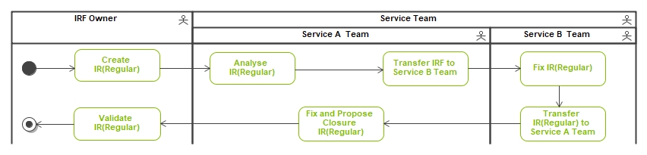
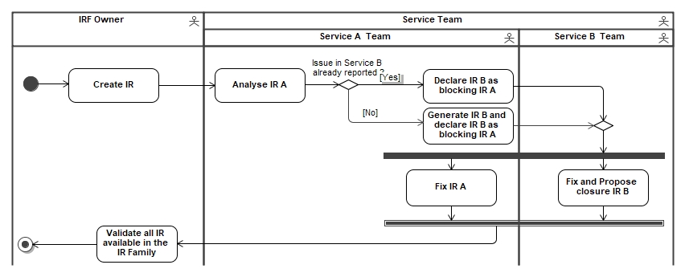
Analyze and Fix IR
Issue detected on Service A that requires also a correction in Service B (ex: buildtime pre-requisite)
Both Service in Global Factory Validation Environment:QAL
Service A and B in Continuous Delivery or in different mode
If Service A and Service B in CD Validation Environment: Sandbox
If Service A in CD and Service B on Global Factory Validation Environment: Sandbox based on the Switch Reference Cluster
If Service A in Global Factory and Service B on Continuous Delivery
Validation Environment: Sandbox based on the Switch Reference Cluster
“IR(Regular)” stands for IRs submitted on a regular program of 3DEXPERIENCE (18x, 19x, 20x …)
“IR(Service)” stands for IRs submitted on a Service that has its own Release Program (managed in Continuous Delivery Mode)

Slide 33
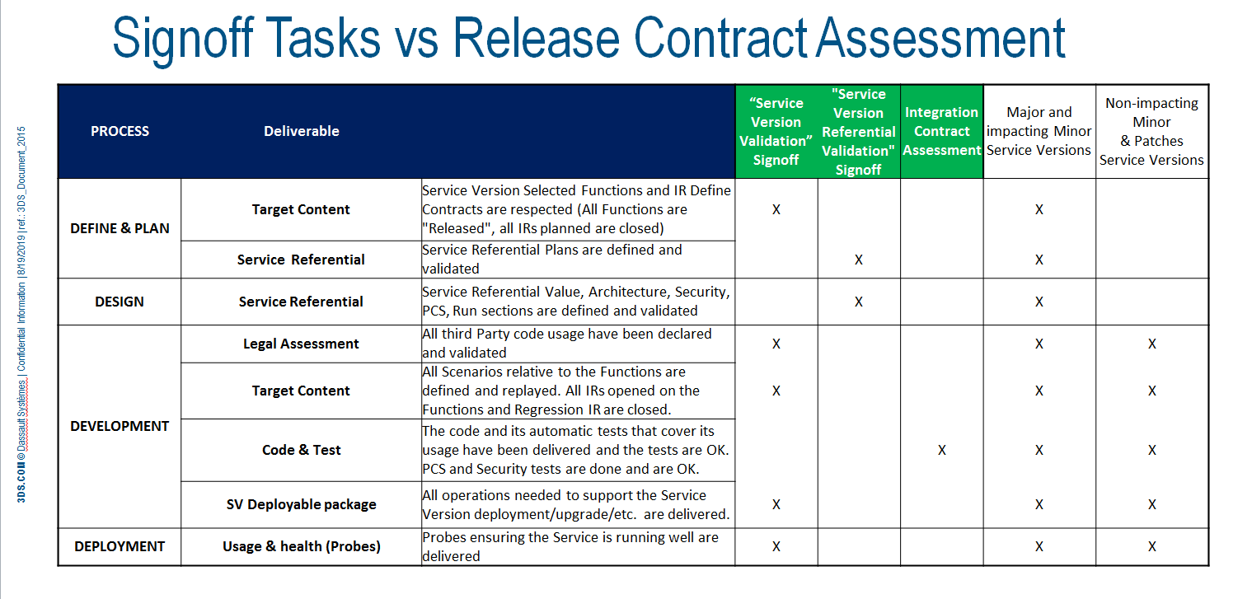
Assess Service Version Quality
What:
Provide Service Version QA assessment based on:
Replay of scenarii identified during Industrialization Plan
Functions Quality Assessment
IR Reported on the Service Version
Assess the Service Version quality is compliant with the expected criteria (see Release Contract Assessment)

Slide 35
QA Activities in Continuous Delivery Life trace
Contributor | Activity | Change ID major[minor] | Date (YYYY/MM/DD) | Change comments (Specify list of Reviewers for major changes) | Maturity
ADD1 | Update | V0R10 | 2019/12/10 | Update of the process with addition in “Prepare QA Environment” of a section on protect/unprotect deployable package | Proposed
ADD1 | Update | V0R11 | 2019/12/10 | Update after YGD review: slide 12 in order to add a warning to not change the doNotDelete tag for a package with status “Released” slide 13 recommendation on deletion of the factory in the newly created QA Stage Slide 14: recommendation on deletion of the useless sandbox Slide 14: Ref cluster destruction imply the destruction of all the sandbox based on it. | Proposed
ADD1 | Update | V0R12 | 2019/12/13 | Update after LFH review: Slide 8: add of the name of the production level and Global Factory Switch Level Slide 13: delete the factory of the stage, only if the stage won’t be used to delivered automated tests | Proposed
ADD1 | Update | V0R13 | 2020/02/12 | Add of slide : How to prepare QA environment for Service Upgrade Test How to prepare QA environment for Data Migration Test | Proposed
ADD1 | Update | V0R14 | 2020/03/19 | Add of Slide : How to deploy a Continuous Delivery Service How to deploy a Global Factory Service How to prepare QA environment for Licensing test | Proposed
ADD1 | Update | V0R15 | 2020/03/30 | Delete a useless box in slide 15 | Proposed

