Slide 1
Employee Data Analysis using Excel
STUDENT NAME: Manju.P
REGISTER NO: 312216992(87D802C09BCD51F81ED4B63A1D5CC90F)
DEPARTMENT: B.COM (GENERAL)
COLLEGE: Shri Krishnaswamy College For Women

Slide 2
PROJECT TITLE
Creating an Employee Performance

Slide 3


AGENDA
Problem Statement
Project Overview
End Users
Our Solution and Proposition
Dataset Description
Modelling Approach
Results and Discussion
Conclusion
3/21/2024 Annual Review

Slide 4

PROBLEM STATEMENT
Our organization faces challenges in effectively managing and improving employee performance. Currently, we lack a standardized, objective system to assess employee contributions, identify strengths and weaknesses, and align individual performance with organizational objectives. This leads to inconsistent evaluations, unclear performance expectations, and difficulties in providing constructive feedback and career development opportunities.

Slide 5

PROJECT OVERVIEW
Define Objectives and Scope
Develop Evaluation Criteria
Design Evaluation Tools
Implement Training
Conduct Evaluations
Analyze Results
Provide Feedback and Development Plans
Monitor and Refine
Ensure Compliance and Fairness

Slide 6

WHO ARE THE END USERS?
Employees
Managers/Supervisors
Human Resources (HR) Professionals
Senior Leadership

Slide 7

OUR SOLUTION AND ITS VALUE PROPOSITION
Solution
Performance Metrics
Evaluation Tools
Feedback Mechanism
Documentation
Training
Integration
Value Proposition:
Improved Performance
Objective Assessments
Career Development
Informed Decision-Making
Enhanced Communication
Increased Employee Engagement

Slide 8
Dataset Description
Creating an employee performance dataset typically involves collecting and organizing data related to various aspects of employee performance. Here’s general components including in a dataset.
Employee ID
Name
Department
Position
Date of Joining
Performance Metrics
Reviews
Training and Development
Attendance Records
Goals and Achievements
Promotions and Raises
Self-Assessment

Slide 9
MODELLING
Define Objectives
Identify Key Performance Indicators (KPIs)
Establish Evaluation Criteria
Gather Data
Choose Evaluation Methods
Develop a Scoring System
Implement and Train
Monitor and Review
Provide Feedback and Support
Evaluate and Refine
9

Slide 10
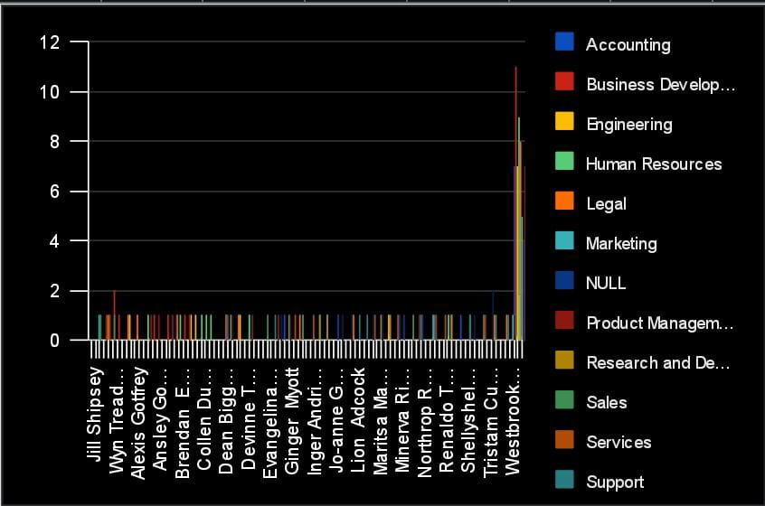
RESULTS
10

Slide 11
conclusion
Creating an effective employee performance evaluation system involves setting clear, measurable goals, providing regular feedback, and aligning performance metrics with organizational objectives. To conclude, a well-designed performance evaluation process not only helps in identifying strengths and areas for improvement but also fosters employee growth and development. By maintaining transparency and consistency, and by involving employees in the goal-setting process, organizations can enhance performance, boost morale, and drive overall success.

