Slide 1
About Me

Slide 2

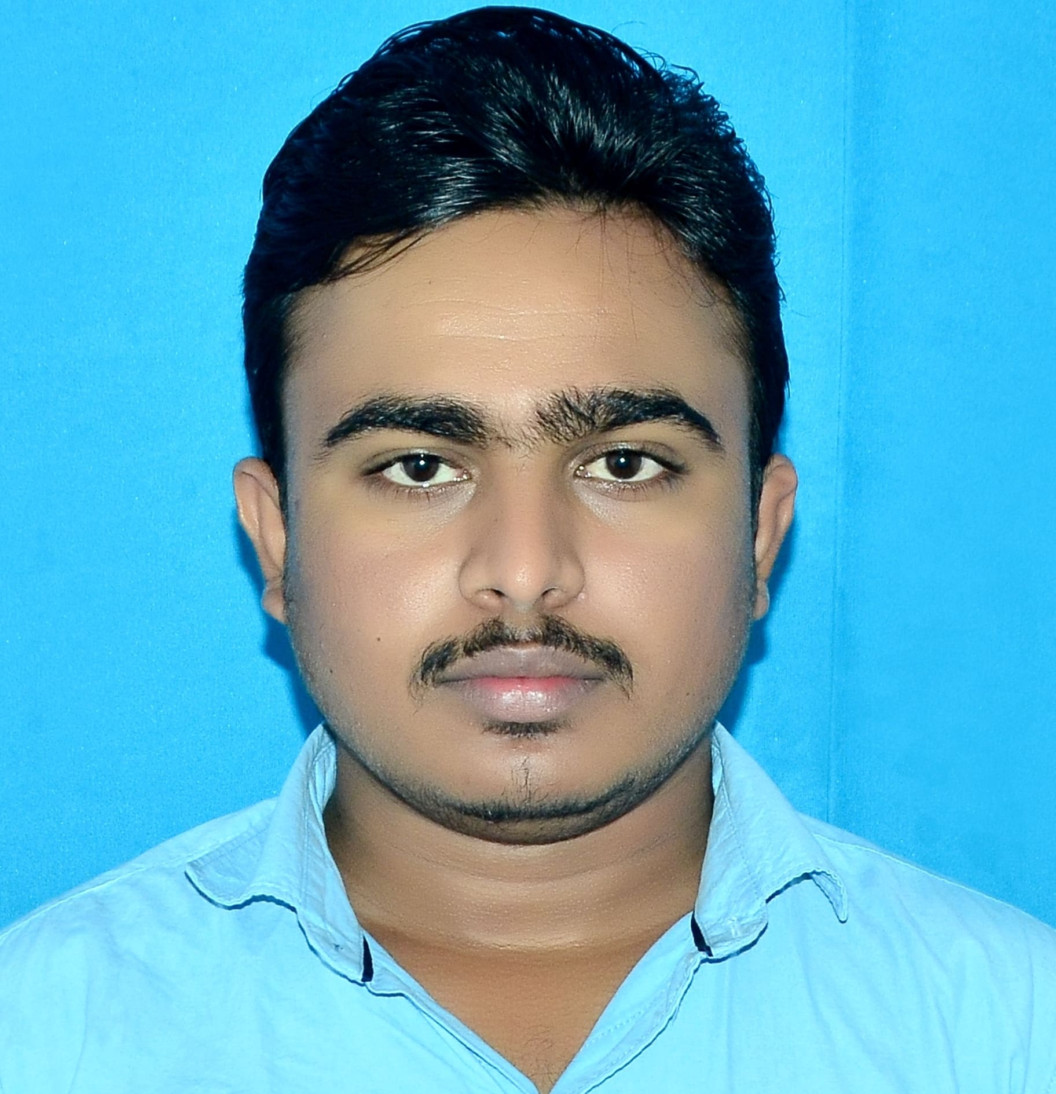

Hello!
I am Manjunatha Patnamsetti
You can find me at:
manupatnamsetti@gmail.com
: https://www.linkedin.com/in/patnamsetti-manjunatha-3a1a3b213

Slide 3
Objective
I Am looking forward to start my career as a Software Developer in a Company which will give an Opportunity to learn, enhance my Potential and grow as an Individual and along with the Organization.

Slide 4
Education
Narayana Jr College,Anantapur
12th Standard
2015-2017
G.Pulla Reddy Engineering College,Kurnool
B.Tech(Mech)
2017-2021

Slide 5
Internship
Completed traning of Hydro Electric Power Station Of 7*110 MW Srisailam Right Bank Power House.
Learnt about the working of Turbines and Generators,
how the mechanism of the Hydral Energy Converted
to Electrical Energy,Transmission procedure and
Maintanace of the Tubines and Related Equipment.

Slide 6
Projects
Reducing temp. rise in photovoltaics by using phase change material
Banking System Interface
Login and Register Form

Slide 7
Skills
Java/Core java
MySQL
HTML
CSS
MongoDB
MS Excel
MS Word
StoryTelling

Slide 8
Achievements
Got Certification From ISRO for Completing the Course ”Satellite Photogrammetry”.
Got Second Prize On The Occasion OF Udan2K19 for creative Writing.
Got Mandal First at Chekumukhi Talent Test which was conducted by Janavignana Vedika.

Slide 9
Strength and Weakness
Team Work,Adaptability and Decision Making
During my Engineering days I volunteered for VSC, a college forum. As a service of charity we need to interact with the people in the real world in order to tackle the challenge in real time in that process I learnt above mentioned skills in order to help them.
Eager to learn
I am very enthuastic towards to learn without thinking of it’s scope and priority I learnt kannada to read a book. To overcome this now I am prioritizing and planning my tasks where to start and when to start.

Slide 10
Hobbies
Geopolitical Analysis
After listening to the Podcast of abhjit Chavda I am fascinated to know about the geopolitics which influence our lives dramatically.
Poetry
I developed a sweet spot on Poetry while I was in my school. This Intrest lead me to write few Poem in My Mother Tongue.
Reading Books
I would love to read a book irrespective of genre and language Evident my interest and passion towards this is I learnt to read Kannada which is neither my mother tongue nor taught in my School.

Slide 11
Thanks!

