Slide 1
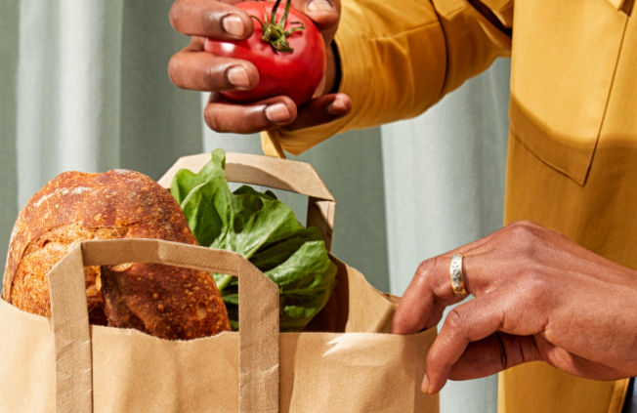
Pitch deck
Mirjam Nilsson​

Slide 2

Instacart – Product re-order and Recommendation System
Manjula M

Slide 3

Business Objective:
Instacart is challenging the community to use the anonymized
data on customer orders over time to predict which previously
purchased products will be in a user’s next order.

Slide 4
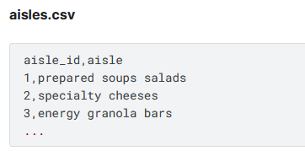
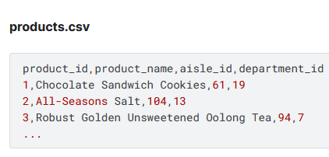
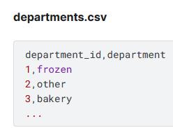
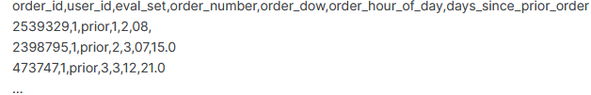
Dataset overview

Slide 5
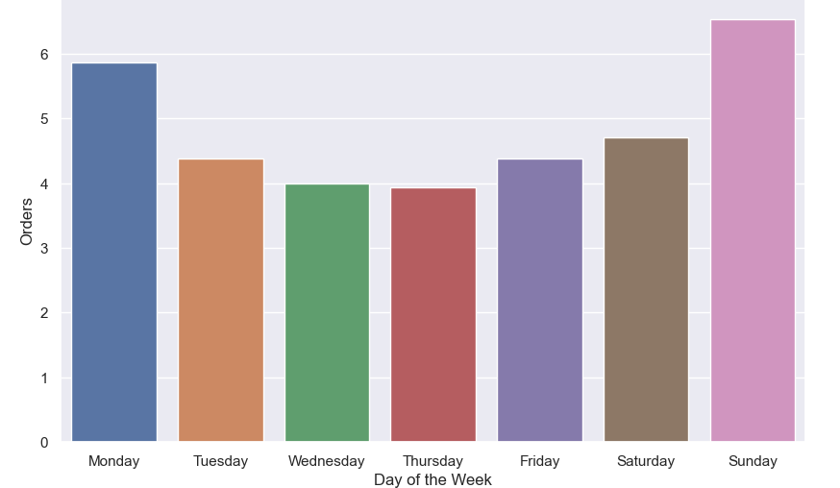

Analysis

Slide 6
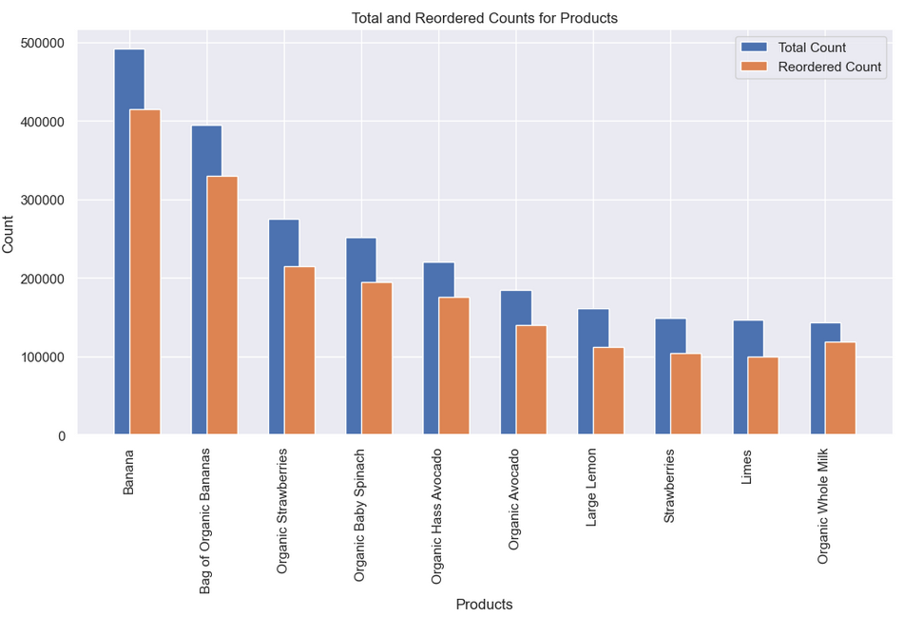

Slide 7
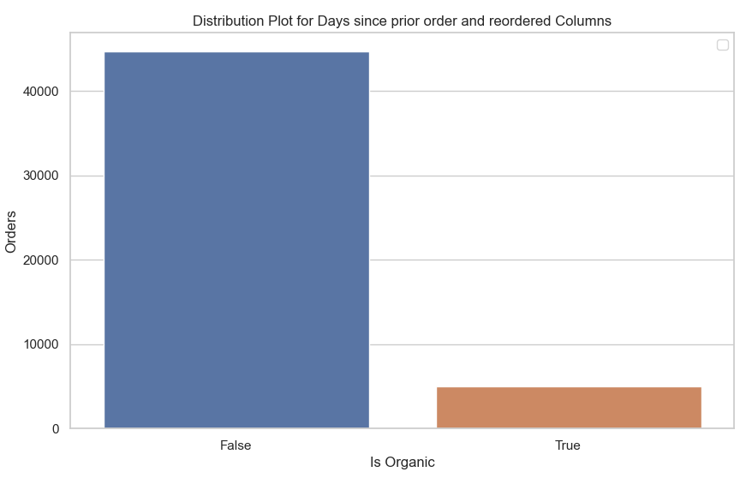

Slide 8
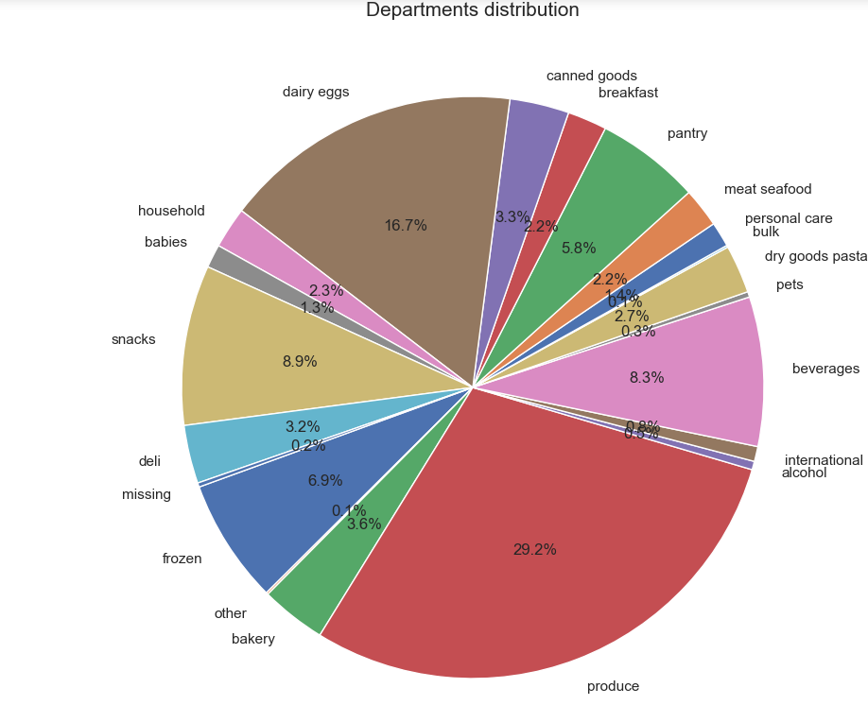

Slide 9
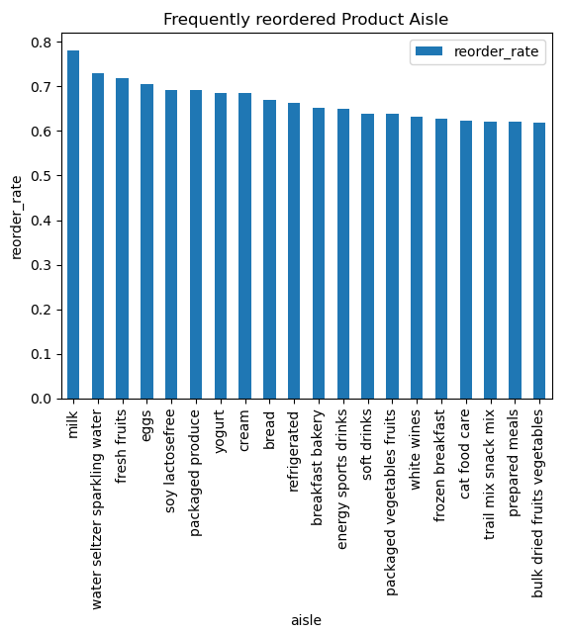
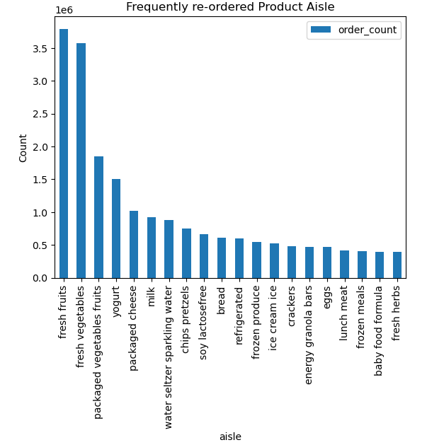

Slide 10
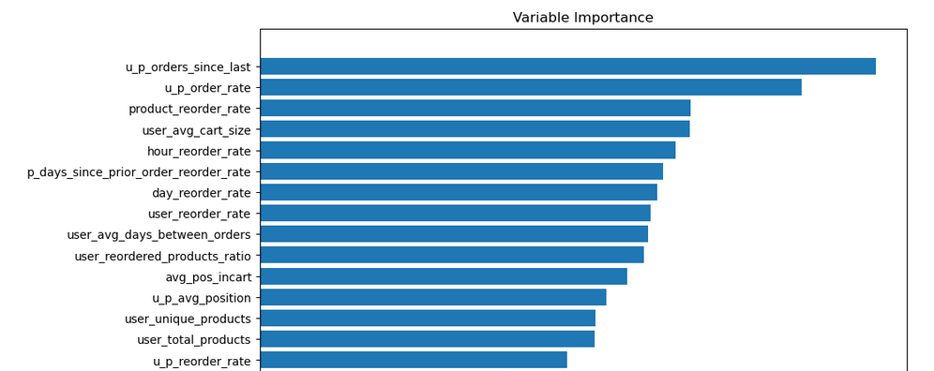

Slide 11
Feature Engineering
When was users last order with the product
How frequently user ordered the product
How frequently the product was reordered
Average how many times user is buying per order
How frequently product was reordered on any given hour

Slide 12
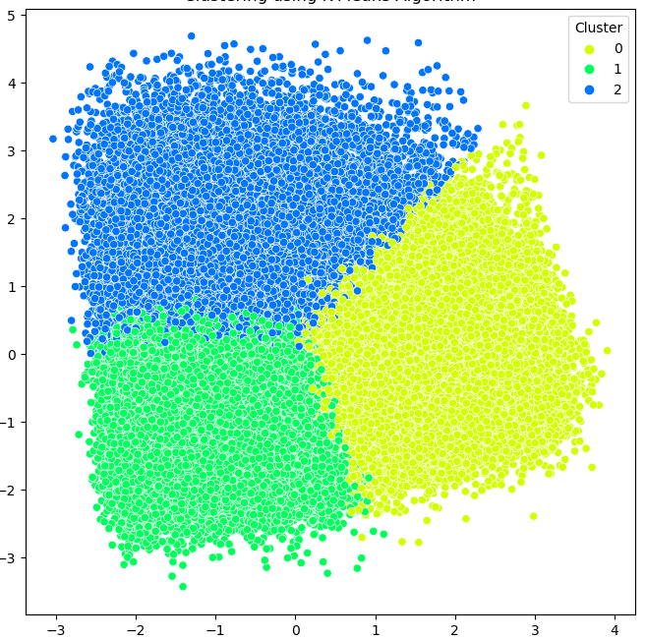
Customers :
Group 0 placed highest orders
Time of order is - 13
Mean lag – 7 days
Group 1 – average number of orders lowest
Mean hour or order - 13
Mean lag between orders – 16 days
Group 2 – average number of order is 9
Mean hour or order is 17
Mean lag between orders – 12

Slide 13
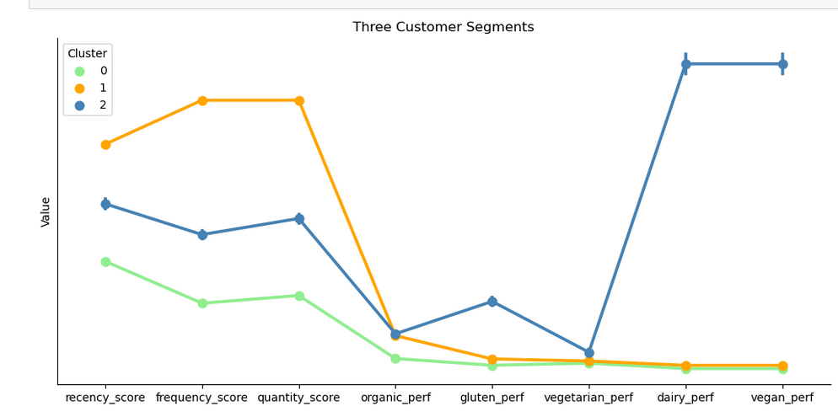

Slide 14

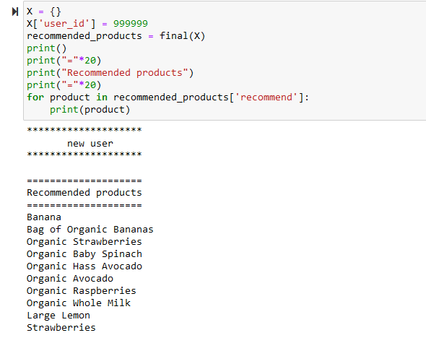
Result :
Accuracy : 91%

Slide 15
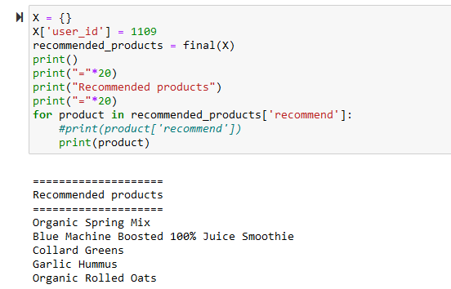
Result :
Accuracy : 91%

Slide 16
Thank you

Slide 17
