Slide 1
Customer Segmentation Using Transactional Credit Card Data Final Presentation
April 19, 2023

Slide 2



Problem Statement
EDA & Feature Engineering
Agenda
Clustering Algorithms
Recommendations

Slide 3

Problem Statement
Redstone Federal Credit Union aims to gain insights into customer spending behaviors by clustering transactional data based on transaction amount, frequency, merchants, location, and seasonality.

Slide 4

Objective
The goal of this unsupervised machine learning project is to identify accounts with similar transaction patterns to segment Customer’s into multiple groups, such as consistently high-spending customers, low-frequency and high-value customers, high-frequency and low-value customers, seasonal spenders, channel-specific spenders, and category-specific spenders.

Slide 5
Steps
Data Exploration
Check the dataset for null values and append proper values where possible.
Feature Engineering
Adding and removing features.
Data Encoding
Change categorical data into numerical data where needed.
Data Scaling
Scale updated data frame to be clustered.
Clustering Techniques
Analyzed using multiple clustering techniques.
Analysis
Determine the best method for clustering to achieve objectives.
Review
Review clustering data from all algorithms to determine any changes that must be made.

Slide 6
Overview
Tools
Programming Language
Mean, Median
Data Encoding Techniques
Frequency Encoding
Data Scaling
MinMax Scaler
Clustering Techniques
K-Means
Visualization
Pie Charts
MS Excel
Python
Statistical Measures
Bar Plots
MeanShift
Gaussian Mixture
BIRCH
One-hot Encoding
Jupyter Notebook
Google Colab
Mode, Sum
Min, Max
Count

Slide 7
Handling Missing Data
Feature | Number Missing | Percentage Missing
NEW_MCID | 0 | 0.0
TRX_DATE | 0 | 0.0
RDT_MRCH_SIC_CODE | 0 | 0.0
RDT_TRASACTION_AMOUNT | 0 | 0.0
RDT_TRANSACTION_CODE | 0 | 0.0
RDT_CHD_EXT_STATUS | 0 | 0.0
RDT_CHD_INT_STATUS | 0 | 0.0
RDT_MERCHANT_CITY | 3816 | 0.02
RDT_MERCHANT_NAME | 6 | 0.0
RDT_MERCHANT_STATE | 7290 | 0.05
BIN | 0 | 0.0
The dataset contains ~16 million rows and 11 columns.
Replaced missing values in the Merchant Name, Merchant City, and Merchant State columns with the most frequent value (mode).

Slide 8
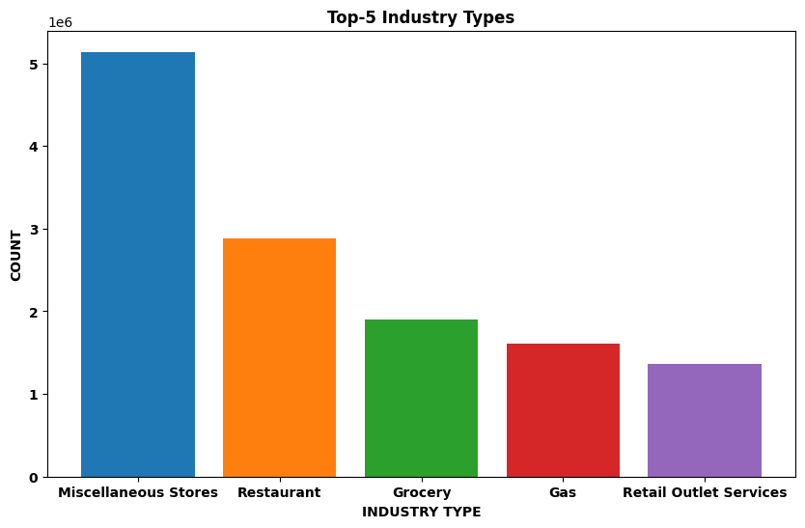
Feature Engineering
SIC Codes
The SIC codes represent the merchant category. There are a total of 537 unique SIC codes in the dataset provided.
Converting SIC Codes to Industry Types
Extracted industry names from the SIC codes to identify the type of products purchased by each customer.

Slide 9
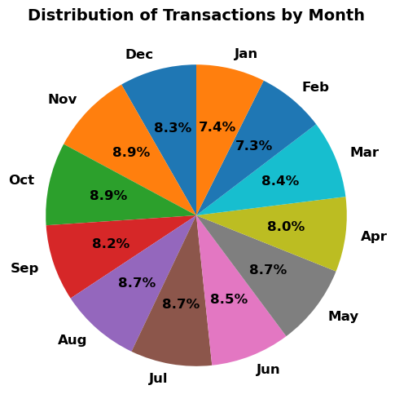
Feature Engineering Cont…
We have added a new column to the dataset called ‘Frequent_Month', which represents the month in which most of the transactions took place for each customer.
This additional information allows us to identify seasonal customers who may have a higher frequency of transactions during certain times of the year.
By analyzing the patterns of these seasonal customers, we can gain insights into their behavior and preferences and use this information to inform our marketing strategies and product offerings.

Slide 10
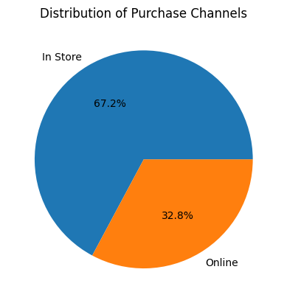
Feature Engineering Cont…
City Column
The city column contains around 5M values which include website links or app information from which customers are buying the products.
Purchase Channel Column
We replaced these unknown city values with online transactions. Using this info, we created a new column called Purchase Channel, which tells us if the transaction is made online or Instore
Percent Online Column
Aggregated the original dataset by unique customer ID, calculated the percentage of online transactions for each customer and stored it in a new column called 'Percent_Online’.

Slide 11
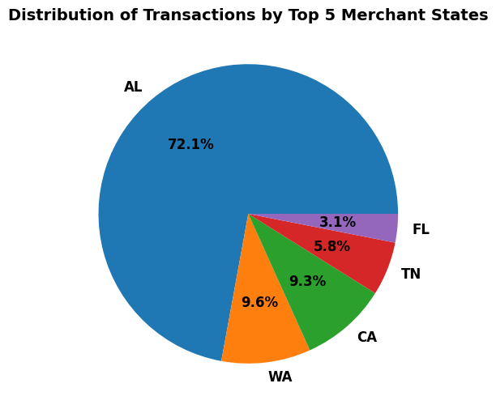
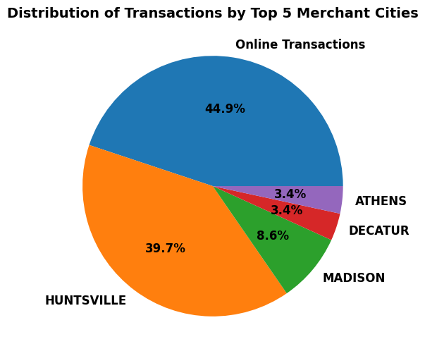
Top 5 Merchant States and Cities

Slide 12
Feature Engineering Cont…
Amount_Spent
Purchase_Frequency
Max_Payment_Amount
CashAdvance_Frequency
Return_Frequency
Min_Payment_Amount
Total_Payment_Amount
Min_CashAdvance
Max_CashAdvance
Total_CashAdvance
Payment_Frequency
Total amount spent by a customer (Purchases – Returns)
How often a customer makes a purchase
Highest amount paid by a customer
Smallest amount paid by a customer
Sum of all payments made by a customer
How often a customer makes a payment
Highest amount of cash advanced by a customer
Smallest amount of cash advanced by a customer
Sum of all cash advances made by a customer
How often a customer makes a cash advance
How often a customer returns
Dataset

Slide 13
Encoding Categorical Data
Encoding is the process of converting categorical data into a numerical format that can be easily understood by machine learning algorithms.
Merchant State
Merchant City
Frequency Encoding
Industry Type
One-Hot Encoding

Slide 14
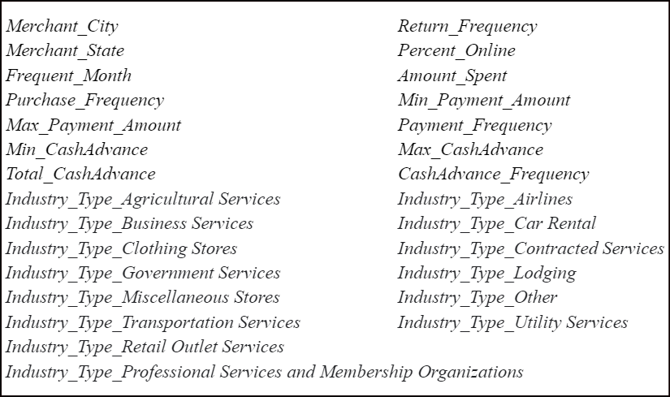
Feature Selection: Correlation-Based Method
We used correlation-based feature selection to choose only one feature from each pair of highly correlated features, reducing redundancy in the data.
This method involves iterating over each feature, checking its correlation with all previously selected features, and adding it to the list of selected features if it meets the threshold.

Slide 15
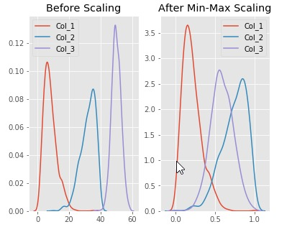
Data Scaling
Data scaling is the process of transforming numerical data to fit within a specific range or distribution.
This is done to ensure that each feature is equally important during analysis and modeling.

Slide 16
Clustering Algorithms
K-means
k-means clustering is a popular unsupervised machine learning algorithm that is used to partition a given dataset into a fixed number of clusters.
The algorithm works by iteratively assigning data points to the nearest cluster centroid and updating the centroids based on the mean of the assigned data points.
Mean Shift
Mean shift clustering is another unsupervised machine learning algorithm that is used to identify the underlying structure of a dataset by identifying clusters with high densities.
Gaussian Mixture
Gaussian Mixture Model (GMM) is a probabilistic clustering algorithm that assumes that the data points are generated from a mixture of Gaussian distributions.
It is adaptive in nature and does not require the number of clusters to be specified beforehand. So, it is considered a popular choice for clustering applications.
In other words, it models each cluster as a probability distribution function, where each data point is a random variable that is generated from one of the probability distributions.
Balanced Iterative Reducing and Clustering using Hierarchies (BIRCH) is a clustering algorithm that can cluster large datasets by first generating a small and compact summary of the large dataset that retains as much information as possible.
This smaller summary is then clustered instead of clustering the larger dataset.
Birch
BIRCH

Slide 17
Comparison of Evaluation Metrics
Clustering Algorithm | Silhouette Score | Davies-Bouldin Index | Calinski-Harabasz Index
K-Means | 0.42 | 1.34 | 28844.16
Mean Shift | 0.31 | 0.82 | 1496.27
Gaussian Mixture | 0.38 | 1.95 | 24205.68
BIRCH | 0.45 | 1.37 | 9403.77
Silhouette Score: It measures how similar an object is to its own cluster compared to other clusters. The score ranges from -1 to 1, where 1 indicates a well-clustered sample, 0 indicates overlapping clusters and negative values indicate misclassified samples.
Davies-Bouldin Index: It measures the average similarity between each cluster and its most similar cluster, where lower values indicate better clustering performance.
Calinski-Harabasz Index: It measures the ratio of the between-cluster dispersion and within-cluster dispersion, where higher values indicate better clustering performance.

Slide 18
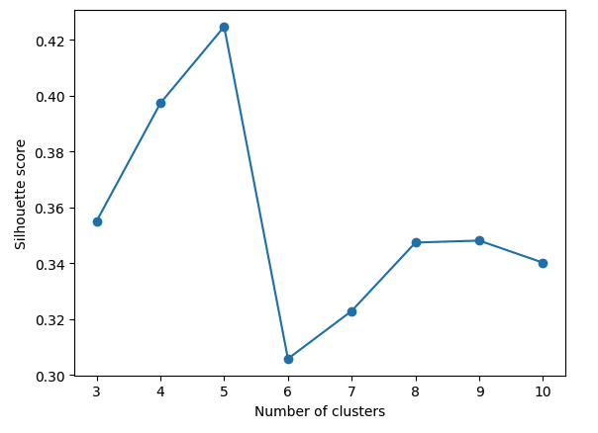
K-Means Silhouette Scores
Silhouette Scores Plot
K-value | Silhouette Scores
3 | 0.3551
4 | 0.3973
5 | 0.4247
6 | 0.3058
7 | 0.3229
8 | 0.3474
9 | 0.3481
10 | 0.3402
After testing potential K values between 3 and 10; the higher silhouette score is shown at K=5. So, we chose 5 as the best value for K in this application.

Slide 19
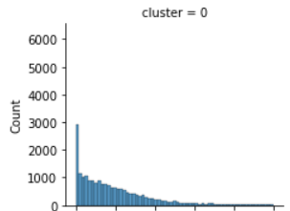
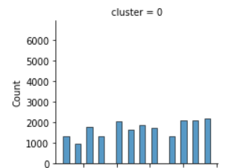
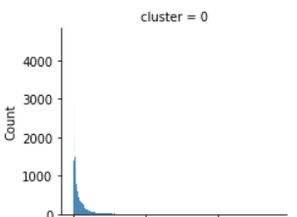
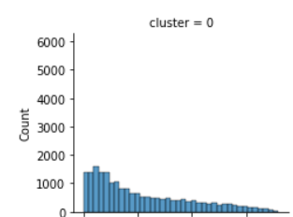
Segment 1 – High Spending, High Frequency, Low Online Transactions
Column | Mean | median | std | min | max
Percent_Online (%) | 18.46 | 13.69 | 18.17 | 0.0 | 100.0
Frequent_Month | 7.03 | 7.0 | 3.40 | 1 | 12
Amount_Spent ($) | 13453.23 | 6759.27 | 18376.37 | -685.99 | 561118.59
Purchase_Frequency | 105.77 | 77.0 | 88.81 | 0.0 | 360.0
This segment includes customers who have high spending level and a high purchase frequency. They make transactions throughout the year and do not show any seasonal purchasing behavior. They are making lesser online transactions which means they are channel specific and prefer to purchase in store.

Slide 20

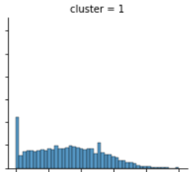
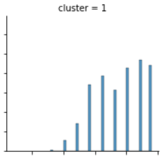
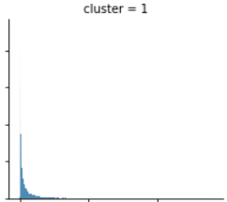
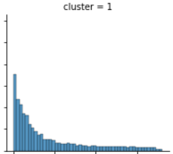
Segment 2 – High Spending, Seasonal, Average No. of Online Transactions
Column | Mean | median | std | min | max
Percent_Online (%) | 31.81 | 31.65 | 20.51 | 0.0 | 100.0
Frequent_Month | 9.37 | 10.0 | 1.96 | 4 | 12
Amount_Spent ($) | 12377.11 | 4833.00 | 19422.74 | -1046.80 | 565067.21
Purchase_Frequency | 84.02 | 45.0 | 91.91 | 0.0 | 360.0
These are customers with high spending levels who make a medium percentage of online transactions and exhibit seasonal purchasing behavior, with more frequent purchases from June to December.

Slide 21
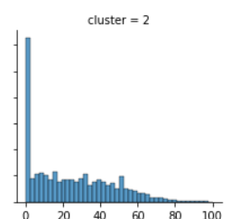
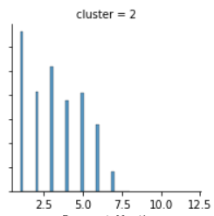
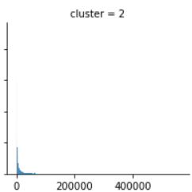
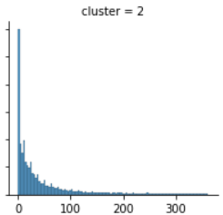
Segment 3 - Low Spending, Low Frequency, Seasonal Customers, Average no. of Online Transactions
Column | Mean | median | std | min | max
Percent_Online (%) | 24.11 | 20.51 | 21.20 | 0.0 | 100.0
Frequent_Month | 3.22 | 3.0 | 1.78 | 1 | 8
Amount_Spent ($) | 5469.35 | 1692.72 | 10739.64 | -1627.73 | 254796.88
Purchase_Frequency | 43.88 | 20.0 | 62.57 | 0.0 | 361.0
These are customers with low spending levels who make a medium percentage of online transactions and exhibit seasonal purchasing behavior, with more frequent purchases from January to June.

Slide 22
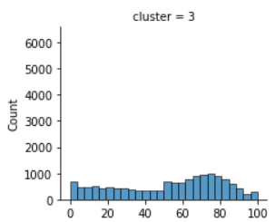
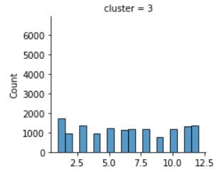
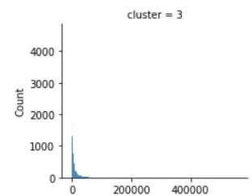
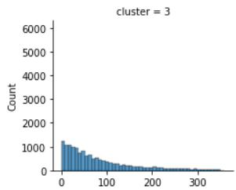
Segment 4 - Medium Spending, Medium Frequency, High Online Transactions
Column | Mean | median | std | min | max
Percent_Online (%) | 52.80 | 59.59 | 27.86 | 0.0 | 100.0
Frequent_Month | 6.39 | 6.0 | 3.61 | 1 | 12
Amount_Spent ($) | 9259.21 | 4268.27 | 14303.05 | -6063.16 | 411426.88
Purchase_Frequency | 80.87 | 56.0 | 76.18 | 0.0 | 359.0
This segment includes customers who have medium spending level and a medium purchase frequency who make a high percentage of online transactions making them channel-specific customers. They make transactions throughout the year and do not show any seasonal purchasing behavior.

Slide 23
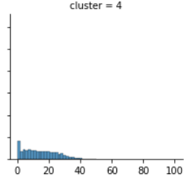
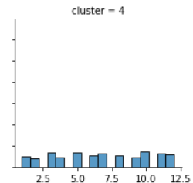
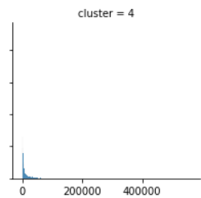
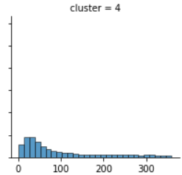
Segment 5 – Medium Spending, High Frequency, Low Online Transactions
Column | Mean | median | std | min | max
Percent_Online (%) | 14.47 | 13.33 | 10.25 | 0.0 | 50.0
Frequent_Month | 6.73 | 7.0 | 3.40 | 1 | 12
Amount_Spent ($) | 11417.57 | 4093.56 | 17668.75 | -1752.58 | 205941.77
Purchase_Frequency | 101.55 | 60.0 | 96.50 | 0.0 | 359.0
This segment includes customers who have medium spending level and a high purchase frequency. They make transactions throughout the year and do not show any seasonal purchasing behavior. They are less likely to make purchases online, indicating that they prefer to shop in store.

Slide 24
Recommendations
From the Customer segmentation findings:
Segment 1 - High Spending, High Frequency, Low Online Transactions
One effective way to encourage repeat purchases is by offering loyalty programs and in-store rewards. Assigning an executive to high-value customers for exclusive deals can also boost retention. Additionally, personalized promotions through targeted email or direct mail campaigns can encourage online purchases.
Segment 2 - High Spending, Seasonal, Average No. of Online Transactions
To drive sales during peak seasons, optimize the online shopping experience by promoting seasonal products and offering targeted promotions. Additionally, encourage repeat purchases during the off-season with personalized recommendations based on past purchase history.
Segment 3 - Low Spending, Low Frequency, Seasonal Customers, Average no. of Online Transactions
To attract cost-conscious shoppers, offer low-cost, high-value items and consider offering BuyNow PayLater or No-cost APRs to increase their purchasing power. Incentivize purchases by offering exclusive seasonal or limited-time products.
Segment 4 - Medium Spending, Medium Frequency, High Online Transactions
Improving the online shopping experience with easy product search and checkout processes, while offering personalized upgrade and exchange options, can increase customer spending frequency.
Segment 5 - Medium Spending, High Frequency, Low Online Transactions
Tailor in-store experiences to attract and retain customers by offering personalized promotions and exchange deals based on their usage. Encourage repeat purchases and boost online transactions by allowing customers to redeem these offers online.

Slide 25
Any Questions?

Slide 26
Thank You

