Slide 1
Project Title | : | Data-Driven Crop Yield Prediction Using Multi-Variate Time- Series Modeling
Description | : | An AI-driven agro-climate forecasting system that integrates IoT-based environmental monitoring and Temporal Fusion Transformer (TFT) models to predict crop yield and key agricultural parameters for data-driven farming decisions.
SDG Addressed | : | SDG 2 Zero Hunger | TRL | : | 3

Slide 2
Introduction
Agricultural productivity is significantly affected by environmental and climatic factors such as temperature, rainfall, humidity, and soil characteristics.
Conventional crop yield prediction techniques often struggle to achieve high accuracy due to their inability to process complex and time-dependent agricultural data effectively.
To address this challenge, this work employs the Temporal Fusion Transformer (TFT), a powerful deep learning architecture specialized for multivariate time-series forecasting and temporal pattern analysis.
The proposed system utilizes weather data, soil parameters, and historical farming records to provide reliable and accurate crop yield predictions.
In addition, IoT-based sensors and Explainable AI methods are incorporated to support real-time field monitoring, interpretable predictions, and smart decision-making in modern agriculture.

Slide 3
Problem Statement
Crop yield prediction is a complex process influenced by dynamic climatic conditions and multiple environmental parameters.
Conventional machine learning approaches often struggle to model long-term temporal patterns and intricate relationships present in agricultural time-series datasets.
Many existing prediction systems also lack interpretability, making it difficult for farmers and agricultural
experts to identify the key factors affecting crop yield outcomes.
Furthermore, the integration of real-time environmental monitoring with intelligent forecasting remains limited in current smart agriculture solutions.
Therefore, there is a strong requirement for a reliable, explainable, and time-series driven crop yield
prediction system to support advanced and data-driven agricultural practices.

Slide 4
Literature Survey
Author / Technique | Method Used | Strength | Limitation
Statistical Models | Regression-based forecasting | Simple and interpretable | Poor nonlinear modeling
Machine Learning Models | Decision Trees, Ensemble Models | Better prediction accuracy | Weak temporal learning
RNN / LSTM Models | Sequential deep learning | Captures time dependencies | Limited interpretability
Transformer Models | Attention-based forecasting | Learns long-range dependencies | High complexity
IoT Smart Agriculture Systems | Sensor-based monitoring | Real-time environmental sensing | Limited AI forecasting integration

Slide 5
Existing Solution & Gaps Analyzed
Existing Solutions | Research Gaps Identified
Traditional statistical forecasting methods | Unable to capture complex nonlinear relationships
Machine learning-based crop prediction systems | Weak handling of temporal dependencies
LSTM and RNN-based forecasting models | Limited interpretability and feature analysis
Transformer-based prediction systems | High computational complexity and limited real- time integration
IoT agricultural monitoring systems | Lack of intelligent forecasting and decision support
Existing agricultural AI models | No unified framework for forecasting, explainability, and IoT integration

Slide 6
Proposed Solution
The proposed system uses the Temporal Fusion Transformer (TFT) for intelligent crop yield
prediction using agricultural time-series data.
Environmental parameters such as temperature, humidity, rainfall, wind speed, and soil pH are processed for forecasting crop productivity.
The TFT model utilizes Variable Selection Networks, Multi-Head Attention, and Gated
Residual Networks for effective temporal learning.
IoT sensors are integrated for real-time environmental monitoring and live agricultural data acquisition.
Explainable AI techniques provide feature importance and attention-based interpretation for transparent and reliable predictions.

Slide 7
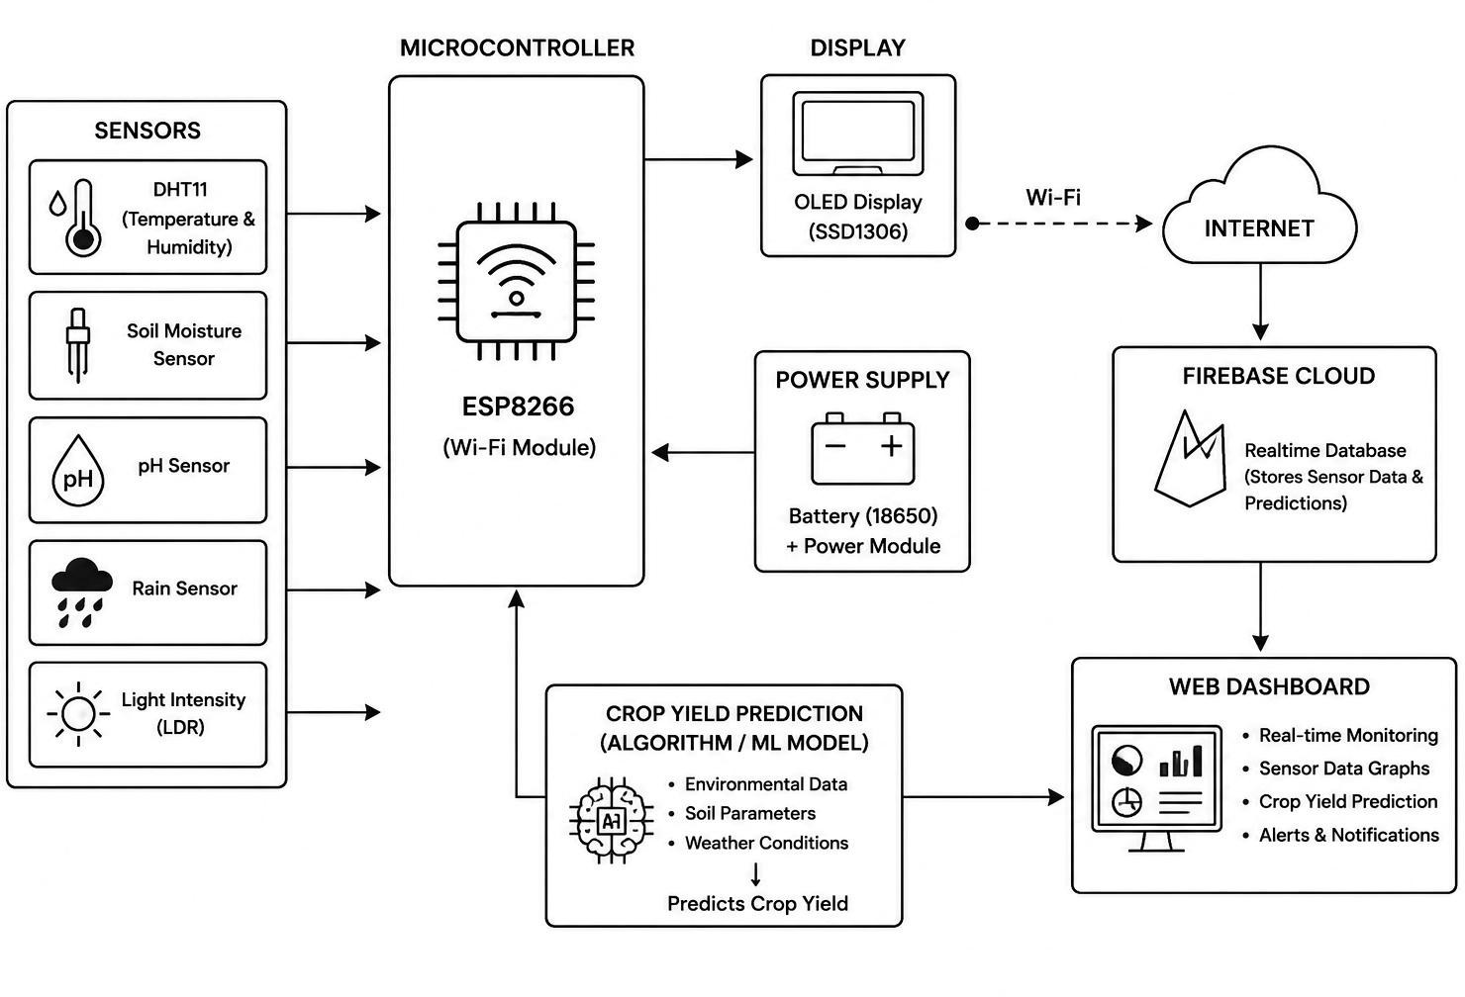
Block Diagram

Slide 8
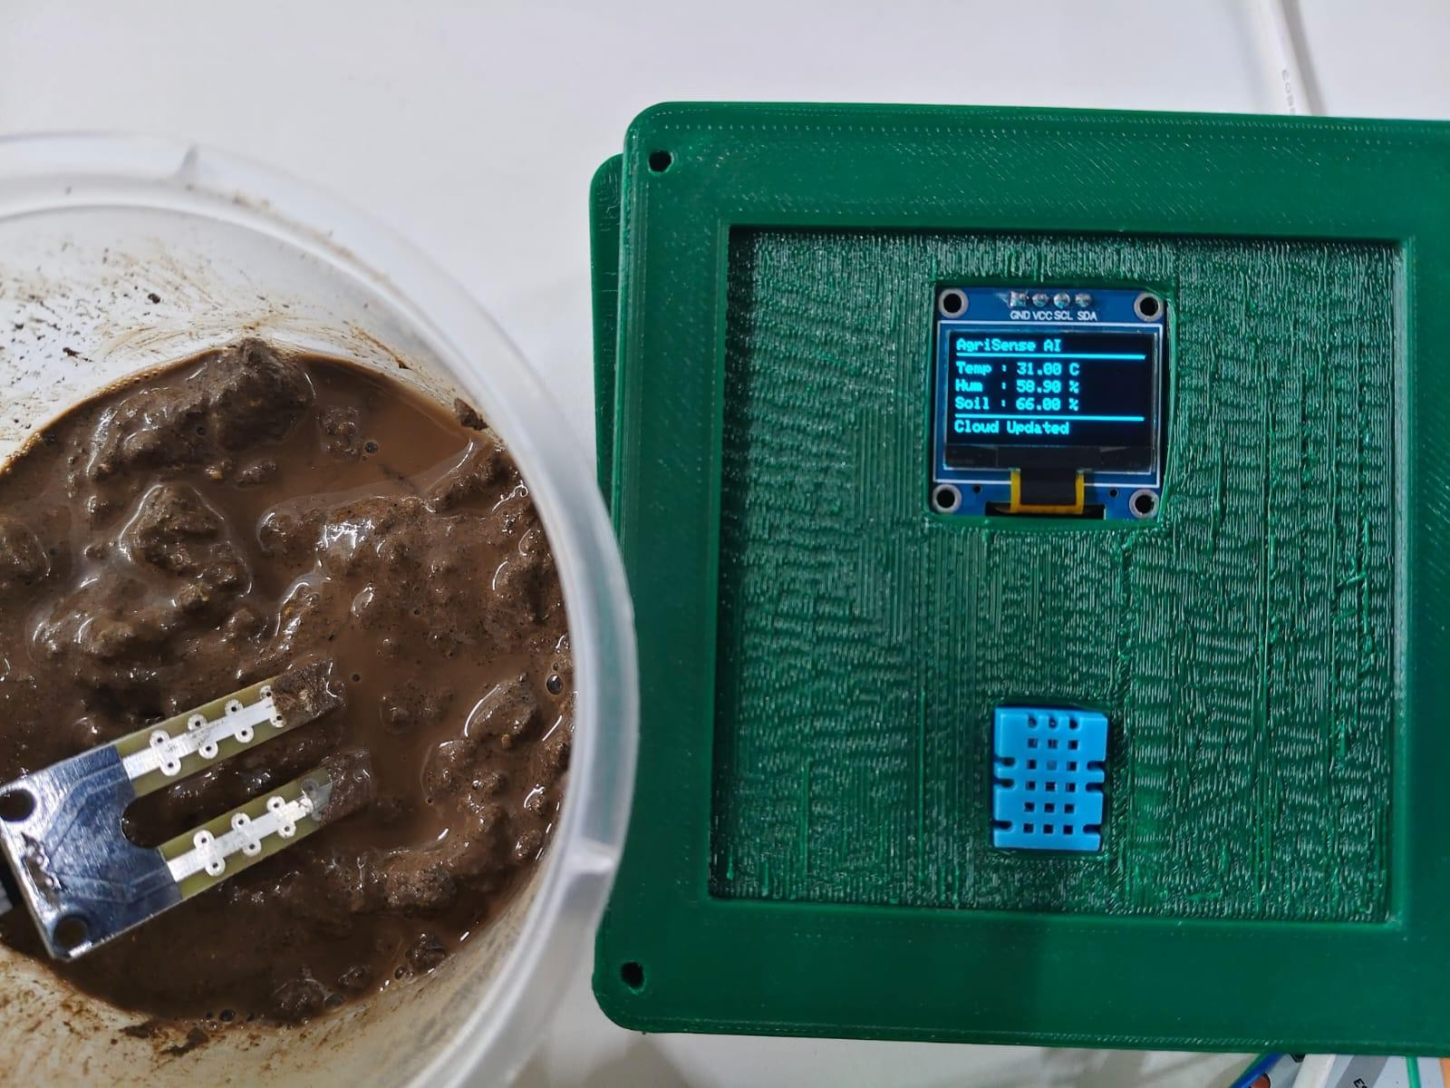
Prototype Image(Hardware)

Slide 9
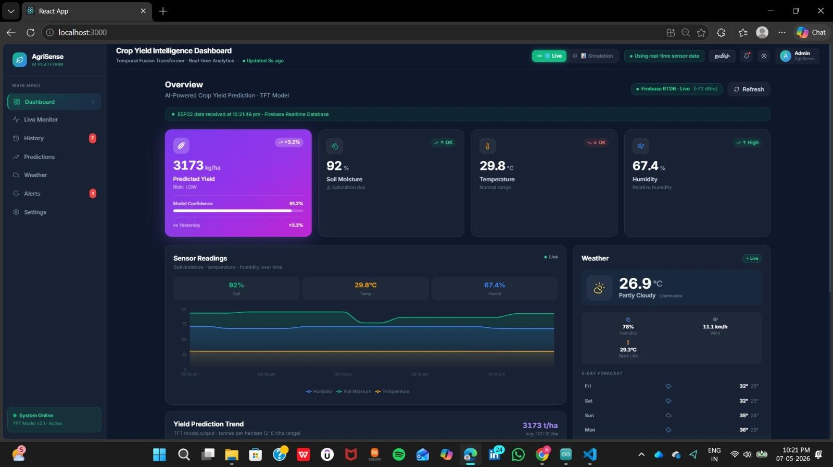
Prototype Image(Software)

Slide 10
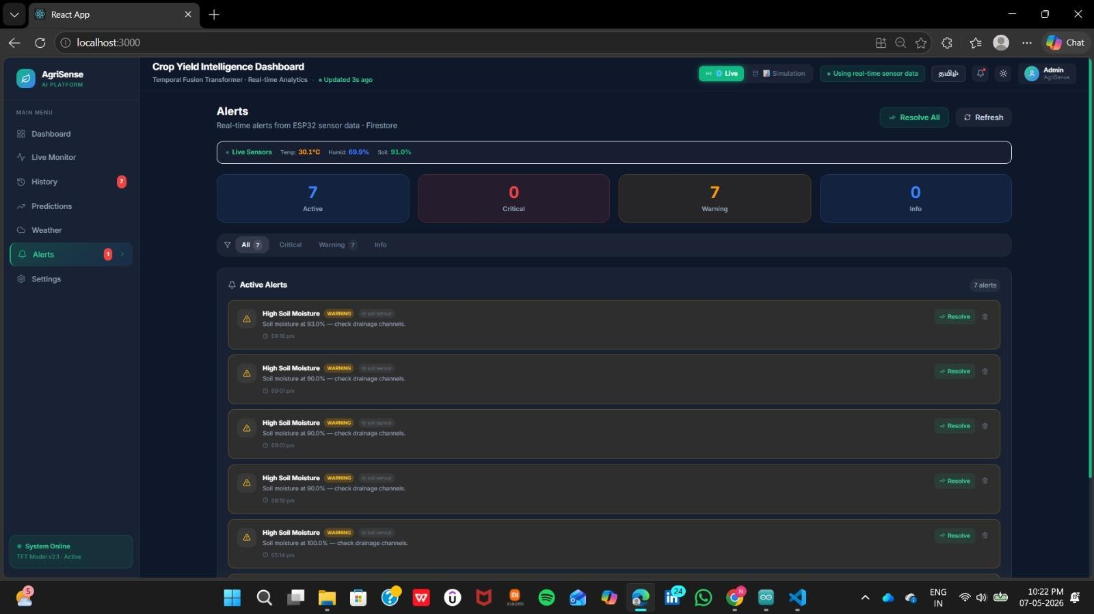
Prototype Image(Software)

Slide 11
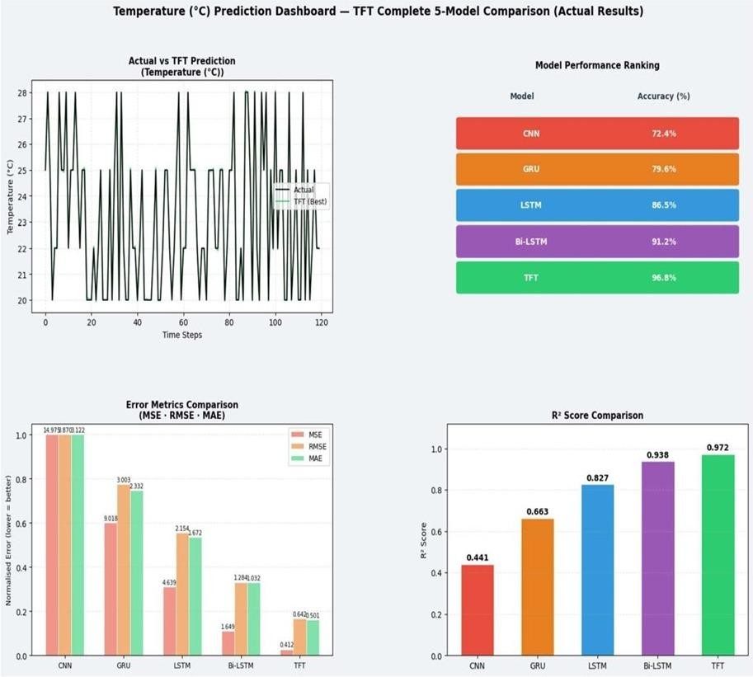
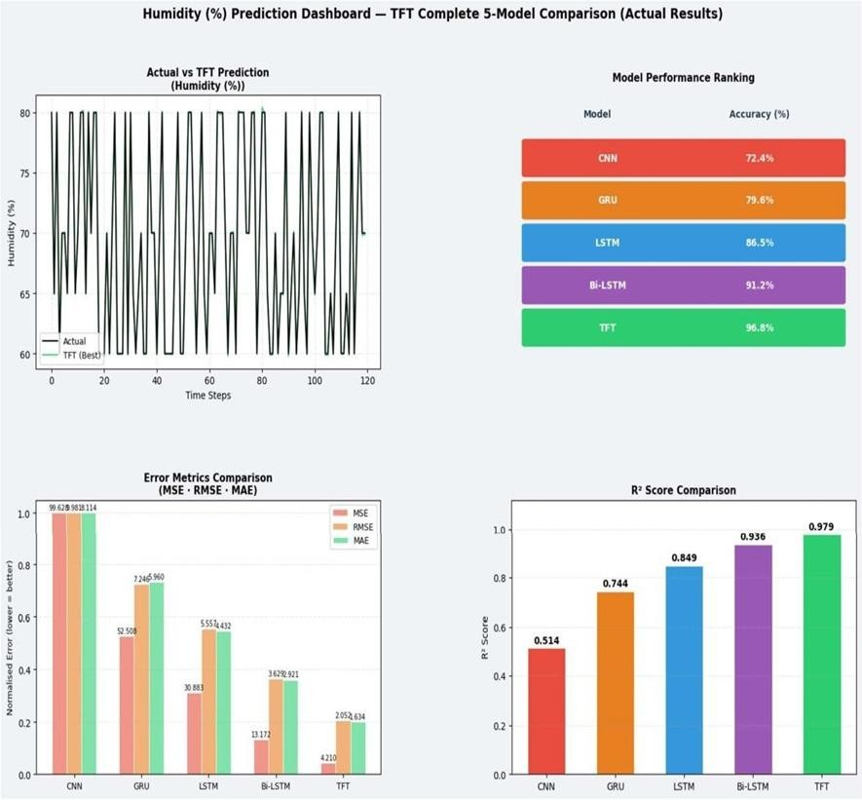

Slide 12
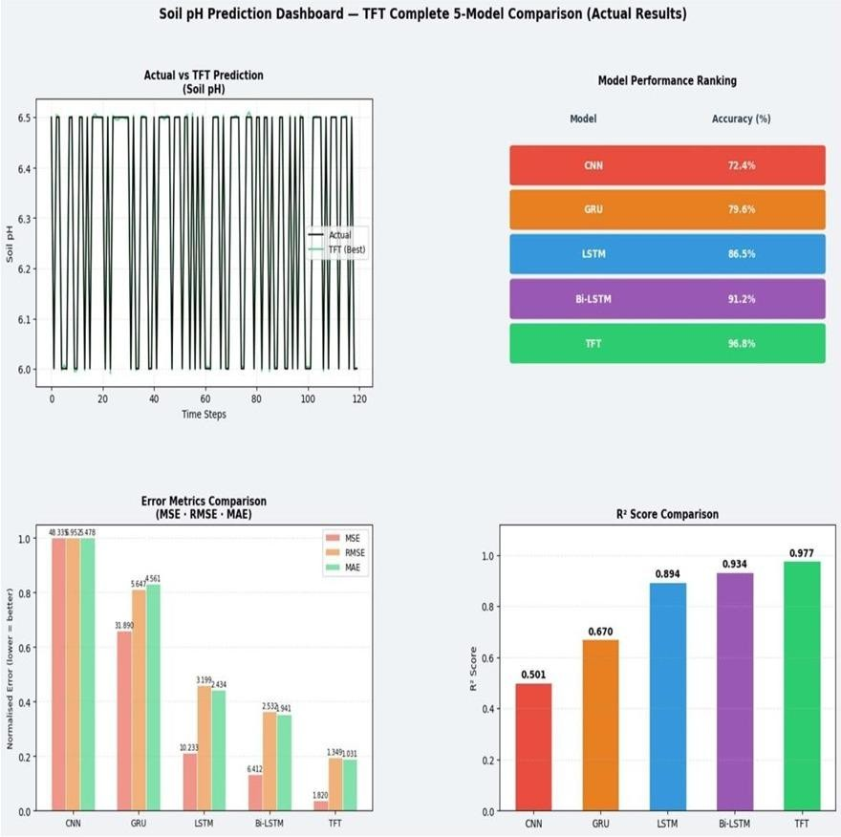
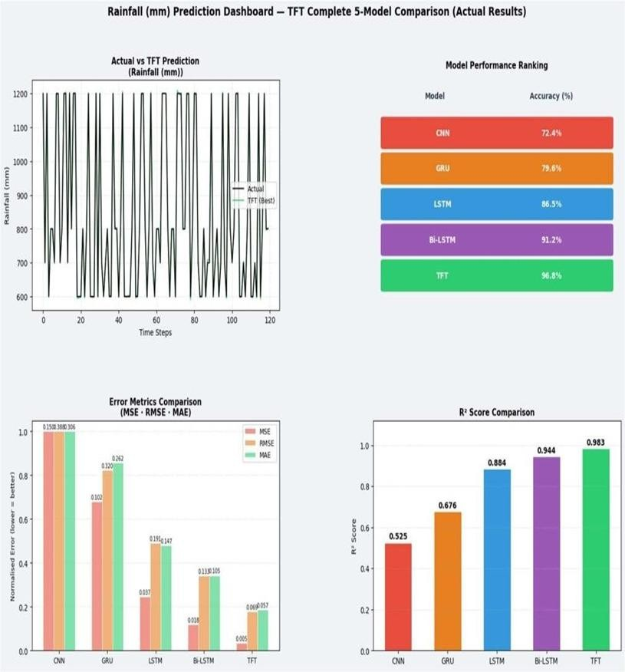

Slide 13
Technology Stack Used
Frontend : React.js Backend API : FastAPI
Cloud Platform : Firebase (Realtime Database + Firestore) Embedded System : ESP8266 (NodeMCU)
Programming : Embedded C++, JavaScript
AI/ML : Machine Learning-based Yield Prediction Communication : WiFi-based IoT Architecture Database : Firebase RTDB & Firestore
UI Framework : React + Modern Responsive Dashboard Hardware : DHT11, Soil Moisture Sensor, OLED Display

Slide 14
Specifications
S.No | HARDWARE COMPONENTS | SPECIFICATIONS | COST
1 | ESP32 Microcontroller | WiFi-enabled dual- core controller | ₹450
2 | DHT11 Sensor | Temperature & humidity monitoring | ₹120
3 | Soil Moisture Sensor | Soil water content sensing | ₹100
4 | Breadboard | Circuit prototyping platform | ₹80
5 | Jumper Wires | Hardware interfacing connections | ₹50
6 | USB Cable & Power Supply | 5V regulated power source | ₹150
7 | Connecting Components | Basic interfacing accessories | ₹100
 | Total |  | ₹1050

Slide 15
Specifications
S.No | SOFTWARE SPECIFICATIONS
1 | Python Programming Language
2 | Jupyter Notebook
3 | Google Colab
4 | Temporal Fusion Transformer (TFT)
5 | Machine Learning & Time-Series Forecasting
6 | Data Visualization and Analysis Tools

Slide 16
Conclusions
The proposed TFT-based framework successfully predicts crop yield by utilizing agricultural time-series data with high efficiency.
Temporal learning mechanisms and multi-head attention enhance forecasting performance while improving the understanding of influential features.
The incorporation of IoT sensors facilitates real-time environmental data collection and
monitoring for smart agriculture systems.
Explainable AI methods ensure transparent, reliable, and interpretable prediction outcomes for users and farmers.
Overall, the developed system contributes to intelligent agricultural decision-making, efficient resource management, and advanced precision farming practices.

Slide 17
References
Bryan Lim et al., “Temporal Fusion Transformers for Interpretable Multi-horizon Time Series Forecasting”
Research Paper (arXiv)
PyTorch Forecasting – Temporal Fusion Transformer Documentation PyTorch Forecasting Documentation (PyTorch Forecasting)
Ashish Vaswani et al., “Attention Is All You Need”
Transformer Research Paper
PyTorch Forecasting GitHub Repository GitHub Repository (GitHub)
Temporal Fusion Transformer Tutorial TFT Tutorial (medium.com)

Slide 18
Thank You

