Slide 1
Project Title | : | AI-based Smart E-Vehicle Battery Management System
Description | : | An intelligent Embedded IoT system that monitors battery parameters in real time and utilizes Machine Learning to predict battery health, optimize charging, and enhance the safety and efficiency of Electric Vehicle batteries.
SDG Addressed | : | 7, 9 ,11
TRL Level | : | 5

Slide 2
OVERVIEW
S.NO | CONTENTS | SLIDE NO.
1 | CHALLENGE STATEMENT | 4
2 | LITERATURE SURVEY | 5
3 | EXISTING METHOD | 6
4 | PROPOSED METHOD | 7
5 | BLOCK/SCHEMATIC DIAGRAM | 8
6 | USE-CASE DIAGRAM | 9
7 | SOFTWARE/HARDWARE IMPLEMENTATION VIDEO | 10
8 | DESCRIPTION OF SOFTWARE/HARDWARE IMPLEMENTATION | 11
9 | EXPERIMENTAL RESULTS | 12,13,14
10 | CONCLUSION & FUTURE WORK | 15
11 | REFERENCES | 16,17
12 | THANK YOU | 18

Slide 3
CHALLENGE STATEMENT
Inefficient Battery Usage:
Lack of real-time monitoring leads to poor battery performance and reduced lifespan in electric vehicles.
Overheating and Safety Risks:
Absence of temperature control can result in overheating, causing potential safety hazards.
No Predictive Maintenance:
Traditional systems don’t use intelligent analysis to predict battery failures or optimize charging cycles.
High-Cost Solutions:
Existing battery management systems are often expensive and not accessible for low-budget or small-scale EV implementations.

Slide 4
LITERATURE SURVEY / BACKGROUND STUDY
S. No | TITLE | AUTHOR(s) | NAME OF ORGANIZATION & YEAR | DESCRIPTION
1 | An Intelligent Battery Management System Using Machine Learning for Electric Vehicles | R. Mehta, S. Goyal | IEEE Access, 2021 | • This paper discusses ML-based prediction models to monitor SoH (State of Health) and SoC (State of Charge). • Real-time battery analytics were explored using supervised learning models.
2 | Design and Development of IoT-Based Battery Monitoring System for EVs | L. Verma, A. K. Singh | International Journal of IoT and Embedded Systems, 2022 | • Presents an IoT-based BMS using ESP32 and sensors to track temperature and voltage. • Ensures cloud monitoring with MQTT protocol.
3 | Real-Time Battery Fault Detection Using AI Techniques | S. Patel, M. Banerjee | Springer – Advances in Intelligent Systems and Computing, 2020 | • Discusses fault diagnosis using neural networks for lithium-ion batteries. • Emphasizes fast anomaly detection.
4 | Battery Management System Based on Fuzzy Logic for Electric Vehicles | T. Nguyen, K. Lee | IEEE Transactions on Vehicular Technology, 2019 | • Introduces fuzzy logic-based balancing and control strategy in BMS. • Enhances energy efficiency and life cycle.

Slide 5
EXISTING METHOD
Basic Monitoring Systems:
Use simple voltage and temperature sensors without predictive capabilities.
Commercial BMS Units:
Available in high-end EVs but are expensive and closed-source.
IoT-Based Solutions:
Some use microcontrollers with cloud logging but lack advanced data analysis.
AI Integration in Premium Models:
Limited to research or high-end vehicles; not budget-friendly or scalable for small users.

Slide 6
PROPOSED / INNOVATIVE METHOD
Low-Cost Hardware Integration:
Use ESP32 with voltage and temperature sensors for real-time monitoring.
Smart Data Collection:
Continuously log battery voltage, temperature, and charging/discharging time.
AI-Based Analysis:
Apply machine learning algorithms in Python to predict battery health and optimize usage.
User-Friendly Output:
Provide insights through a simple dashboard or display, enabling proactive battery maintenance.

Slide 7
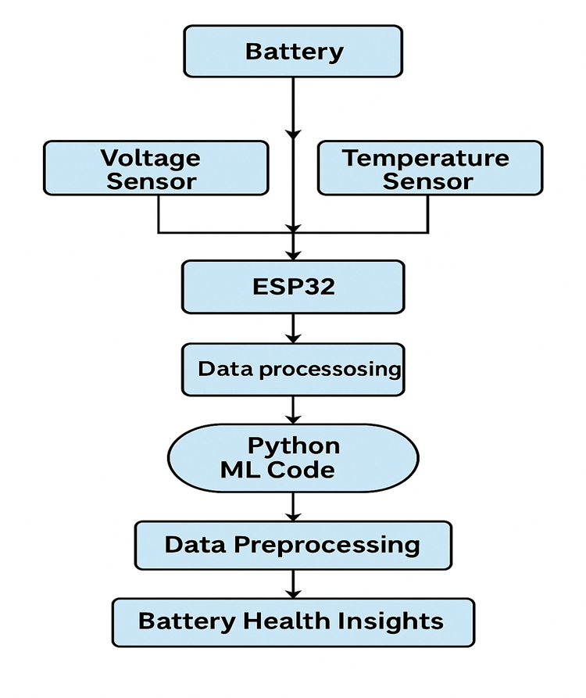
BLOCK / SCHEMATIC DIAGRAM

Slide 8
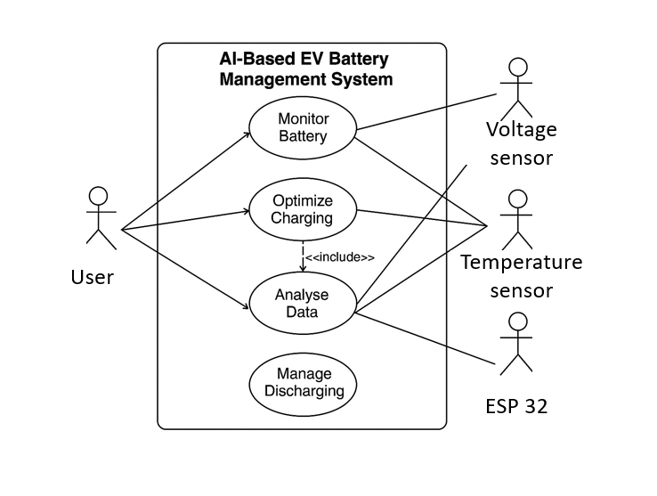
USE CASE DIAGRAM

Slide 9
SOFTWARE/HARDWARE IMPLEMENTATION VIDEO
A detailed solution demo explaining the Proof of Concept (PoC)

Slide 10
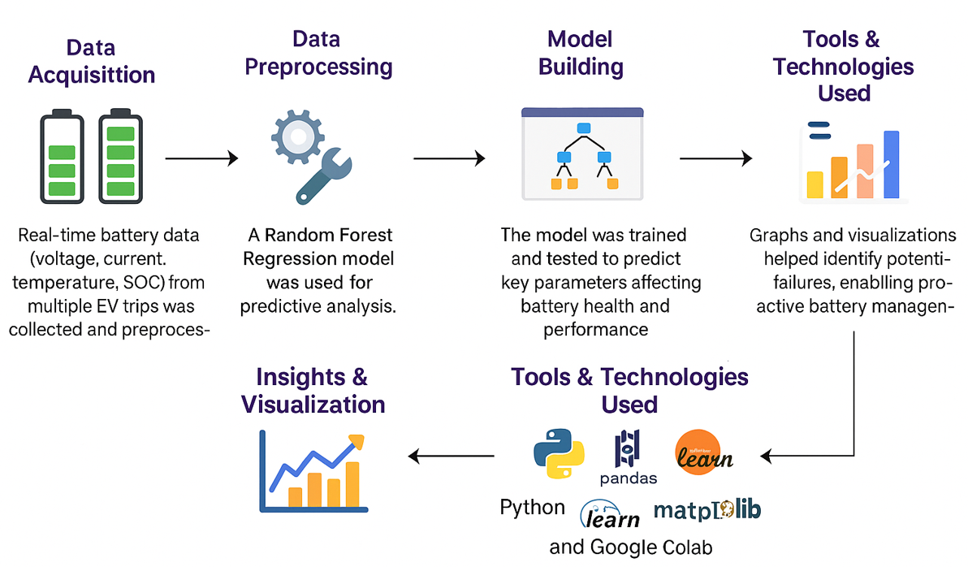
DESCRIPTION OF SOFTWARE/HARDWARE IMPLEMENTATION

Slide 11
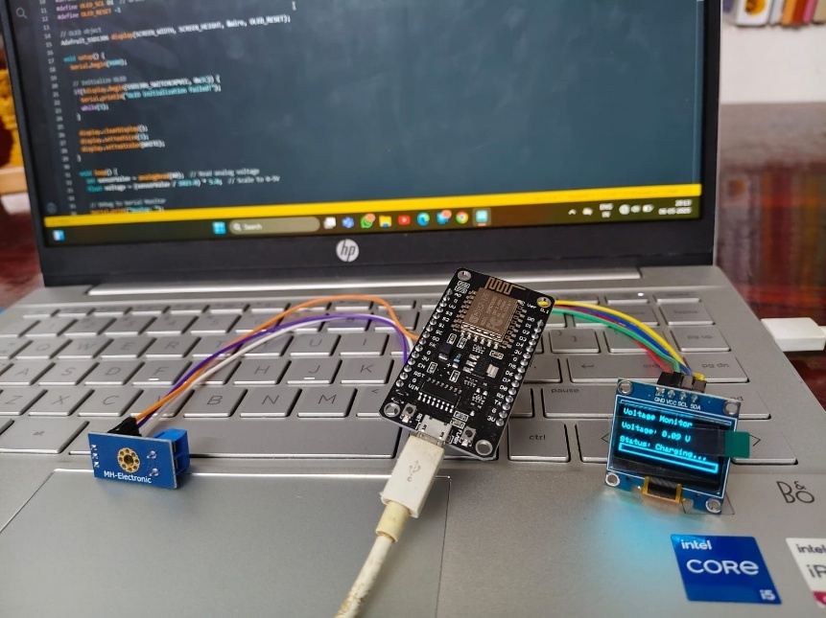
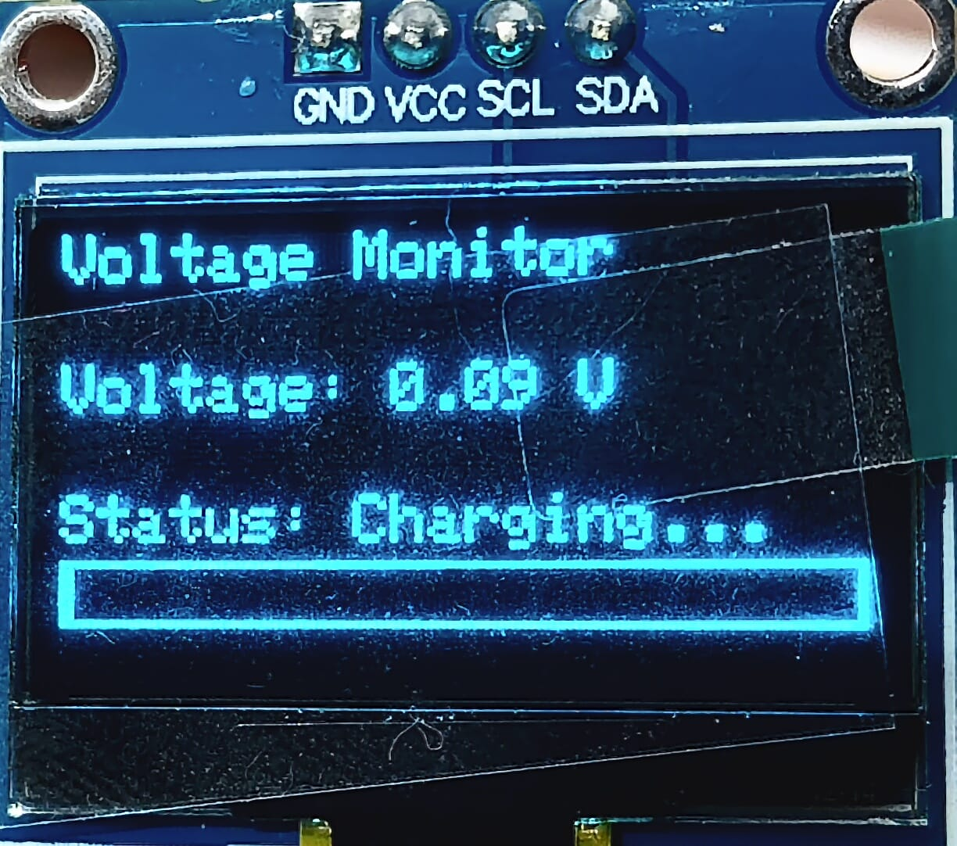
EXPERIMENTAL RESULTS

Slide 12
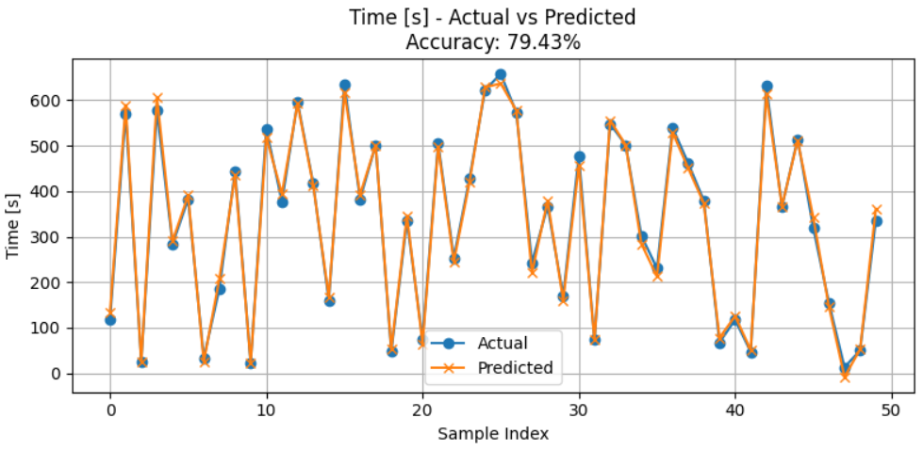
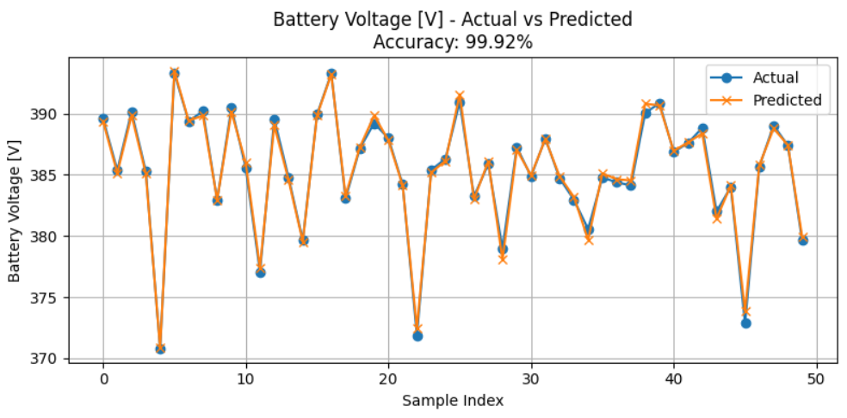
Mean Squared Error (MSE) for Time [s]: 186.5834
Mean Absolute Error (MAE) for Time [s]: 11.3046
Root Mean Squared Error (RMSE) for Time [s]: 13.6596
Mean Absolute Percentage Error (MAPE): 20.57%
Accuracy: 79.43%
Simulation Time (Model Training + Prediction): 0.0645 seconds
Total Execution Time (Data + Plot + Metrics): 2.6341 seconds
Mean Squared Error (MSE) for Battery Voltage [V]: 0.1507
Mean Absolute Error (MAE) for Battery Voltage [V]: 0.2957
Root Mean Squared Error (RMSE) for Battery Voltage [V]: 0.3882
Mean Absolute Percentage Error (MAPE): 0.08%
Accuracy: 99.92%
Simulation Time (Model Training + Prediction): 0.0145 seconds
Total Execution Time (Data + Plot + Metrics): 0.3630 seconds

Slide 13
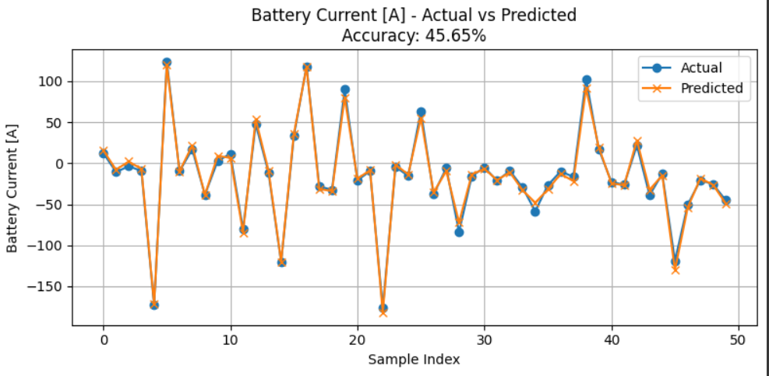
Mean Squared Error (MSE) for Battery Current [A]: 24.8006
Mean Absolute Error (MAE) for Battery Current [A]: 3.7663
Root Mean Squared Error (RMSE) for Battery Current [A]: 4.9800
Mean Absolute Percentage Error (MAPE): 54.35%
Accuracy: 45.65%
Simulation Time (Model Training + Prediction): 0.0117 seconds
Total Execution Time (Data + Plot + Metrics): 0.3066 seconds

Slide 14
CONCLUSION & FUTURE WORK
Sensor Integration:
Addition of more advanced sensors (e.g., current, humidity, internal resistance) for higher accuracy.
Edge AI Deployment:
Shift machine learning models from cloud to edge devices (like ESP32/ESP8266) for real-time on-device predictions.
Mobile App Interface:
Develop a mobile dashboard to display battery health and predictions to users in real time.
Battery Optimization Algorithms:
Implement intelligent algorithms for charging/discharging control to maximize battery life and efficiency.

Slide 15
REFERENCES
M. Chen, G. A. Rincon-Mora, Accurate electrical battery model capable of predicting runtime and I–V performance, IEEE Transactions on Energy Conversion, 2006.
Y. Zhang, C.-Y. Wang, Battery power management based on real-time electric vehicle data, Journal of Power Sources, 2020.
P. Sharma, N. Jain, Design and implementation of IoT-based smart battery monitoring system, International Journal of Scientific & Engineering Research, 2019.
A. Barré, B. Deguilhem, et al., A review on lithium-ion battery ageing mechanisms and estimations for automotive applications, Journal of Power Sources, 2013.
G. L. Plett, Battery management systems, Volume I: Battery Modeling, Artech House, 2015.

Slide 16
J. Jaguemont, L. Boulon, Y. Dubé, A comprehensive review of lithium-ion batteries used in hybrid and electric vehicles at cold temperatures, Applied Energy, 2016.
S. Das, A. Mahapatra, Machine learning in electric vehicle battery management systems: A review, Energy AI, 2022.
Y. Xing, E. W. M. Ma, K. L. Tsui, M. Pecht, An ensemble model for predicting the remaining useful performance of lithium-ion batteries, Microelectronics Reliability, 2013.
N. Ravi, P. Rajalakshmi, Design and development of a smart BMS using ESP8266 for electric vehicles, 2020 IEEE International Conference on Power Electronics.
Blynk IoT Platform Documentation, Getting Started with Blynk for ESP8266/NodeMCU,

Slide 17
THANK YOU

