Slide 1



YOUR healthcare OFFICE solution
Project Title : Salaries for San Francisco Employee Data Analysis And Salary Prediction.
Investor Opportunity
-Manju Suthar

Slide 2


Introduction:
The San Francisco Employees Salary Analysis project aims to examine public employee compensation data from 2011 to 2018. The dataset, comprising over 300,000 records, includes details such as base pay, overtime pay, other pay, benefits, and total compensation.
Public employee compensation analysis is essential for ensuring transparency and helping decision-makers understand salary trends and patterns. Through data analysis and visualization, this project explores key insights into salary distribution, high-paying job roles, and salary trends over the years.
Furthermore, a machine learning model is developed to predict total compensation based on various salary components, enabling better future pay forecasting.

Slide 3
Agenda :
Introduction
Problem Statement
Dataset
Data Preprocessing
Exploratory Data Analysis
Model Building
Future Scope & Improvements
Final Takeaways & Conclusion

Slide 4
Problem Statement :
The objective of this project is to analyze the compensation data of San Francisco public employees from 2011 to 2018 to:
1. Understand Salary Patterns: Identify the key factors influencing total compensation, including base pay, overtime pay, other pay, and benefits.
2. Identify High-Paying Job Titles: Discover which roles receive the highest compensation.
3. Analyze Pay Trends: Track how average compensation has changed over the years.
4. Predict Total Compensation: Build a predictive model to estimate employee salaries using machine learning techniques.

Slide 5
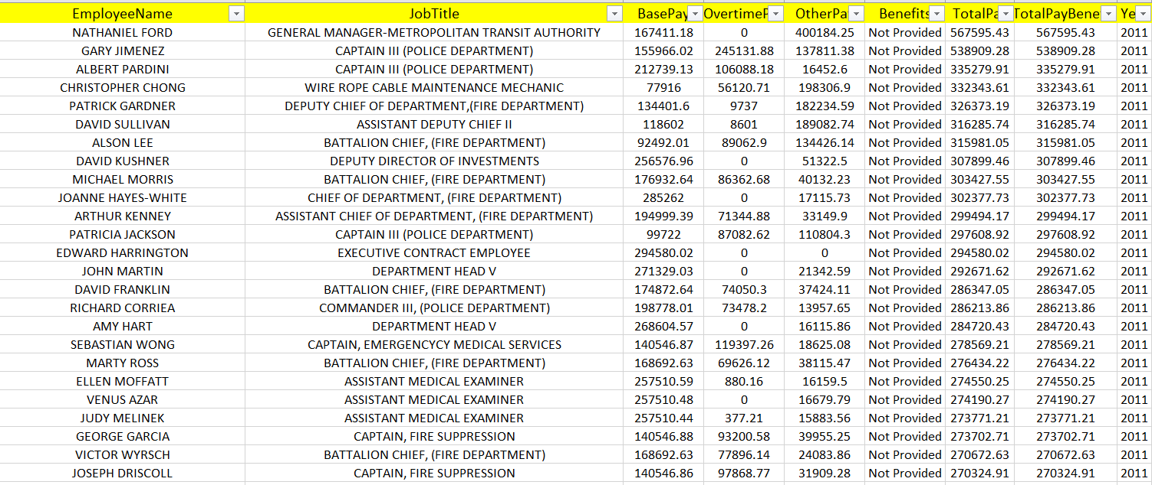
Dataset
About Dataset :
This Dataset contains more than 300k employee records found in San Francisco from 2011 to 2018. Complete and accurate information is necessary to increase public understanding of government and help decision makers, including elected officials and voters, make informed decisions. This Dataset is provided by the Nevada Policy Research Institute as a public service and is dedicated to providing accurate, comprehensive and easily searchable information on the compensation of public employees in California

Slide 6
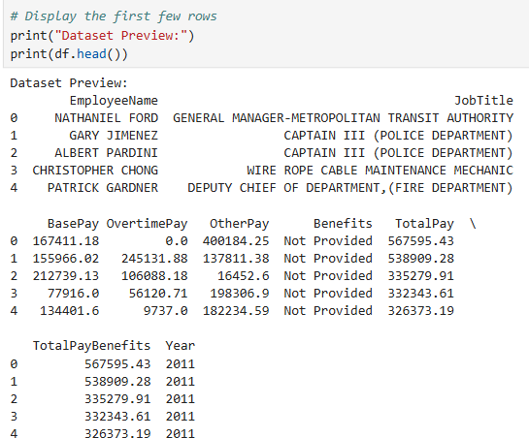
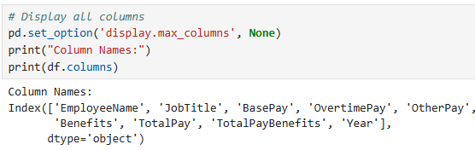
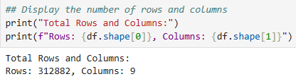
Understanding Of Data :

Slide 7
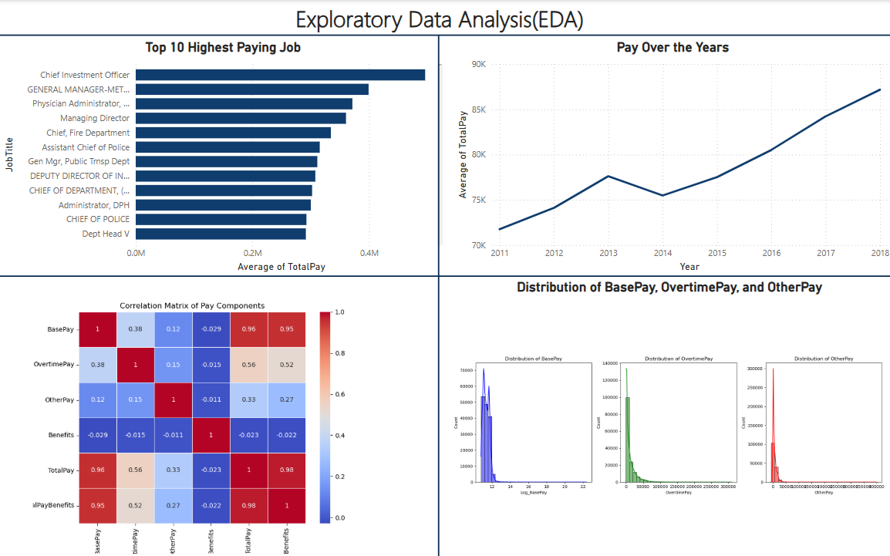
Exploratory Data Analysis

Slide 8
EDA :
High-Paying Job Titles: Roles like Chief Investment Officer and General Manager - Metropolitan Transit Authority have significantly higher average salaries.
Salary Trend (2011-2018): Average total pay for San Francisco employees shows a rising trend, with a spike in 2013, a dip in 2014, and steady growth thereafter, peaking in 2018.
Salary Distribution: Base Pay, Overtime Pay, and Other Pay are right-skewed, meaning most employees earn lower amounts, while a few earn significantly higher salaries.
Compensation Breakdown: Base pay is the major contributor to total pay, while benefits play a moderate role. Overtime and other pay types have weaker correlations with total pay.

Slide 9

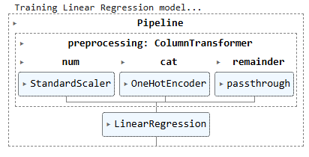
Model Building
📌 Steps:
Data preprocessing (scaling, encoding).
Train-test split (70%-30%).
ML Models: Linear Regression & Random Forest Regressor. 📌 Visuals:
Pipeline diagram (Preprocessing → Model Training → Prediction).

Slide 10

Linear Regression Model :
📌 Results:
MAE: 0.123
R² Score: 0.9999
📌Conclusion: The Linear Regression model has achieved excellent performance with a Mean Absolute Error (MAE) of 0.123 and an R-squared score (R²) of 0.9999. This indicates that the model is highly accurate and can predict the target variable with minimal error. However, the near-perfect R² score might also indicate potential overfitting, so it is recommended to validate the model using cross-validation or additional test data.

Slide 11
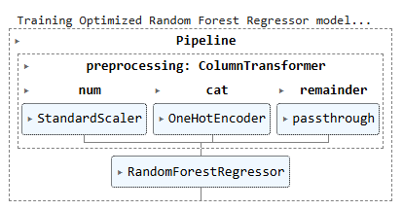
Random Forest Regressor Model
📌 Results:
MAE: 1963.91
R² Score: 0.9970
📌 Advantage: Captures complex relationships better. 📌 Limitation: Higher MAE than Linear Regression.
📌 Conclusion : The Random Forest Regressor model has achieved a Mean Absolute Error (MAE) of 1963.91 and an R-squared score (R²) of 0.9970. This indicates that the model has a very high accuracy and is able to capture the relationship between the features and the target variable effectively.

Slide 12
Model Comparison
Model | MAE | R² Score
Linear Regression | 0.123 | 0.9999
Random Forest | 1963.91 | 0.9970
📌 Conclusion:
In this analysis, i have compared two regression models: Linear Regression and Random Forest Regressor.The Linear Regression model achieved a Mean Absolute Error (MAE) of 0.123 and an R-squared score of 0.9999, indicating an almost perfect fit with the data.The Random Forest Regressor model resulted in a significantly higher MAE of 1963.91 and a slightly lower R-squared score of 0.9970.Based on the evaluation metrics, Linear Regression performed better than Random Forest Regressor.

Slide 13
Final Takeaways & Future Scope :
🔹 Final Takeaways
✅ Key Findings Recap:
Base pay is the primary driver of total compensation.
Executive roles earn the highest salaries.
Benefits significantly impact total pay.
The model provides reasonable accuracy in salary predictions.
✅ Best Performing Model:
Linear Regression outperformed Random Forest based on evaluation metrics.

Slide 14
Future Scope & Improvements
🔸 Feature Engineering: Adding new derived features for better accuracy. 🔸 More Data Sources: Including inflation rates, industry trends, and experience levels for richer insights. 🔸 Hyperparameter Tuning: Fine-tuning models for better performance. 🔸 Deep Learning Models: Exploring Neural Networks for better salary predictions.
🔸 The model can be improved with additional features like experience, inflation, or industry trends.
Employee | Job Title | Actual Salary | Predicted Salary (Linear Reg.) | Predicted Salary (RF)
A | Manager | $120,000 | $118,500 | $121,000
B | Analyst | $80,000 | $79,200 | $82,500

Slide 15

Manju Suthar .
- 1/04/2025

