Slide 1




Slide 2

Team 4:-
Book Recommendation System
Team Members
Miss.KURAKALAVA MANJULA
VARIKUPPALA VAMSHI
Ms. Tejaswini H K
Mr. Ravindrakumar Amardev sharma
Mr Kamal Kiran Mahanna
Hanumannagari Nandini

Slide 3

BUSSINESS OBJECTIVE
books and users, develop a recommendation system that suggests books to users based on their preferences and interests. The system should take into account factors such as the user's reading history, ratings and reviews, demographic information, and other relevant data. The goal is to provide personalized recommendations that are relevant and useful to the user, with the aim of increasing user engagement and satisfaction.
The book recommendation system should be able to handle a large volume of data, and should be scalable to accommodate new users and books as they are added to the dataset. The system should also be able to adapt to changing user preferences over time, and be able to provide recommendations for both popular and niche genres.

Slide 4
Data summery
The Book Recommendation System data set contains information on books, users, and their interactions. It includes data on book titles, authors, genres, publication dates, ratings, reviews, and user demographics such as age, gender, and location.

Slide 5
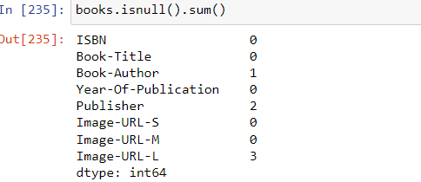
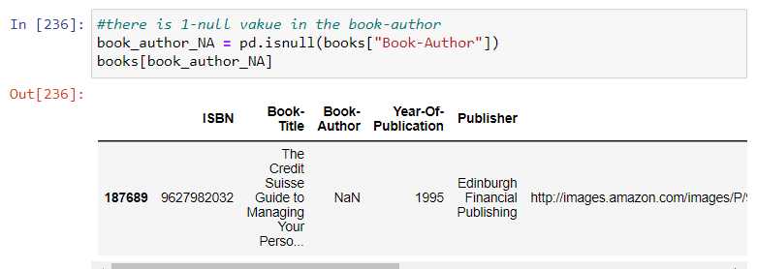
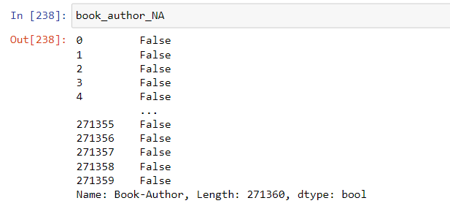
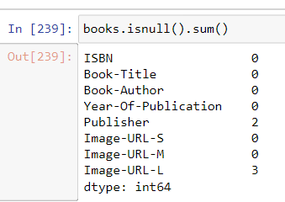
Data cleaning
Replace the Null value to manual entry in Author same as,image,Publisher
Eg Author

Slide 6
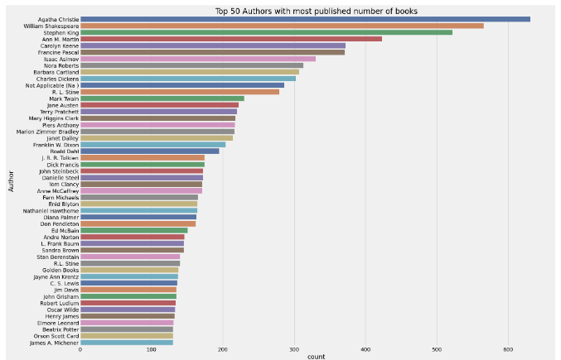
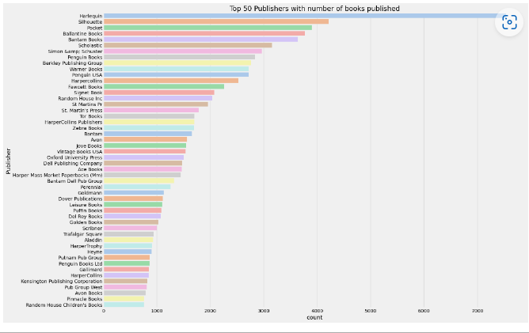
Observation From Book_DF
Authors
Publisher

Slide 7
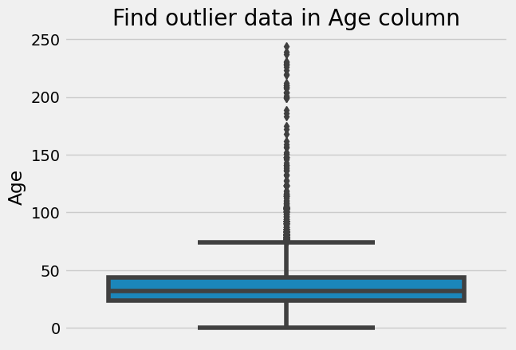
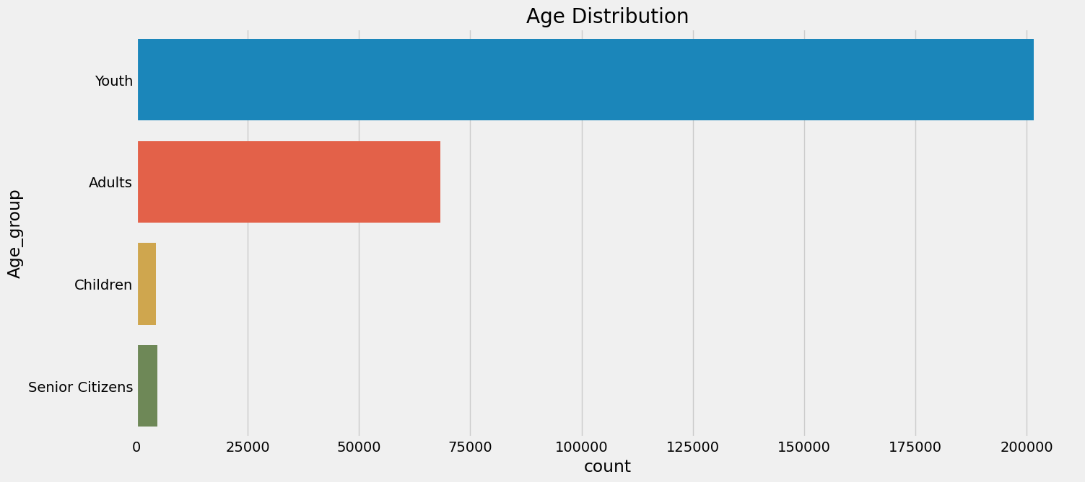
Observation From user_df
Outlier of Age coloum
Age Distribution

Slide 8
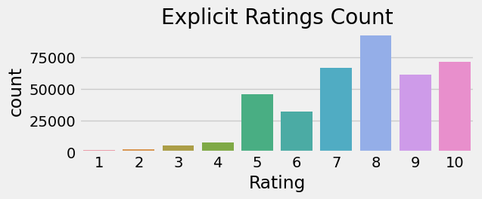
Observation from book rating

Slide 9
Model no 1- popularity based recommendation
#Weighted Rating(WR)=[vR/(v+m)]+[mC/(v+m)]
#where,
# v is the number of votes for the books;
# m is the minimum votes required to be listed in the chart;
# R is the average rating of the book; and
# C is the mean vote across the whole report.
# Now we find the values of v,m,R,C.
C= Final_Dataset['Avg_Rating'].mean()
m= Final_Dataset['Total_No_Of_Users_Rated'].quantile(0.80)
Top_Books = Final_Dataset.loc[Final_Dataset['Total_No_Of_Users_Rated'] >= m]
print(f'C={C} , m={m}')
Top_Books.shape

Slide 10
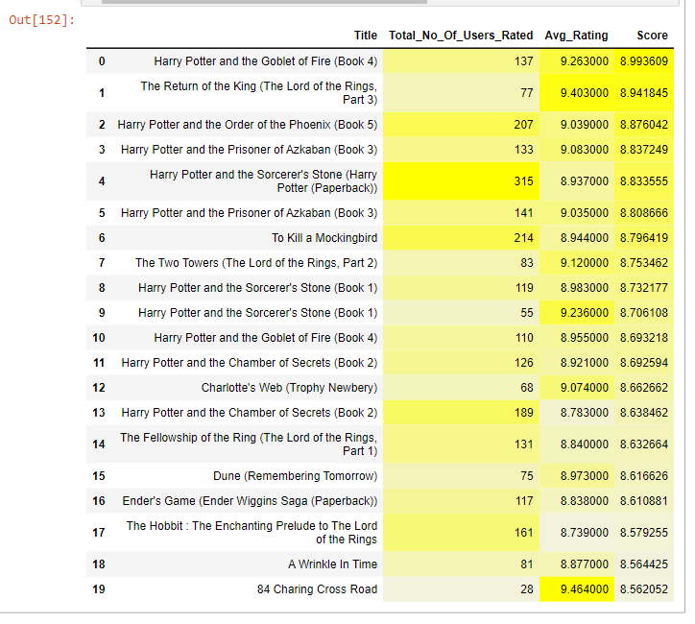

Slide 11
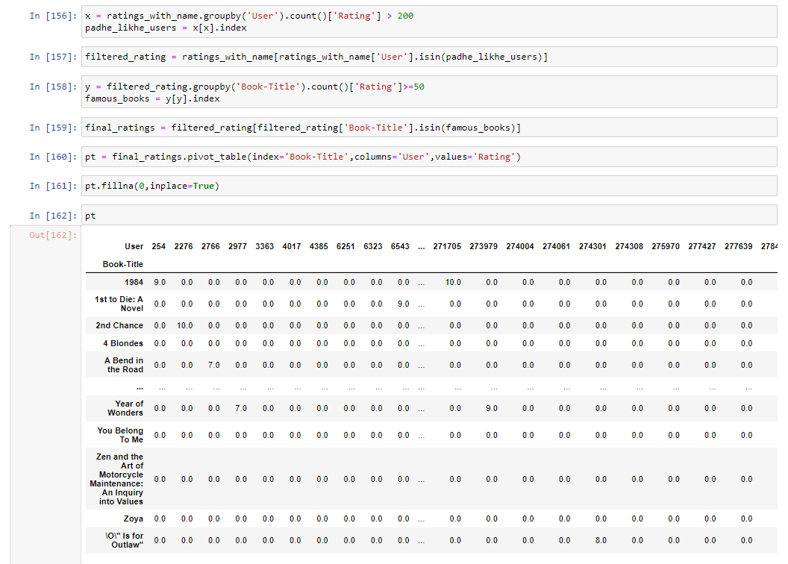
Model Based Collaborative Filtering

Slide 12
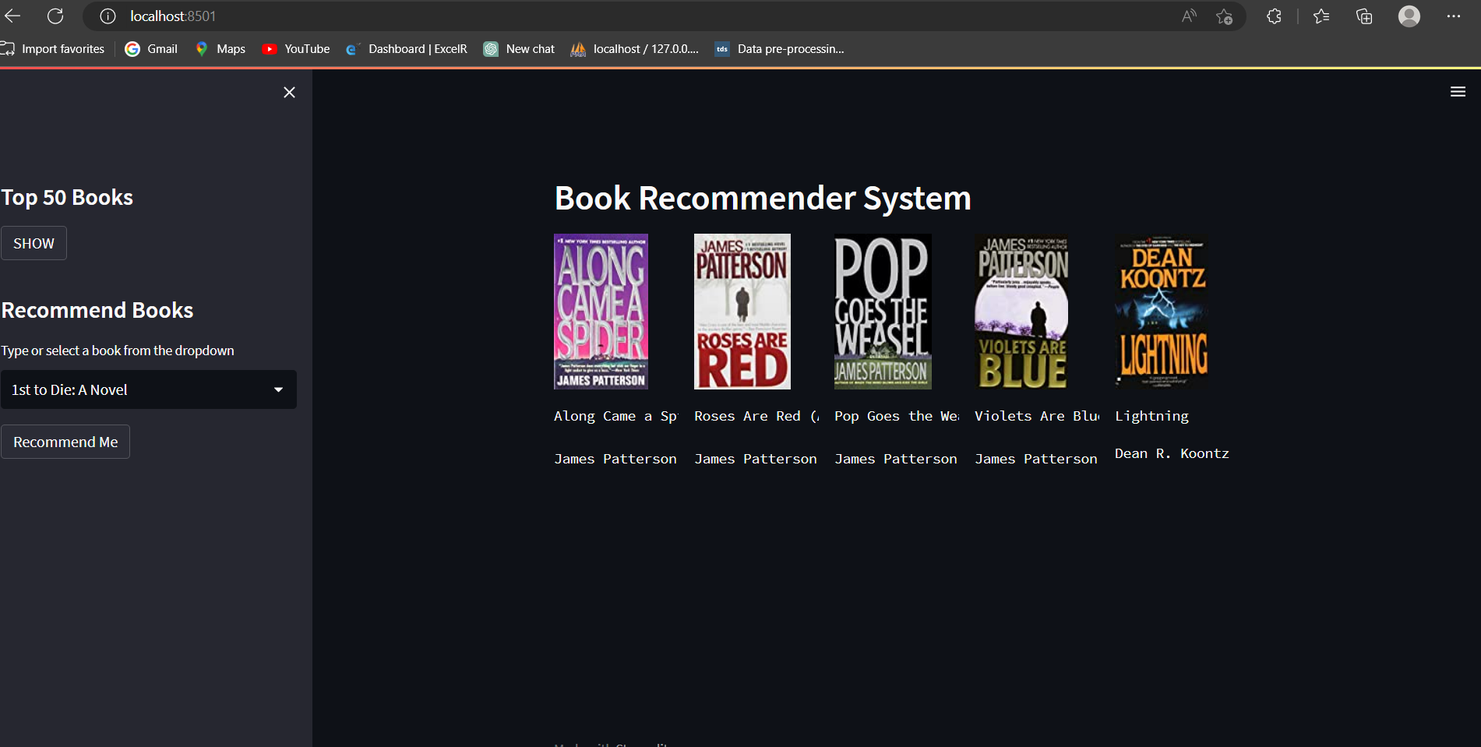
Model deployment

Slide 13
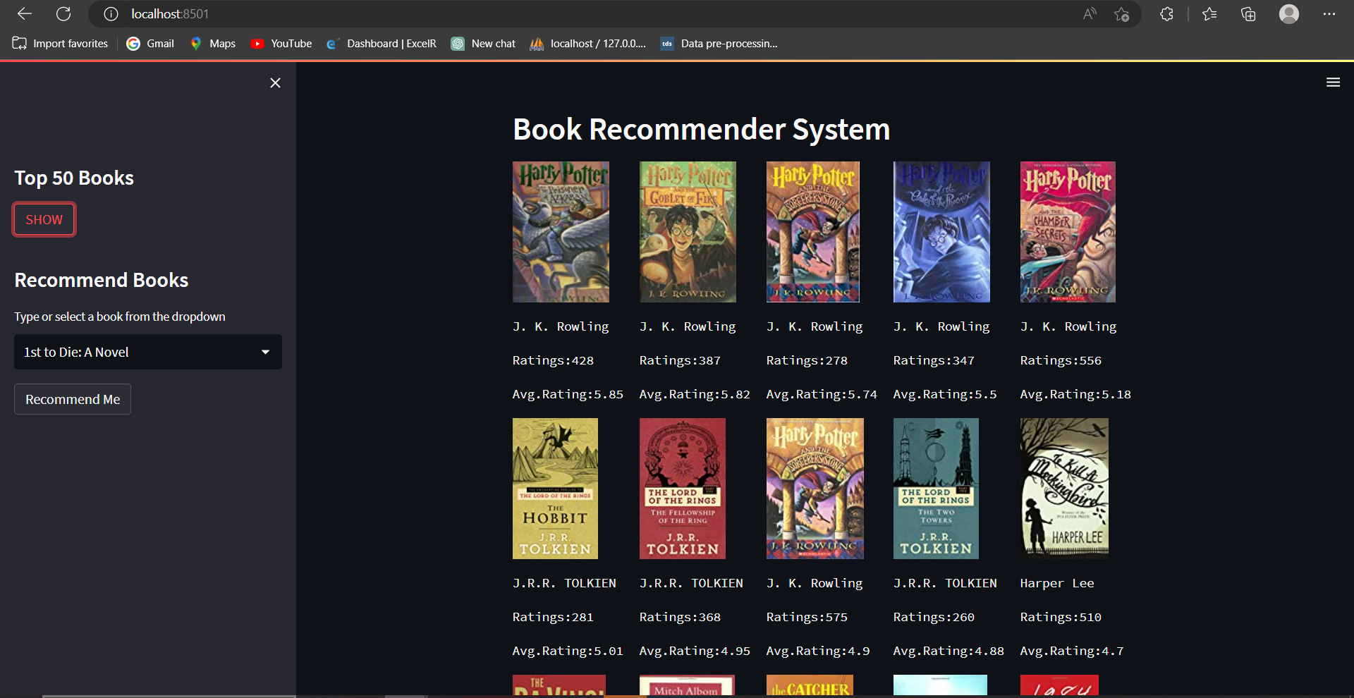
Model deployment for top 50 book

Slide 14
Challenges
Handling of sparsity was a major challenge as well since the user interactions were not present fort he majority of the books.
Understanding the metric for evaluation was a challenge as well.
Since the data consisted of text data,data cleaning was a major challenge in features like Location etc..
Decision making on missing value imputations and outlier treatment was quite challenging as well.

Slide 15
Conclusion
In EDA, the Top 50 most rated books were essentially novels. Books like The Lovely Bone and The Secret Life of Bees were very well perceived.
Majority of the readers were of the age bracket 20-35 and most of them came from North American and European countries namely USA, Canada, UK, Germany and Spain.
If we look at the ratings distribution, most of the book have high ratings with maximum books be ingrated8.
Ratings below 5 are few in number. Author with the most books was Agatha Christie, William Shakespeare and Stephen King.
For modelling, it was observed that for model based collaborative filtering SVD technique worked way better than NMF with lower Mean Absolute Error(MAE).

Slide 16
Thank you

