Slide 1
Netflix Movie Data Analysis
Data Science & Data Analyst
Name : Manjunath M Bandiwaddar

Slide 2
Netflix Movie Data Analysis Project
Netflix, founded on August 29, 1997, in Scotts Valley, California, by Reed Hastings and Marc Randolph, began as a DVD-by-mail service.
Hastings, a computer scientist and mathematician, co-founded the company after being inspired by a hefty late fee from a traditional video rental store.
Randolph, a marketing executive, played a pivotal role in shaping Netflix's early user interface and branding

Slide 3
The Project Objective
The Problem:
In today's competitive streaming landscape, understanding audience preferences is key.
This project aims to uncover insights from a movie dataset to inform content strategy.
The Goal:
To perform a comprehensive data analysis using Python to identify key trends in the Netflix
movie
Library, including:
The most common and popular genres.
Movies with the highest and lowest ratings.
Production trends over time.

Slide 4
The Tools:
This analysis was conducted using Python, leveraging the power of libraries such as Pandas for data manipulation and Matplotlib and Seaborn for creating compelling data visualizations that highlight key findings.

Slide 5
Steps
What is the most frequent genre of movies released on Netflix?
Which has highest votes in vote avg column?
What movie got the highest popularity? what's its genre?
What movie got the lowest popularity? what's its genre?
Which year has the most filmmed movies?

Slide 6
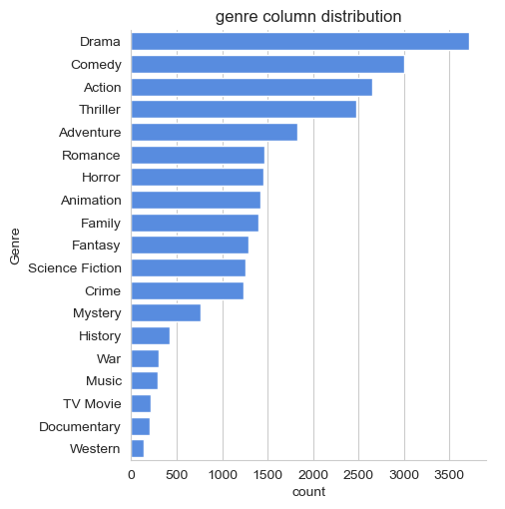
The most frequent genre in the dataset

Slide 7
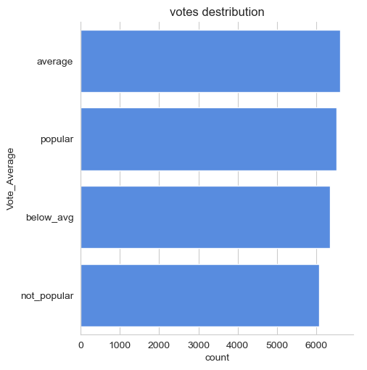
Genres has highest votes

Slide 8
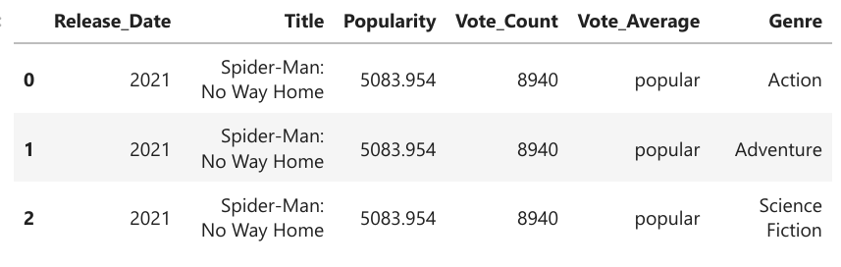
Movie got the highest popularity
Spider-Man: No Way Home has the highest popularity rate in our dataset and it has genres of Action, Adventure and Science Fiction .

Slide 9
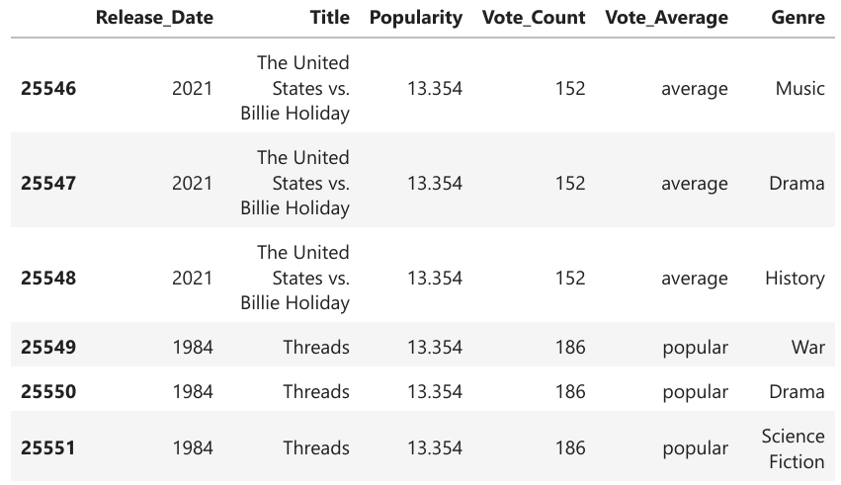
Movie got the lowest popularity
The united states, thread' has the highest lowest rate in our dataset and it has genres of music , drama , 'war', 'sci-fi' and history`.

Slide 10
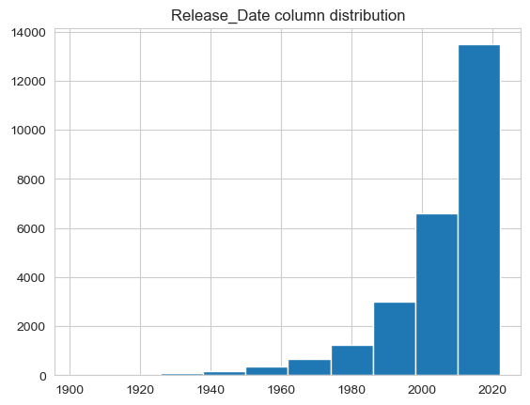
Year which has the most filmmed movies

Slide 11
Conclusion
By combining data manipulation with powerful visualization techniques, this project provides a clear, actionable overview of the dataset. The insights gained can be used to inform content strategy, optimize production schedules, and enhance viewer experience on a streaming platform.

