Slide 1
Car Price Prediction
Regression Problem

Slide 2
Problem Statement
Client works with small traders, who sell used cars. With the change in market due to covid 19 impact, client is facing problems with their previous car price valuation machine learning models.
So, they are looking for new machine learning models from new data. We collected data from car dekho and OLx and we are using that data here to train the model
The target variable in the train data is continuous. So, we need to use regression model to train and to predict the prices.

Slide 3
Skills Used
Language used for this project is Python.
Libraries required for this project are Pandas, Numpy, Matplotlib, Seaborn. Sickit-learn.

Slide 4
Data Set
The data is collected from car dekho, Olx websites.
The data set contains price, brand, model, transmission, kilometers drivern, Variant, Manufactured year,Fuel and no of owners.

Slide 5
Data Set
While doing data science project first thing is we have to load the data set, this can be done with Pandas.read_csv()
The data set contains null values in the values, we removed the null values for better data.

Slide 6
Statistics
With the help of pandas.describe () function we can get mean, median, min and max value of each numerical column.
I see that there is lot of difference in Kilometers driven column. Also there is skewness.

Slide 7
Data Cleaning
We know that the data set contains null values, after the research I found that the data set also contains skewness and outliers in the data.
Removed null values from the data.

Slide 8
Data Cleaning
Removed skewness by using square root transformation.

Slide 9
Data Cleaning
The next step is to check outliers in the data. For this we can use box plot visualization and to remove those outliers we have two techniques they are zscore and IQR.
The most effective technique is IQR. The IQR contains the middle bulk of your data, so outliers can be easily found once you know the IQR.

Slide 10
Encoding
To train the data set with machine learning algorithms we need numerical data. So we use encoding technique to change the categorical data into numerical format.
If the column have only two values in a column we will use one hot encoding, if the column have 2+ values then we will use Label encoding.

Slide 11
Machine Learning techniques
First we want to split the data for training and testing purpose and later we will apply any 4 machine learning algorithms to train the model and will check which will give best r2_score and low RMSE.
R2_score shows how good the model is working.

Slide 12
Algorithms
I used 4 algorithms to train the model.
They are:
**LinearRegression
**DecisionTreeRegressor
**KneighborsRegressor
**RandomforestRegressor

Slide 13
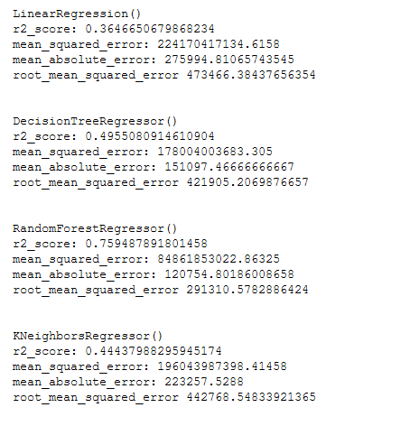
Output of Algorithms
The result came from the applied 4 machine learning models.

Slide 14
Compare scores
From the results we can see that RandomForestRegressor is working good with less RMSE when compared with other algorithms
So We will do tuning process to increase the accuracy.

Slide 15
Tuning
We will do hyper parameter tuning for random forest regressor and will find best parameters.
With the help of these best parameters when you train randome forest regressor the r2_score increased 4%. This high r2_score saved by importing joblib for feature purpose to transform the test data and get predicted prices.

Slide 16
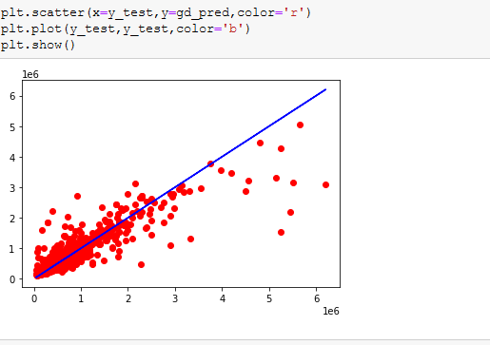
Predicted visualization
The red data points on the blue line shows how good the model is working. If most of the data point are connected to the line then it is working. Data point are plotted in red.

