Slide 1
HOUSING: PRICE PREDICTION
Regression Problem

Slide 2
Problem Statement
The company “Surprise Housing” has decided to enter the Australian Housing market and real estate to purchase houses at a price below their actual values and flip them at a higher price.
For the same purpose, the company has collected a data set from the sale of houses in Australia. This data trained with various machine learning models to predict the prices for the given test data.
The target variable in the train data is continuous. So, we need to use regression model to train and to predict the prices.

Slide 3
Skills Used
Language used for this project is Python.
Libraries required for this project are Pandas, Numpy, Matplotlib, Seaborn. Sickit-learn.

Slide 4
Data Set
The data set have train and test data in excel format.
The train data is used to train the model to predict the prices, later you can apply the test data to get the sale prices.
The data set contains 81 columns and 1168 rows.

Slide 5
Data Set
While doing data science project first thing is we have to load the data set, this can be done with Pandas.read_csv()
The data set contains 3 float, 35 integer and 43 object data type columns.
The data set contains null values in the values, we can handle the null values by simple imputer which is sickit-learn technique to handle missing values.

Slide 6
Statistics
With the help of pandas.describe () function we can get mean, median, min and max value of each numerical column.
In most of the numerical columns mean is greater than median, also in most of the columns the min value is Zero (0).

Slide 7
Statistics
The standard deviation (std) is high in most of the columns, this shows that the data points are widely spread.
From these observation we came to know that there is skewness in the given data and we have to do scaling because of the min and max value has drastically high difference.

Slide 8
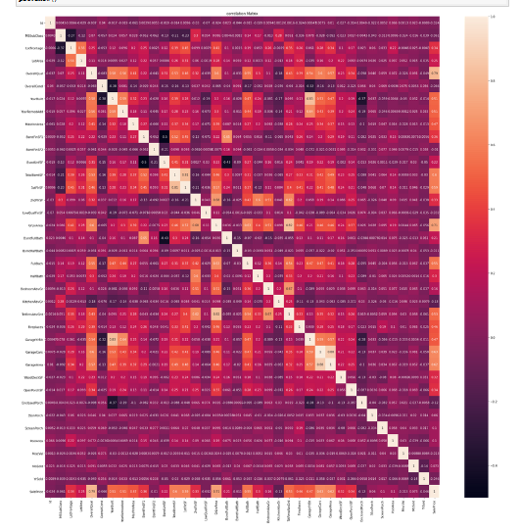
Visualization

Slide 9
Visualization
The above is the heat map used for numerical data to check how the numerical independent variables are correlated with the target variable.
From this heat map the result is the OveralQual, GlivArea is good the house price increase.

Slide 10
Data Cleaning
We know that the data set contains null values, after the research I found that the data set also contains skewness and outliers in the data.
So I used simple imputer for handling null values.

Slide 11
Data Cleaning
For Skewed data I used log and square root transformation to remove skewness. Log transformation is most effective but will not work for all the columns for such columns I used square root.
Also, we know that some columns have 0 (zero) values and also these columns have skewness. So when you apply log transformation the result will be “Nan”. To avoid this we have to add constant value for those columns.

Slide 12
Data Cleaning
The next step is to check outliers in the data. For this we can use box plot visualization and to remove those outliers we have two techniques they are zscore and IQR.
The most effective technique is IQR. The IQR contains the middle bulk of your data, so outliers can be easily found once you know the IQR.

Slide 13
Data Cleaning
The columns removed from the data set are:
** ID:It is removed because it is unique value.
**Utilities: This column have only 1 value in all rows which are not effective.
** 'PoolQC','Fence','MiscFeature','Alley‘ :
These columns are removed because nearly 80% of the data have null value. So if you handle null value in these columns 80% of the data is changing. So it will be messy, that’s reason I removed.

Slide 14
Encoding
To train the data set with machine learning algorithms we need numerical data. So we use encoding technique to change the categorical data into numerical format.
If the column have only two values in a column we will use one hot encoding, if the column have 2+ values then we will use Label encoding.

Slide 15
Scaling
We know that many columns have high difference in minimum and maximum values . So we will do scaling for the data. Scaling will normalize the data, it is very important for Regression problem.

Slide 16
Machine Learning techniques
First we want to split the data for training and testing purpose and later we will apply any 4 machine learning algorithms to train the model and will check which will give best r2_score and low RMSE.
R2_score shows how good the model is working.

Slide 17
Algorithms
I used 4 algorithms to train the model.
They are:
**LinearRegression
**DecisionTreeRegressor
**KneighborsRegressor
**RandomforestRegressor

Slide 18
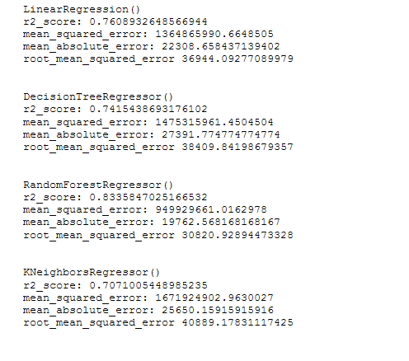
Output of Algorithms
The result came from the applied 4 machine learning models.

Slide 19
Compare scores
From the results we can see that RandomForestRegressor is working good with less RMSE when compared with other algorithms
So We will do tuning process to increase the accuracy.

Slide 20
Tuning
We will do hyper parameter tuning for random forest regressor nd will find best parameters.
With the help of these best parameters when you train randome forest regressor the r2_score increased 1%. This high r2_score saved by importing joblib for feature purpose to transform the test data and get predicted prices.

Slide 21
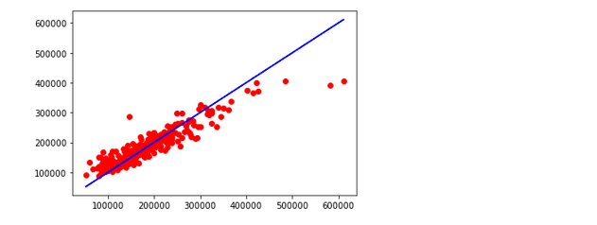
Predicted visualization
The red data points on the blue line shows how good the model is working. If most of the data point are connected to the line then it is working. Data point are plotted in red.

