Slide 1
Image scrapping and classification model
CNN problem

Slide 2
Problem Statement
Images are one of the major sources of data in the field of data science and AI. This field is making appropriate use of information that can be gathered through images by examining its features and details. ‘
The task is to collect the images (Sarees, Trousers,Jeans) from ecommerce website(Amazon.in) and to do Image classification by using CNN model.

Slide 3
Skills Used
Language used for this project is Python.
Selenium and BeautifluSoup used for scrapping Images.
TensorFlow and Keras are used to build the CNN model

Slide 4
Data Set
Data is collected from Amazon.in and data set contains 706 images with 3 labels.

Slide 5
Data preprocessing
All the images will have different sizes, to train the data all the images should be of same size. So with the help of ImageDataGenerator we rescaled the images to same width and height

Slide 6
Building CNN model
There are different types of CNN models to do Image classification problem. In this project I used VGG16 CNNmodel.
Vgg16 model is built with 16 layers and 3x3 kernals.
The network comprises of 134,272,835 parameters.

Slide 7
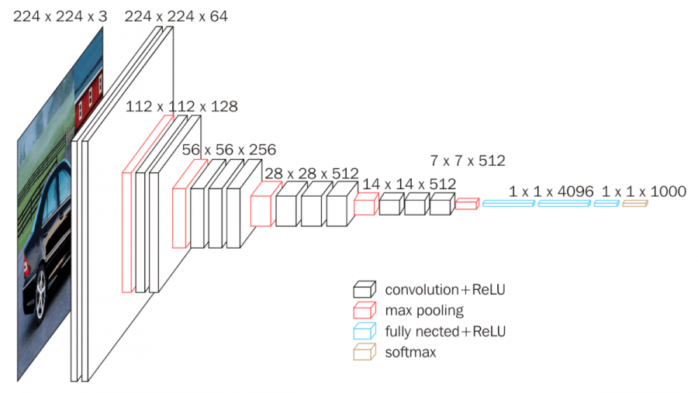
Vgg16 architecture

Slide 8
Vgg16 architecture
In the above slide we can see the architecture of vgg16 with the help of this architecture I built vgg16 model and train the scrapped data.

Slide 9
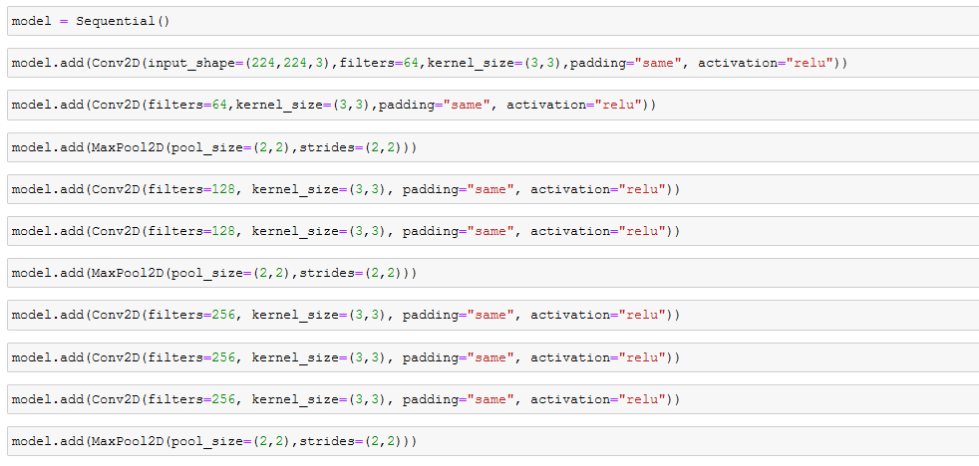
Building Model

Slide 10
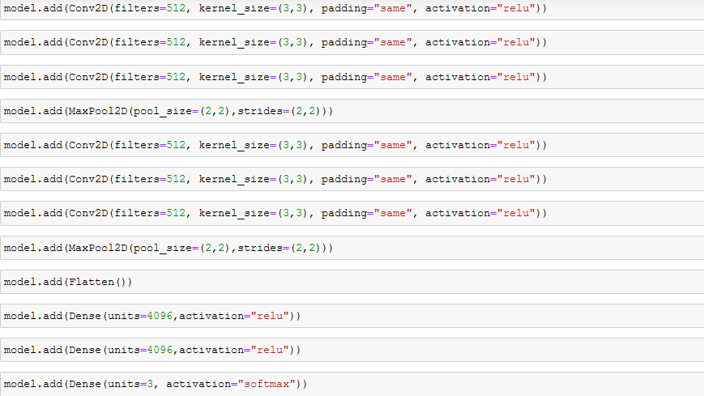
Building Model

Slide 11
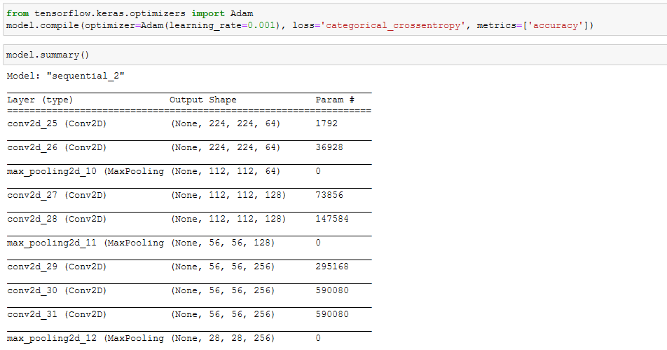
Building Model

Slide 12
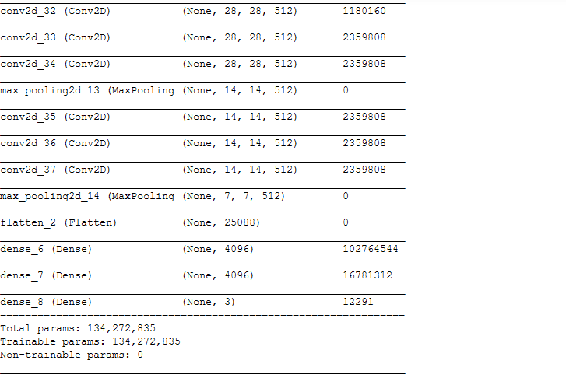
Building Model

Slide 13
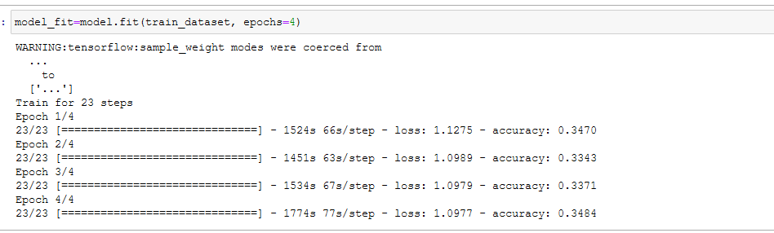
Building Model

Slide 14
End
We can see that with epochs 4 we got less loss rate and more accuracy.

