Slide 1
Malignant comments classification
Classification Problem

Slide 2
Problem Statement
social media enables people to express their opinions widely online. However, at the same time, this has resulted in the emergence of conflict and hate, making online environments uninviting for users.
Although researchers have found that hate is a problem across multiple platforms, there is a lack of models for online hate detection.
Online hate, described as abusive language, aggression, cyberbullying, hatefulness and many others has been identified as a major threat on online social media platforms.
Our goal is to build a machine learning model with the help of past data and to predict the maligant values for new comments.

Slide 3
Skills Used
Language used for this project is Python.
Libraries required for this project are Pandas, Sickit-learn, NLP.

Slide 4
Data Set
Train data set contains 159571 rows and 8 columns.
Test daya set contains 153164 rows and 2 columns.

Slide 5
Data Cleaning
Used NLP techniques to clean the data.
Regular expression is used to convert email address into word email, phone number into word number, remove punctuation, stopwords and did lemmatization

Slide 6
Changing text to numeric.
We have different bag of words techniques from NLP to treat the text data and convert it into vectors. Because we need numeric data to train the model.
Here we used Tf-Idf technique to convert the text data into vectors.

Slide 7
Visualization
With the help of wordcloud or tag clouds are graphical representations of word frequency that give greater prominence to words that appear more frequently in a source text.

Slide 8
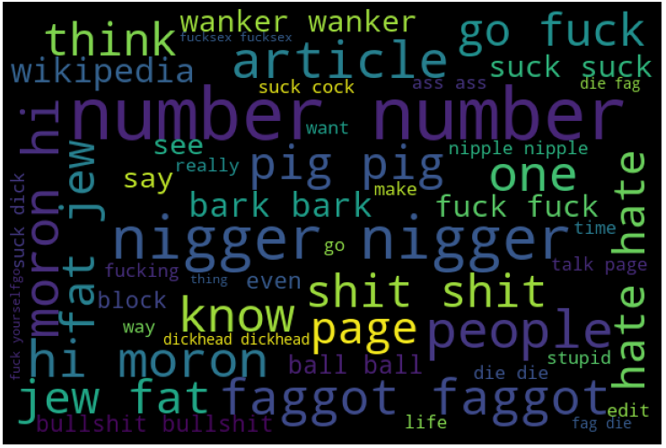
From above visualization we can see that the words which shows the maligant is yes. Visualization

Slide 9
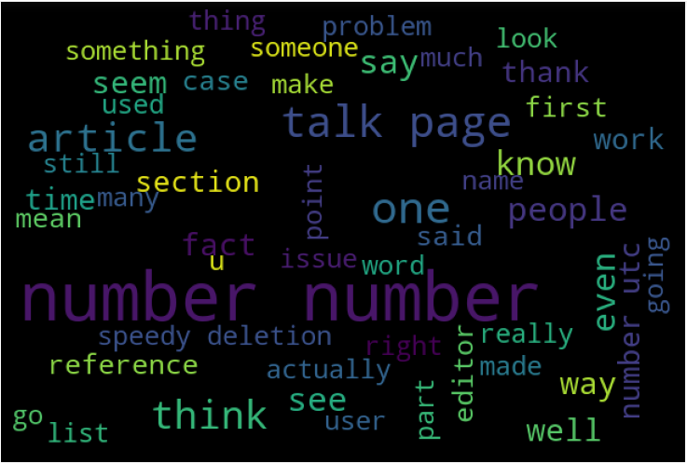
Visualization
From above visualization we can see that the words which shows the maligant is NO.

Slide 10
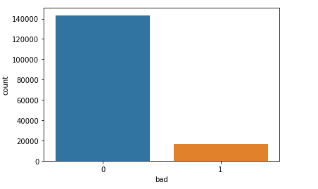
Visualization
We can see that the target variable is imbalnced so we will use sampling process.

Slide 11
ML Algorithms
I used 3 algorithms to train the model.
They are:
**LogisticRegression
**Naïve bayes
**DecisionTreeClassifier

Slide 12
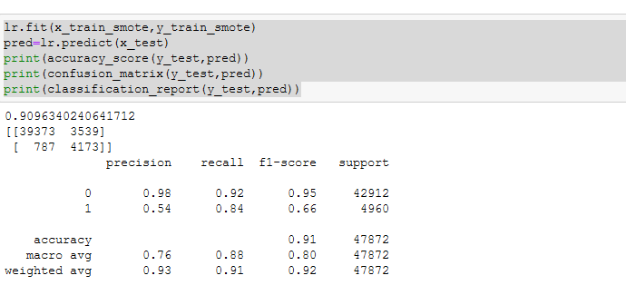
Output of Algorithms
Logistic Regression:

Slide 13
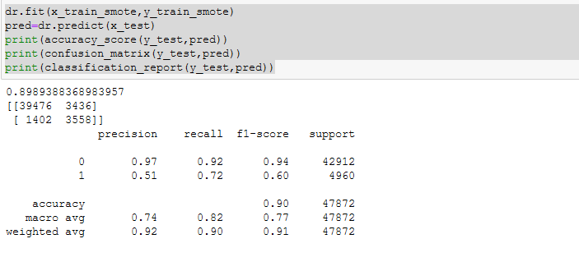
Output of Algorithms
DecisionTree Classifier

Slide 14
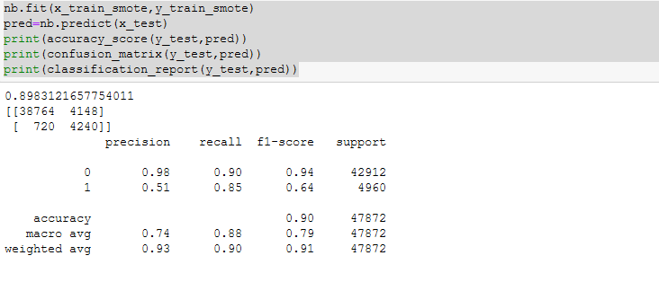
Output of Algorithms
Naïve Bayes

Slide 15
Compare scores
From the 3 algorithms it shows that LogisticRegression is working better with better accuracy and F1 score when compared with other algorithms.

Slide 16
Test_data
Now we will get the test data and we will do the data pre processing which we did for train data and used tfidf technique to convert text into vectors and predicted the values for the each comment in the provided test data.

Slide 17
Outcome of Text dat
From test data we predicted 79783 are not toxic and 73381 are toxic.
Using Word cloud we checked how good the precited values

Slide 18
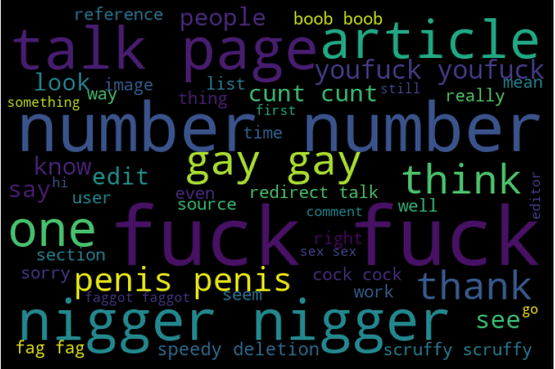
Word cloud for toxic

Slide 19
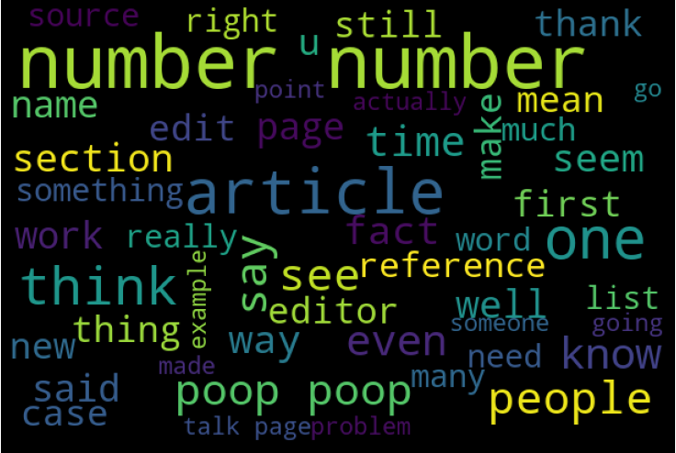
Wordcloud for non toxic

Slide 20
End
We can see that the wordcloyud for test data and we can confirm that the model is good and saved the data into CSV format

