Slide 1
Lean Six Sigma Project
Project Name: Improving CDD Process Adherence
Process: Client Due Diligence (CDD) Process
Presented by: K.S.Manjunath
Project type: Six sigma Green Belt Project

Slide 2
Our Team
Data Analyst
IT Support
Compliance officer

Slide 3
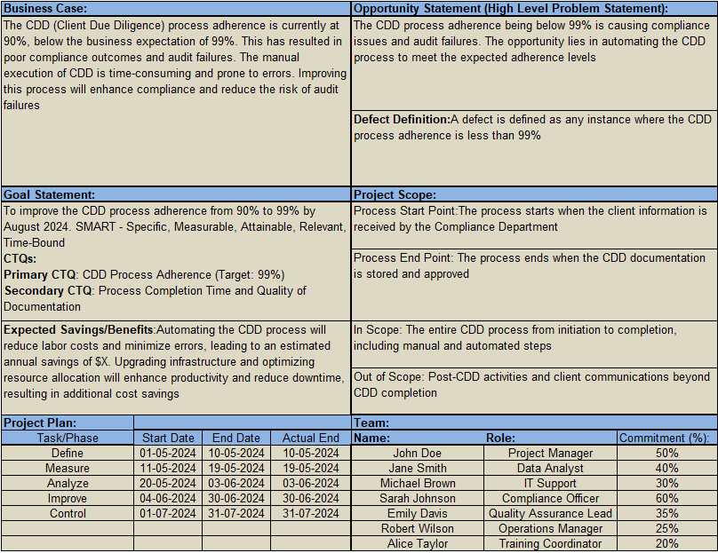
DMAIC Project Charter

Slide 4
Define Phase

Slide 5
SIPOC
Supplier | Input | Process | Output | Customer
Compliance Department | Client Information | 1. Receive client information | Completed CDD reports | Compliance Department
IT Department | Regulatory Guidelines | 2. Verify Client Identity | Notification of high-risk clients | Senior Management
Data Entry Team | IT systems | 4. Trigger manual CDD process | Internal audit reports | Internal Audit Team
Legal Team | Compliance Checklists | 5. Conduct detailed CDD checks
 |  | 6. Document findings
 |  | 7. Review and approve CDD results
 |  | 8. Store CDD documentation

Slide 6
Measure Phase

Slide 7
Data Collection Plan Worksheet Key Output Measure Y
CTQ | Measure Description (op definition) | Data Type (Cont//Disc) | How Many? (sampling) | How Collected (use additional sheets if needed) | By Whom | Segmentation criteria (as appropriate)
CDD Process Adherence | Percentage of CDD processes adhered to within 30 days | Discrete data (percentage) | 100 samples per month | Extracted from compliance reports and audit data | Compliance Team | By region (if applicable)

Slide 8
CDD Process Completion Time (in Minutes)
CDD Process ID | Completion Time (Minutes)
1 | 45
2 | 50
3 | 40
4 | 55
5 | 48
6 | 42
7 | 60
8 | 38
9 | 47
10 | 43
11 | 52
12 | 50
13 | 45
14 | 44
15 | 46

Slide 9
Output Sigma Understanding the Capability of the Process
Define the following:
CTQ: CDD Process Adherence
Target: 99% adherence
Defect: Less than 99% adherence
Unit: CDD Process
Opportunity: One (each CDD process instance)
S.NO | ATTRIBUTES | SYMBOLS | ENTER
1 | Number of Units Processed | N = | 1000
2 | Total Number of Defects Made (instances of non-adherence) | D = | 100
3 | Number of Defects opportunities per unit | O = | 1
4 | Solve for Defects per million opportunities | DPMO = | (D/N) * 1,000,000 = 100,000
5 | Sigma Level | SIGMA = | 2.93

Slide 10
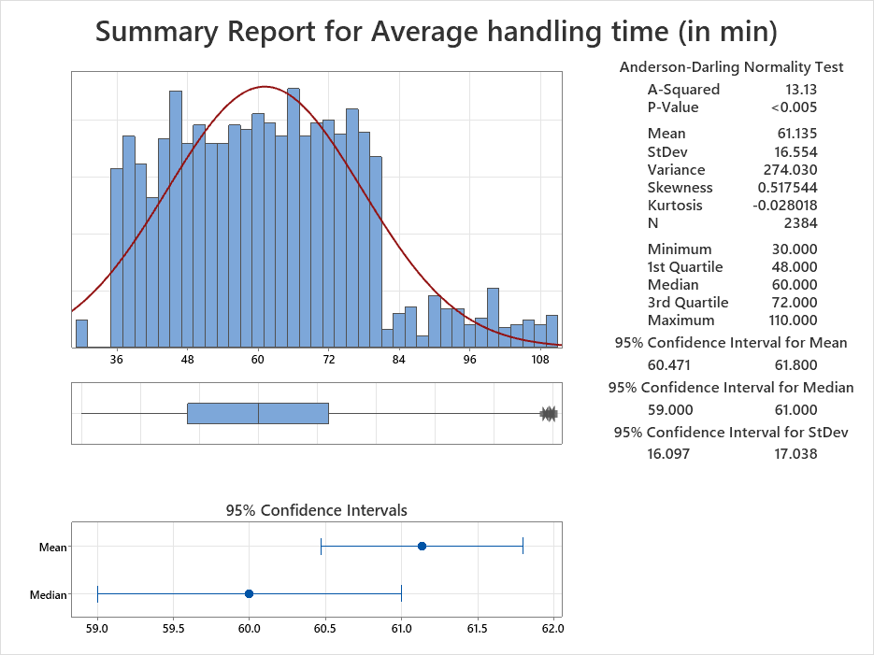
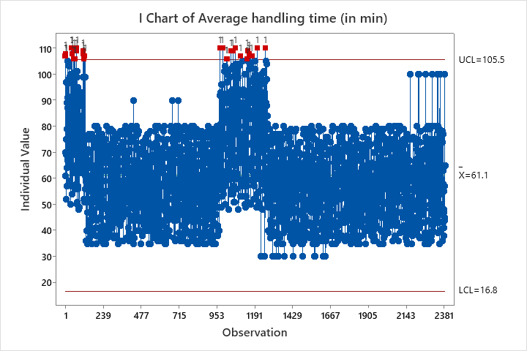
Understanding process variation… Measurement

Slide 11
Key learnings
Average Handling Time: 62.39 minutes
Standard Deviation: 17.15 minutes
Stability: Several out-of-control points
Actions:
Investigate out-of-control points
Reduce variability, improve stability

Slide 12
Analyze Phase

Slide 13
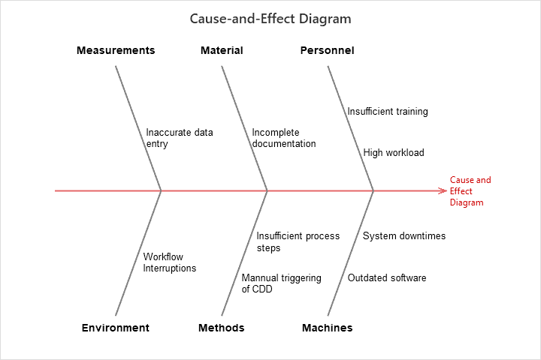
Fishbone Diagram

Slide 14
FMEA
Failure Mode | Effect of Failure | Severity | Cause of Failure | Occurrence | Current Controls | Detection | Risk Priority Number (RPN) | Recommended Action
Software Malfunction | System Downtime | 8 | Inadequate Testing | 6 | QA Testing | 4 | 192 | Implement automated testing
Hardware Failure | System Crash | 9 | Outdated Hardware | 5 | Regular Maintenance | 5 | 225 | Upgrade hardware
User Error | Incorrect Data Entry | 7 | Insufficient Training | 7 | User Training | 3 | 147 | Improve training programs
Network Issue | Communication Breakdown | 6 | Network Congestion | 4 | Network Monitoring | 6 | 144 | Increase bandwidth
Security Breach | Data Loss | 10 | Weak Security Protocols | 3 | Security Audits | 3 | 90 | Strengthen security measures

Slide 15
Prioritization of X’s: Control / Impact Matrix Y=f (X1, X2, …, Xn)
IMPACT
High | Medium | Low
In Our Control
- Insufficient Training | - Incomplete documentation | - Inaccurate data entry
- High workload | - Insufficient process steps | - Workflow Interruptions
- Manual triggering of CDD
- Outdated software
Out of Our Control
- System downtimes
C
O
N
T
R
O
L
Classify your X’s coming from your C/E Diagram (Fishbone Diagram).

Slide 16
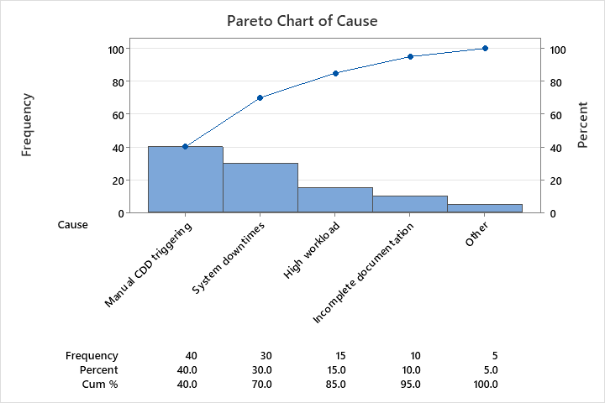
Pareto Chart: 80/20 rule

Slide 17
Root Cause Analysis
1. Manual CDD Triggering
Root Cause: Lack of automation
2. System Downtimes
Root Cause: Unreliable IT infrastructure
3. High Workload
Root Cause: Inefficient resource allocation
4. Incomplete Documentation
Root Cause: Lack of SOPs and checklists
5. Inaccurate Data Entry
Root Cause: Insufficient training and data validation

Slide 18
8 Wastes identified in our process
1. Transportation:
Movement of materials/products not adding value.
2. Inventory:
Excess products and materials not being processed.
3. Motion:
Unnecessary movements by people.
4. Waiting:
Idle time waiting for the next step in a process.
5. Overproduction:
Producing more than is needed.
6. Overprocessing:
More work or higher quality than required by the customer.
7. Defects:
Effort involved in inspecting for and fixing defects.
8. Skills:
Underutilizing people's talents, skills, and knowledge.

Slide 19
IMPROVE PHASE

Slide 20
Describe Solution(s) Selected
Root Cause | Solution
Manual CDD Triggering | Implement an automated CDD system.
System Downtimes | Upgrade IT infrastructure and introduce redundant systems.
High Workload | Reallocate resources and introduce workload balancing.
Incomplete Documentation | Develop and implement SOPs and checklists.
Inaccurate Data Entry | Provide comprehensive training and implement data validation tools.

Slide 21
To achieve the goal, Implementation Plan
Solution | Responsible Person | Target Date
Implement an automated CDD system. | IT Manager | 08/08/2024
Upgrade IT infrastructure and introduce redundant systems. | IT Manager | 15/08/2024
Reallocate resources and introduce workload balancing. | Operations Manager | 22/08/2024
Develop and implement SOPs and checklists. | Quality Assurance Lead | 29/08/2024
Provide comprehensive training and implement data validation tools. | Training Coordinator | 05/09/2024

Slide 22
Potential Cost Savings
Area | Description | Estimated Savings
Automation Implementation | Reducing manual intervention in CDD triggering, leading to lower labor costs. | Reduction in labour costs
Infrastructure Upgrade | Minimizing system downtimes, leading to fewer interruptions and increased productivity. | Reduced downtime costs
Resource Allocation | Efficient resource management, reducing overtime and improving employee productivity. | Savings in overtime costs
SOPs and Checklists | Streamlining documentation processes, reducing errors and rework. | Reduced rework costs
Training and Validation | Enhancing data accuracy and reducing errors, leading to fewer corrective actions. | Savings from fewer errors

Slide 23
CONTROL PHASE

Slide 24
To sustain the improvement, Control Plan
Control Measure | Frequency | Responsible Person | Monitoring Method
Automated CDD System Performance Review | Monthly | IT Manager | System performance reports
IT Infrastructure Health Check | Weekly | IT Manager | Downtime logs and system checks
Resource Allocation and Workload Assessment | Quarterly | Operations Manager | Workload balance reports
SOPs and Checklist Compliance Audit | Monthly | Quality Assurance Lead | Internal audits and spot checks
Data Entry Accuracy Review | Bi-weekly | Training Coordinator | Data validation and accuracy checks

Slide 25
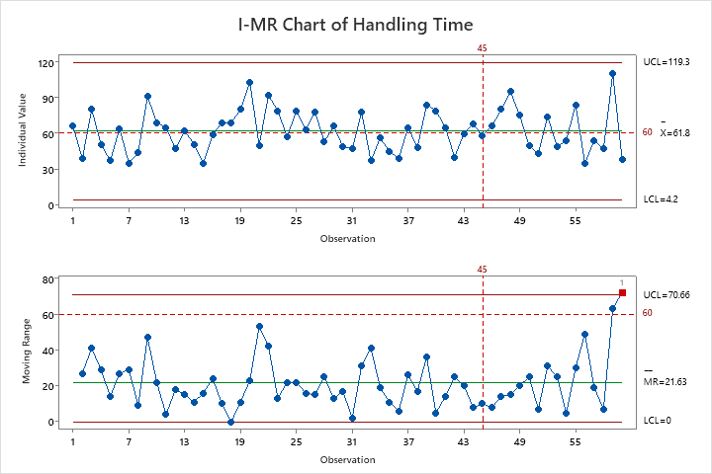
Process Monitoring

Slide 26
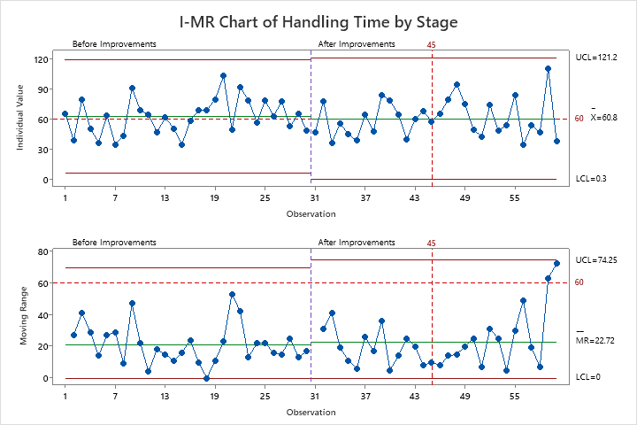
Before and After Improvement Comparison

Slide 27
Inference:
Before Improvement: The process had a higher mean handling time with more variation and
frequent out-of-control points, indicating an unstable process.
After Improvement: The mean handling time reduced significantly and the process variation
decreased, reflecting a more stable and controlled process.

Slide 28
Lessons Learned
1. Process Improvement Insights:
Manual processes can be significantly improved with automation.
Regular maintenance and upgrades of IT infrastructure are crucial to avoid downtimes.
Efficient resource allocation and workload balancing can enhance productivity and reduce stress on employees.
SOPs and checklists are essential for ensuring process consistency and completeness.
Continuous training and data validation are vital for maintaining data accuracy and reducing errors.
2. Challenges Faced:
Initial resistance to change from staff.
Implementation of automation required significant upfront investment.
Coordination among different departments was necessary to ensure smooth process transitions.

Slide 29
3.Key Takeaways
Importance of involving all stakeholders in process improvement initiatives.
Need for continuous monitoring and adjustment to sustain improvements.
Value of clear communication and training in ensuring successful implementation of new processes.

Slide 30
Thank you

