Slide 1



&
Github Desktop & Github – Kickstart Guide
By
Vaishali, Rohan,Aditya, Abhishek & Cheliyan

Slide 2
Topics :
Version Control – What & Why ?
Distributed Version Control – Why?
Version Control Tools
Github & Git (Github Desktop)

Slide 3
Version Control System - VCS
Management system
Manages/Track the changes that the developers make in a project
Collaborate with other developers
Helps to analyze the project (Opportunity Areas / Timelines)
Avoid Conflicts
Save Storage Space

Slide 4
Distributed Version Control
Central repositories Vs Local repositories
Central Repository
Local Repository
Located on remote server
Consists of “.git” repository folder
For team to share and exchange data
Located on local machine
Resides as a “.git” folder inside project root
Only admin of the machine can work with this repository

Slide 5
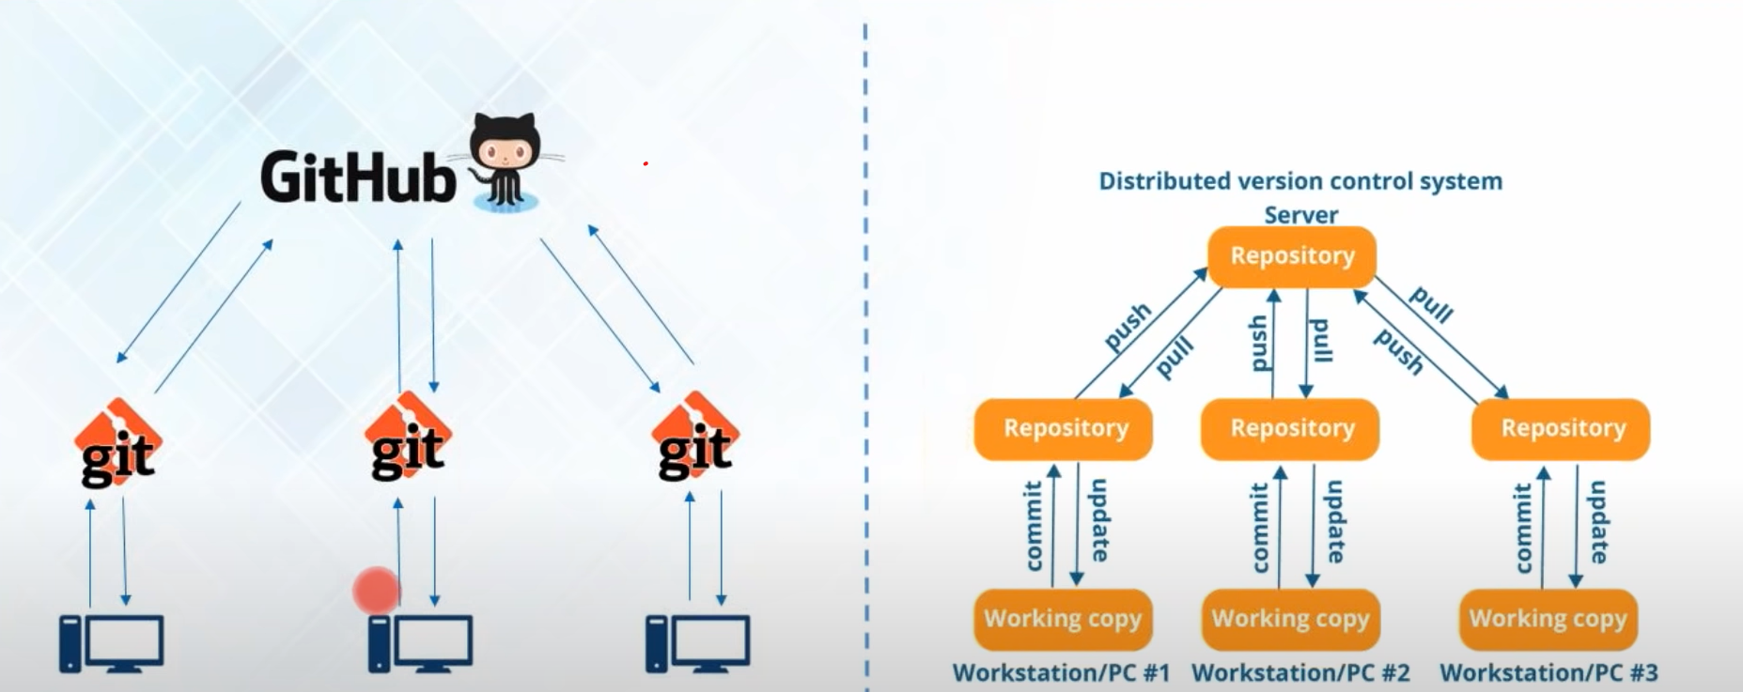
Version Control Tools

Slide 6
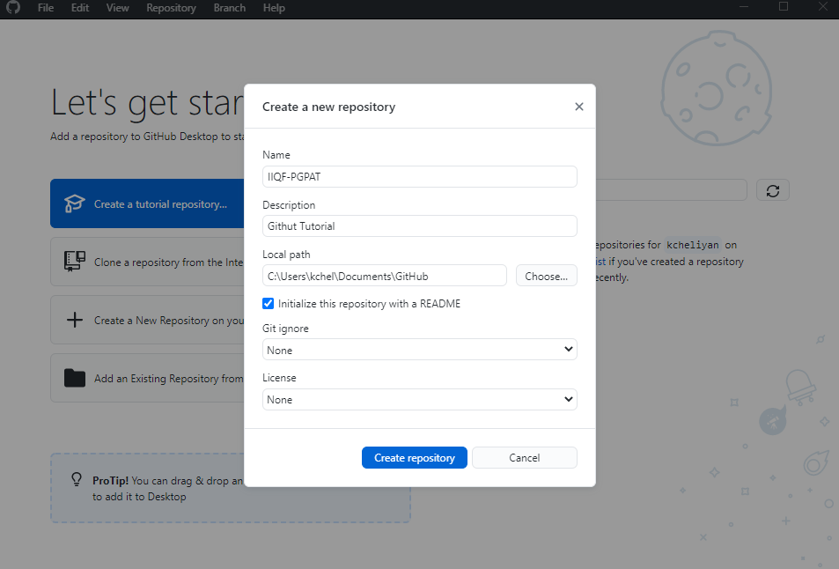
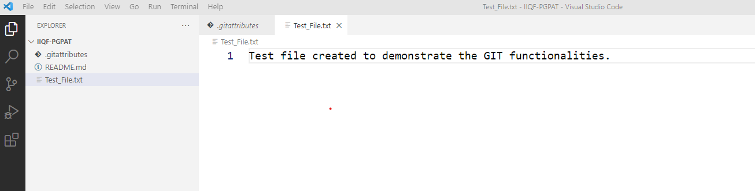
Github Desktop
Step-1 (Create repo)
Step-2 (Create new file)

Slide 7
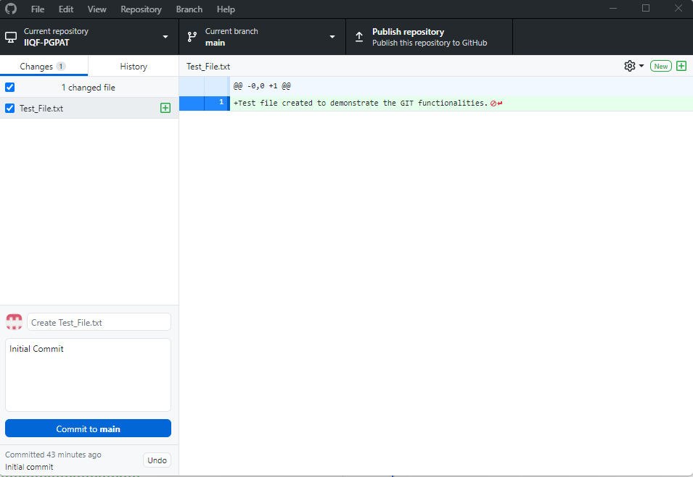
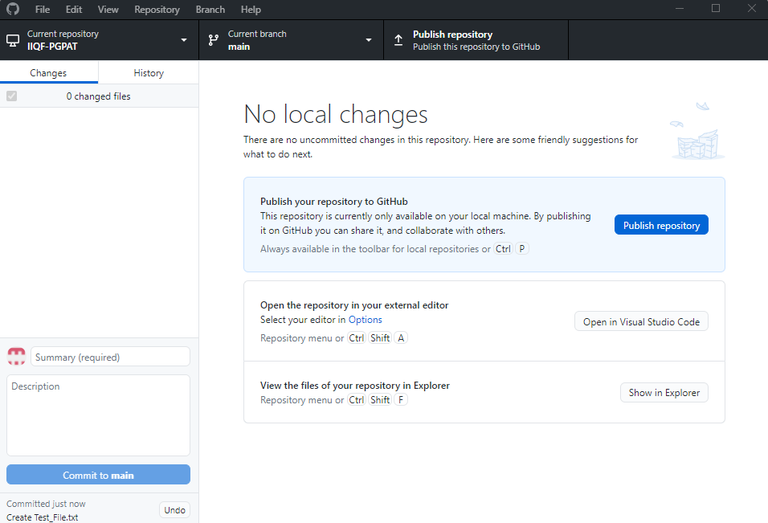
Contd…
Step-3 (Commit changes to the main branch)
Step-4 (Publish the code with other team members)

Slide 8
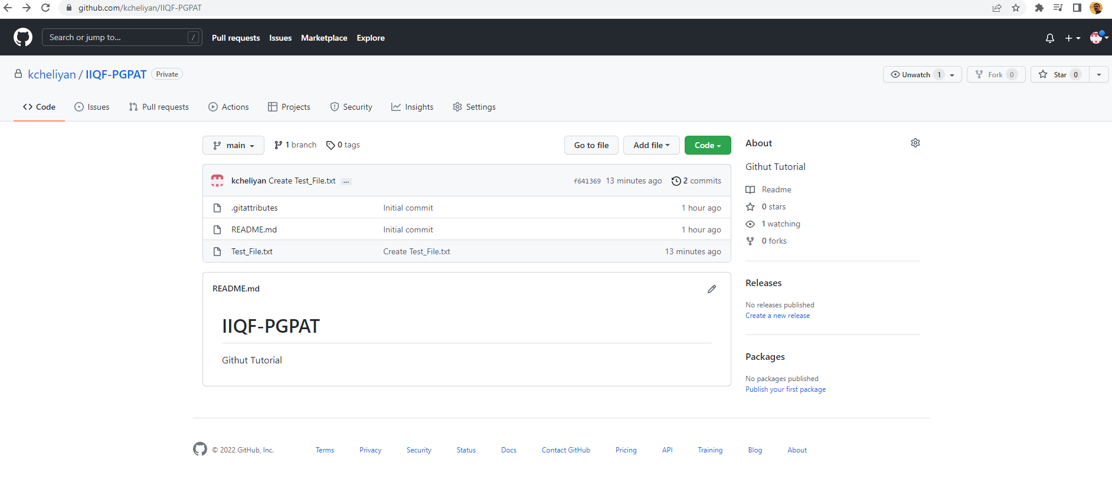
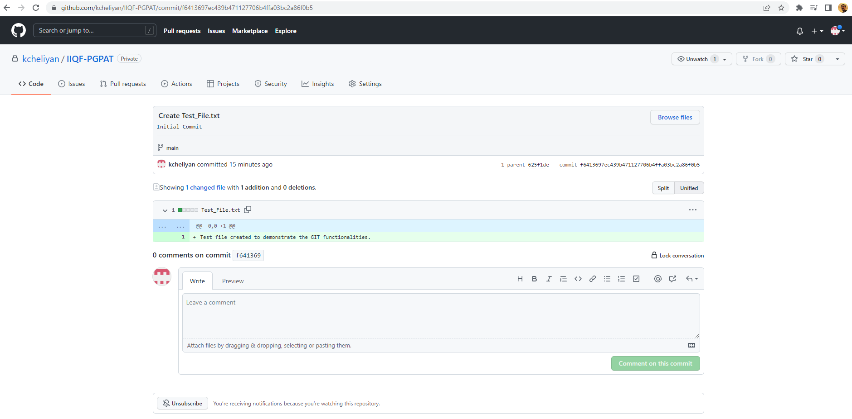
Contd..
Track Changes from Github

Slide 9
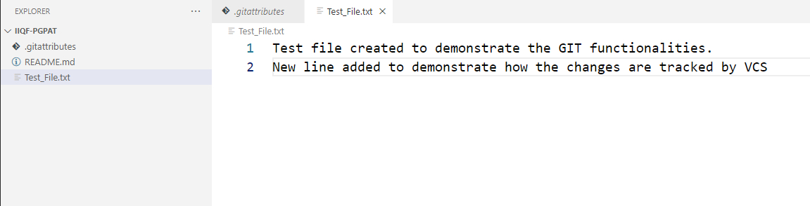
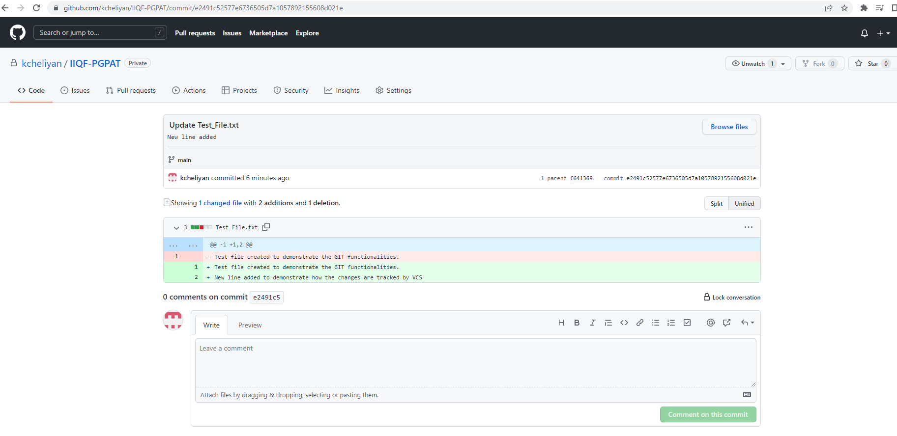
Contd..
File edited with a new line :
Changes reflected in Github :

Slide 10
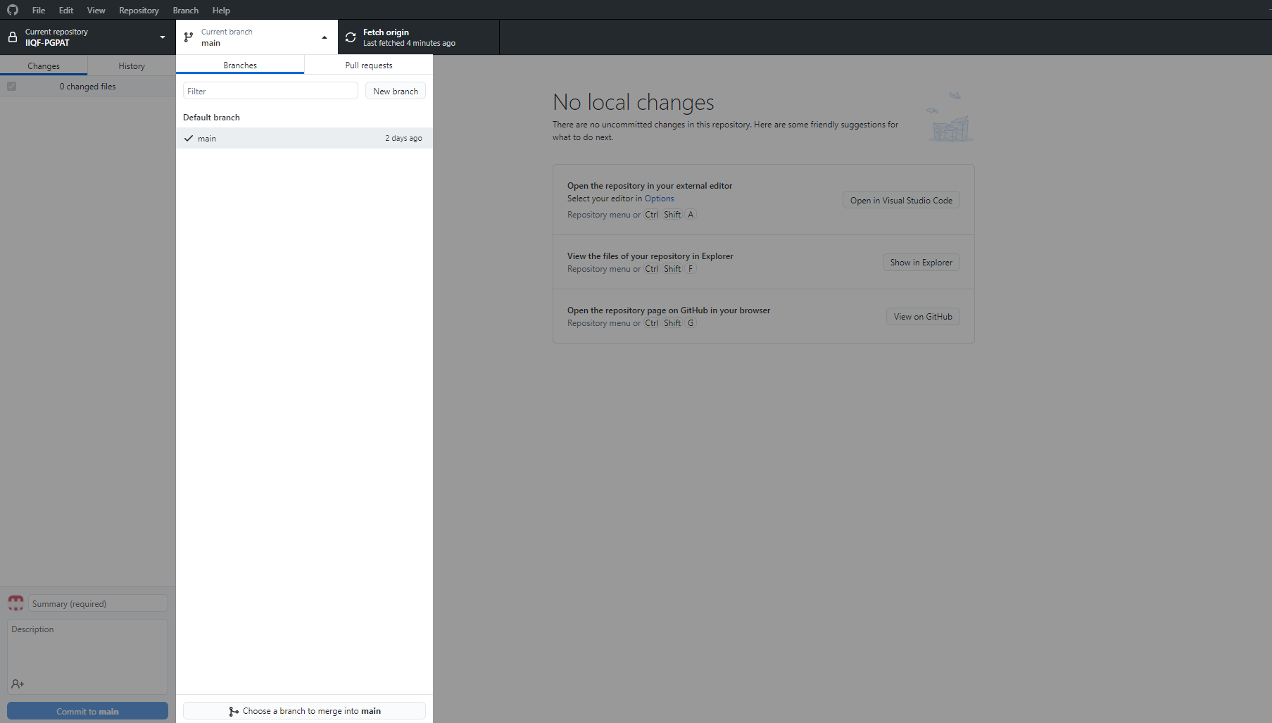
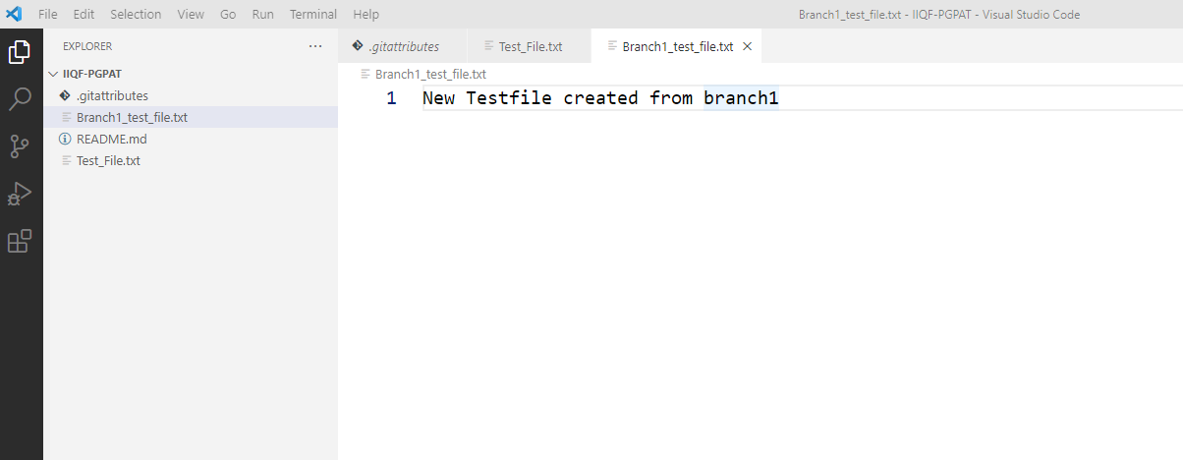
Working with Branches
Step1 : Create New Branch
Step2 : Create a new file

Slide 11
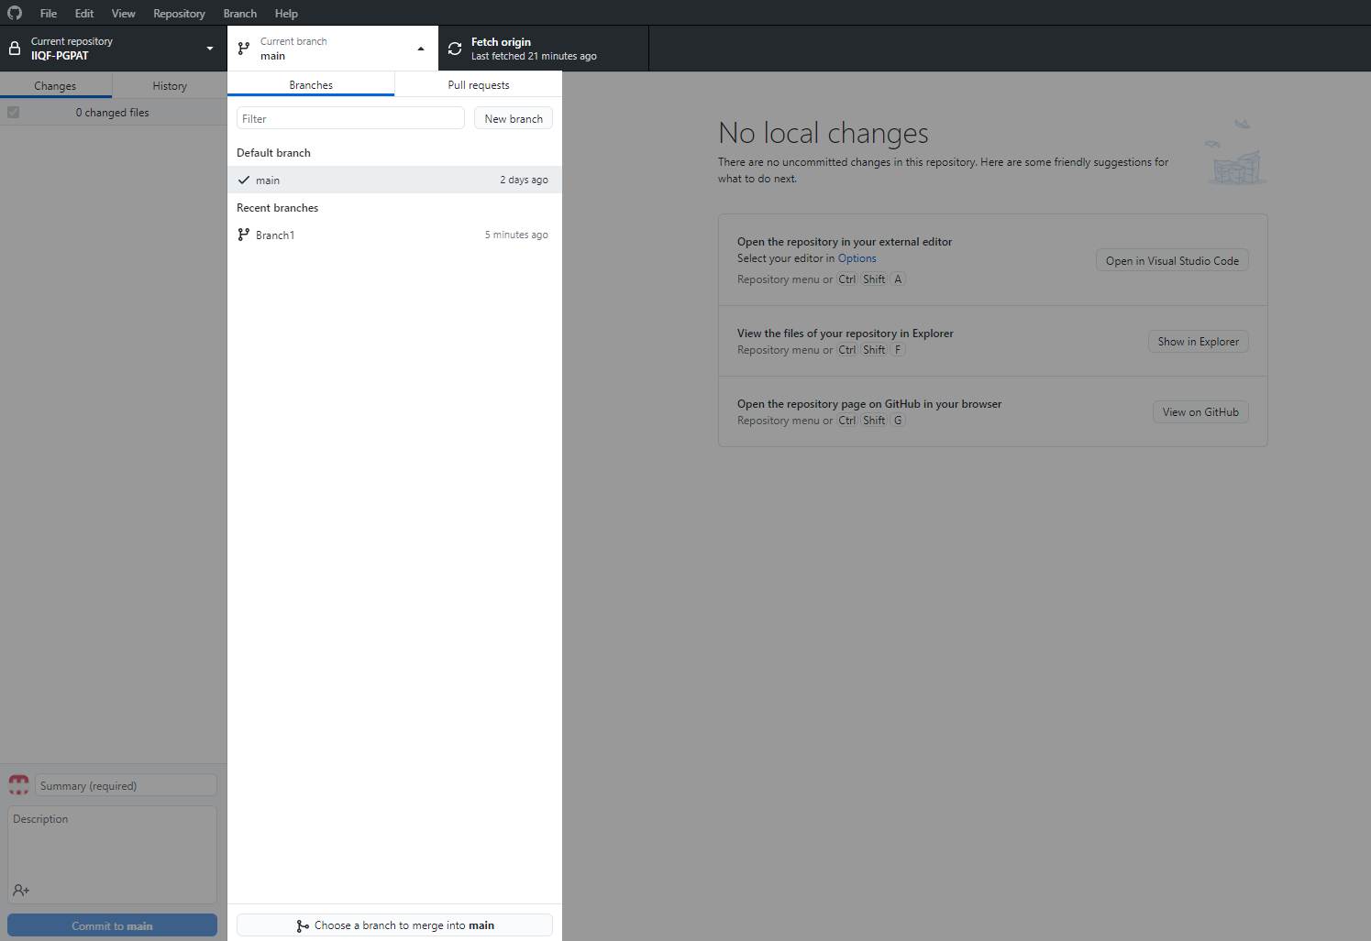
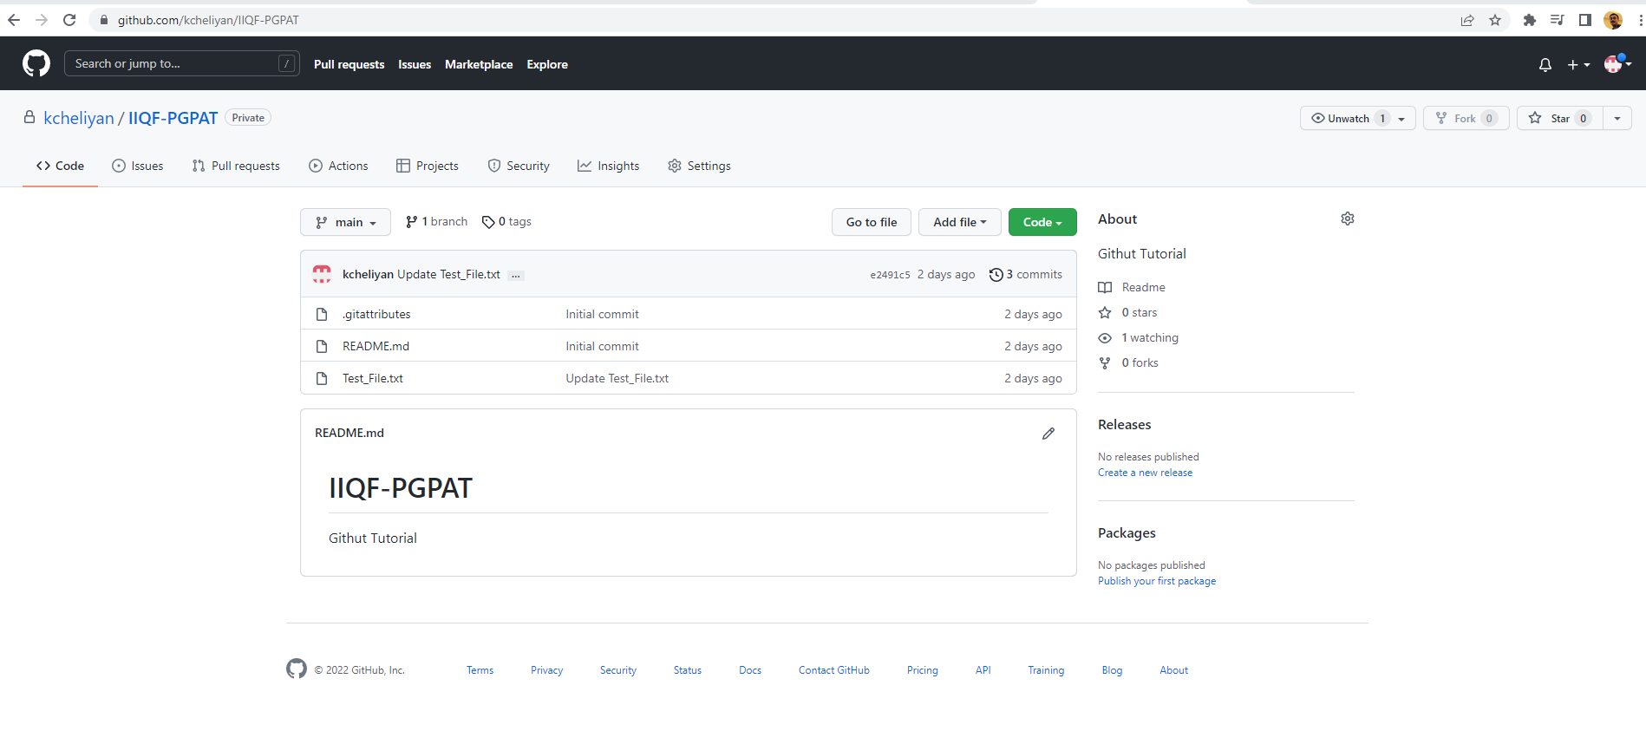
Working with Branches
Step3 : Switch back to default branch
Step4 : New file no longer listed in default branch

Slide 12
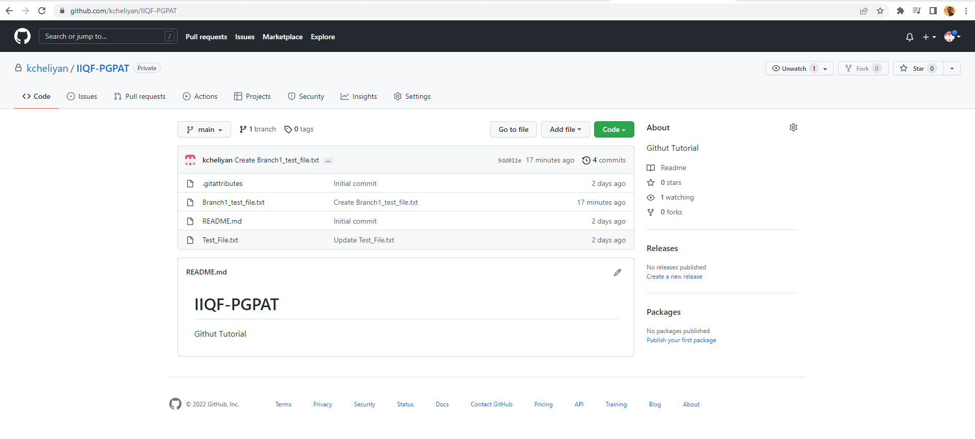
Working with Branches
Step5 : Merge the branch and publish to see the newly added file

Slide 13

Questions?
This Photo by Unknown Author is licensed under CC BY-SA-NC

