Slide 1


IBM DB2
IBM DB2 Installation on Linux Operating System
Manjunath Badiger
Consultant GD E&D

Slide 2

Installation Steps
Introduction
Software License Agreement
Installation Type
Installation Action
Installation Directory
Instance Setup
Partitioning Options
Instance – owning user
Fenced User
Contact
Summary
3

Slide 3
Introduction
To start the DB2 Setup wizard:
If we have downloaded the DB2 database product image, we must extract and untar the product file.
Extract the product file: gzip -d product.tar.gz where product is the name of the product that you downloaded.
Untar the product file: On Linux operating systems tar -xvf product.tar where product is the name of the product that you downloaded.
Change directory: cd ./product where product is the name of the product that you downloaded.
Enter the ./db2setup command from the directory where the database product image resides to start the DB2 Setup wizard.
The IBM DB2 Setup Launchpad opens. From this window, we can view installation prerequisites and the release notes, or we can proceed directly to the installation. We can also review the installation prerequisites and release notes for late-breaking information.
Click Install a Product and the Install a Product window will display the products available for installation.
Launch the installation by clicking Install New. Proceed through the installation following the DB2 Setup wizard's prompts.
3

Slide 4
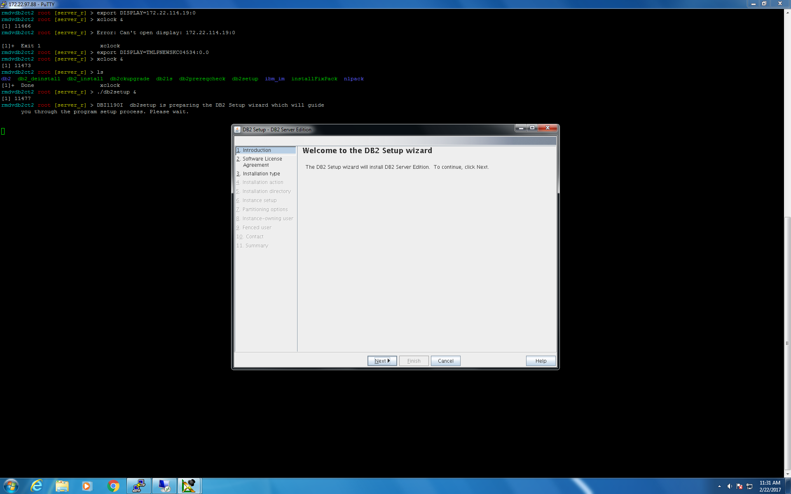
Click “Next” ….
3

Slide 5
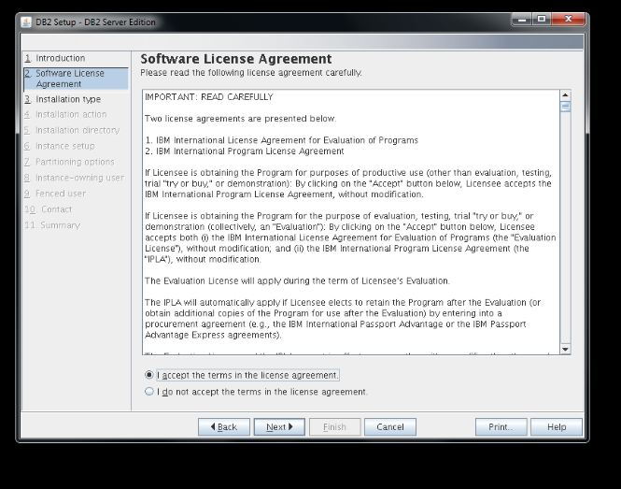
Software License Agreement
Accept the software license agreement and continue with the installation
3

Slide 6
Installation Type
Select the installation type of DB2 to install there are three types of installation :-
1) Typical
2) Custom
3) Compact
In this section we have selected the Typical Installation as a standard installation which includes all the standard features.
3

Slide 7
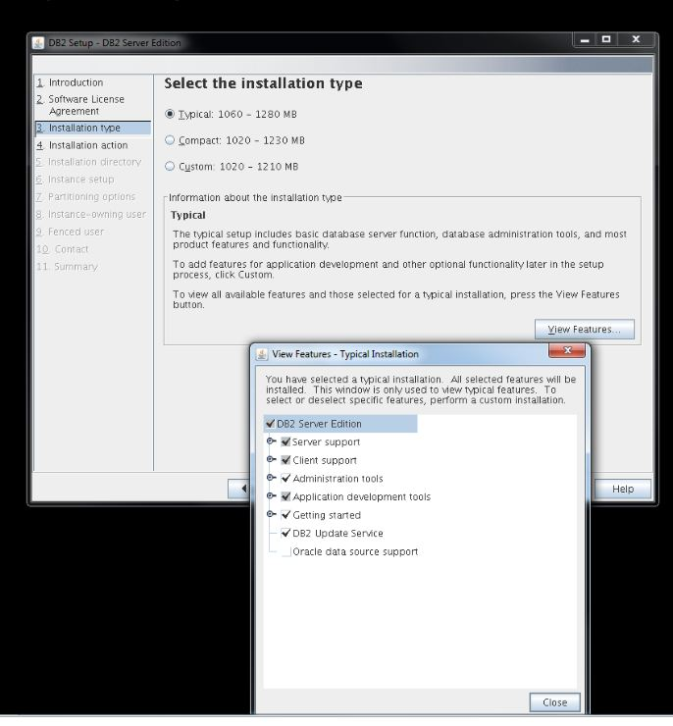
Select Typical and Click “Next”
3

Slide 8
Installation Action
This step performs installation action.
Select “Install DB2 Server Edition…”
DB2 response file we will be created.
For root installation the path for response file creation is /root/db2server.rsp
3

Slide 9
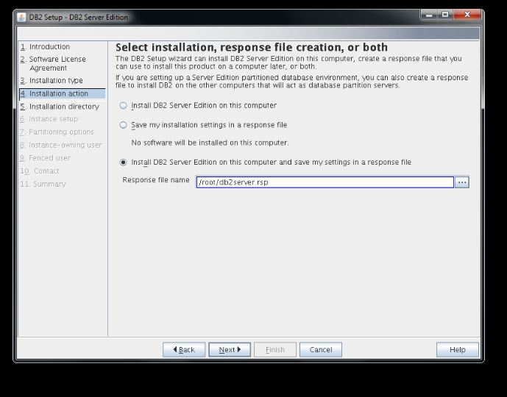
Click “Next”…
3

Slide 10
Installation Directory
In this step the setup program asks for selection of installation directory.
We can change the directory, if we want to install in a particular directory or keep the default directory.
3

Slide 11
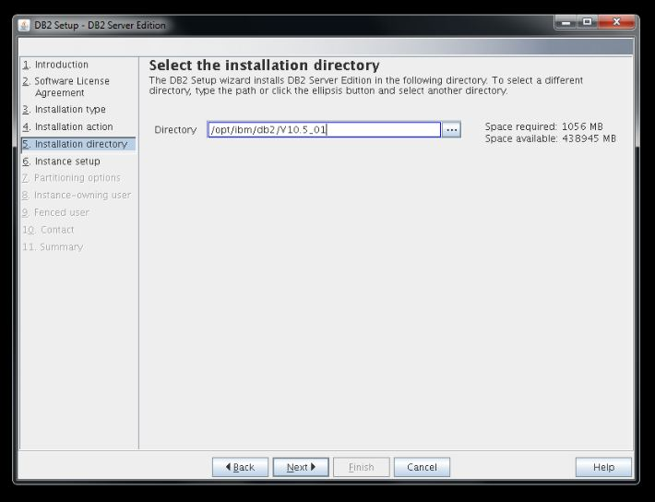
Click “Next” …..
3

Slide 12
Instance Setup
In this step, the setup asks for creation of DB2 Server Instance.
So select the option to create a instance and continue with the installation.
3

Slide 13
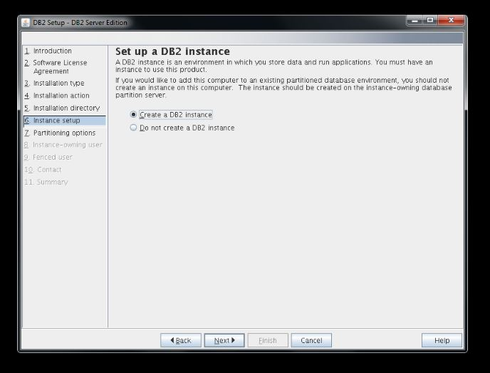
Click “Next” …..
3

Slide 14
Partitioning Options
In this step, setup asks for creating single partition instance or multiple partition instance.
Based on the requirement we can select the single or multiple instance partition.
In this step we have selected Single Partition Instance to install.
3

Slide 15
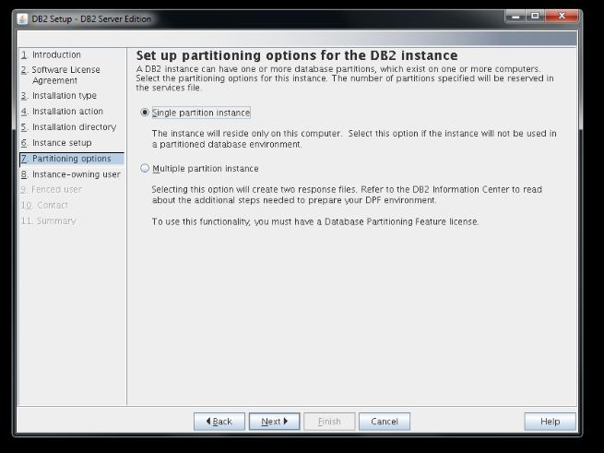
Click “Next” …..
3

Slide 16
Instance – owning user
DB2 has two user groups :-
1) Administrator/Owner
2) Non-administrator/ Fenced User
For Owner group provide the user information with username and password.
And also for the Fenced User.
3

Slide 17
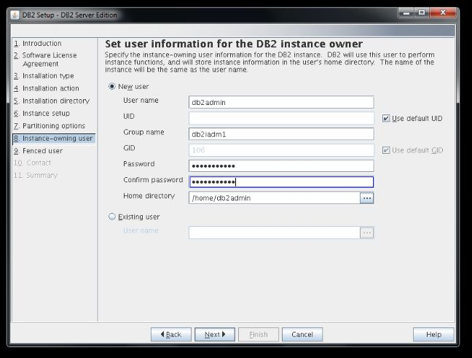
Click “Next” …..
3

Slide 18
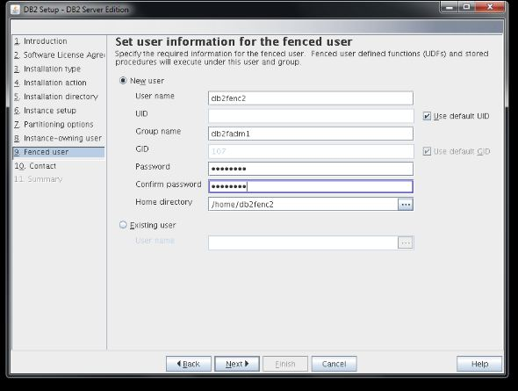
Click “Next” …..
3

Slide 19
Contact Information
In this section, setup asks for user to provide the contact information to monitor the health performance of db2.
3

Slide 20
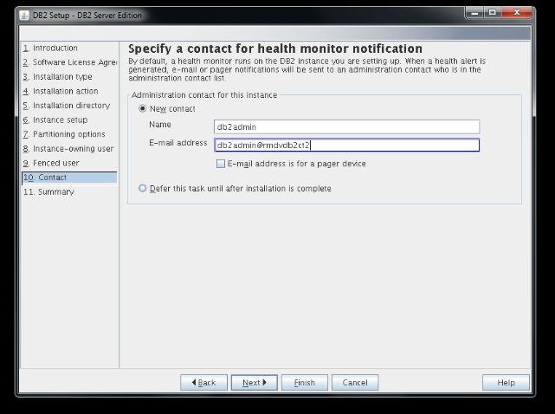
Click “Next” …..
3

Slide 21
Summary
This is the last step of DB2 installation, which provides the summary of what all options we have selected to install in our system.
3

Slide 22
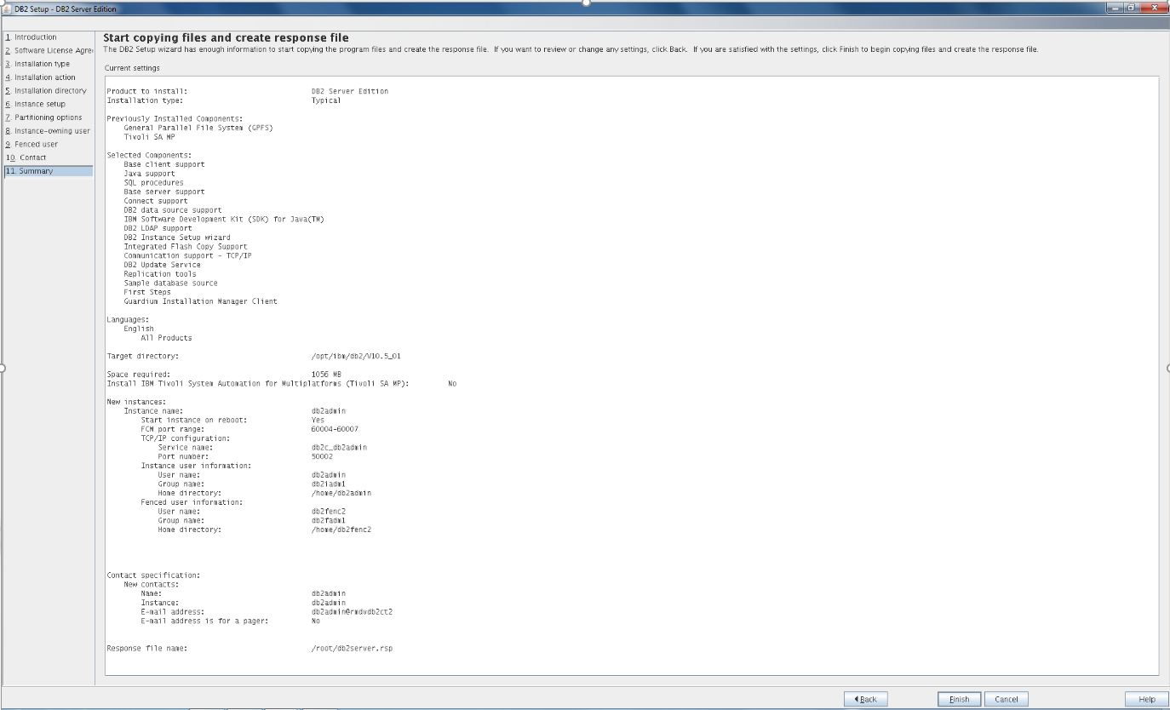
Click “Finish” …..
3

Slide 23
Post Installation Steps
After successful completion of the DB2 installation the following screen will appear on the screen to perform the post installation steps.
Alongside a log file is also created after the installation of DB2.
3

Slide 24
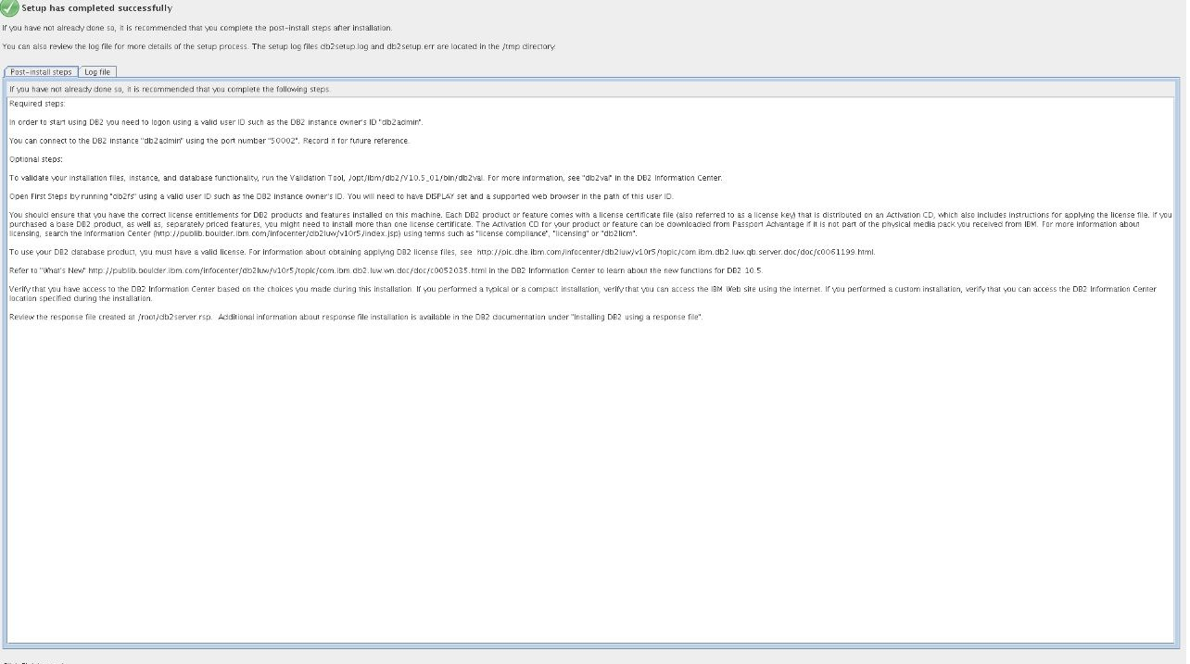
3

Slide 25
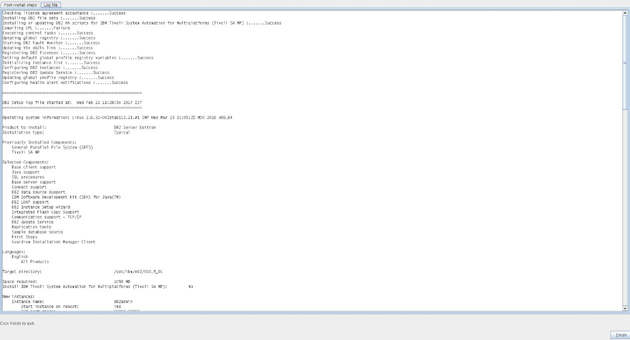
Click “Finish” to Exit the wizard …..
3

Slide 26
THANK YOU
3

