Slide 1

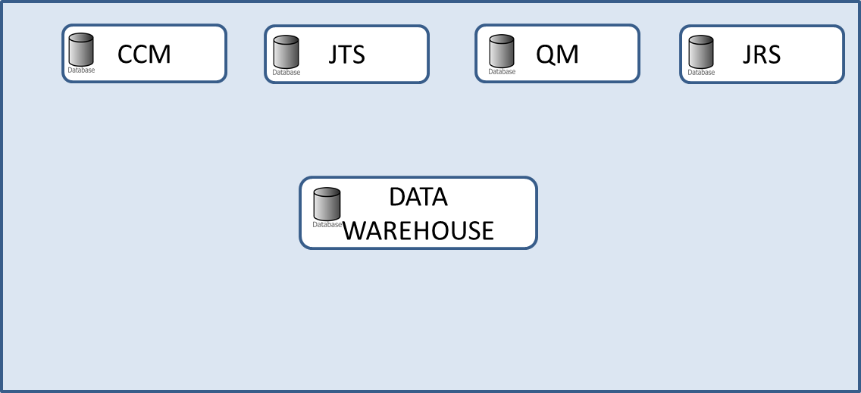
client
IHS Server
CCM
JRS
QM
JTS
APPLICATION SERVER
APPLICATION SERVER
APPLICATION SERVER
APPLICATION SERVER
DATABASE SERVER

