Slide 1
Introduction to SQL
February 23, 2012
Calvin Pan

Slide 2
“Any sufficiently advanced technology is indistinguishable from magic.”
- Arthur C. Clarke

Slide 3
What is SQL?
Language developed by IBM in 1970s for manipulating structured data and retrieving said data
Several competing implementations from IBM, Oracle, PostgreSQL, Microsoft (we use this one, specifically SQL Server 2008)
Queries: statements that retrieve data

Slide 4
How data in a relational database is organized
Tables have columns (fields) and rows (records)
Tables can be related (value in certain field from table A must exist in corresponding field from table B)
Views (stored queries which can be treated like tables)
Notes:
Relation example: association results depend on both snp_info and probe_info tables
Justification for views: data you need is in different (but related) tables; write the query once, then select from it

Slide 5
The only statement you need to know
SELECT
Used to retrieve data from tables
Can also be used to perform calculations on data from tables

Slide 6
Components of the SELECT statement
[ WITH <common_table_expression>]
SELECT select_list [ INTO new_table ]
[ FROM table_source ] [ WHERE search_condition ]
[ GROUP BY group_by_expression ]
[ HAVING search_condition ]
[ ORDER BY order_expression [ ASC | DESC ] ]
-- parts in square brackets [] are optional
the only required part
commonly used
Notes:
From http://msdn.microsoft.com/en-us/library/ms189499(v=sql.100).aspx

Slide 7
Simple SELECT example
ProbesetID | Snp_chr | Snp_bp | p
1415670_at | 1 | 3013441 | 0.80984
1415670_at | 1 | 3036178 | 0.0014957
raw_pvalues
-- comments are preceded by two hyphens
-- * means all columns are returned
SELECT * FROM raw_pvalues
WHERE p < 1
ProbesetID | Snp_chr | Snp_bp | p
1415670_at | 1 | 3013441 | 0.80984
1415670_at | 1 | 3036178 | 0.0014957
Notes:
1 search criterion

Slide 8
Another simple SELECT example
ProbesetID | Snp_chr | Snp_bp | p
1415670_at | 1 | 3013441 | 0.80984
1415670_at | 1 | 3036178 | 0.0014957
raw_pvalues
-- comments are preceded by two hyphens
-- * means all columns are returned
SELECT * FROM raw_pvalues
WHERE p < 1e-2 AND snp_bp > 3020000
ProbesetID | Snp_chr | Snp_bp | p
1415670_at | 1 | 3036178 | 0.0014957
Notes:
2 search criteria

Slide 9
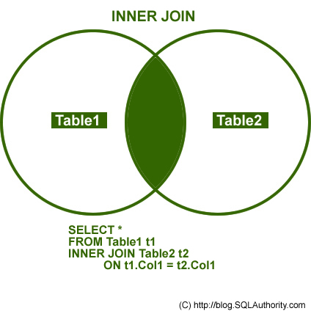
SQL Joins
Notes:
Association results example

Slide 10
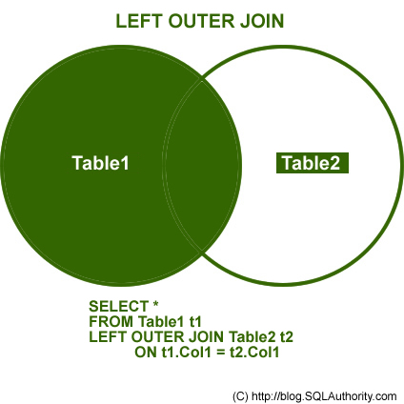
SQL Joins

Slide 11
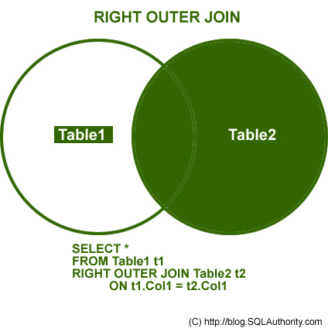
SQL Joins

Slide 12
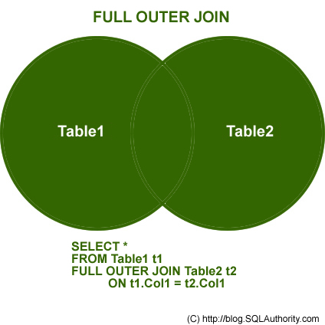
SQL Joins

Slide 13
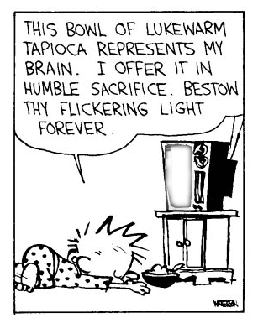

Slide 14
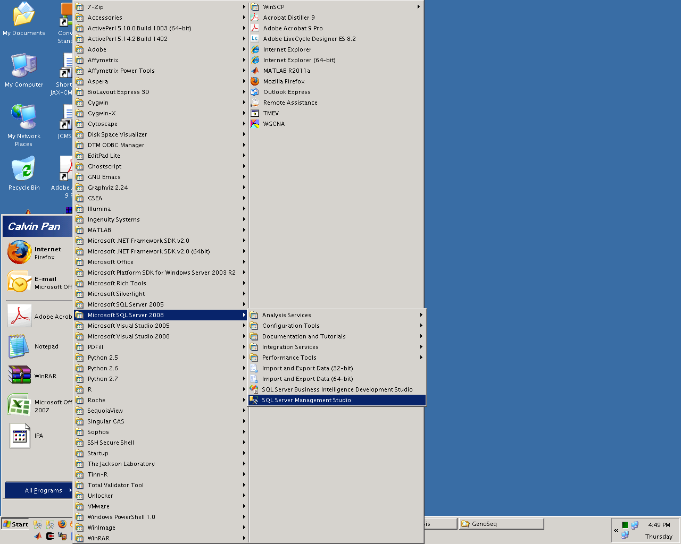
Notes:
Launch the 2008 version of SQL Server Management Studio

Slide 15
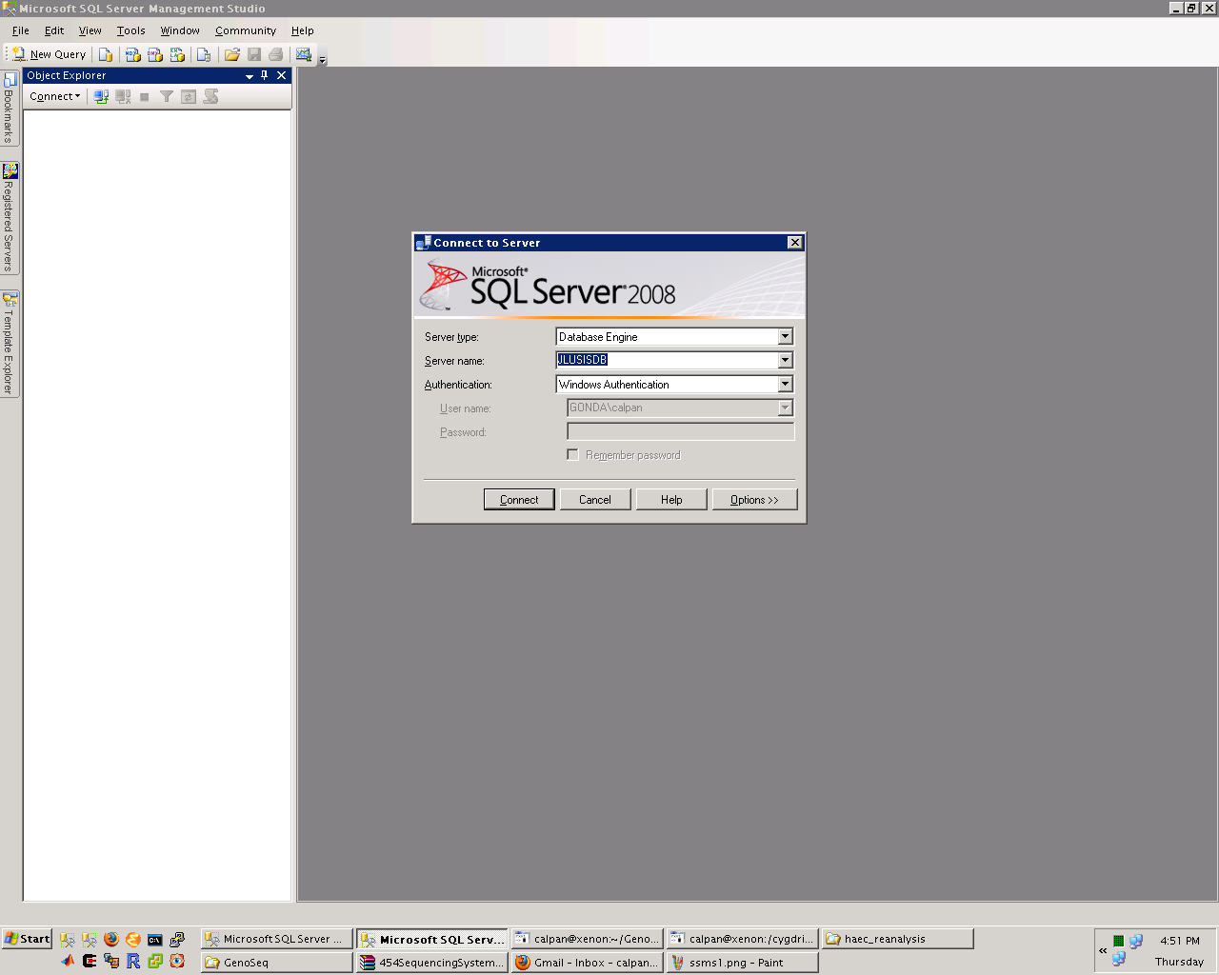
Notes:
Connect to JLUSISDB

Slide 16
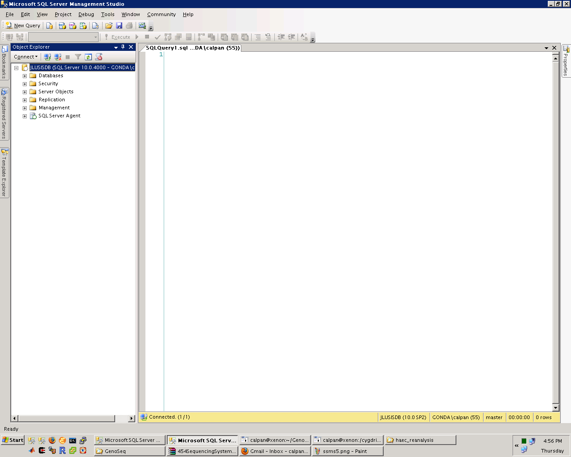
Notes:
Initial view

Slide 17
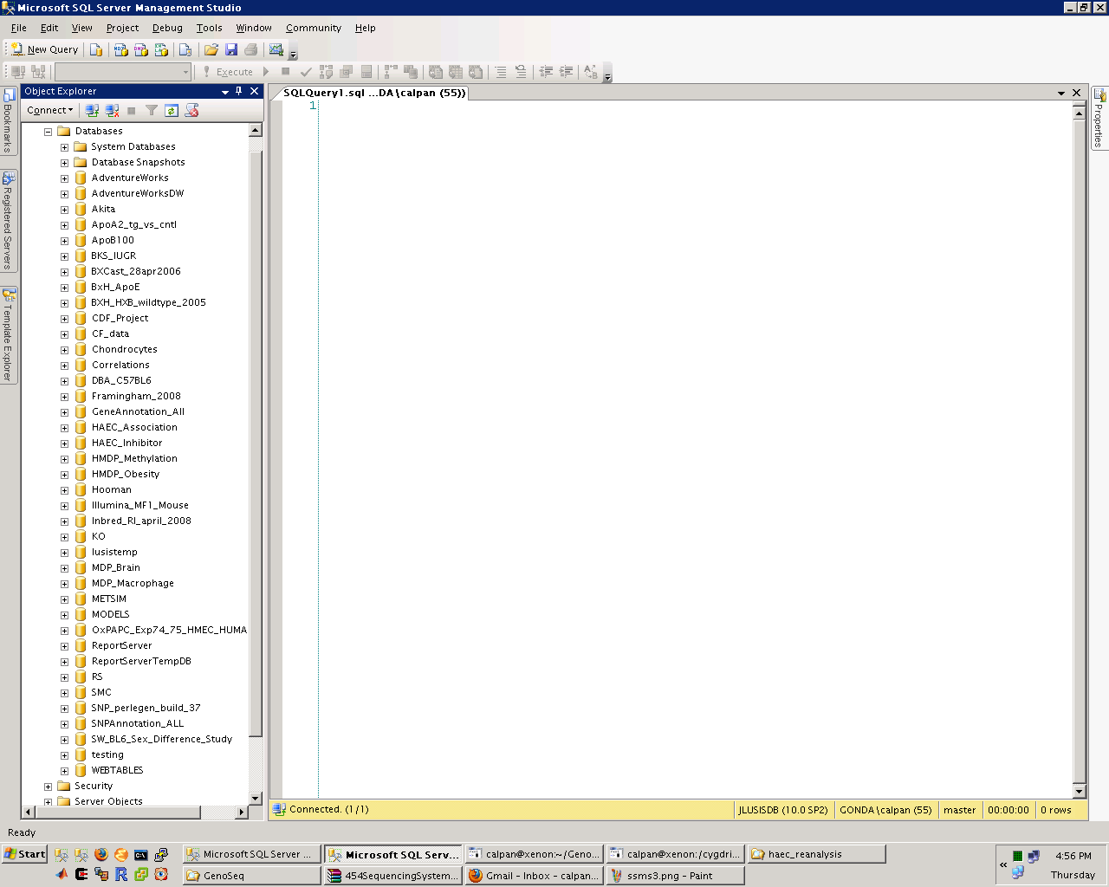
Notes:
Expand database list

Slide 18
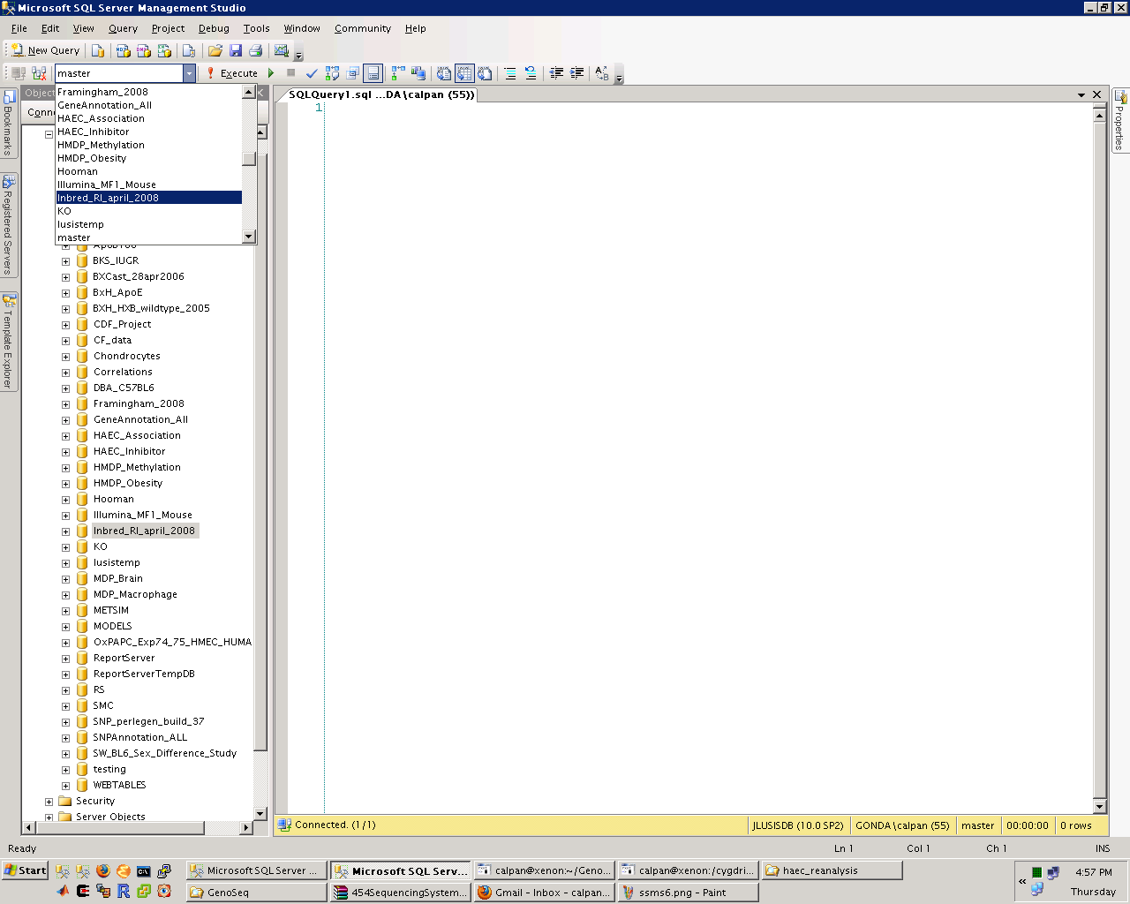
Notes:
Change current database to Inbred_RI_april_2008

Slide 19
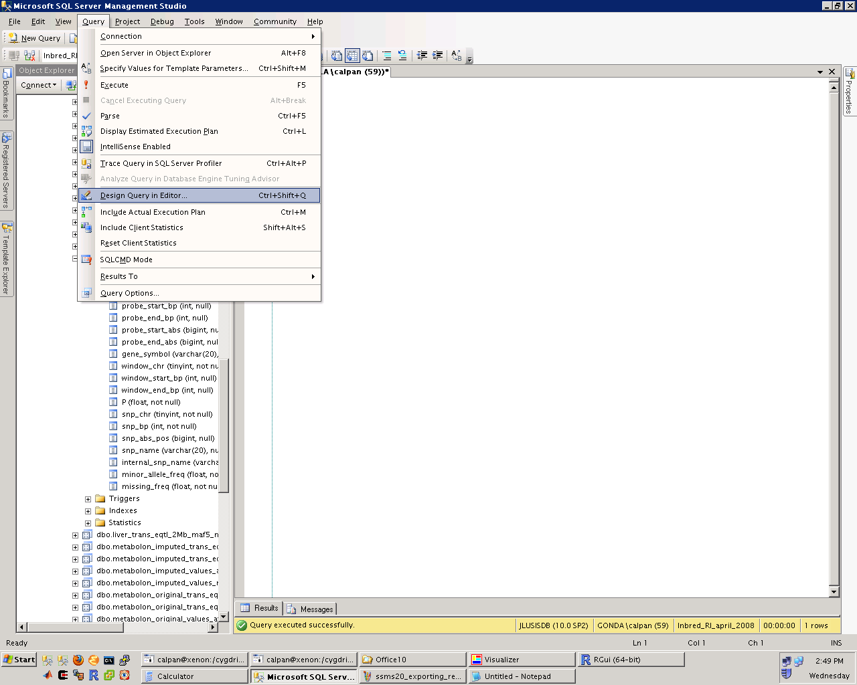

Slide 20
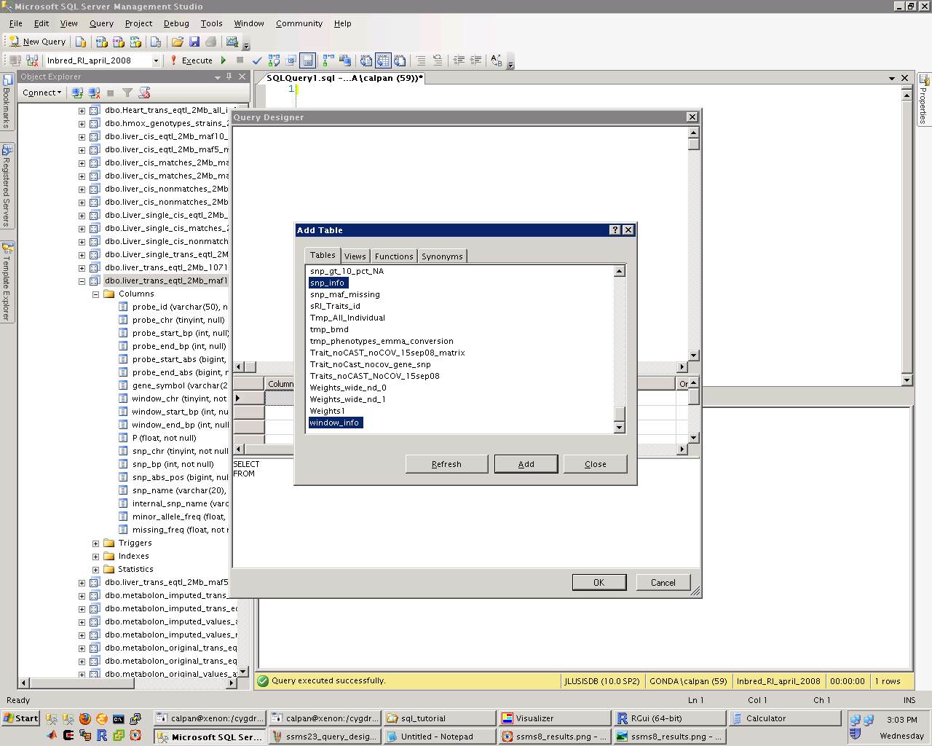
Notes:
Four tables are selected, but only two of the selections are visible.

Slide 21
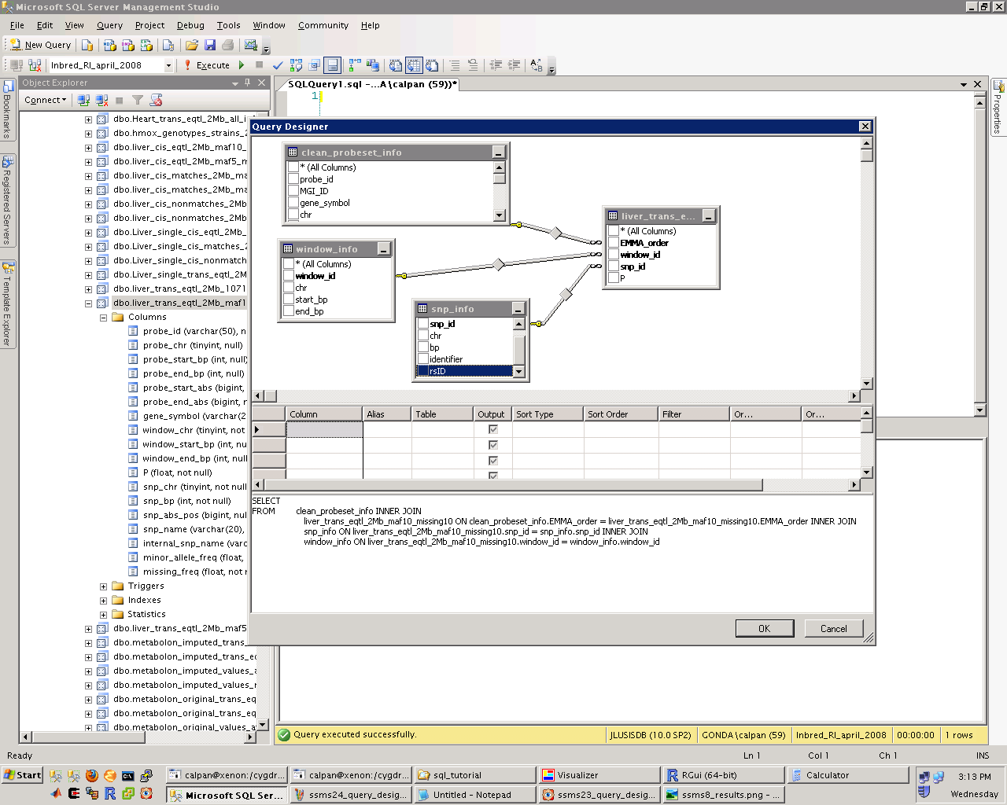

Slide 22
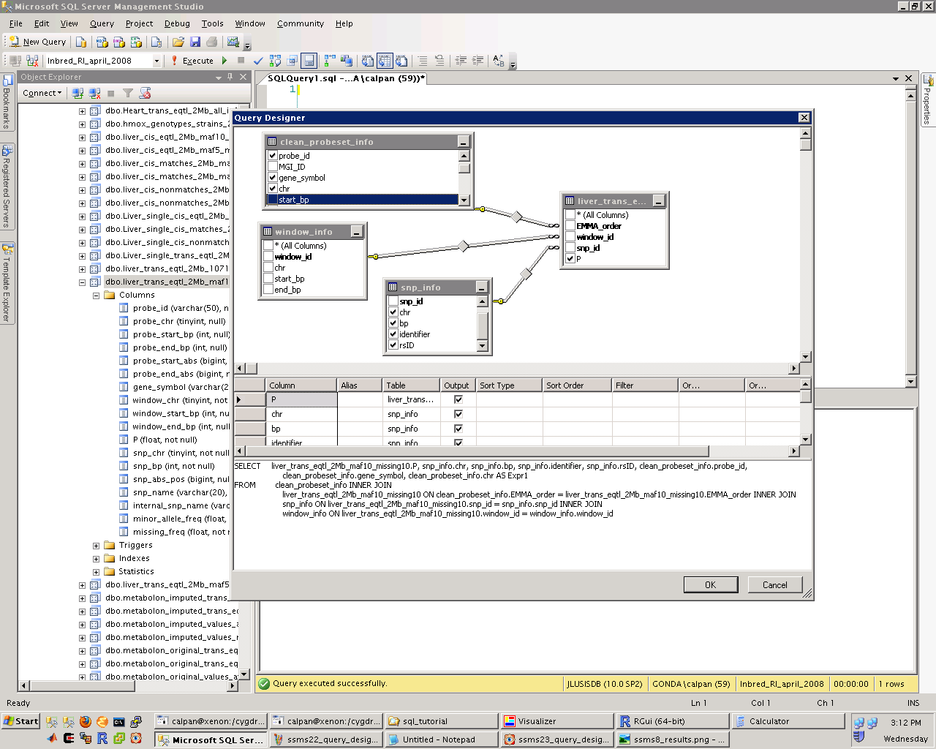

Slide 23
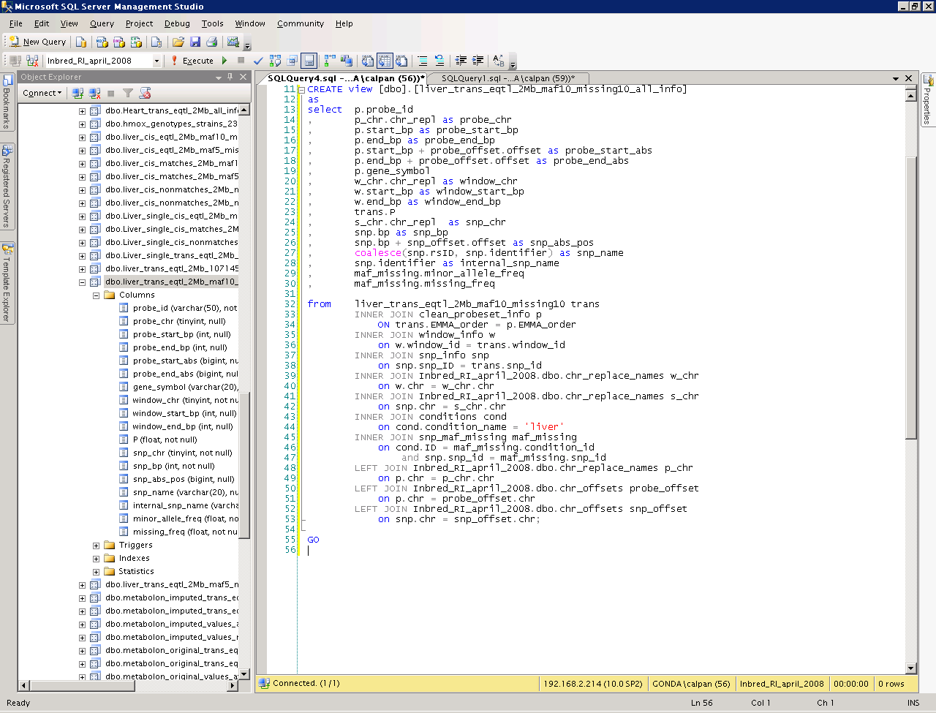
Notes:
select p.probe_id
, p_chr.chr_repl as probe_chr
, p.start_bp as probe_start_bp
, p.end_bp as probe_end_bp
, p.start_bp + probe_offset.offset as probe_start_abs
, p.end_bp + probe_offset.offset as probe_end_abs
, p.gene_symbol
, w_chr.chr_repl as window_chr
, w.start_bp as window_start_bp
, w.end_bp as window_end_bp
, trans.P
, s_chr.chr_repl as snp_chr
, snp.bp as snp_bp
, snp.bp + snp_offset.offset as snp_abs_pos
, coalesce(snp.rsID, snp.identifier) as snp_name
, snp.identifier as internal_snp_name
, maf_missing.minor_allele_freq
, maf_missing.missing_freq
from liver_trans_eqtl_2Mb_maf10_missing10 trans
INNER JOIN clean_probeset_info p
ON trans.EMMA_order = p.EMMA_order
INNER JOIN window_info w
on w.window_id = trans.window_id
INNER JOIN snp_info snp
on snp.snp_ID = trans.snp_id
INNER JOIN Inbred_RI_april_2008.dbo.chr_replace_names w_chr
on w.chr = w_chr.chr
INNER JOIN Inbred_RI_april_2008.dbo.chr_replace_names s_chr
on snp.chr = s_chr.chr
INNER JOIN conditions cond
on cond.condition_name = 'liver'
INNER JOIN snp_maf_missing maf_missing
on cond.ID = maf_missing.condition_id
and snp.snp_id = maf_missing.snp_id
LEFT JOIN Inbred_RI_april_2008.dbo.chr_replace_names p_chr
on p.chr = p_chr.chr
LEFT JOIN Inbred_RI_april_2008.dbo.chr_offsets probe_offset
on p.chr = probe_offset.chr
LEFT JOIN Inbred_RI_april_2008.dbo.chr_offsets snp_offset
on snp.chr = snp_offset.chr;

Slide 24
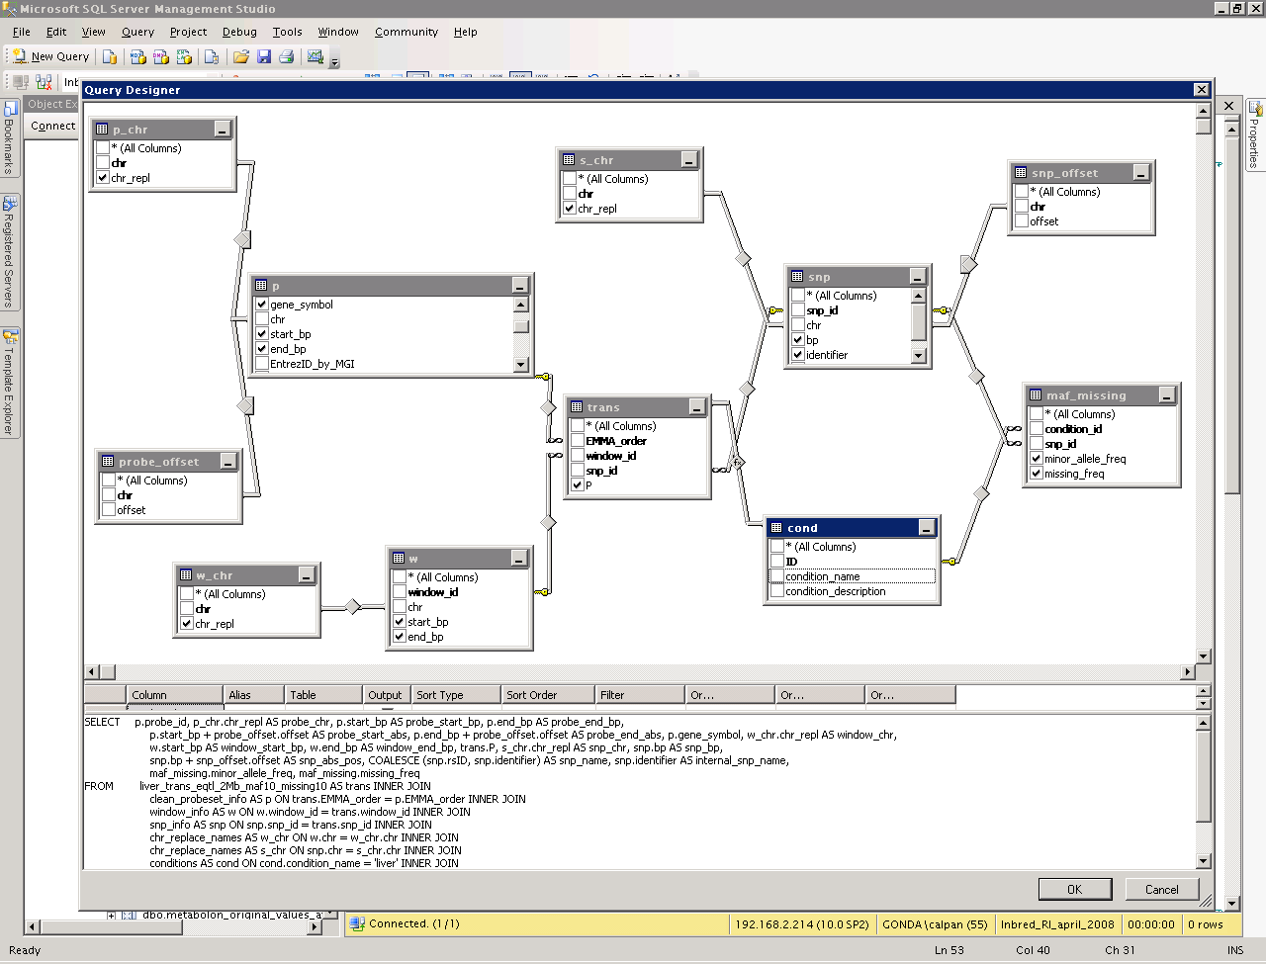
Notes:
What the view definition looks like in the Query Designer

Slide 25
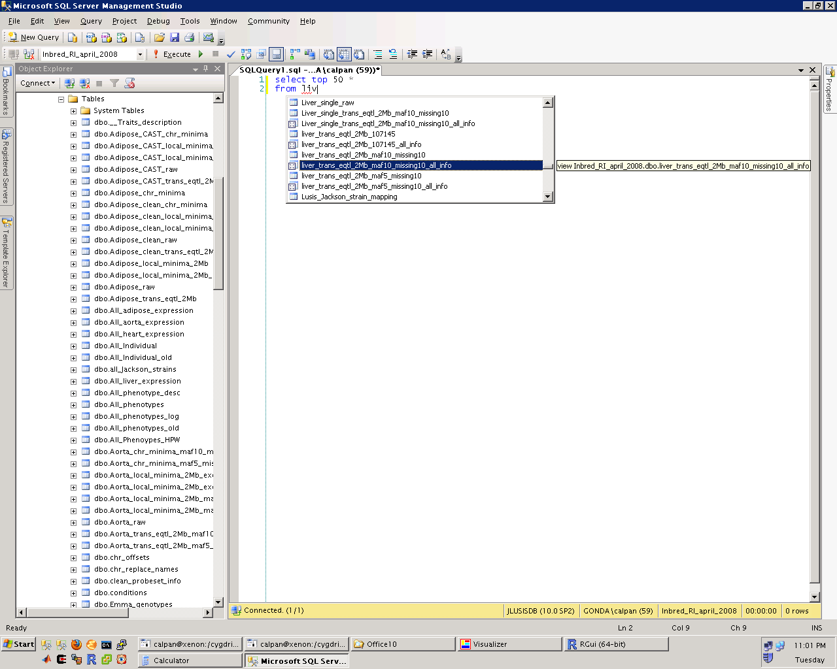
Notes:
IntelliSense in action

Slide 26
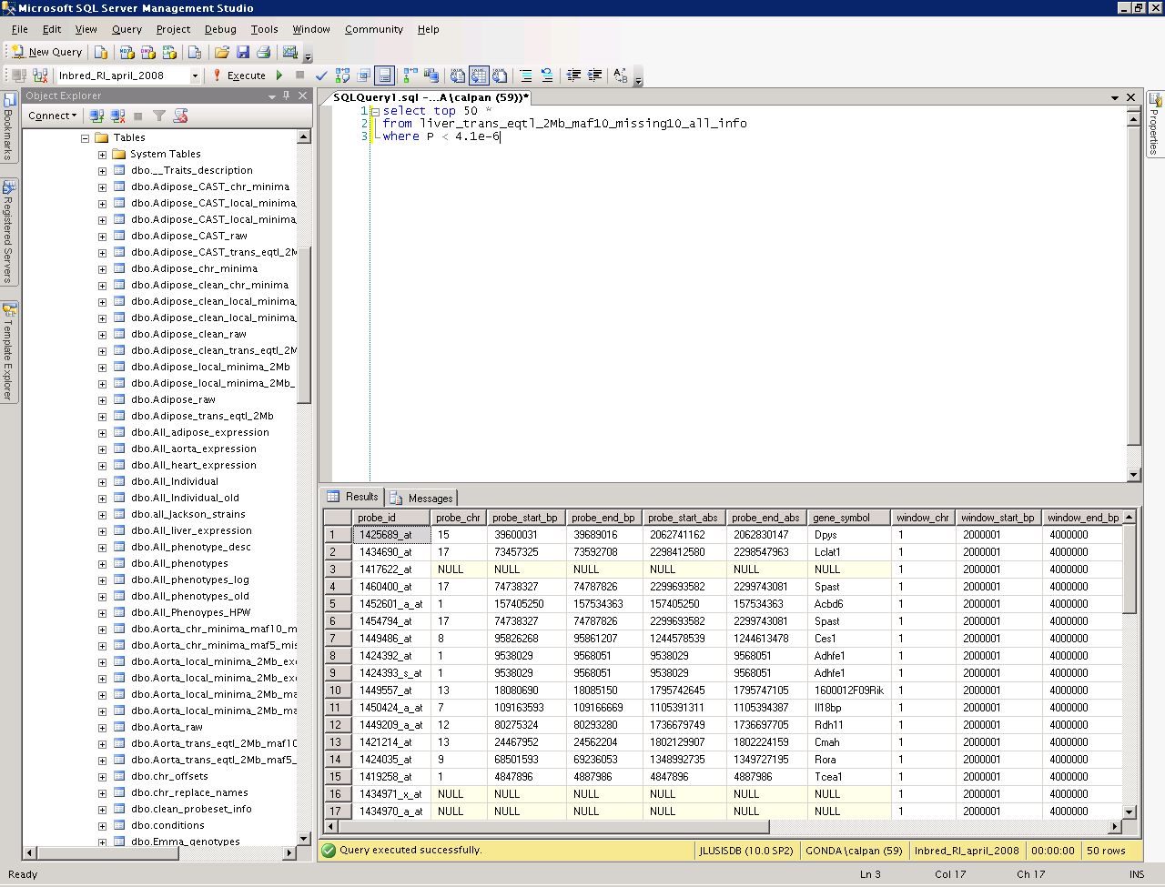
Click here to run query!
Notes:
select top 50 *
from liver_trans_eqtl_2Mb_maf10_missing10_all_info
where P < 4.1e-6

Slide 27

Notes:
-- order of results not guaranteed unless ORDER BY clause is specified
select top 50 *
from liver_trans_eqtl_2Mb_maf10_missing10_all_info
where P < 4.1e-6
order by P

Slide 28
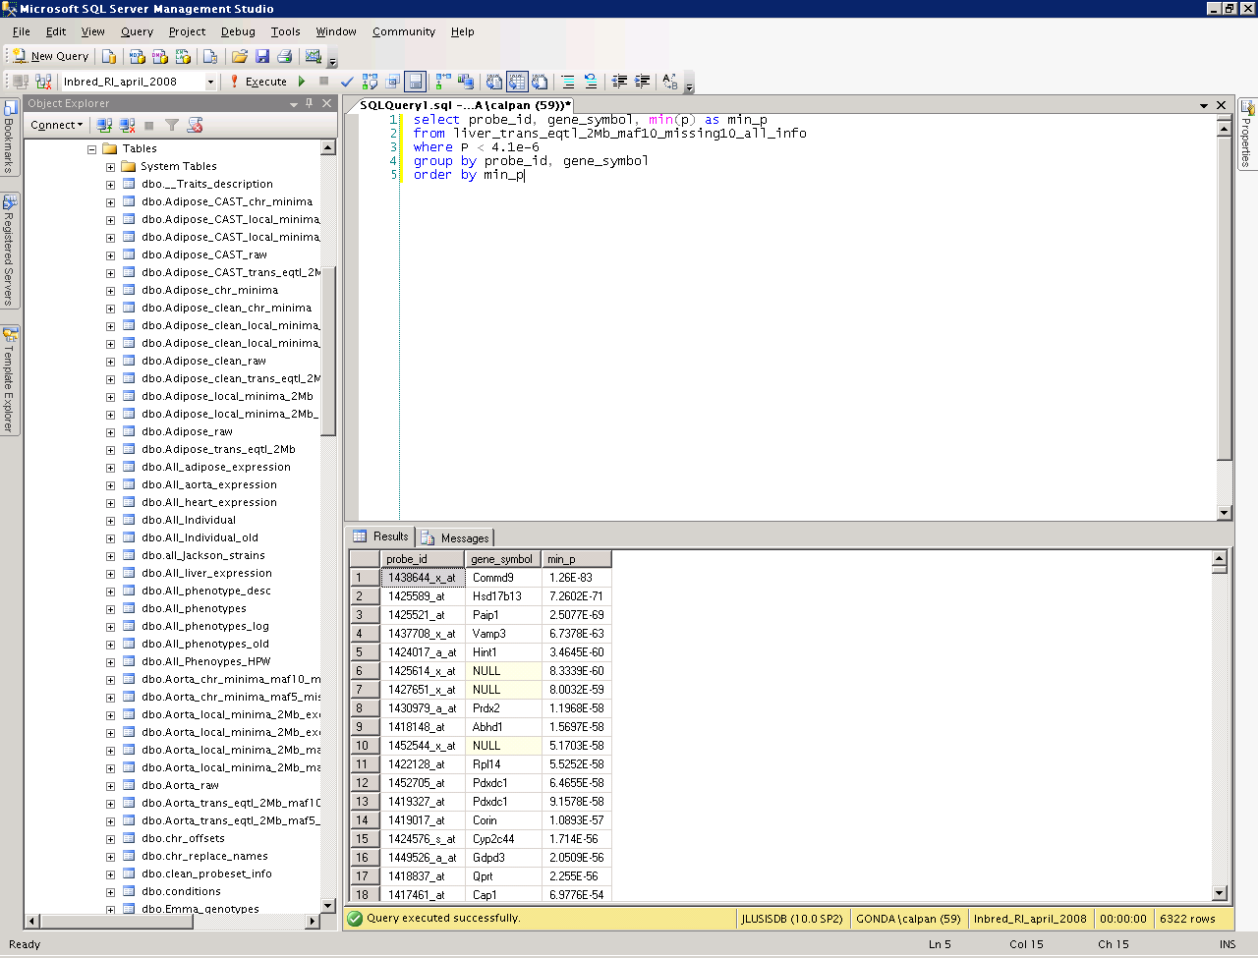
aggregate function
alias
Notes:
-- aggregate functions, aliases
select probe_id, gene_symbol, min(p) as min_p
from liver_trans_eqtl_2Mb_maf10_missing10_all_info
where P < 4.1e-6
group by probe_id, gene_symbol
order by min_p

Slide 29
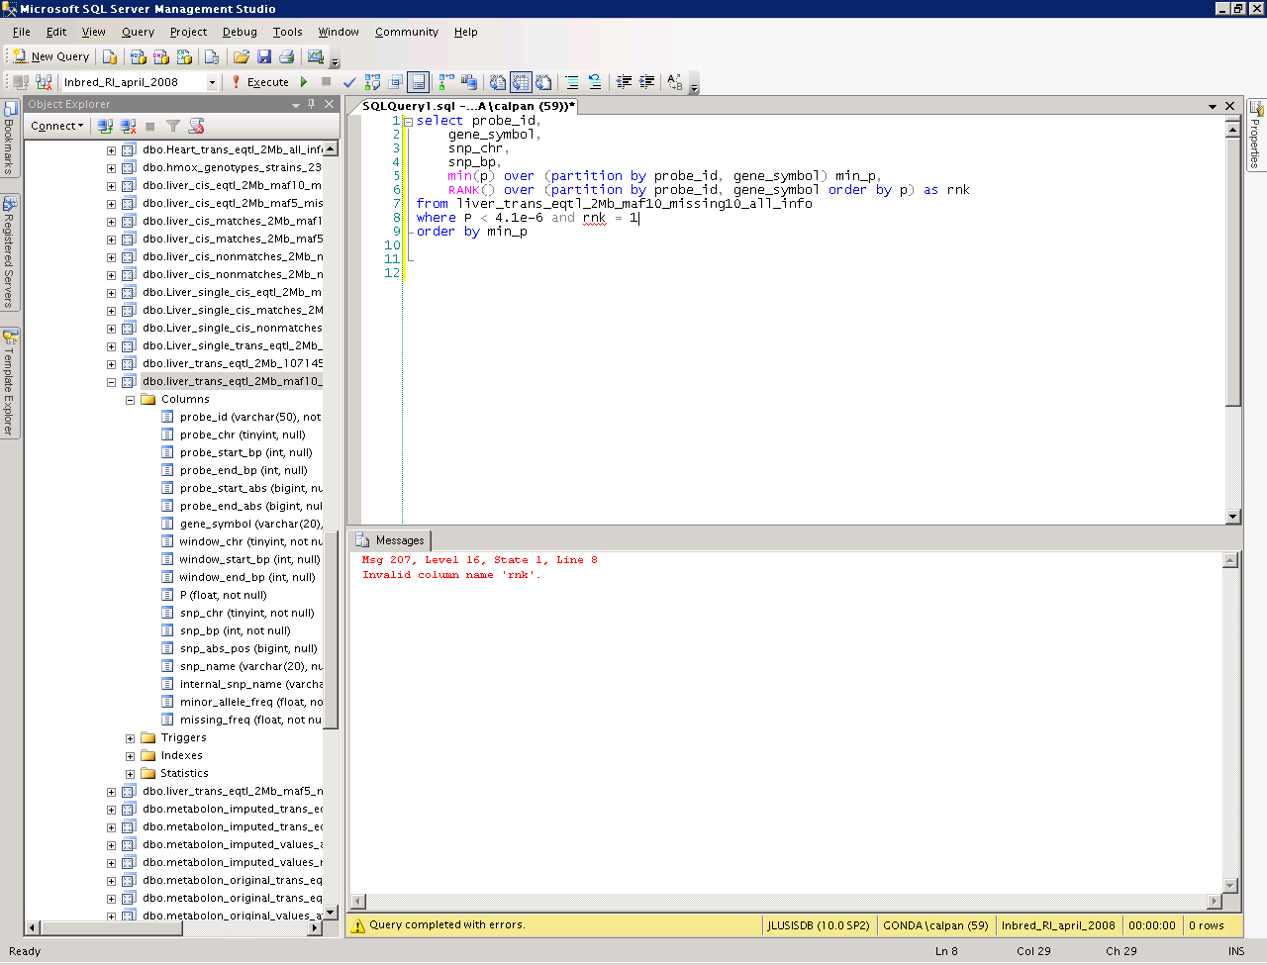
Notes:
Note red squiggle, like Word’s Autocorrect

Slide 30
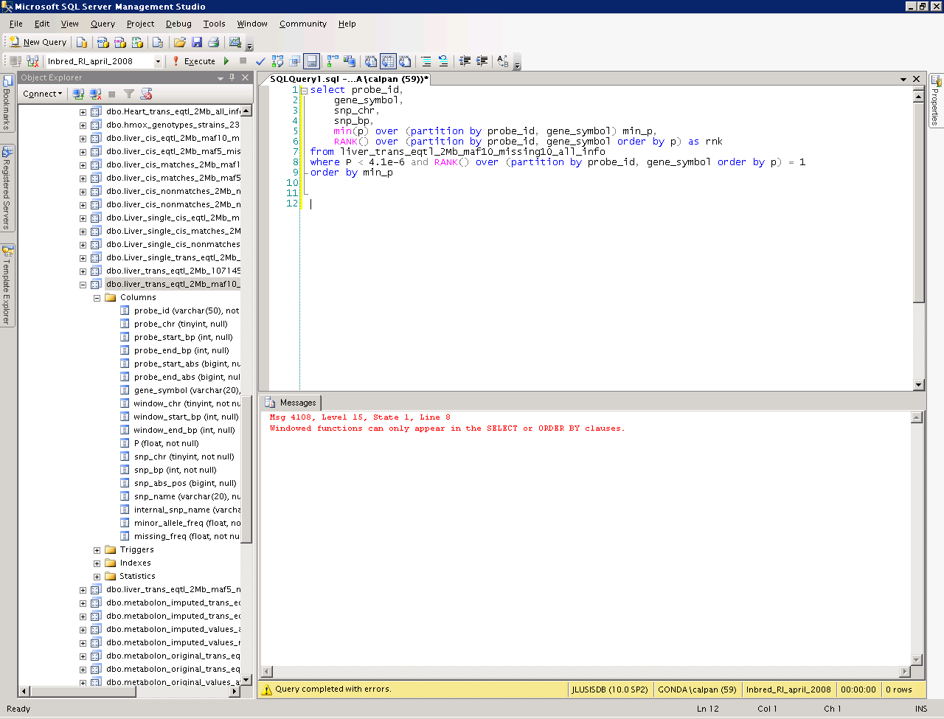
Notes:
This doesn’t work either.

Slide 31
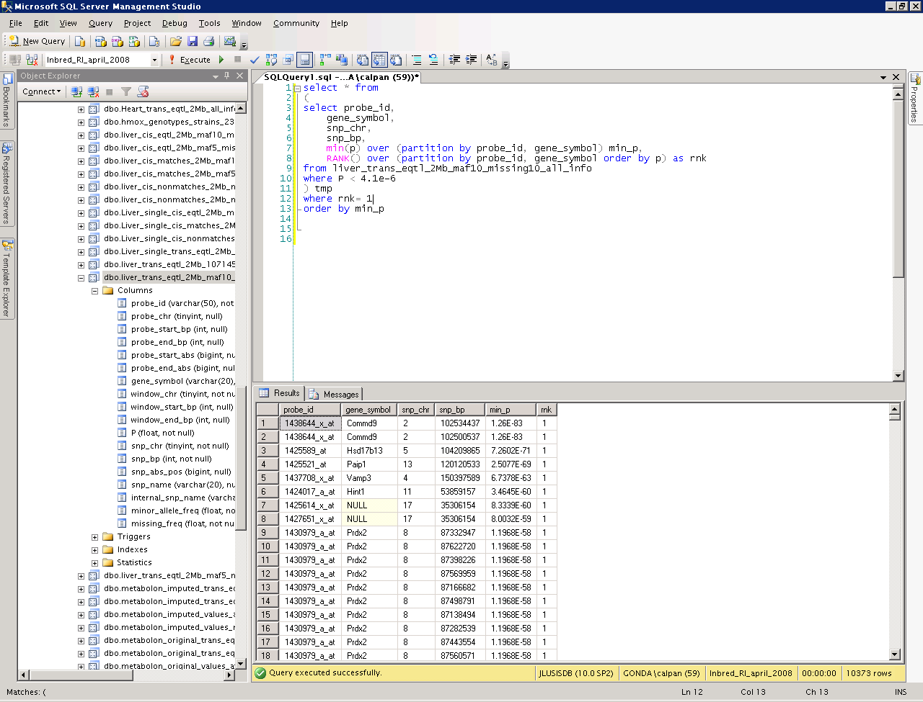
derived table
Notes:
-- result from query can be treated as table
select * from
(
select probe_id,
gene_symbol,
snp_chr,
snp_bp,
min(p) over (partition by probe_id, gene_symbol) min_p,
RANK() over (partition by probe_id, gene_symbol order by p) as rnk
from liver_trans_eqtl_2Mb_maf10_missing10_all_info
where P < 4.1e-6
) tmp
where rnk= 1
order by min_p

Slide 32
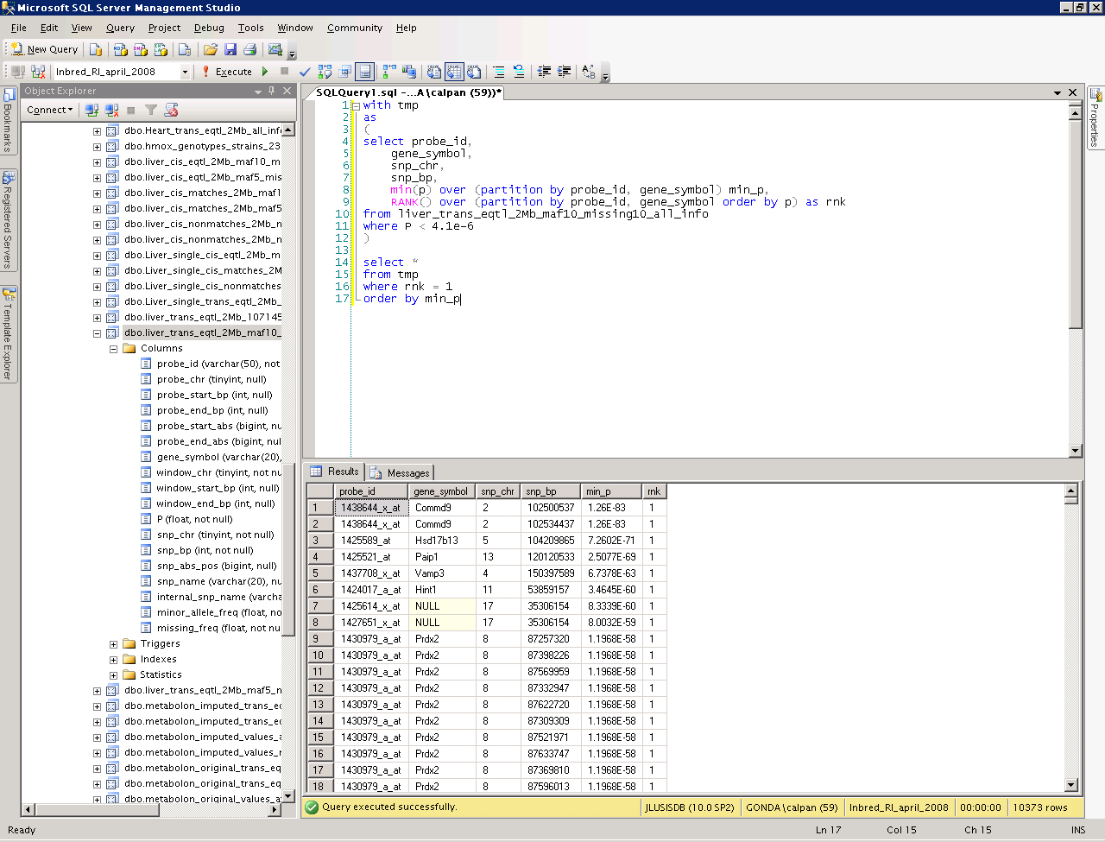
common table expression (CTE)
Notes:
-- alternate method to achieve same results
with tmp
as
(
select probe_id,
gene_symbol,
snp_chr,
snp_bp,
min(p) over (partition by probe_id, gene_symbol) min_p,
RANK() over (partition by probe_id, gene_symbol order by p) as rnk
from liver_trans_eqtl_2Mb_maf10_missing10_all_info
where P < 4.1e-6
)
select *
from tmp
where rnk = 1
order by min_p

Slide 33
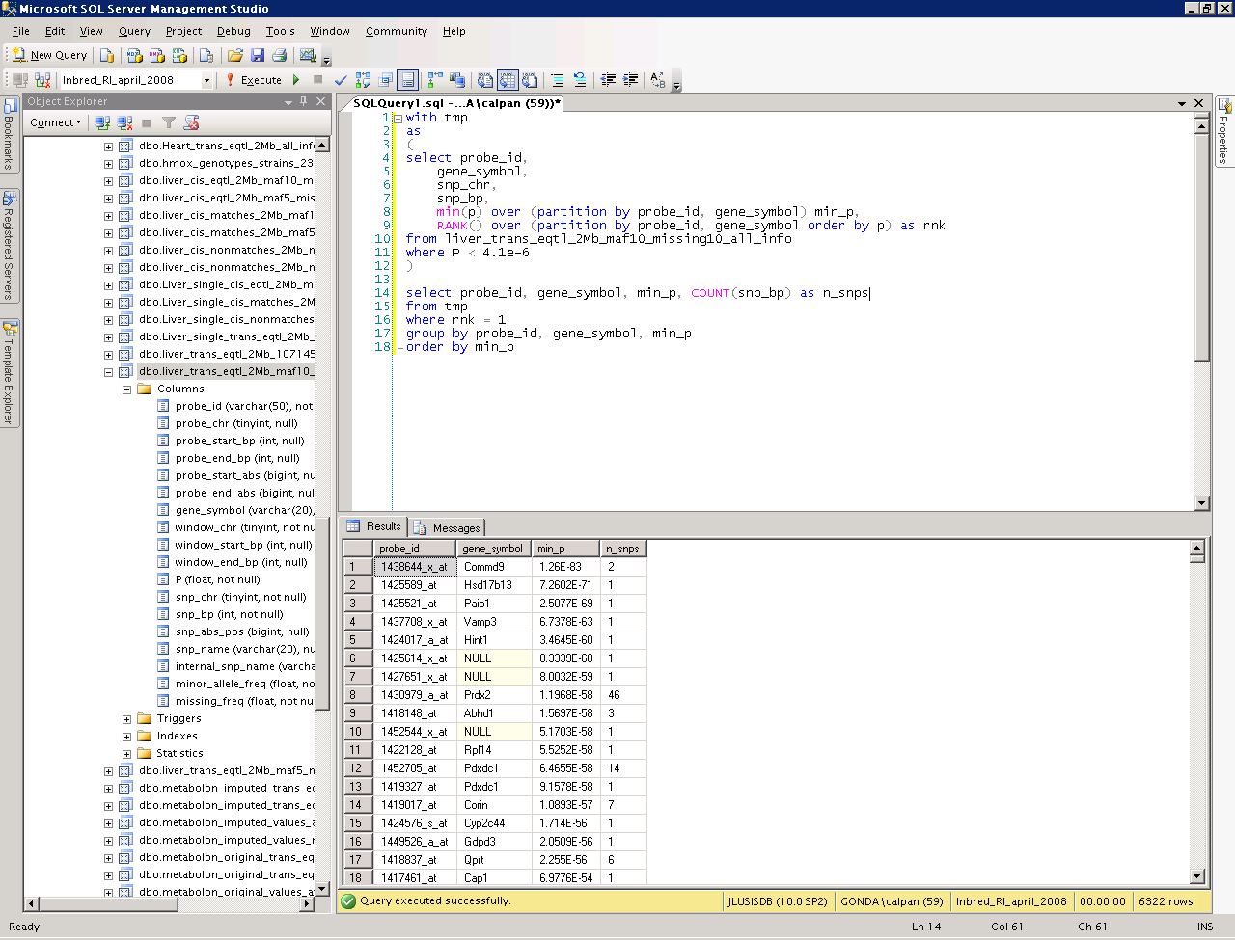
Notes:
-- aggregate results from common table expression
with tmp
as
(
select probe_id,
gene_symbol,
snp_chr,
snp_bp,
min(p) over (partition by probe_id, gene_symbol) min_p,
RANK() over (partition by probe_id, gene_symbol order by p) as rnk
from liver_trans_eqtl_2Mb_maf10_missing10_all_info
where P < 4.1e-6
)
select probe_id, gene_symbol, min_p, COUNT(snp_bp) as n_snps
from tmp
where rnk = 1
group by probe_id, gene_symbol, min_p, snp_chr
order by min_p

Slide 34
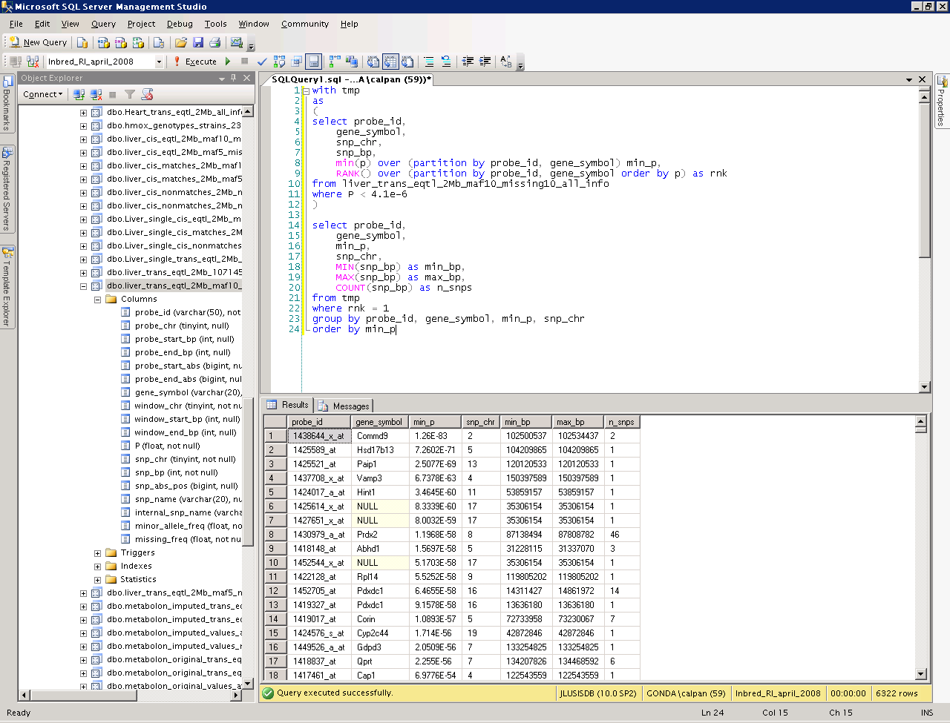
Notes:
-- multiple aggregate functions on CTE results
with tmp
as
(
select probe_id,
gene_symbol,
snp_chr,
snp_bp,
min(p) over (partition by probe_id, gene_symbol) min_p,
RANK() over (partition by probe_id, gene_symbol order by p) as rnk
from liver_trans_eqtl_2Mb_maf10_missing10_all_info
where P < 4.1e-6
)
select probe_id,
gene_symbol,
min_p,
snp_chr,
MIN(snp_bp) as min_bp,
MAX(snp_bp) as max_bp,
COUNT(snp_bp) as n_snps
from tmp
where rnk = 1
group by probe_id, gene_symbol, min_p, snp_chr
order by min_p

Slide 35

Notes:
-- search criteria using aggregate functions can only be used in HAVING clause, not WHERE
with tmp
as
(
select probe_id,
gene_symbol,
snp_chr,
snp_bp,
min(p) over (partition by probe_id, gene_symbol) min_p,
RANK() over (partition by probe_id, gene_symbol order by p) as rnk
from liver_trans_eqtl_2Mb_maf10_missing10_all_info
where P < 4.1e-6
)
select probe_id,
gene_symbol,
min_p,
snp_chr,
MIN(snp_bp) as min_bp,
MAX(snp_bp) as max_bp,
COUNT(snp_bp) as n_snps
from tmp
where rnk = 1
group by probe_id, gene_symbol, min_p, snp_chr
having COUNT(snp_bp) > 5
order by min_p

Slide 36
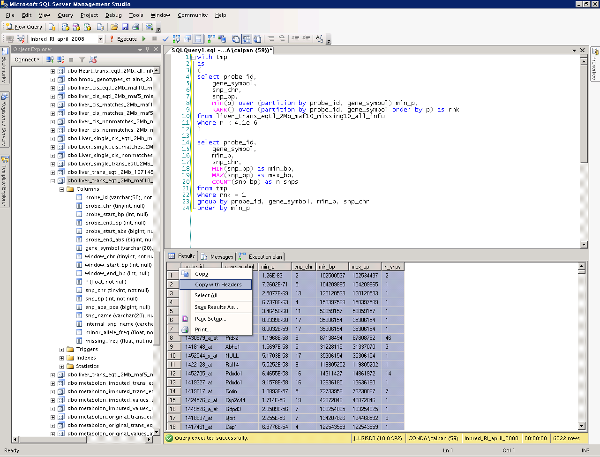

Slide 37


Slide 38
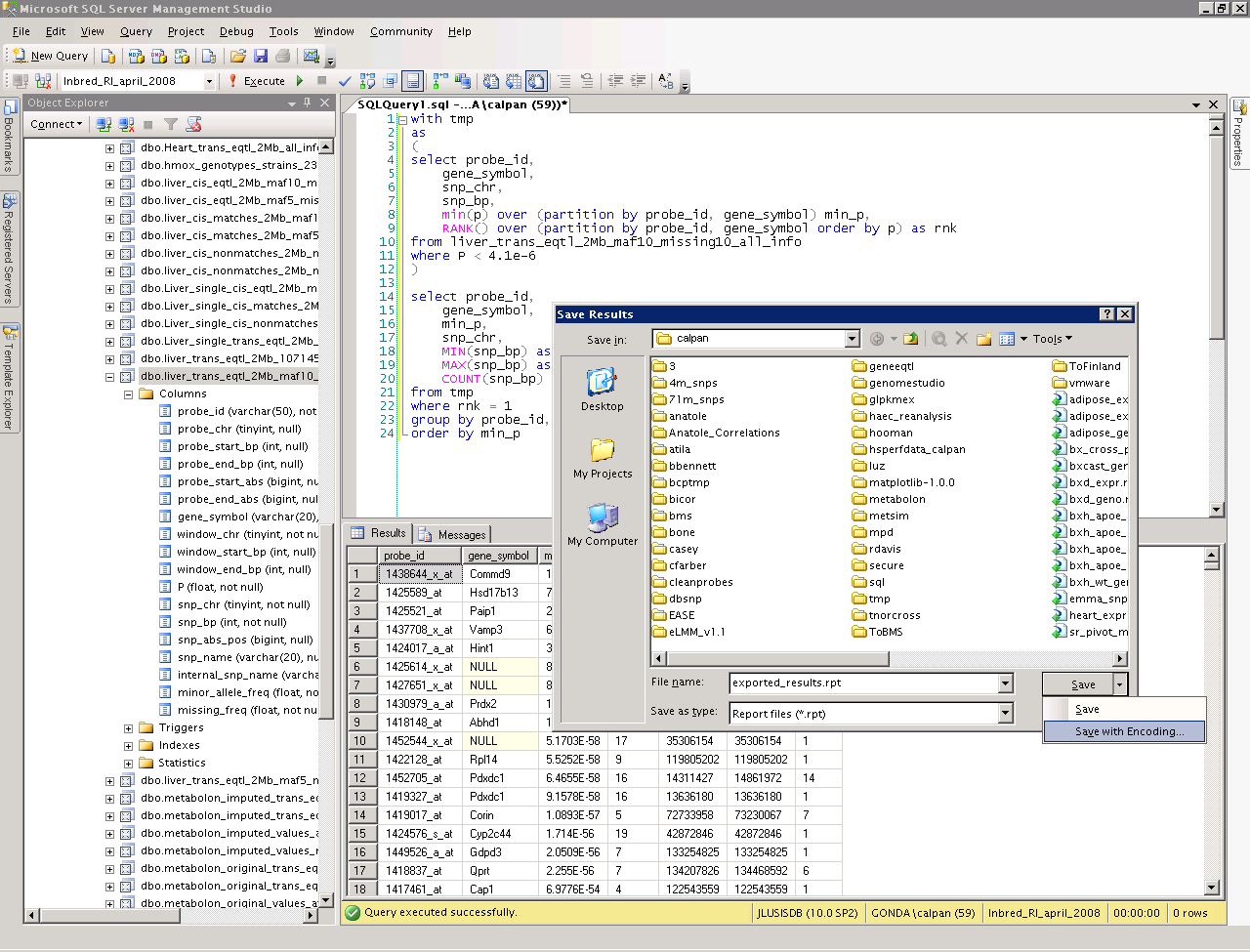

Slide 39
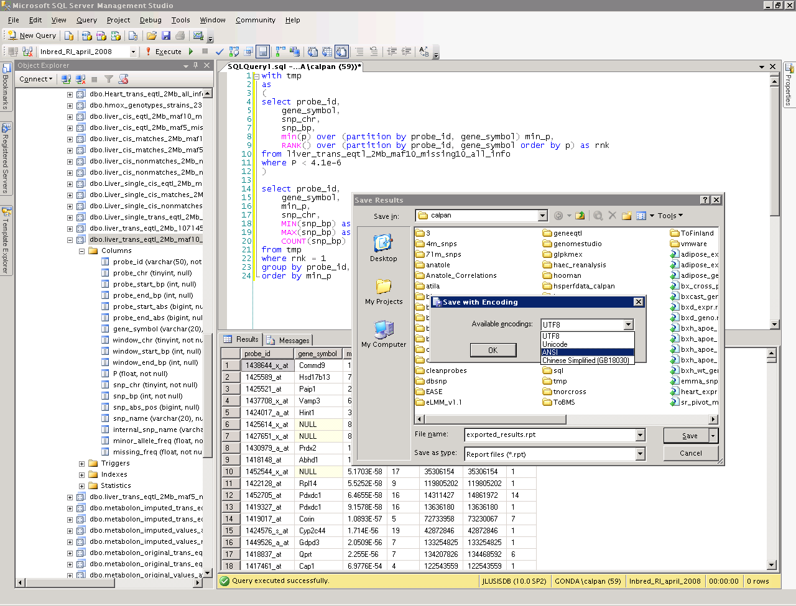

Slide 40
Using SQL from R
Connect to database

Slide 41
Using SQL from R
Connect to database
Run query

Slide 42
Using SQL from R
Connect to database
Run query
There is no step 3

Slide 43
Connecting to SQL Server from R
# requires RODBC package to be installed
library(RODBC)
ch = odbcConnect('DSN=Inbred')
# DSN: data source name
# use DTM ODBC Manager to see available DSNs
# on Xenon

Slide 44
Running a SQL query from R
# results is a data frame
results = sqlQuery(ch, 'select * from snp_info')
# or
q = 'select * from snp_info'
results = sqlQuery(ch, q)

Slide 45
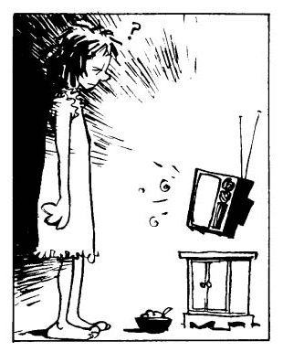

Slide 46
References/Resources
SQL Server Books Online T-SQL reference (main page): http://msdn.microsoft.com/en-us/library/bb510741(SQL.100).aspx
SQL Server Books Online T-SQL reference (SELECT statement): http://msdn.microsoft.com/en-us/library/ms189499(v=sql.100).aspx
Tutorial: SQL Server Management Studio: http://msdn.microsoft.com/en-us/library/bb934498(v=sql.100).aspx
Tutorial: Writing Transact-SQL Statements: http://msdn.microsoft.com/en-us/library/ms365303(v=sql.100).aspx
SQL Server Express Edition (free, requires Windows): http://www.microsoft.com/betaexperience/pd/SQLEXP08V2/enus/
SQL joins: http://en.wikipedia.org/wiki/Join_(SQL); http://blog.sqlauthority.com/2009/04/13/sql-server-introduction-to-joins-basic-of-joins/
RODBC: http://cran.r-project.org/web/packages/RODBC/RODBC.pdf
pyodbc: http://code.google.com/p/pyodbc/
Instant SQL Formatter (makes code easier to read): http://www.dpriver.com/pp/sqlformat.htm

Slide 47
Using SQL from Python
Connect to database
Run query
Fetch results

Slide 48
Connecting to SQL Server from Python
# requires pyodbc
import pyodbc
c = pyodbc.connect('DSN=Inbred')

Slide 49
Running a SQL query from Python
q = 'select * from snp_info'
# results is a list
results = c.execute(q).fetchall()

