Slide 1

Mini-Project [ITP+NPV]
TITLE : Loan Dataset Analysis
Submitted by : Muzammil Firdous M A
Manjunath I Kunte
Munir Sheth
Nandish S Pattanashetti
Nandakumar

Slide 2
Problem Definition
Dataset: Loan Dataset
Problem Statement :
The company needs information about the previous loans that were made and the status of the customers who received those loans in order to decide whether or not to make another loan to that customer in the future and how much loan money should be given to that person. The company also needs information about the current loans (from 2007 to 2011).

Slide 3
Data Set Description
The dataset includes all available loan information for loans granted
from 2007 to 2011.
Data Dictionary -
1.annual_inc - The self-reported annual income provided by the borrower during registration.
2.dti - A ratio calculated using the borrower’s total monthly debt payments on the total debt obligations, excluding mortgage and the requested LC loan, divided by the borrower’s self-reported monthly income.
3.emp_length -Employment length in years. Possible values are between 0 and 10 where 0 means less than one year and 10 means ten or more years.
4.funded_amnt - The total amount committed to that loan at that point in time.
5.funded_amnt_inv -The total amount committed by investors for that loan at that point in time.
6.grade - LC assigned loan grade

Slide 4
7.id - A unique LC assigned ID for the loan listing.
8.installment - The monthly payment owed by the borrower if the loan originates.
9.int_rate - Interest Rate on the loan
10.last_pymnt_amnt-Last total payment amount received
11.last_pymnt_d -Last month payment was received
12.loan_amnt -The listed amount of the loan applied for by the borrower. If at some point in time, the credit department reduces the loan amount, then it will be reflected in this value.
13.loan_status - Current status of the loan
14.member_id -A unique LC assigned Id for the borrower member.
15.purpose - A category provided by the borrower for the loan request.
16.term -The number of payments on the loan. Values are in months and can be either 36 or 60.
17.total_acc -The total number of credit lines currently in the borrower's credit file
18.total_pymnt -Payments received to date for total amount funded
19.total_pymnt_inv -Payments received to date for portion of total amount funded by investors
20.total_rec_int -Interest received to date

Slide 5
Business Importance of Problem
Loan analysis helps in ensuring that loans are given to the customers who can and will repay them on time and with the proper terms. In determining the type of analysis needed and the most effective way to meet the need, it is important to consider the nature of the loan, as well as if the company intends to deny the loan due to unresolved past loan accounts.

Slide 6
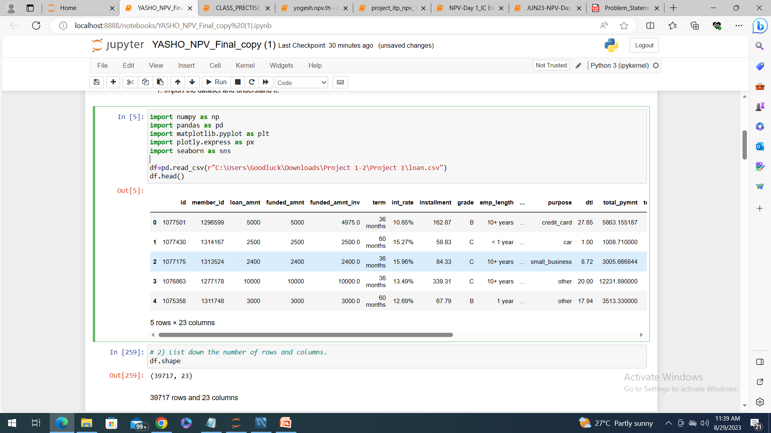
Question 1 Import the dataset and understand it.
Provide understanding
Code snippet
Solution
Inference – if available

Slide 7
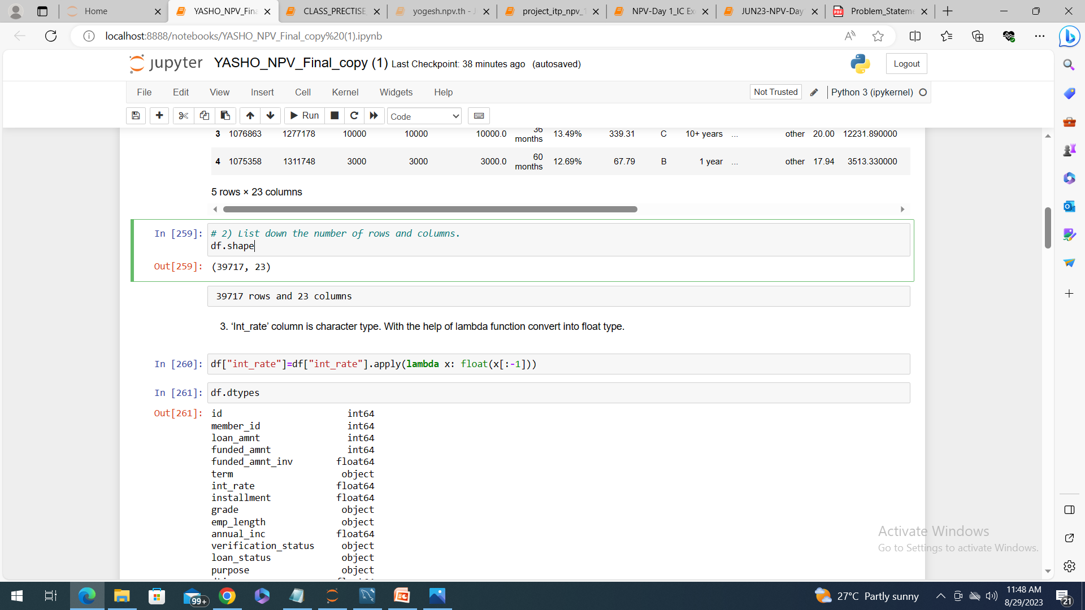
Question 2 List down the number of rows and columns.
#Finding the number of columns and rows in the given dataset.

Slide 8
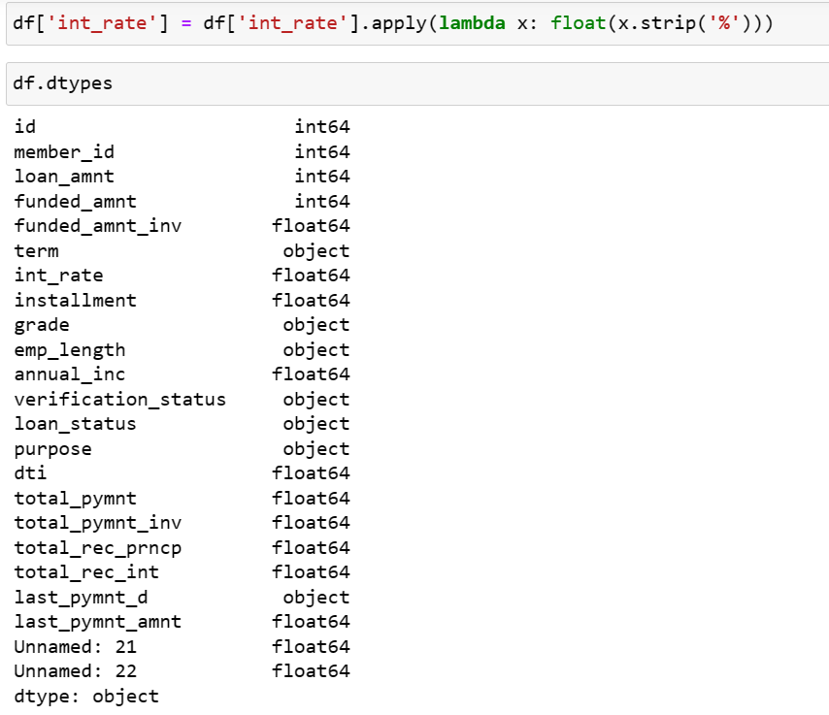
Question 3 ‘Int_rate’ column is character type. With the help of lambda function convert into float type.
#Convert the datatype of the column ‘Int_rate’ from character to float type using lambda function.

Slide 9
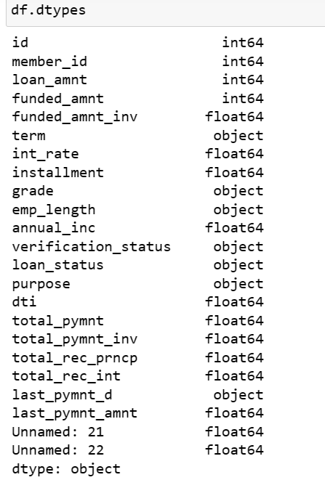
Question 4 Check the datatypes of each column.
#Display the datatype of each columns of the dataset.

Slide 10
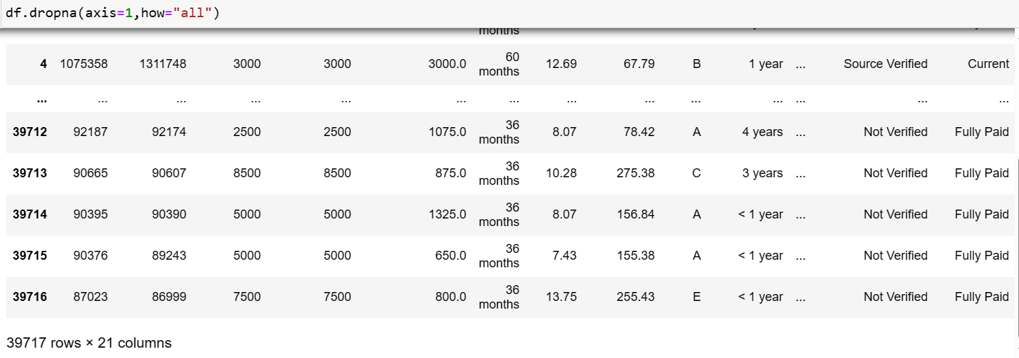
Question 5 Cleaning the dataset- Remove the columns having complete NaN value in the entire dataset.
#Drop the columns having all it’s rows as NaN.

Slide 11
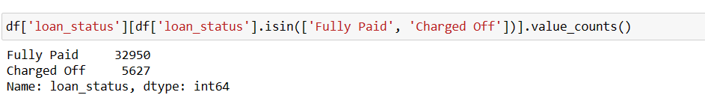
Question 6 Write the code to find the value counts of the ‘loan_status’ category column and filter only the ‘fully paid’ and ‘charged off’ categories.
#Obtain the number of occurrence of ‘fully paid’ and ‘charged off’ in the ‘loan_status’ column.

Slide 12
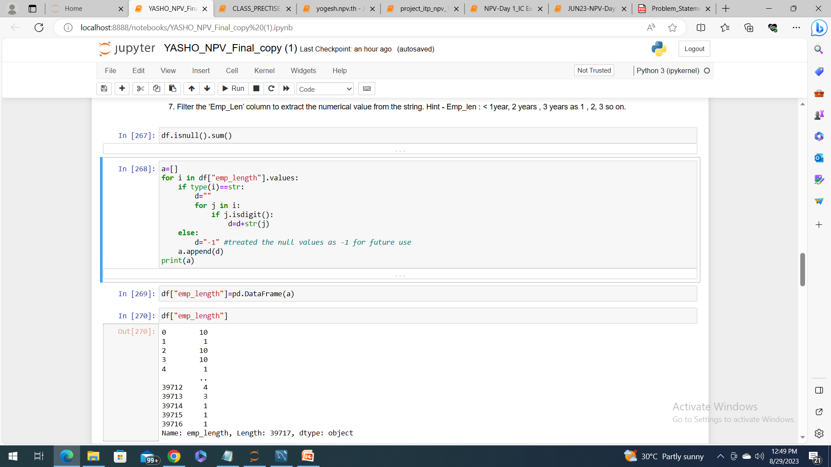
Question 7 Filter the ‘Emp_Len’ column to extract the numerical value from the string.
#Write a code to extract only the numerical value from the column ‘Emp_len’ like < 1year, 2 years , 3 years as 1 , 2, 3 so on.

Slide 13
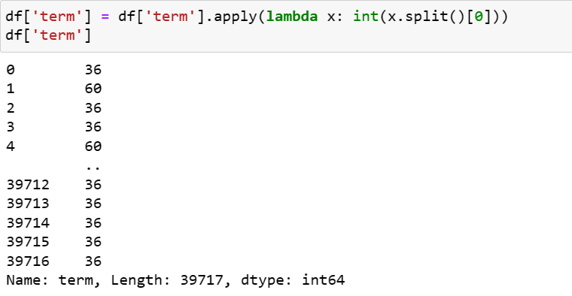
Question 8 Using the Lambda function, remove the month from the ‘term’ column such that ‘36 months’, ‘60 months’ appear as 36 and 60 respectively.
#Write a code to extract only the numerical value from the column ‘term’ for ‘36 months’, ‘60 months’ appear as 36 and 60 respectively.

Slide 14
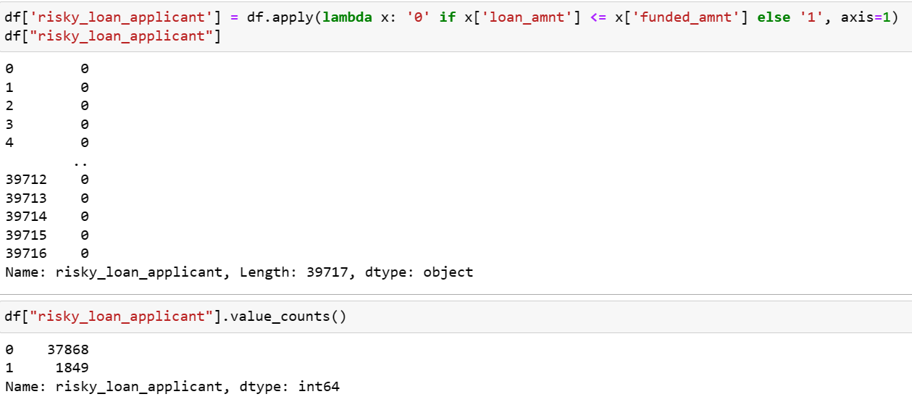
Question 9 Create a new column as risky_loan_applicant by comparing loan_amnt and funded_amnt with the following criteria – If loan_amnt is less than equals to funded_amnt set it as ‘0’ else set it as ‘1’.
# By comparing loan_amnt and funded_amnt with the following criteria, a new column labeled risky_loan_applicant can be created. If loan_amnt is less than equal to funded_amnt, set the column's value to "0," otherwise set it to "1."

Slide 15
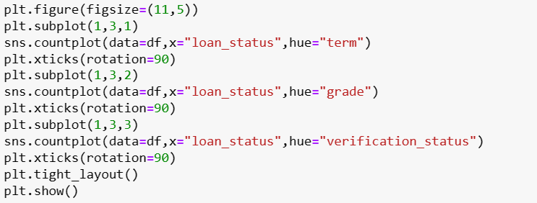
Question 10 Using the bar plot visualize the loan_status column against categorical column grade, term, verification_status . Write the observation from each graph.
# Visualize the loan_status column against the categorical columns grade, term, and verification_status using a bar plot along with inferences.

Slide 16
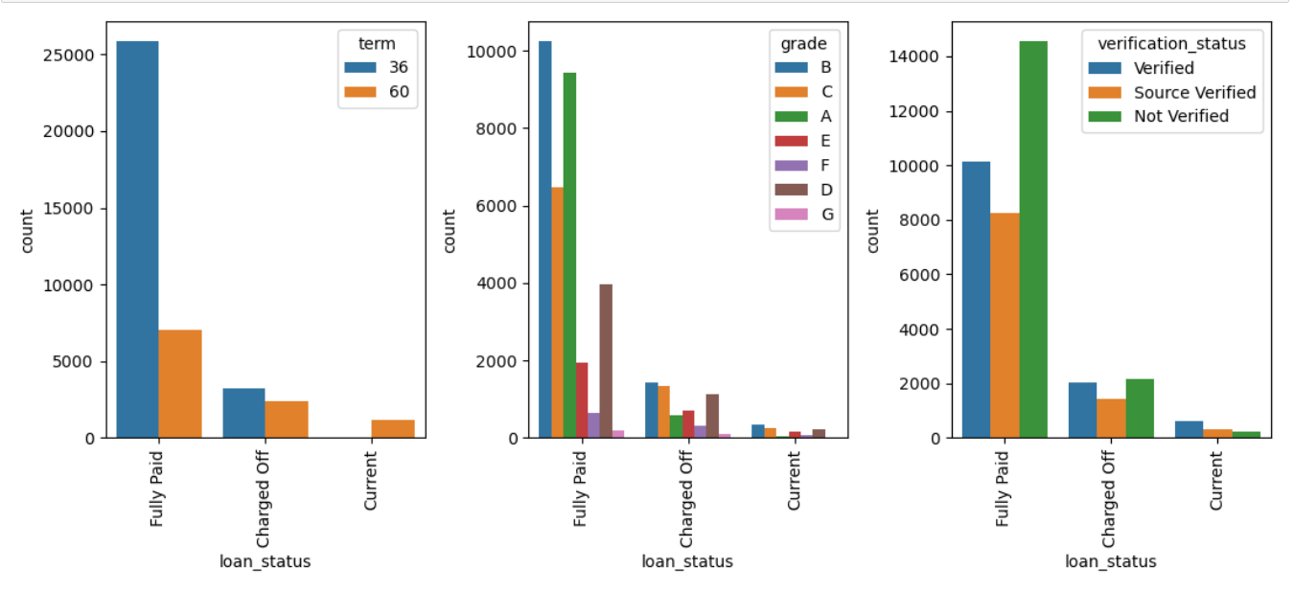
Inferences:
We can see that number of not verified fully paid loan_status is more.
It’s almost the same number of not verified and verified charged off loan status are present.
We can see that verified current loan_status more in number.
In verification status most of the people not verified but they fully paid.
For the term 36, mostly the status is fully paid and there is no loan with current status.
The count of loans with different grades are the least with current status.

Slide 17
Question 11 Using a user defined function convert the ‘emp_len’ column into categorical column as follows - If emp_len is less than equals to 1 then recode as ‘fresher’. If emp_len is greater than 1 and less than 3 then recode as ‘junior’. If emp_len is greater than 3 and less than 7 then recode as ‘senior’ If emp_len is greater than 7 then recode as ‘expert’.
# The "emp_len" column should be converted into a category column using the user-defined function as follows: If emp_len is less than 1, recode it as "fresher". Recode as 'junior' if emp_len is greater than 1 and less than 3, otherwise. Recode as 'senior' if emp_len is higher than 3 and less than 7 'Expert' should be recoded if emp_len is more than 7.

Slide 18
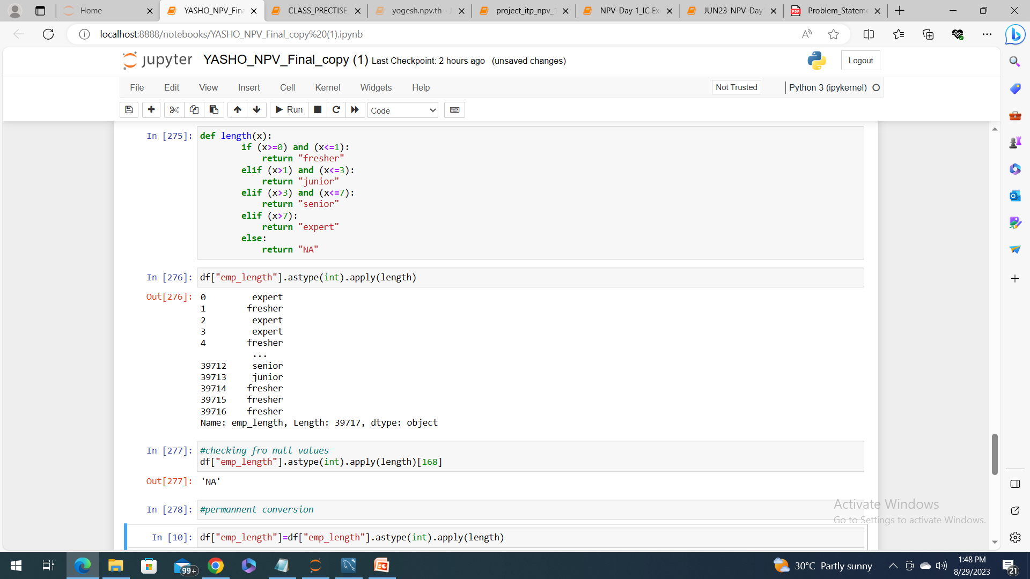

Slide 19
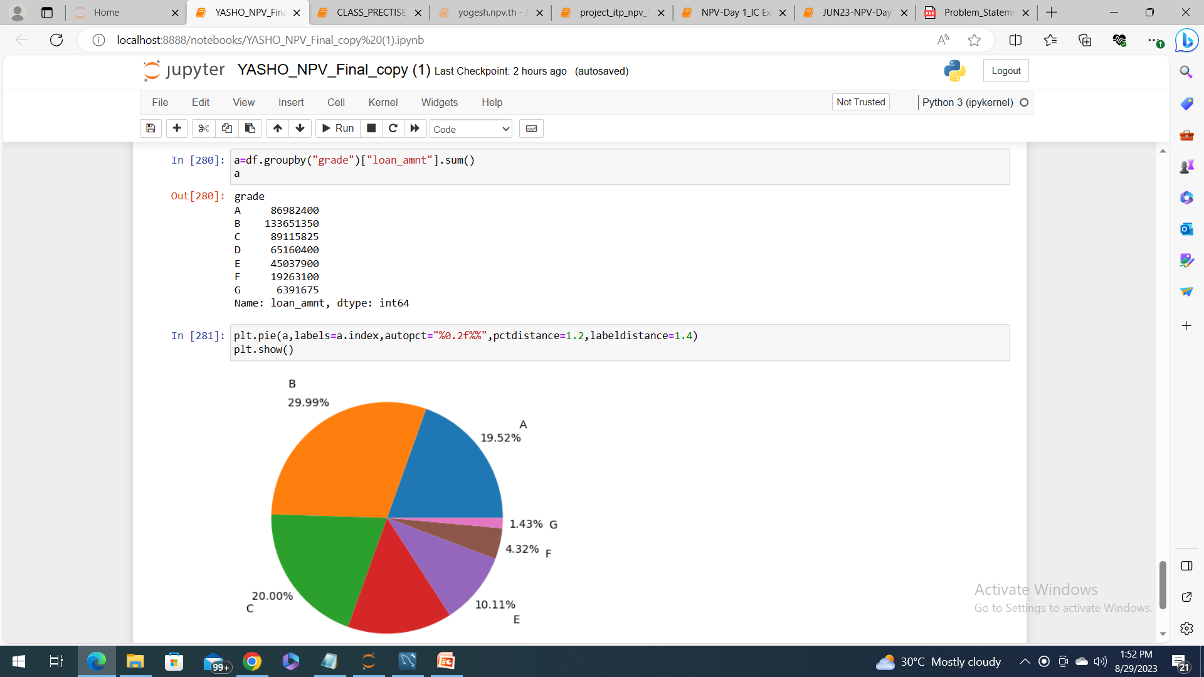
Question 12 Find the sum of ‘loan_amnt’ for each grade and display the distribution of ‘loan_amnt’ using a pie plot.
# For each grade, calculate the total amount of "loan_amnt" and use a pie chart to show the distribution of "loan_amnt."

Slide 20
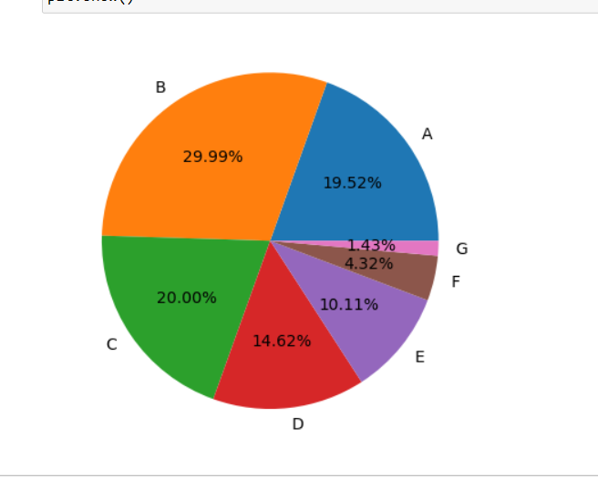
Inferences:
The total loan amount provided by the company for loan grade B is highest, followed by that of grade C then A.
The total loan amount for loan grade G is lowest, followed by that of grade F.

Slide 21
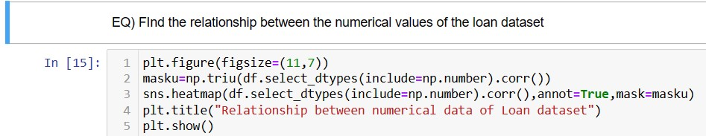
Question 13 Find the relation between the numerical values of the dataset.
#obtain the correlation of numerical dataset (df.select_dtypes(include=np.number))
#mask the upper triangle using np.triu
#use sns.heatmap

Slide 22
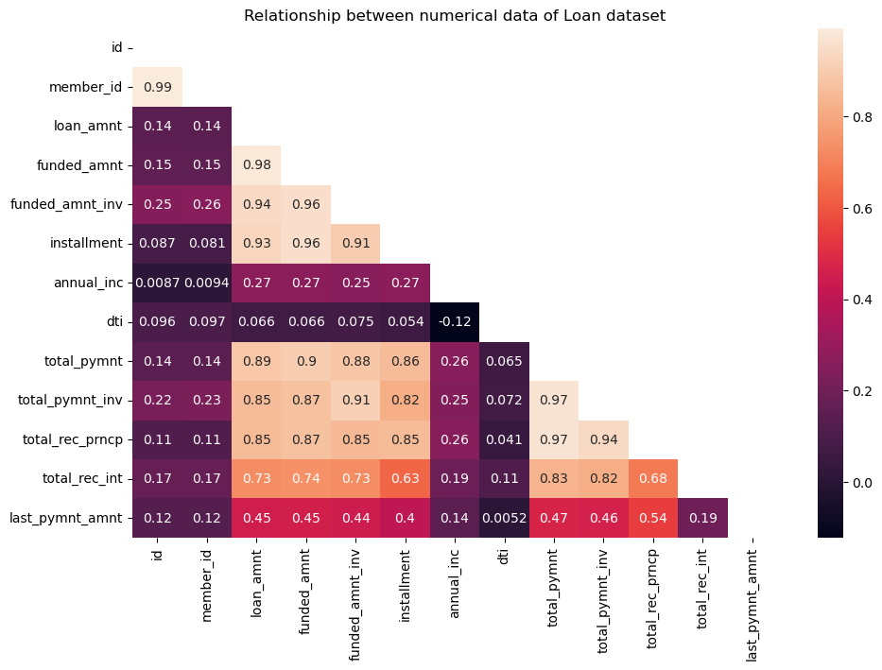
total_payment_invested has very high positive correlation with total_payment.
total_rec_prncp has very high positive correlation with total_payment.
total_funded_amnt has very high positive correlation with invested with loan amnt and funded amnt.
total_payment has very high positive correlation with funded amnt.
total rec_prici has very high positive correlation with total payment invested and total payment.
member_id and id have high positive correlation but does not give inference as its just a number given to customer.
dti and annual income have weak negative correlation.

Slide 23

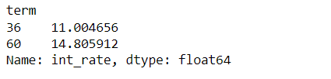
Question 14 How does the term of the loan affect the interest rate? You can compare the average interest rates for 36 months and 60 months terms..
#The question is asking about the relationship between the term of a loan (how long it takes for the loan to be paid back) and the interest rate of the loan. Specifically, it’s asking whether loans with a term of 36 months have different average interest rates compared to loans with a term of 60 months.

Slide 24
Question 15 What is the most common loan purpose?
#The question is asking for the most common purpose for which loans are taken out, according to the dataset. In the context of the dataset, each loan has a specific purpose (for example, debt consolidation, credit Card, Car, major purchase, etc.). and also find the count of it.

Slide 25
Question 16 What is the percentage of loans that were funded in full?
#The question is asking for the average loan amount for each loan grade. In the context of the dataset, each loan is assigned a grade (A, B, C, etc.), and each loan has a specific loan amount. The question is asking you to calculate the average of these loan amounts for each grade and also find the count of it.

Slide 26
Conclusions
Lessons learned
Importing data from various sources to python
Handling of different datatypes
Exposure to robust functions using different libraries of pythons
Handling of missing values
Manipulation of data using different tools of python
Detection of type of errors
Descriptive and descriptive statistics

Slide 27
Conclusions
Skills used
Programming language :Python 3
Libraries used : Pandas, Numpy, Matplotlib.pyplot, Plotly.express, seaborn
Pandas series, pandas datframes,Slicing ,Filters, lambda functions, User-defined functions, Seaborn plots, Pyplots, numpy.nan, fillna, dropna.
Apply, map, replace, for loop,

Slide 28
Conclusions
Domain understanding developed
An insight into the segregation of loan applications
Using previously captured data to consider new applications
Using skills of python to correlate between different attributes of loan applications
The impact of previously captured data on the future of the company
Risk analysis of the banking domain

Slide 29


Thank You !!!....

