Slide 1
Secure data hiding in image using steganography
CAPSTONE PROJECT
Presented by : Manjunath Mattam
Student Name : Manjunath Mattam
College Name & Department : Sri krishnadevaraya university college of engineering and technology,
Electronics and Communication Engineering

Slide 2
OUTLINE
Problem Statement
Technology used
Wow factor
End users
Result
Conclusion
Git-hub Link
Future scope

Slide 3
Problem Statement
Security Vulnerabilities – Steganographic methods can be detected by steganalysis, compromising confidentiality.
Limited Payload Capacity – Most techniques allow only small data embedding without noticeable distortion.
Trade-off Between Imperceptibility and Robustness – Higher invisibility often reduces resistance to attacks like compression and noise.
Detection by Machine Learning Algorithms – AI-based steganalysis can accurately identify hidden data, reducing effectiveness.
Embedding and Extraction Complexity – Some methods require high computational resources, limiting real-time use.

Slide 4
Technology used
The program uses the following technologies and libraries:
OpenCV (cv2) – Used for image processing, reading, modifying, and saving images.
OS Module (os) – Used to execute system commands (e.g., opening the encrypted image).
String Manipulation – Basic Python operations for encoding and decoding messages.

Slide 5
Wow factors
Hidden in Plain Sight – Unlike encryption, where data looks scrambled, steganography hides information inside ordinary files like images, audio, or videos, making it invisible to the naked eye.
Dual Security Layer – Some techniques combine steganography with encryption, making it harder for attackers to detect and decode the hidden message.
Difficult to Detect – Since the hidden data is embedded within pixels or sound waves, it blends naturally with the original file, making detection challenging without advanced tools.
Versatile Cover Media – Can be applied to various media types such as images, audio, video, or even text, making it highly adaptable.
Survives Some Modifications – Advanced techniques allow hidden messages to remain intact even after resizing, cropping, or compressing the media.

Slide 6
End users
Cybersecurity Professionals – Use steganography to securely transmit sensitive data without detection.
Journalists & Whistleblowers – Hide confidential information or messages to protect sources and avoid censorship.
Law Enforcement & Intelligence Agencies – Utilize steganography for covert communication and digital forensics.
Hackers & Cybercriminals – Malicious actors use it to hide malware, sensitive data, or secret communications.
Government & Military – Securely exchange classified information and covert messages without raising suspicion.
Researchers & Academicians – Study steganography techniques for digital security, AI, and cryptography advancements.

Slide 7
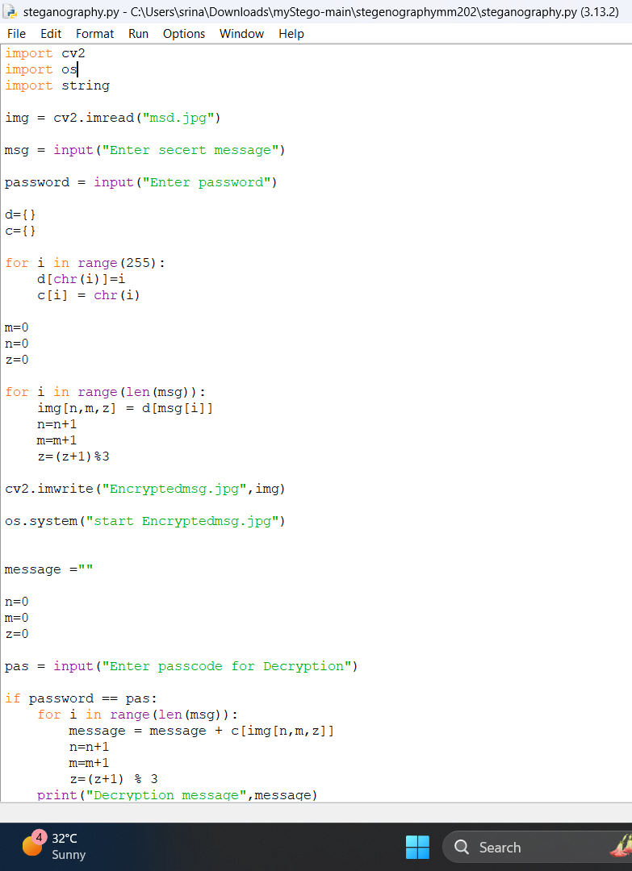
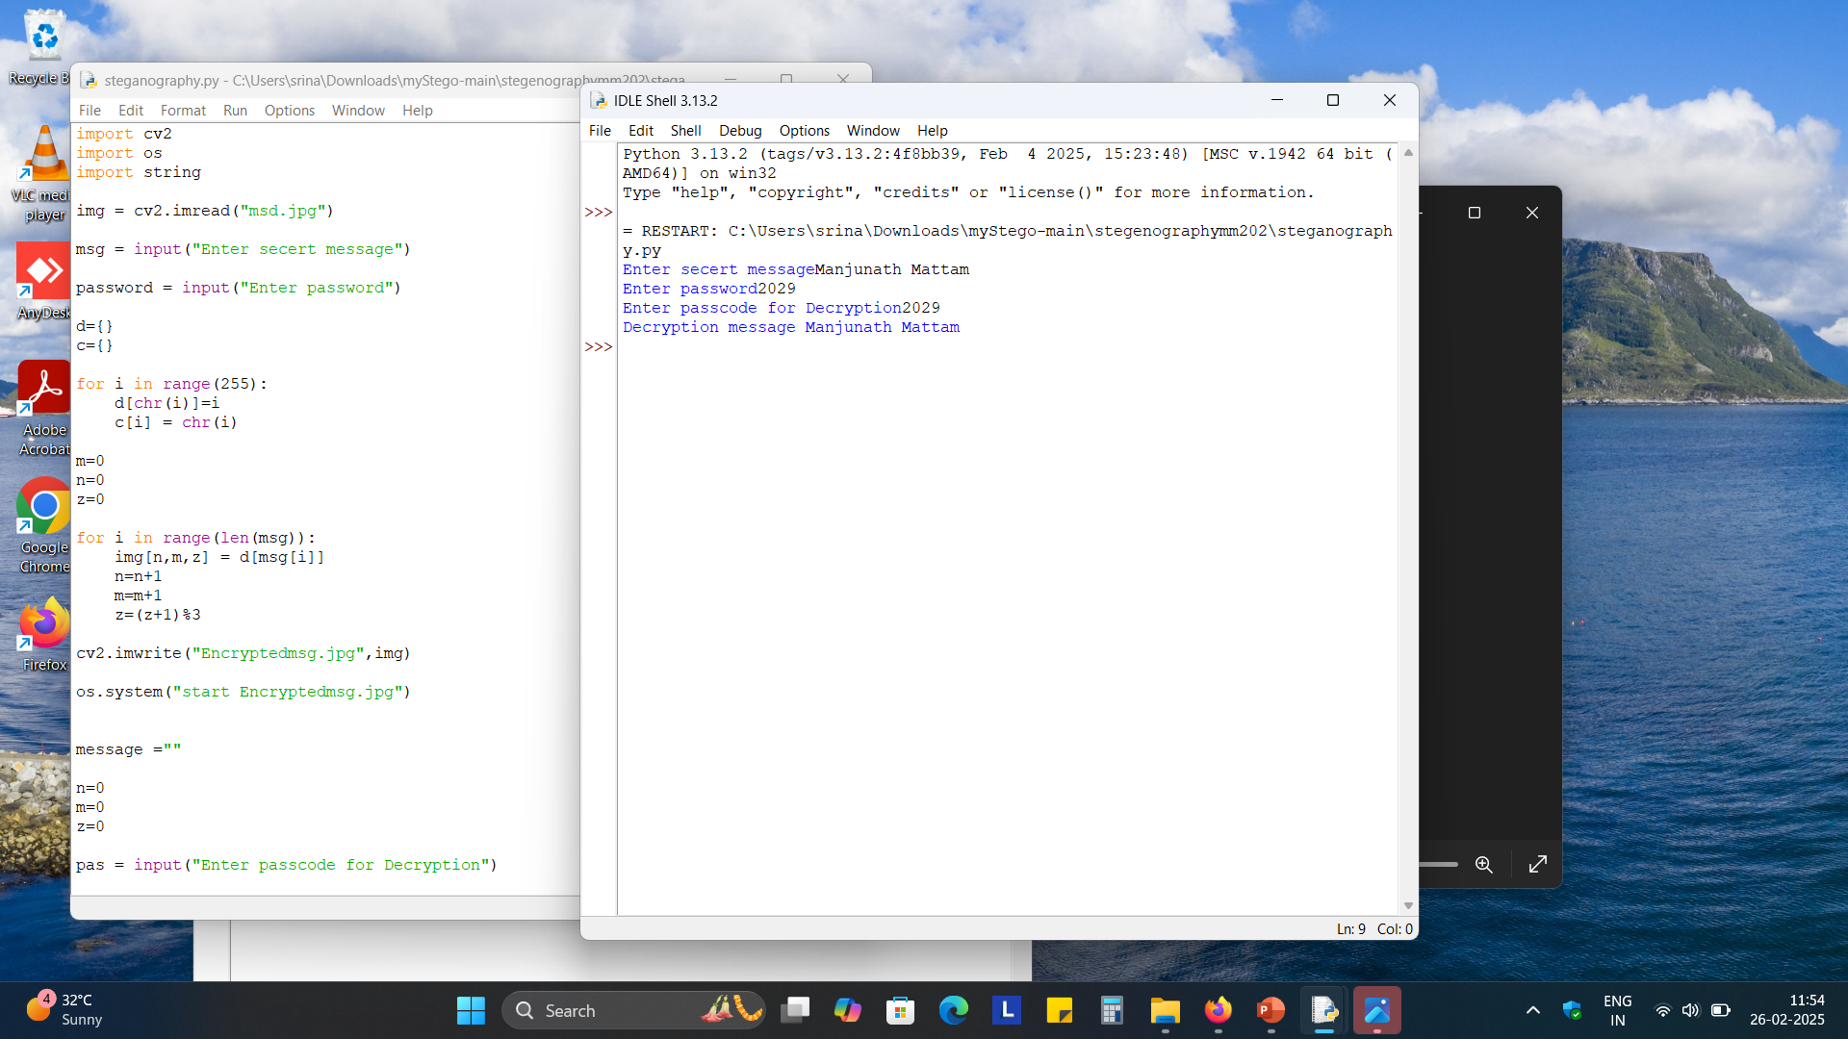
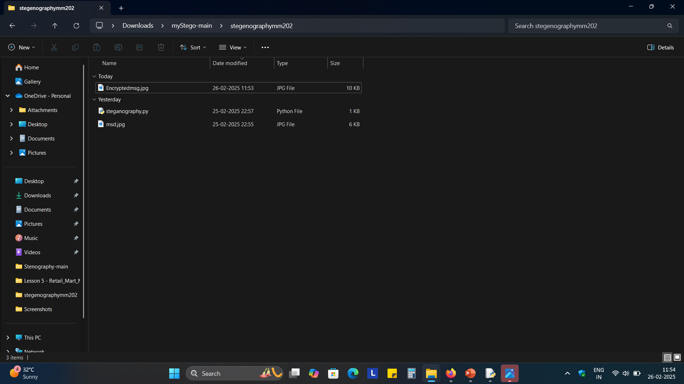
Results

Slide 8
Conclusion
Steganography is a powerful technique for covert communication and data security, offering advantages like hidden-in-plain-sight messaging and dual-layer security. However, its effectiveness is challenged by security vulnerabilities, limited payload capacity, and the trade-off between imperceptibility and robustness. The rise of AI-driven steganalysis makes detection easier, while high computational complexity and cover media dependency limit its widespread use. Additionally, legal and ethical concerns arise due to its potential misuse in cybercrimes.
Despite these challenges, continuous advancements in steganographic techniques, such as deep learning-based methods and adaptive embedding, are improving its security and efficiency. When combined with encryption and strong authentication mechanisms, steganography remains a valuable tool for secure communication, digital watermarking, and data protection.

Slide 9
GitHub Link
GITHUB LINK : https://github.com/ManjunathM202/steganography-mm202.git

Slide 10
Future scope(optional)
1. Advanced Cryptographic Steganography
Combining steganography with encryption algorithms (AES, RSA, etc.) to enhance security.
Quantum steganography for ultra-secure data transmission in a post-quantum world.
2. AI & Machine Learning-Driven Steganography
AI-powered adaptive steganography to dynamically adjust embedding techniques based on cover media properties.
Deep learning models to create more robust, undetectable steganographic methods.
3. Steganography in Secure Communications
Used for government, military, and intelligence operations to transmit confidential messages undetectably.
Stealth networking for organizations to prevent cyber espionage and secure sensitive business data.
4. Steganography for Malware Detection & Prevention
Reverse steganography to detect hidden threats inside images, videos, and network packets.
Defensive steganography to create fake hidden data that misleads cybercriminals.
5. Blockchain & Steganography Integration
Embedding blockchain transaction data in images to create tamper-proof records.
Watermarking NFTs with hidden ownership details to prevent counterfeiting.

Slide 11
THANK YOU

