Slide 1

Project Presentation
FastAPI MySQL REST API in Python
REST API principles for handling GET, POST, PUT, and DELETE operation
manjunath.kvmc@gmail.com || in/manjunatha-k-v-7a053822b/ || github.com/Manjunatha-kv ||hackerrank.com/manjunath_kvmc

Slide 2
PYTHON
Python is a popular and versatile programming language offering readability, power, and diverse applications. Its extensive libraries, large community, and beginner-friendliness make it an excellent choice for beginners and experienced programmers alike.
Features:
Dynamically typed:
Interpreted:
Object-oriented:
Large standard library:
Extensive third-party ecosystem:
Common Use Cases:
Web development:
Data science and analysis:
Machine learning:
Automation and scripting:
System administration:
manjunath.kvmc@gmail.com || in/manjunatha-k-v-7a053822b/ || github.com/Manjunatha-kv ||hackerrank.com/manjunath_kvmc

Slide 3
FAST API
FastAPI is a modern, high-performance Python framework for building APIs quickly and efficiently. It offers features like automatic documentation, Pydantic integration, security, and asynchronous capabilities. With its clean syntax, strong community, and diverse use cases, FastAPI is an excellent choice for modern web development.
Features
Automatic OpenAPI documentation
Pydantic integration
Asynchronous capabilities
Dependency injection.
Security features:
Use Cases
RESTful APIs
Machine learning model APIs
Microservices
Real-time applications
Data pipelines
Websockets
manjunath.kvmc@gmail.com || in/manjunatha-k-v-7a053822b/ || github.com/Manjunatha-kv ||hackerrank.com/manjunath_kvmc

Slide 4
REST APIs
REST APIs are foundational tools for modern web development, offering a standardized and versatile way to build connected applications. With their ease of use, scalability, and wide adoption, REST APIs are a powerful choice for various communication and data exchange needs.
Key Concepts:
Resources:
Endpoints:
HTTP methods:
Request and response:
JSON:
Use Cases:
Building web applications and mobile apps
Exposing data and functionality to third-party systems
Integrations between different software components
Managing data exchange within microservices architectures
manjunath.kvmc@gmail.com || in/manjunatha-k-v-7a053822b/ || github.com/Manjunatha-kv ||hackerrank.com/manjunath_kvmc

Slide 5
FastAPI & RESTful API Principles: CRUD in One Page
FastAPI simplifies building RESTful APIs, using HTTP methods for CRUD operations:
GET: Retrieve resources (e.g., /users/{id} to get a specific user).
POST: Create new resources (e.g., /posts to create a new post).
PUT: Update existing resources (e.g., /users/{id} to update a user's name).
DELETE: Delete resources (e.g., /users/{id} to delete a user).
Key Principles:
Resource-based: APIs operate on resources represented by nouns (e.g., users, products).
Stateless: Each request contains all necessary information, unlike session-based approaches.
Standard responses: Use HTTP status codes to indicate success/error (e.g., 200 for success, 404 for not found).
JSON data: Commonly used for data exchange for its structured format.
manjunath.kvmc@gmail.com || in/manjunatha-k-v-7a053822b/ || github.com/Manjunatha-kv ||hackerrank.com/manjunath_kvmc

Slide 6
let's see how these principles translate to CRUD operations:
GET: Retrieves resources. For example, /users/1 might fetch details of user with ID 1.
POST: Creates new resources. For instance, /posts with relevant data might create a new post.
PUT: Updates existing resources. For example, /users/1 with updated information might modify user details.
DELETE: Removes resources. For instance, /users/1 might delete the user with ID 1.
manjunath.kvmc@gmail.com || in/manjunatha-k-v-7a053822b/ || github.com/Manjunatha-kv ||hackerrank.com/manjunath_kvmc

Slide 7
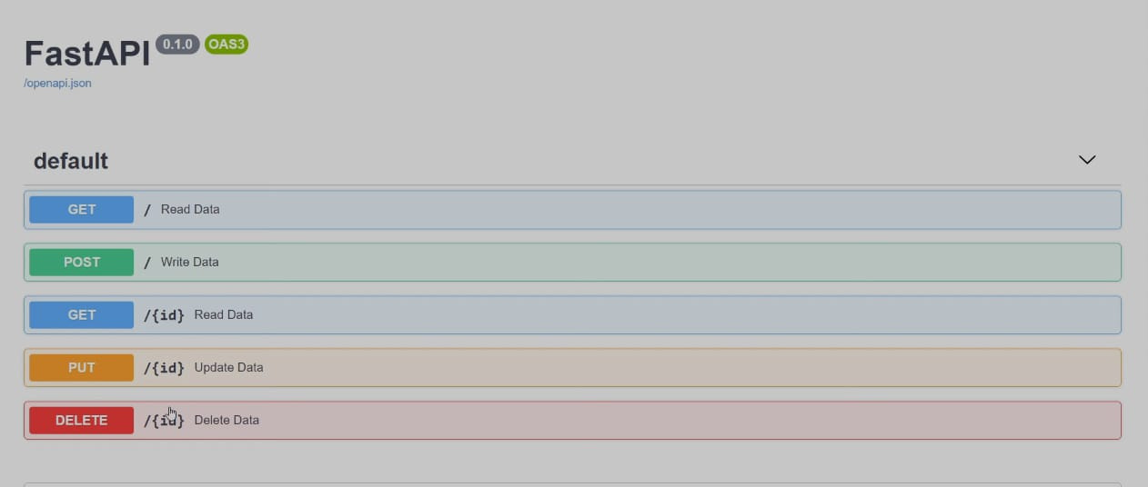
Expected Output
manjunath.kvmc@gmail.com || in/manjunatha-k-v-7a053822b/ || github.com/Manjunatha-kv ||hackerrank.com/manjunath_kvmc

Slide 8

THANK YOU
Necessity is the mother of invention
manjunath.kvmc@gmail.com || in/manjunatha-k-v-7a053822b/ || github.com/Manjunatha-kv ||hackerrank.com/manjunath_kvmc

