Slide 1
Failed Banking Transaction Analysis on GCP
Manjunatha Poojari

Slide 2
Project Overview
Objective:
Analyze failed banking transactions from multiple branches.
Scope:
3 Cities, 5 branches each, daily CSV data (7 days).
Goal:
Ingest, clean, filter, and visualize data.

Slide 3
Data Ingestion Process
Branches upload CSVs to GCS bucket.
Tool: gsutil command line utility.
Example command:
gsutil cp *.csv gs://your-bucket-name/transactions/

Slide 4
Dataproc Cluster Setup
Tool: Google Cloud Dataproc (Single Node)
Benefits: Scalable, cost-effective, integrates with GCS.
Job 1: Read, clean, and combine CSV files.

Slide 5
Execute Jobs
Execute the pyspark job by using below command
Example:
“gcloud dataproc jobs submit pyspark process_transactions.py \ --cluster=banking-analysis-cluster \--region=your-region”

Slide 6
Storing to Cloud SQL (MySQL)
Create Cloud SQL instance (MySQL).
Load the data from bucket to cloud sql database
Run sql queries

Slide 7
Analysis & Visualization using BigQuery
Connect BigQuery from Cloud SQL.
Run Sql Queries
Visualization: BigQuery Looker Studio

Slide 8
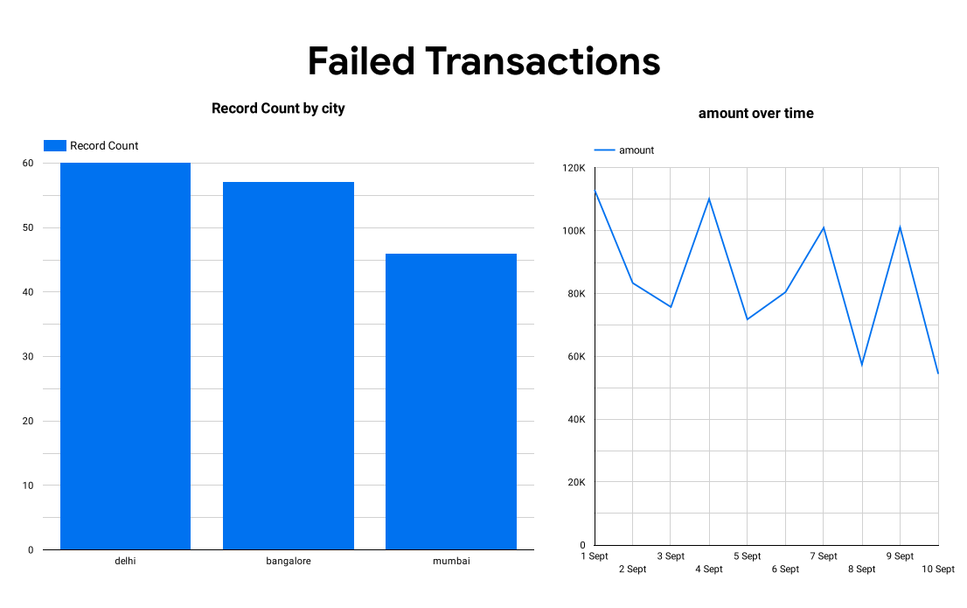
Sample outputs

Slide 9
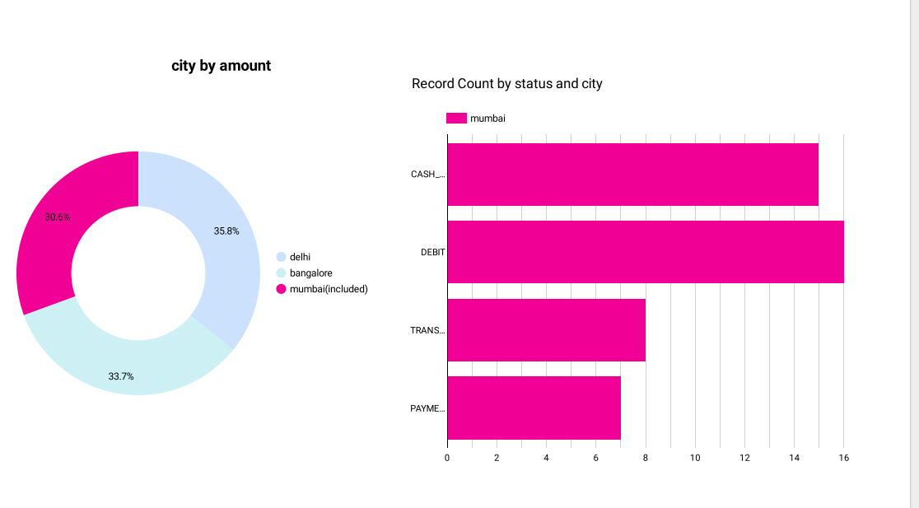

Slide 10
Benefits
Efficient Data Cleaning
Real-time Insights
Integrated GCP Services

Slide 11
Next Steps
Enhance with ML Models for Prediction

Slide 12
Thank you!

