Slide 1
Employee Data Analysis using Excel
STUDENT NAME:MANJU.S
REGISTER NO:2213331042115
DEPARTMENT: COMMERCE
COLLEGE BHARATHI WOMEN'S COLLEGE

Slide 2
PROJECT TITLE
Employee Performance Analysis using Excel

Slide 3


AGENDA
Problem Statement
Project Overview
End Users
Our Solution and Proposition
Dataset Description
Modelling Approach
Results and Discussion
Conclusion
3/21/2024 Annual Review

Slide 4

PROBLEM STATEMENT
Could you clarify what specific aspects of employee performance you need to analyze or the goals you want to achieve with this analysis? This will help in providing a more targeted problem statement.

Slide 5

PROJECT OVERVIEW
1.Data Analysis
2.Actionable Insights
3.Implementation and Monitoring
4.Performance Evaluation

Slide 6

WHO ARE THE END USERS?
1.Employees Themselves:
2.Executives and Senior Leaders
3.Human Resources Team
4.Managers and Supervisors

Slide 7

OUR SOLUTION AND ITS VALUE PROPOSITION
When analyzing employee performance, vendors typically offer solutions with features like real-time analytics, customizable reporting, and integration with existing HR systems. Their decision-making, and tools for setting and tracking goals.

Slide 8
Dataset Description
of IoT devices, both public and private, both fixed and mobile, arranged with their respective owner. All these objects need to be categorized by their typology, brand and model,

Slide 9

THE "WOW" IN OUR SOLUTION
3/21/2024 Annual Review
9

Slide 10
MODELLING
10

Slide 11
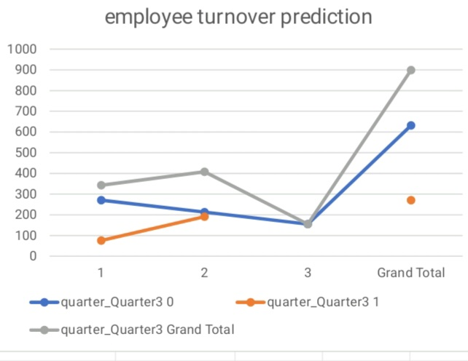
RESULT
11

Slide 12
conclusion

