Slide 1
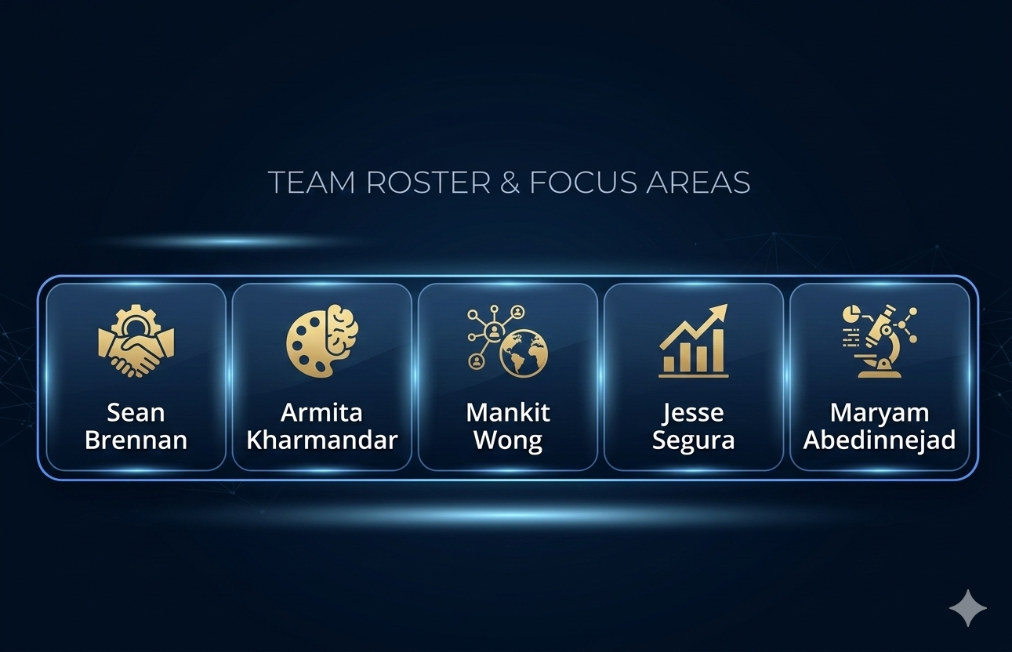
Bank Marketing Project
Predicting Term Deposit Subscriptions

Slide 2
Business Motivation & Dataset
Question: How can we increase subscription rates to term deposits while reducing telemarketing costs?
Dataset: UCI Bank Marketing Dataset
Pre-campaign vs Post-campaign:
Pre-campaign: Known before calling → used for modeling
Post-campaign: Known after calling → ‘duration’removed to avoid leakage
Categorical Features | Numerical Features
Job | Age
Marital | Campaign
Contact,… | Euribor3m,…
Dataset:
Direct marketing campaigns from a Portuguese bank
Goal:
Predict whether a client will subscribe (y: yes/no)
Importance:
Target high-probability clients, reduce cost, increase ROI

Slide 3

Model Selection
Models used for prediction:
• Logistic Regression (baseline)
• Decision Tree (simple, interpretable)
• Random Forest (ensemble, reduces overfitting)

Slide 4
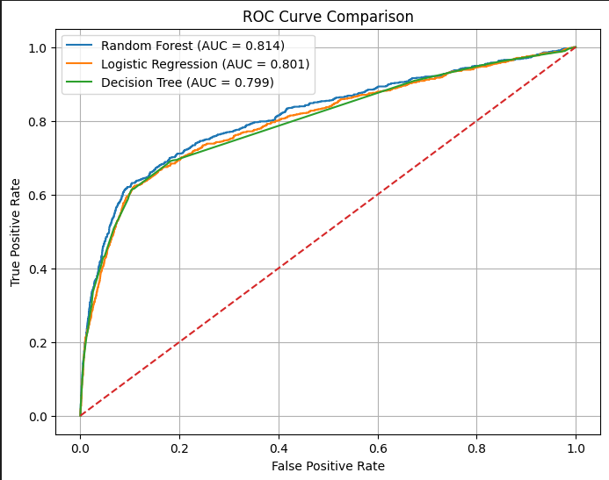
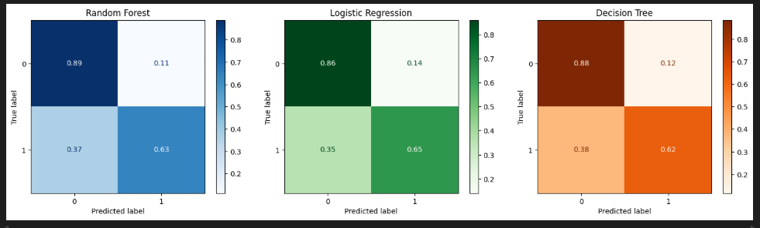
Model Evaluation
Metrics: Accuracy, Recall (Subscribers), F1-score
Notes:
Differences are very small (~0.01).
This is common in the Bank Marketing dataset.
Reason:
Tree models cannot extract much extra structure
Most predictive variables are simple demographic / economic variables, not complex interactions.
Logistic regression captures slightly more subscribers
Random Forest reduces false positives

Slide 5
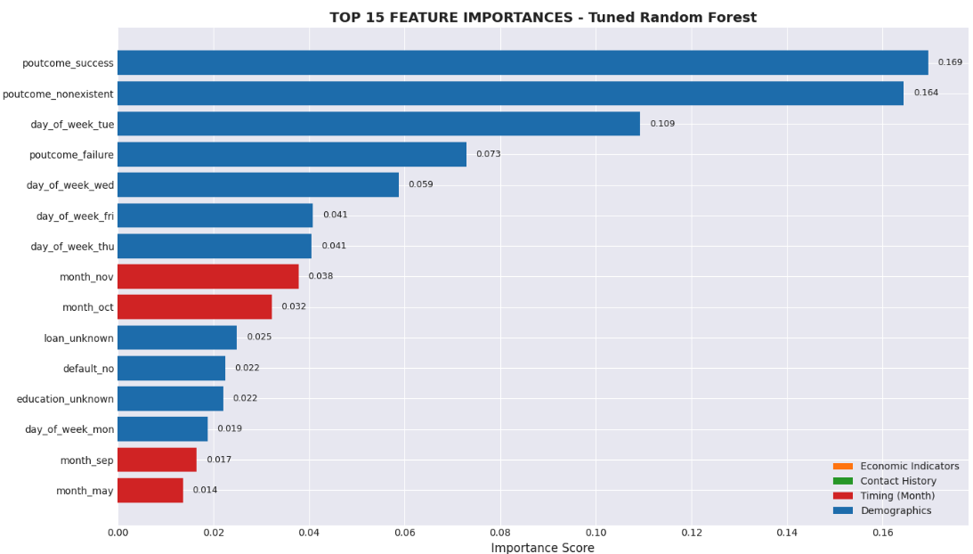
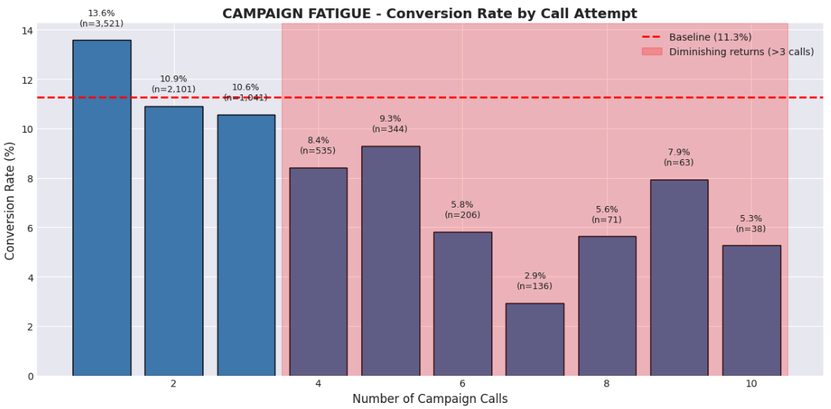
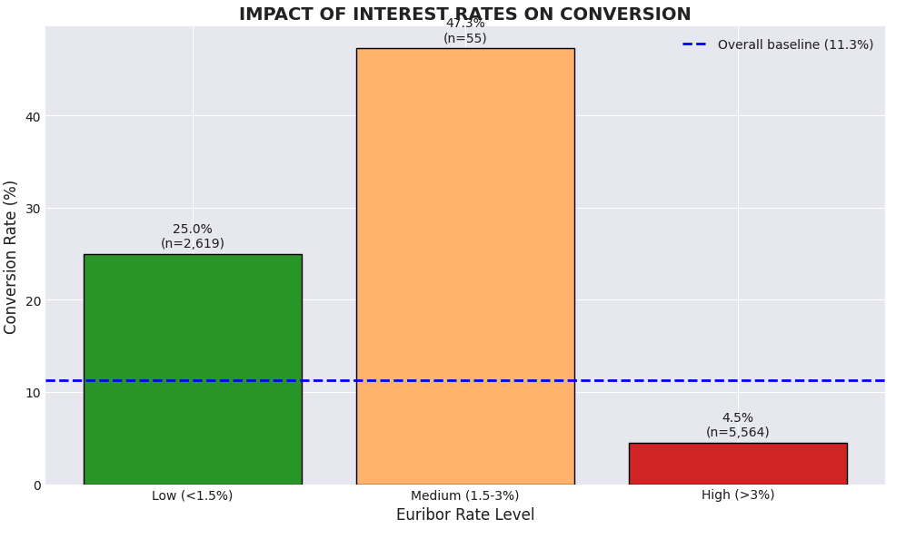
Feature Importance (SHAP Values)
Top features affecting campaign success:
• previous campaign outcome
• contact history
• euribor3m
• age
• contact type
1. Target Audience (Who to Call)
Students: +42% lift in subscription probability
Retirees: +33% lift
Avoid: Blue-collar, Services, Married
2. Strategic Timing (When to Call)
Euribor3m dominates timing decisions
Optimal: Call when Euribor < -1.6

Slide 6

Key Takeaways / Findings
Marketing Strategy:
Focus calls on high-propensity clients
Limit calls to 3 per customer
Skip low-propensity leads → save resources
Timing:
Target low euribor periods → higher conversions
Compliance & Explainability:
SHAP explainability for audits
Only pre-campaign data → prevents leakage
Impact:
30–40% fewer calls, same or higher conversions
Actionable for stakeholders: CDO, CRO, CMO

Slide 7
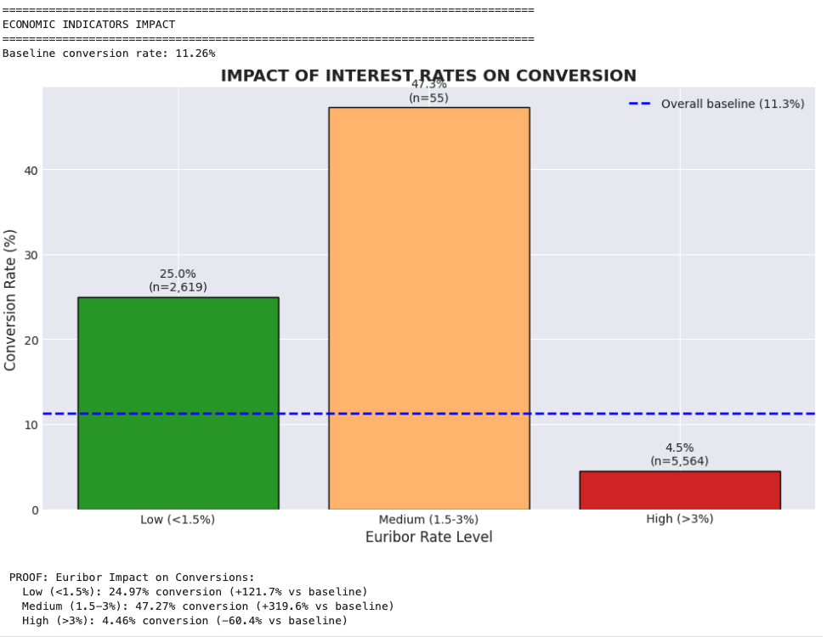
Appendix

Slide 8
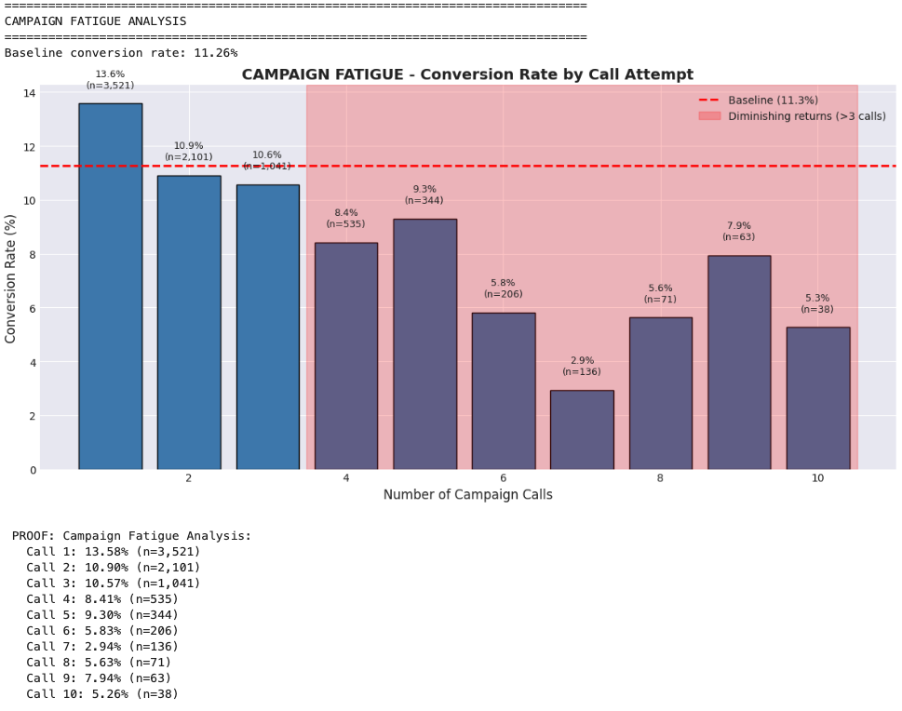
Appendix

Slide 9
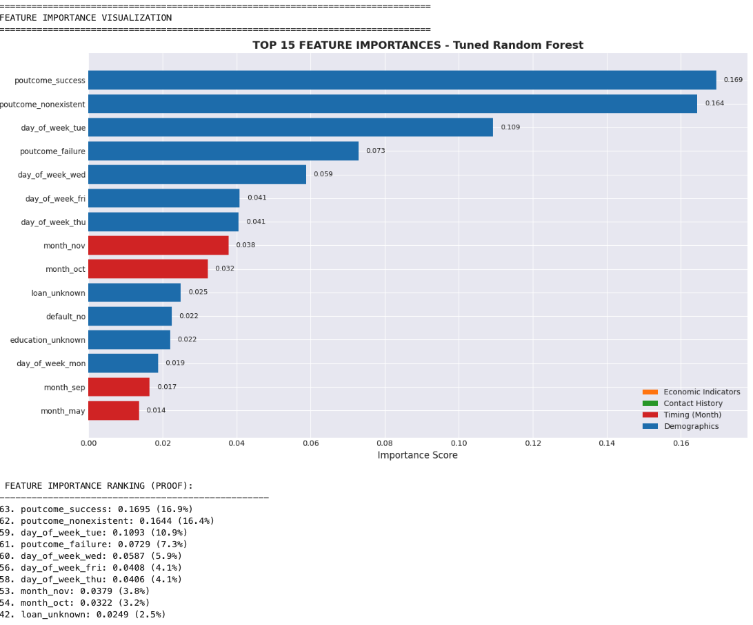
Appendix

