Slide 1


Introduction to E-Commerce Product Selection
This presentation will explore the challenges of maximizing product selection for an e-commerce platform. We will delve into the Knapsack Problem as a mathematical framework for understanding these challenges, and discuss how approximation algorithms can be used to find near-optimal solutions.

Slide 2


The Knapsack Problem
The Knapsack Problem involves choosing a subset of items with maximum value while adhering to a weight constraint. This analogy can be applied to an e-commerce platform, where the items represent products and the weight represents constraints like inventory or budget.
Value
Represents the profit generated by selling a product.
Weight
Represents the resources consumed by the product, like inventory or shipping costs.
Constraint
Represents the limitations on available resources.

Slide 3

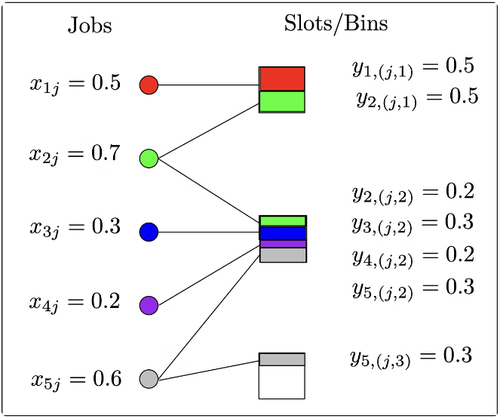
Approximation Algorithms for Knapsack
Approximation algorithms offer efficient solutions to complex problems like the Knapsack Problem. These algorithms aim to find solutions that are close to the optimal solution within a reasonable timeframe.
1
Greedy Algorithm
Chooses items based on their value-to-weight ratio, prioritizing items with the highest return per unit of resource consumed.
2
Dynamic Programming
Builds a table of optimal solutions for smaller subproblems, ultimately finding the optimal solution for the entire Knapsack Problem.
3
Approximation Algorithms
Focus on finding solutions that are close to the optimal solution within a specified error tolerance.

Slide 4
Maximizing Product Selection Objectives
The goal is to maximize the overall value of the product selection, which can be measured in terms of revenue, profit, customer satisfaction, or other relevant metrics. The algorithm should prioritize products that contribute the most to these objectives.
Revenue Maximization
Profit Maximization
Customer Satisfaction
Prioritizes products that generate the highest revenue per unit sold.
Considers both revenue and cost, aiming to maximize the difference between the two.
Includes factors like product rating, customer reviews, and repeat purchase rates.

Slide 5
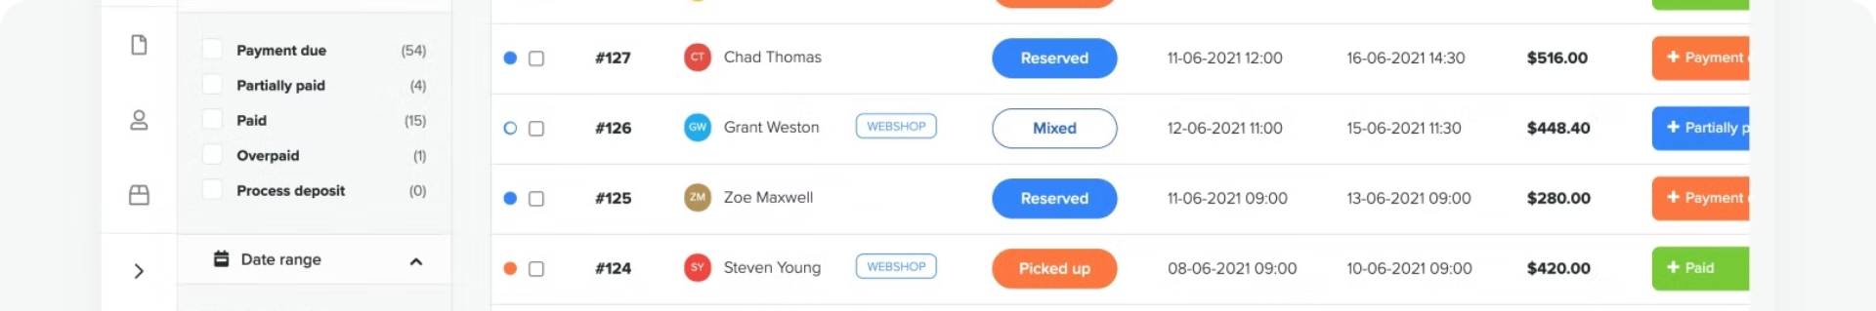
Constraints and Tradeoffs in Product Selection
E-commerce platforms face various constraints, including limited inventory, shipping capacity, and budget. The algorithm must consider these constraints and make tradeoffs to maximize product selection within the available resources.
Inventory
Limited availability of products.
Shipping Capacity
Constraints on the volume and weight of products shipped.
Budget
Financial limitations on purchasing products.

Slide 6





Implementing the Approximation Algorithm
Implementing an approximation algorithm requires careful design and coding. The algorithm should be optimized for efficiency and scalability to handle large datasets and real-time updates.
Data Acquisition
Collect data on product value, weight, and other relevant metrics.
Algorithm Implementation
Code the chosen approximation algorithm to efficiently select products.
Integration with Platform
Connect the algorithm with the e-commerce platform's product management system.

Slide 7

Optimizing the Approximation Algorithm
Optimization involves improving the algorithm's performance, reducing its running time, and improving the accuracy of the solutions it produces. This can involve techniques like pruning, heuristics, and parallel processing.
1
Pruning
2
Heuristics
3
Parallel Processing
Eliminating unnecessary computations by identifying and removing irrelevant data or options.
Using rules of thumb or approximate solutions to guide the search for optimal product selections.
Distributing the computational workload across multiple processors to accelerate the algorithm's execution.

Slide 8




Evaluating the Effectiveness of the Approach
The effectiveness of the approximation algorithm should be evaluated using metrics like accuracy, efficiency, and impact on key business objectives. This involves comparing the algorithm's performance to alternative approaches and analyzing its impact on revenue, profit, and customer satisfaction.
Revenue Increase
Profit Margin Improvement
Customer Satisfaction
Measure the impact on revenue generation.
Evaluate the increase in profitability.
Analyze customer feedback and ratings.

Slide 9
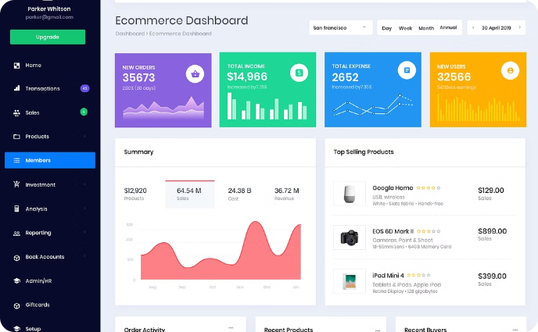

Integrating the Solution into the E-Commerce Platform
Integrating the approximation algorithm into the e-commerce platform involves connecting it with the platform's product management system, user interface, and data infrastructure. The integration should be seamless and user-friendly, providing a smooth experience for both administrators and customers.
Product Management System
User Interface
The algorithm should be integrated with the system that manages product information and inventory.
The platform should present the selected products in an appealing and user-friendly manner.

Slide 10


Conclusion and Next Steps
This presentation has outlined a comprehensive approach to maximizing product selection for an e-commerce platform. By leveraging approximation algorithms, e-commerce businesses can optimize their product offerings, improve profitability, and enhance customer satisfaction. Future research should focus on developing more sophisticated algorithms that can adapt to dynamic environments and incorporate real-time feedback from customers.

