Slide 1
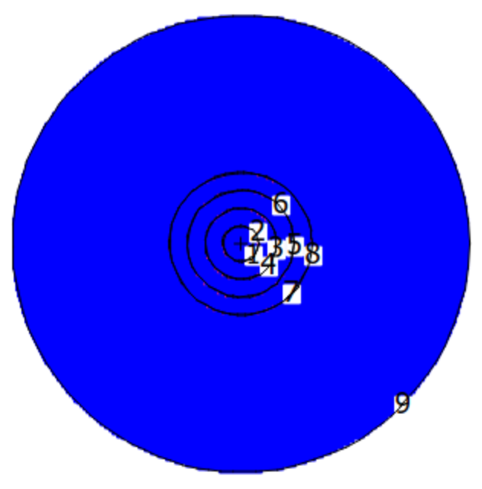
Study of a
Low-Enriched Uranium
Neutron Source Concept Using MCNP Code
Cordell Griggs
Notes:
Timing: ~1 minute. Open with the big question: how can we model a neutron source that is useful while staying constrained by criticality safety? Define this as a modeling and criticality-safety presentation, not a hardware design review.

Slide 2
Roadmap
1
Motivation & Goal
Importance of neutrons and source efficiency
2
Background Concepts
Chain reactions and how to quantify source efficiency
3
Tool
Monte Carlo method and MCNP inputs
4
Study
Procedure for optimizing source geometry & Modeling Constraints
5
Findings
Qualitative trends and quantitative efficiency outcomes
6
Conclusion
Can this source concept be implemented in real-world?
Notes:
Timing: ~1 minute. Tell the audience the talk has three parts: physics motivation, MCNP method, and results/limitations.

Slide 3
Why are neutrons useful?
Neutrons are used to probe fundamental physics
Neutrons are used in precision experiments to probe the Standard Model and narrow down theories for why its wrong.
Measuring a non-zero nEDM with current means of precision would provide an explanation for the matter-antimatter asymmetry of the universe
Measuring a zero nEDM with higher precision narrows down theories that explain the asymmetry
These experiments require an efficient neutron source. More neutrons can lead to better sensitivity.
Source
Experiment
Neutron Source → Experiment
Notes:
Timing: ~2 minutes. Emphasize that source performance is not only about making neutrons; it is about delivering useful neutrons without crossing safety limits.

Slide 4
Goal:
Researchers at LANL are interested in using an 18 kg mass of Uranium to boost the number of UCNs generated at LANSCE. In order to demonstrate the possibility of creating an efficient neutron source using 18kg of LEU, we aimed to demonstrate a geometry that achieves criticality using cylinders. Cylinders are sub-optimal for neutron sources, so using them acts to counteract real-life factors, such as structural support, to a degree.
Notes:
Timing: ~2 minutes. Emphasize that source performance is not only about making neutrons; it is about delivering useful neutrons without crossing safety limits.

Slide 5
Chain reactions and k_{eff}
Neutron Escapes
Uranium Fissions
Uranium Fission
Cycle Repeats
Initial Neutron
Neutron Continues Chain
Neutron Escapes
k_{eff} = # neutrons in current generation / # neutrons in previous generation
Notes:
Timing: ~2 minutes. Define k_eff carefully. The diagram is conceptual: two neutrons leak away and one continues, corresponding to approximately steady multiplication.

Slide 6
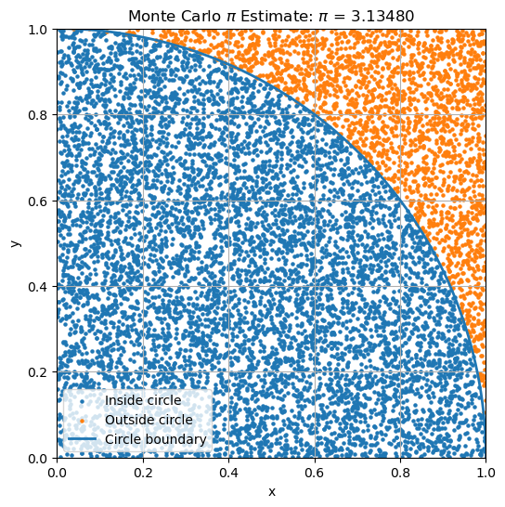
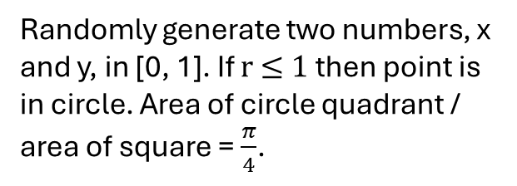
Monte Carlo Intuition
Estimate a deterministic quantity by averaging many random histories
Randomly sample many points or particle histories and average the outcomes of those samples.
Uncertainty decreases as the number of histories increases.
π example
Randomly generate two numbers, x and y, in [0, 1]. If r ≤ 1 then point is in circle. Area of circle quadrant / area of square = $\frac{π}{4}$.
Notes:
Timing: ~2 minutes. Use the pi example to make Monte Carlo familiar. Then say MCNP replaces random points with random neutron histories governed by interaction probabilities.

Slide 7
MCNP’s Specific Procedure to Estimate k_{eff}
How does MCNP estimate k_{eff}?
The Monte Carlo N-Particle (MCNP) code uses Monte Carlo simulations to estimate k_{eff} for a given geometry of materials. It repeats many cycles in which a first-generation neutron is spawned at a given position and it's (and following-generation neutron's) interactions are simulated. Each cycle involves imposing random walks on the neutron(s), modeling interactions after each step of the walk, and repeating the process for the following generations until k_{eff} converges whence it can be accurately estimated. During this process, the interaction amplitudes are contained in a large of collection of data to which the MCNP code uses to calculate the probability of an interaction at the given initial and final momenta of the step. Furthermore, the resulting k_{eff} 's of each individual cycle are averaged to a final k_{eff} estimate.
Notes:
Timing: ~1.5 minutes. Keep this high-level. Avoid reading code line-by-line. The goal is that the audience understands the structure of an input file.

Slide 8
How the MCNP model is organized
Three card types define the simulation
Surface cards
Define boundaries and shapes
Cell cards
Assign materials to volumes
Data cards
Define materials + Run Conditions
Surfaces are the geometric boundaries
Cells are the regions or volumes between surfaces
Materials define composition and density
kcode/ksrc define the initial conditions and statistical parameters to estimate k_{eff}
Notes:
Timing: ~1.5 minutes. Keep this high-level. Avoid reading code line-by-line. The goal is that the audience understands the structure of an input file.

Slide 9
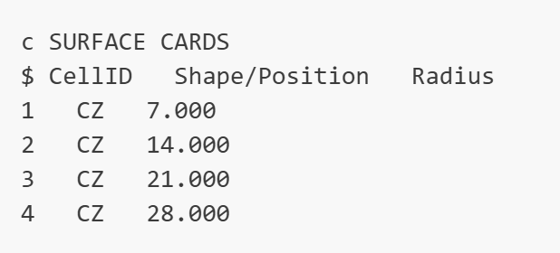
Surface Cards Example
Notes:
Timing: ~1.5 minutes. Keep this high-level. Avoid reading code line-by-line. The goal is that the audience understands the structure of an input file.

Slide 10
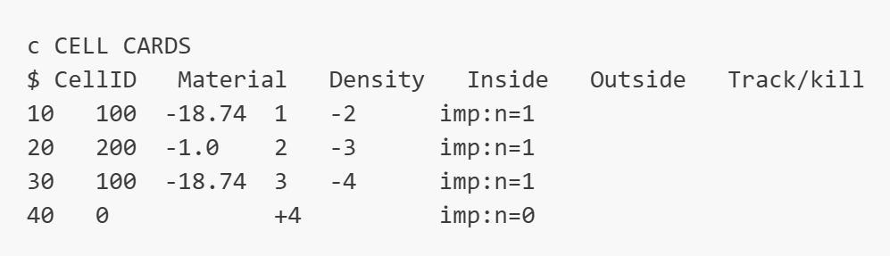
Cell Cards Example
Notes:
Timing: ~1.5 minutes. Keep this high-level. Avoid reading code line-by-line. The goal is that the audience understands the structure of an input file.

Slide 11
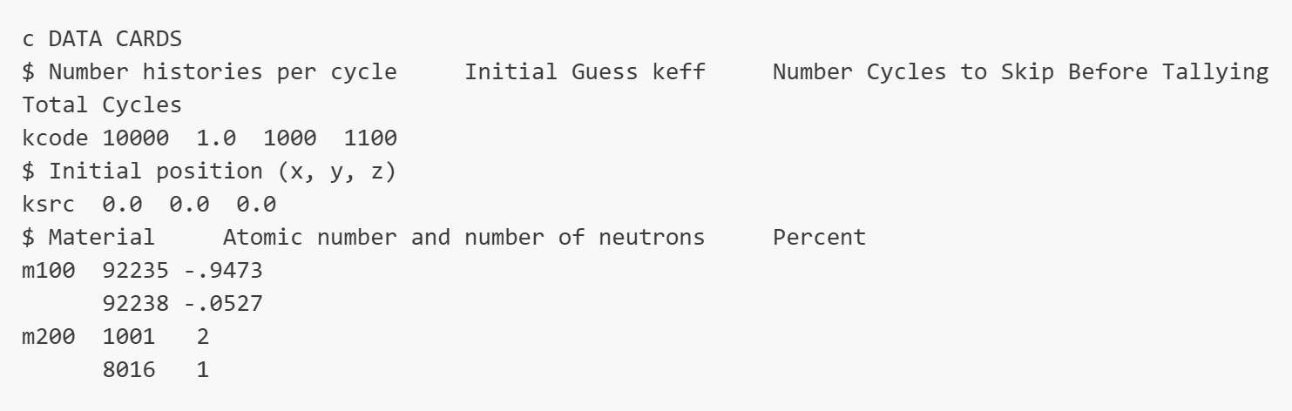
Data Cards Example
Notes:
Timing: ~1.5 minutes. Keep this high-level. Avoid reading code line-by-line. The goal is that the audience understands the structure of an input file.

Slide 12
Scope & Model Constraints
What was restricted, and what was idealized
Study used a fixed 18 kg LEU (80-20) mass limit and concentric cylindrical geometry
→ real-world engineering constraints were not included in the idealized model
Water regions were modeled between LEU shells to moderate or slow down neutrons and increase their probability to fission
The study explored geometry sensitivity using repeated MCNP runs in which k_{eff} was estimated and geometric parameters were adjusted incrementally
Notes:
Timing: ~1.5 minutes. Clarify that the model is intentionally idealized, so conclusions are about simulation trends, not a final source design.

Slide 13
Workflow: Sweeping Parameters
The study identified qualitative trends to optimize geometry
1. Define a General Geometry
2. Run MCNP to
Estimate kₑ_{ff}
3. Adjust Variables
4. Observe Trend & Refine Geometry
Because total mass was constrained, changing one parameter often forced another to change.
The results are best interpreted as qualitative trends for our specific mass constraint rather than a quantitative general result.
Notes:
Timing: ~2 minutes. Explain how you changed one parameter at a time when possible, but mass conservation couples variables. Emphasize the value of systematic comparison.

Slide 14
Qualitative Analysis Factors & Findings
What changed in the simulations
Moderation Layers
Mass-Opportunity Cost of Top & Bottom Surfaces
Mass Allocation Throughout Shells
Water can slow neutrons into a more favorable energy or momentum range for fission with LEU
Too much spacing can spread the system out and increase leakage
Adding LEU caps/end material was mass-expensive in the study.
Longer cylinders reduced total leakage in the model.
LEU shell count, thickness, and spacing are coupled by the mass constraint.
These parameters had to be adjusted accordingly.
Overall message: The model is a balance between favorable geometric features and their mass opportunity cost.
Notes:
Timing: ~2 minutes. Keep this qualitative. Avoid listing exact dimensions. The useful takeaway is the competition between moderation and leakage under a mass constraint.

Slide 15
Notable Simulation Outcomes
Highest simulated case
k_{eff} = 1.0386
σ = 0.0006
12 kg LEU near-threshold case
k_{eff} = 0.991
σ ≈ 0.0008
kₑ_{ff} = 1
0.991
1.0386
Safety Context: The lower mass near the safety threshold has a ~16% chance of going critical.
Notes:
Timing: ~2 minutes. State the numerical results as reported, but emphasize that exceeding unity is a safety-relevant flag, not a design goal. Use this slide to transition into limitations.

Slide 16
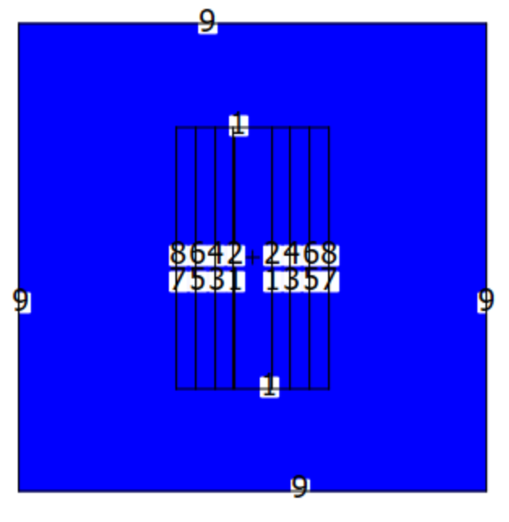
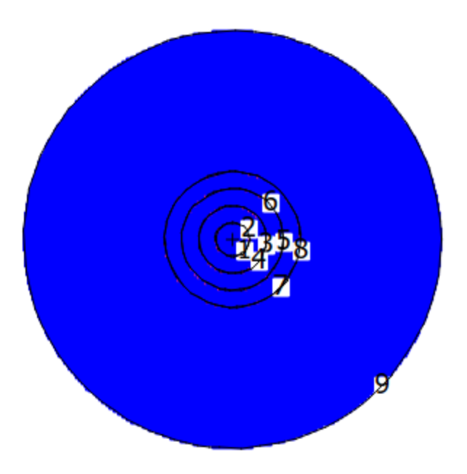
Highest k_{eff} Achieved
The model incorporates four 65 mm thick and 56 cm tall LEU shells spaced apart by 4 cm of water. Additionally, the inner-radius of the center shell is 4 cm. The geometry does not include top and bottom parts of the LEU shells because of the mass opportunity cost as previously mentioned. This geometry yields k_{eff} = 1.0386 and σ = 0.0006
.
Notes:
Timing: ~2 minutes. State the numerical results as reported, but emphasize that exceeding unity is a safety-relevant flag, not a design goal. Use this slide to transition into limitations.

Slide 17
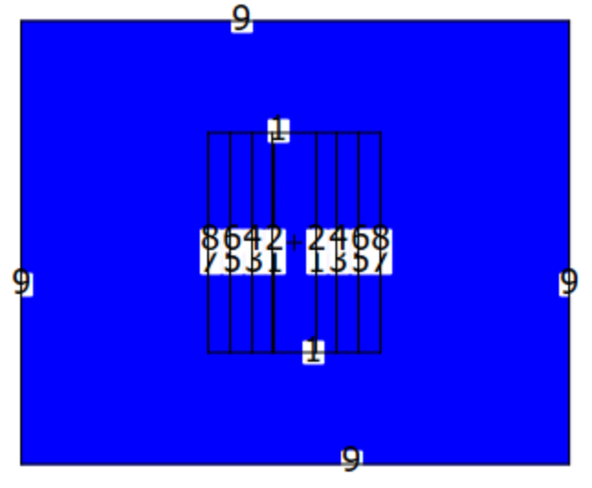
12 kg LEU Geometry Near Criticality
The geometry depicted above uses 12 kg of LEU estimating k_{eff} = 0.991 and σ = 0.0008. It involves four 60 mm thick and 42 cm tall LEU shells with 4 cm of water spaced between them. It also does not use LEU on the top and bottom portions of the shells.
.
Notes:
Timing: ~2 minutes. State the numerical results as reported, but emphasize that exceeding unity is a safety-relevant flag, not a design goal. Use this slide to transition into limitations.

Slide 18
Conclusion
Using cylinders, we were able to model a geometry that yields k_{eff} = 1.0386 and σ = 0.0006. We were also able to produce a geometry using only 12 kg of LEU that yields k_{eff} = 0.991 and σ = 0.0008. This supports the possibility of creating an efficient and safe neutron source with 18 kg of LEU.
Acknowledgments: Dr. Marie Blatnik taught me how to use the MCNP code and explained concepts like the chain reactions to me
Notes:
Timing: ~2 minutes. This is the most important safety framing slide. Make clear that MCNP results are inputs into a larger safety process, not standalone authorization.

