Slide 1
Some Numerical Methods for Time-Dependent PDEs
Michael Potts

Slide 2
Intro and Motivation
PDEs model physical phenomena such as diffusion, wave propagation, and countless other things.
Analytical solutions are often unavailable due to nonlinearities and complex boundary conditions
Numerical methods are therefore essential for approximating solutions and understanding system behavior
We will examine two approaches for time-dependent PDEs:
Method of Lines
Exponential Time Difference RK4
Together, these methods provide a foundation for numerically studying a wide range of PDEs

Slide 3

The Method of Lines: Theory
Method of Lines combines numeric differentiation (spatial discretization) with ODE solvers
It requires the PDE to be written as a system that is first-order in time, with the time derivative isolated
Converts the PDE into a system of coupled ODEs in the remaining spatial variables
We can see how it works through applying it to the 1D heat equation.
$$∂_{t}u=∂_{x}^{2} u$$

Slide 4
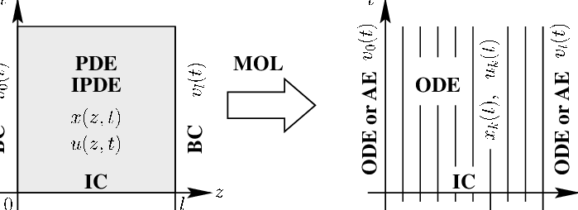

The first step is to discretize over our spatial coordinates.
$$\text{Let} \text{our} \text{spatial} \text{domain} \text{range} \text{from}\text{ 0 }\text{to} \text{L}\text{. }\text{Let} \text{n} \text{be} \text{the} \text{number} \text{of} \text{discretized} \text{points}\text{.}$$
$$\text{Thus}\text{, }\text{our} \text{domain} \text{points} \text{become} D=\{0,\frac{L}{n},\frac{2 L}{n},…,L\}$$

Slide 5

Then, we must discretize our solution over those points.
$$\text{Let} u_{k}\left(t\right)=u\left(x_{k},t\right) \text{where} x_{k}∈D$$

Slide 6
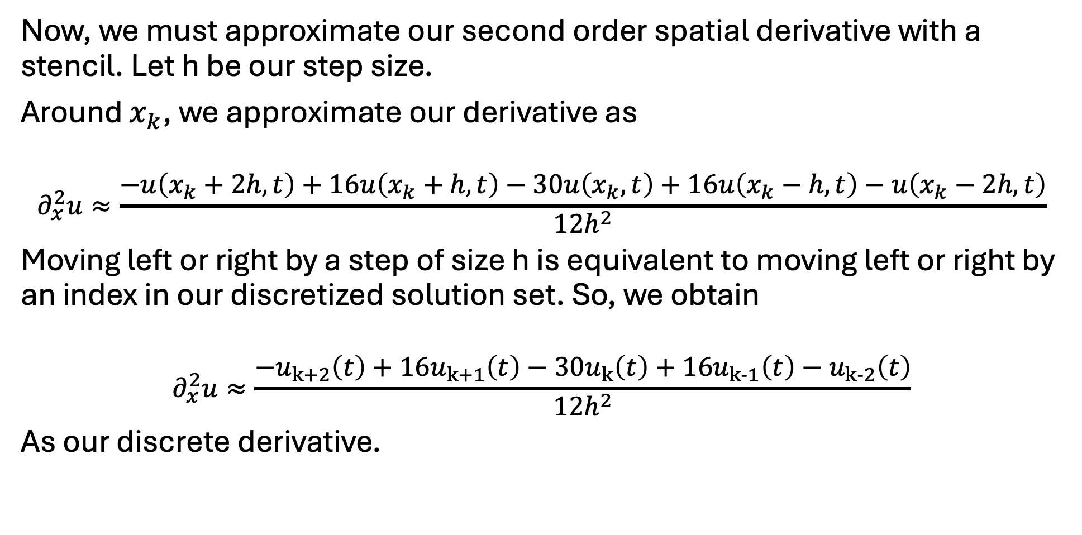
Now, we must approximate our second order spatial derivative with a stencil. Let h be our step size.
Around $x_{k}$, we approximate our derivative as
$∂_{x}^{2}u≈\frac{−u\left(x_{k}+2h,t\right)+16u\left(x_{k}+h,t\right)−30u\left(x_{k},t\right)+16u\left(x_{k}−h,t\right)−u\left(x_{k}−2h,t\right)}{12h^{2}}$
Moving left or right by a step of size h is equivalent to moving left or right by an index in our discretized solution set. So, we obtain
$$∂_{x}^{2}u≈\frac{−u_{k+2}\left(t\right)+16u_{k+1}\left(t\right)−30u_{k}\left(t\right)+16u_{k-1}\left(t\right)−u_{k-2}\left(t\right)}{12h^{2}}$$
As our discrete derivative.

Slide 7
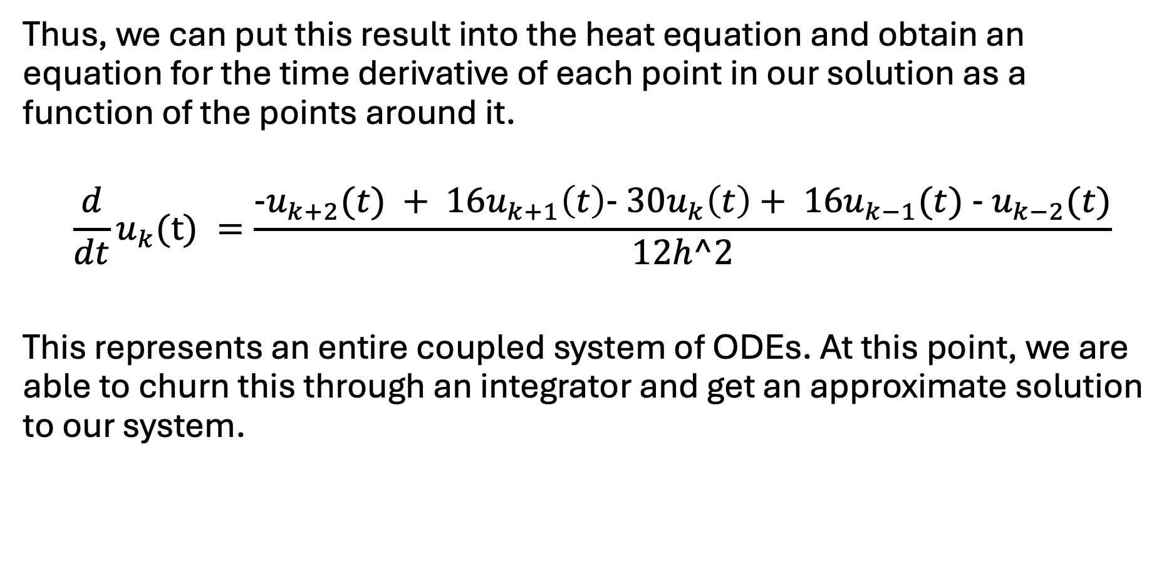
Thus, we can put this result into the heat equation and obtain an equation for the time derivative of each point in our solution as a function of the points around it.
$$\frac{d}{dt}u_{k}(t) =\frac{-u_{k+2}(t) + 16u_{k+1}\left(t\right)- 30u_{k}\left(t\right)+ 16u_{k−1}(t) - u_{k−2}(t)}{12h^2}$$
This represents an entire coupled system of ODEs. At this point, we are able to churn this through an integrator and get an approximate solution to our system.

Slide 8
Method of Lines: Results
The procedure that was outlined generalizes to different kinds of problems and higher dimensions.
Now we get to see what interesting simulations this method can produce!
Since they are so common in intro courses for PDEs, the two we will test here are the 2D heat and wave equation.

Slide 9
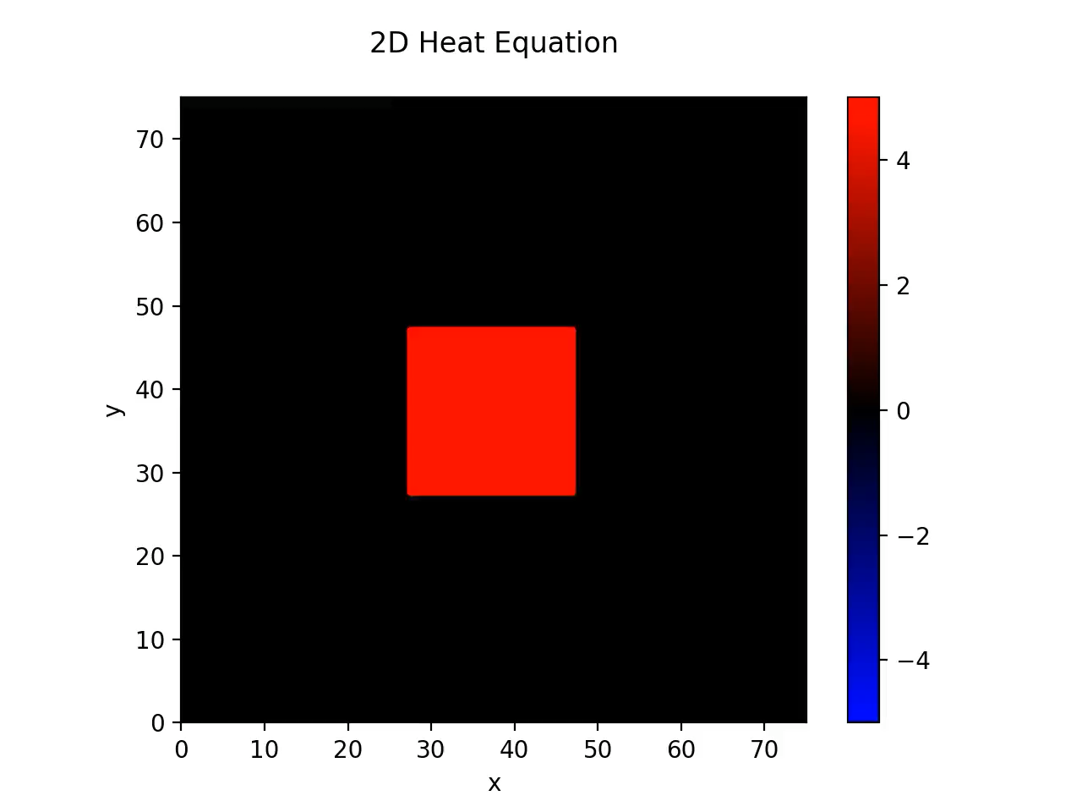

Slide 10


Slide 11
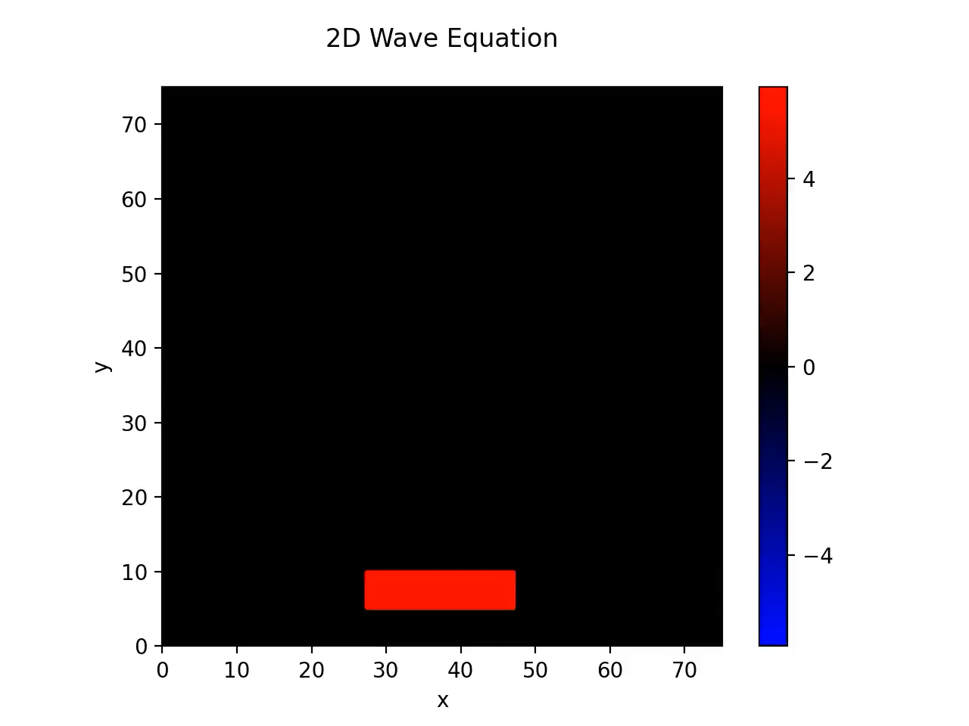

Slide 12

The Kuramoto-Sivashinsky Equation (KSE)
There is no simulation on this slide.
Here is what this PDE looks like
$$∂_{t} u={- ∇}^{2}u - ∇^{4}u - {\left|∇u\right|}^{2}$$
Where
$$∇^{4}=∂_{x}^{4}+2 ∂_{x}^{2} ∂_{y}^{2}+∂_{y}^{4}$$
Is the Bilaplacian

Slide 13
Why no simulation yet?
High-order derivatives (e.g., fourth-order) and nonlinear terms make the PDE difficult to handle
Discretizing high order operators like the bilaplacian is complex, especially due to mixed derivative terms
The equation is stiff, requiring careful numerical treatment
Basic approaches like the Method of Lines may be insufficient for a reasonable discretization.
A more sophisticated method is needed for:
Accurate handling of high-order spatial derivatives
Stable and efficient time stepping

Slide 14

Exponential Time Difference RK4: Theory
To simulate the KSE, we will construct an algorithm known as Exponential Time Difference RK4 (ETDRK4) by considering PDEs of the form
$$∂_{t}u=Lu+N\left(u,t\right)$$
Where L is a linear operator and N(u,t) is the nonlinear term
It is a pseudo spectral method that is designed for handling stiff, high order problems.

Slide 15
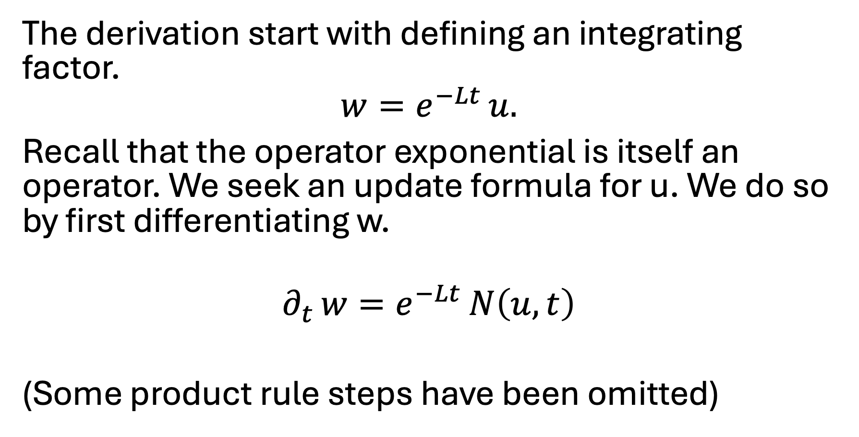
The derivation start with defining an integrating factor.
$$w=e^{−Lt} u.$$
Recall that the operator exponential is itself an operator. We seek an update formula for u. We do so by first differentiating w.
$$∂_{t} w=e^{−Lt} N\left(u,t\right)$$
(Some product rule steps have been omitted)

Slide 16
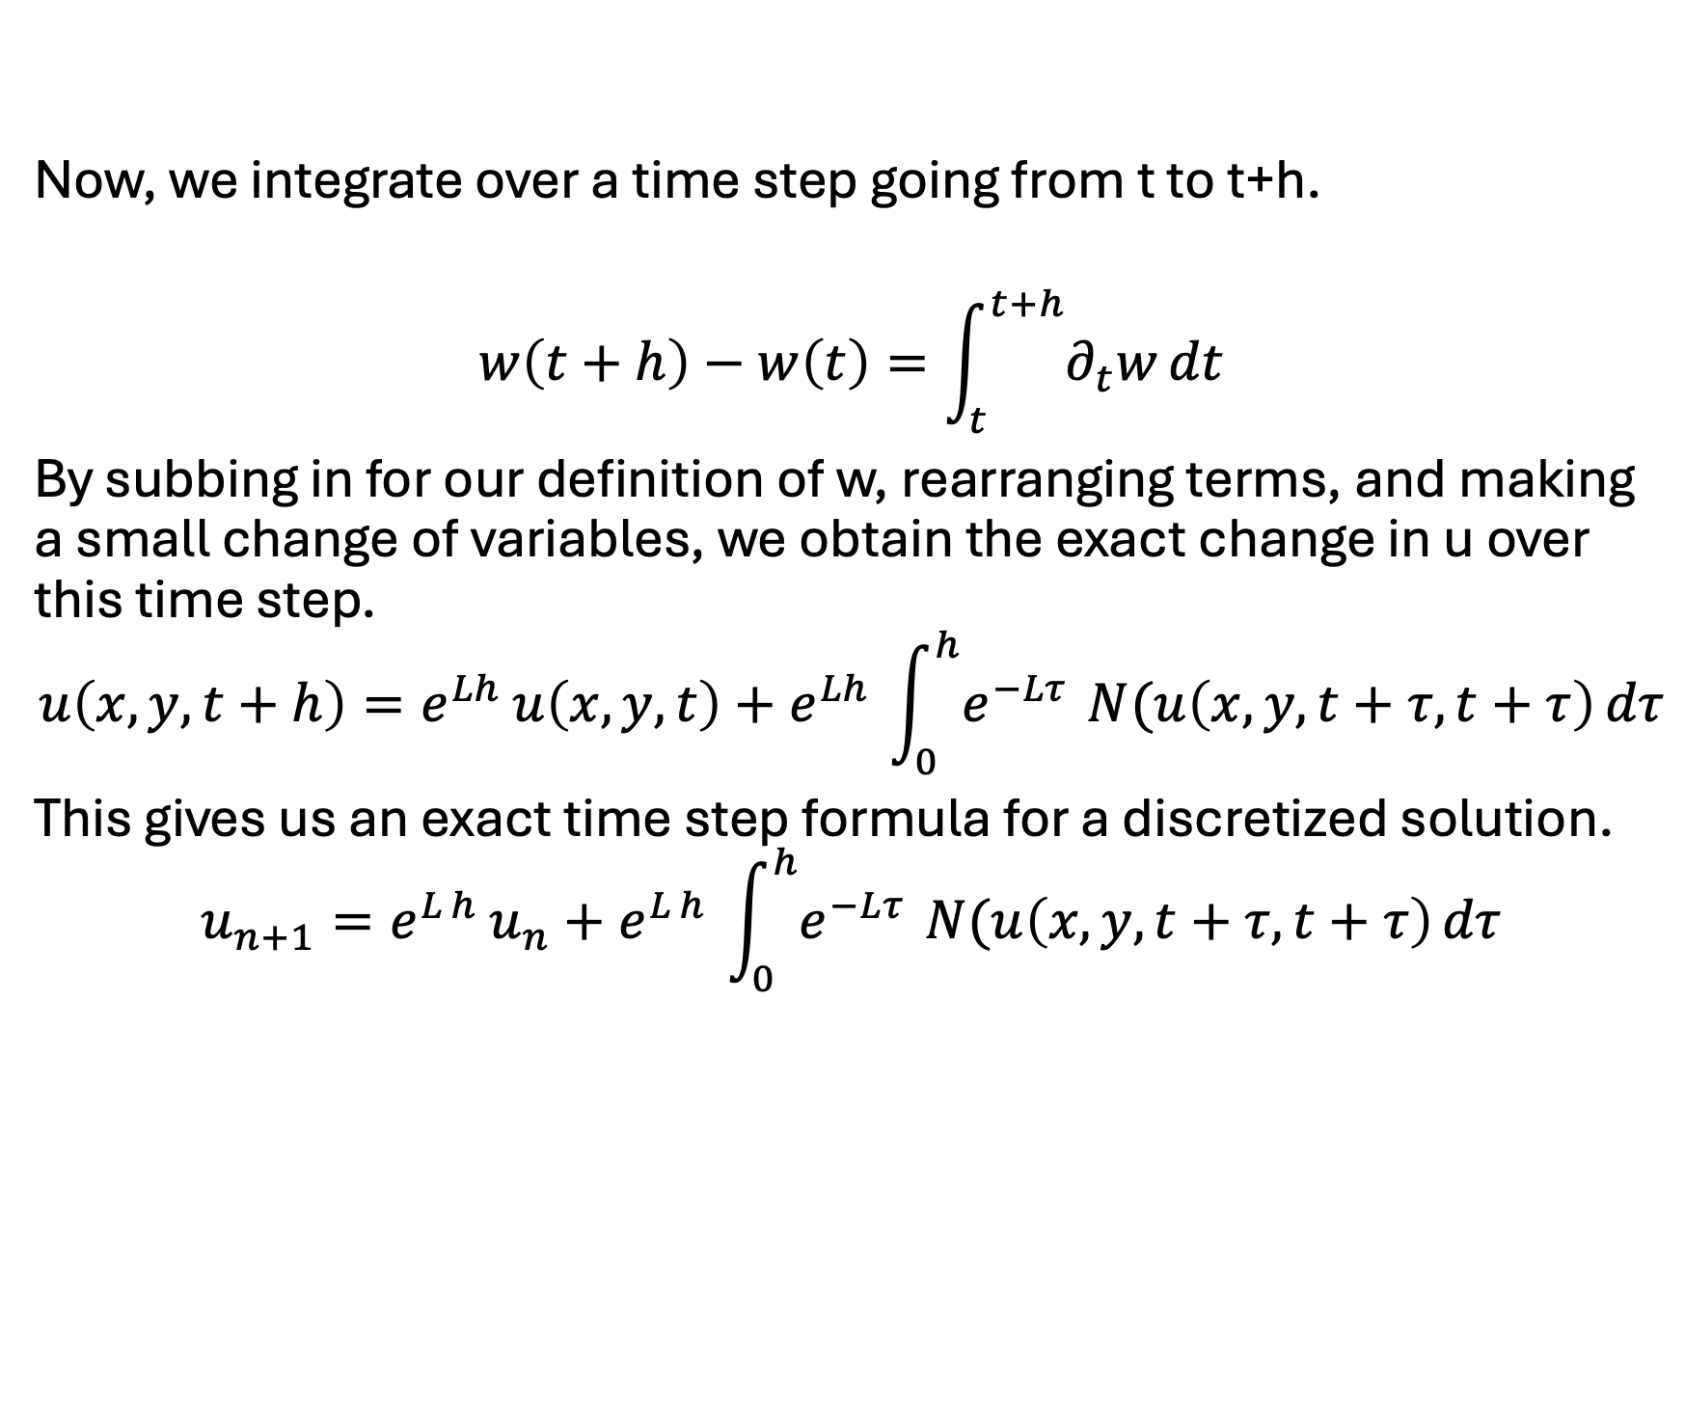
Now, we integrate over a time step going from t to t+h.
$$w\left(t+h\right)−w\left(t\right)=\int_{t}^{t+h}{∂_{t}w}dt$$
By subbing in for our definition of w, rearranging terms, and making a small change of variables, we obtain the exact change in u over this time step.
$$u\left(x,y,t+h\right)=e^{Lh} u\left(x,y,t\right)+e^{Lh} \int_{0}^{h}{e^{−Lτ}} N(u\left(x,y,t+τ,t+τ\right) dτ$$
This gives us an exact time step formula for a discretized solution.
$$u_{n+1}=e^{L h} u_{n}+e^{L h} \int_{0}^{h}{e^{−Lτ}} N(u\left(x,y,t+τ,t+τ\right) dτ$$

Slide 17
Some Things Before Moving Forward
Note some that we never discretized the operator L. In fact, if there is no nonlinear term, then this method will be exact.
We have not done anything different from the construction of other exponential time differencing methods. The distinction comes in how you approximate the integral of the nonlinear term.
Hence the name, ETDRK4 uses an RK4-like quadrature to approximate it in terms of our discretization variables.

Slide 18
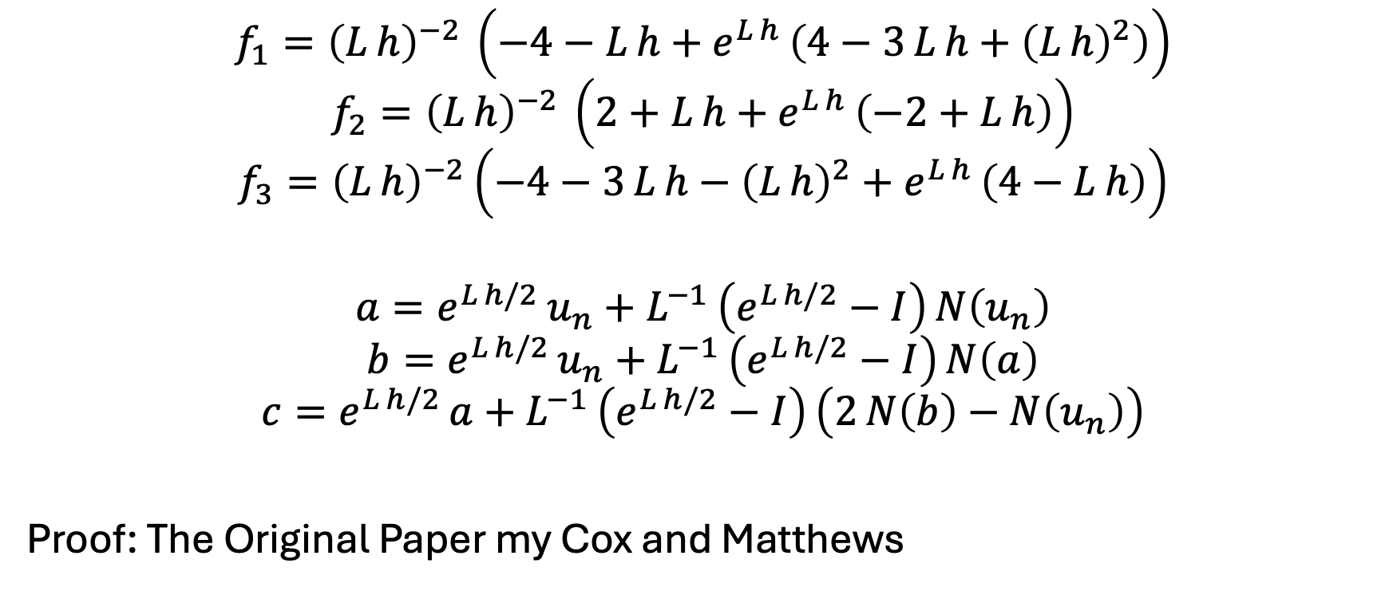
Our Quadrature Coefficients
$$f_{1}​={\left(L h\right)}^{−2} \left(−4−L h+e^{L h} \left(4−3 L h+{\left(L h\right)}^{2}\right)\right)$$
$$f_{2}={\left(L h\right)}^{−2} \left(2+L h+e^{L h} \left(−2+L h\right)\right)$$
$$f_{3}​={\left(L h\right)}^{−2}\left(−4−3 L h−{\left(L h\right)}^{2}+e^{L h} \left(4−L h\right)\right)$$
$$a=e^{L h/2} u_{n}+L^{−1} \left(e^{L h/2}−I\right) N\left(u_{n}\right)$$
$$b=e^{L h/2} u_{n}+L^{−1} \left(e^{L h/2}−I\right) N\left(a\right)$$
$$c=e^{L h/2} a+L^{−1} \left(e^{L h/2}−I\right) \left(2 N\left(b\right)−N\left(u_{n}\right)\right)$$
Proof: The Original Paper my Cox and Matthews

Slide 19

The Final Update Formula!
$$u_{n+1}=e^{L h} u_{n}+h \left(N\left(u_{n}\right) f_{1}+2 \left(N\left(a\right)+N\left(b\right)\right) f_{2}+N\left(c\right) f_{3}\right)$$
At this point, the theory for this method has technically been fully developed. You can, hypothetically, go and compute all the update terms by expanding these operator exponentials.
This is, of course, silly to do in practice, so we can do some more theory to

Slide 20
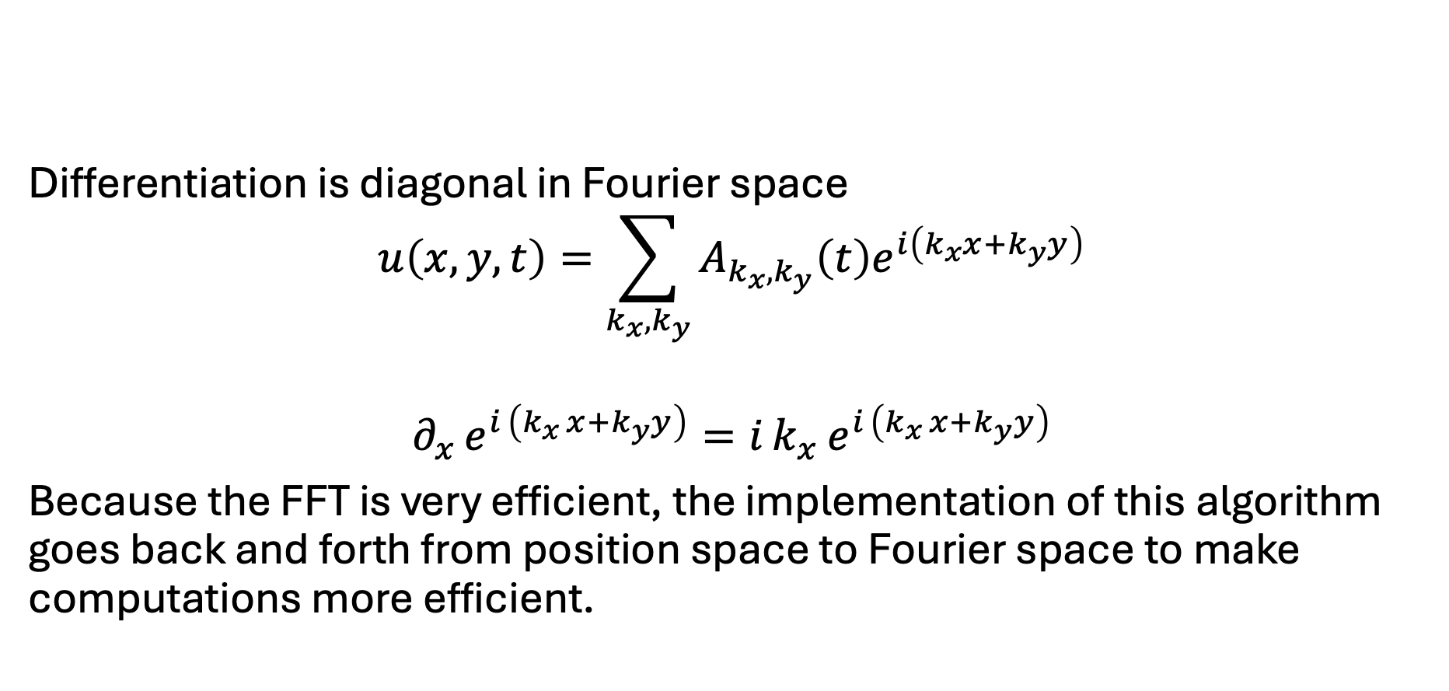
Some Extra Bits of Theory
Differentiation is diagonal in Fourier space
$$u\left(x,y,t\right)=\sum_{k_{x},k_{y}}{A_{k_{x},k_{y}}\left(t\right)e^{i\left(k_{x}x+k_{y}y\right)}}$$
$$∂_{x} e^{i \left(k_{x} x+k_{y}y\right)}=i k_{x} e^{i \left(k_{x} x+k_{y}y\right)}$$
Because the FFT is very efficient, the implementation of this algorithm goes back and forth from position space to Fourier space to make computations more efficient.

Slide 21
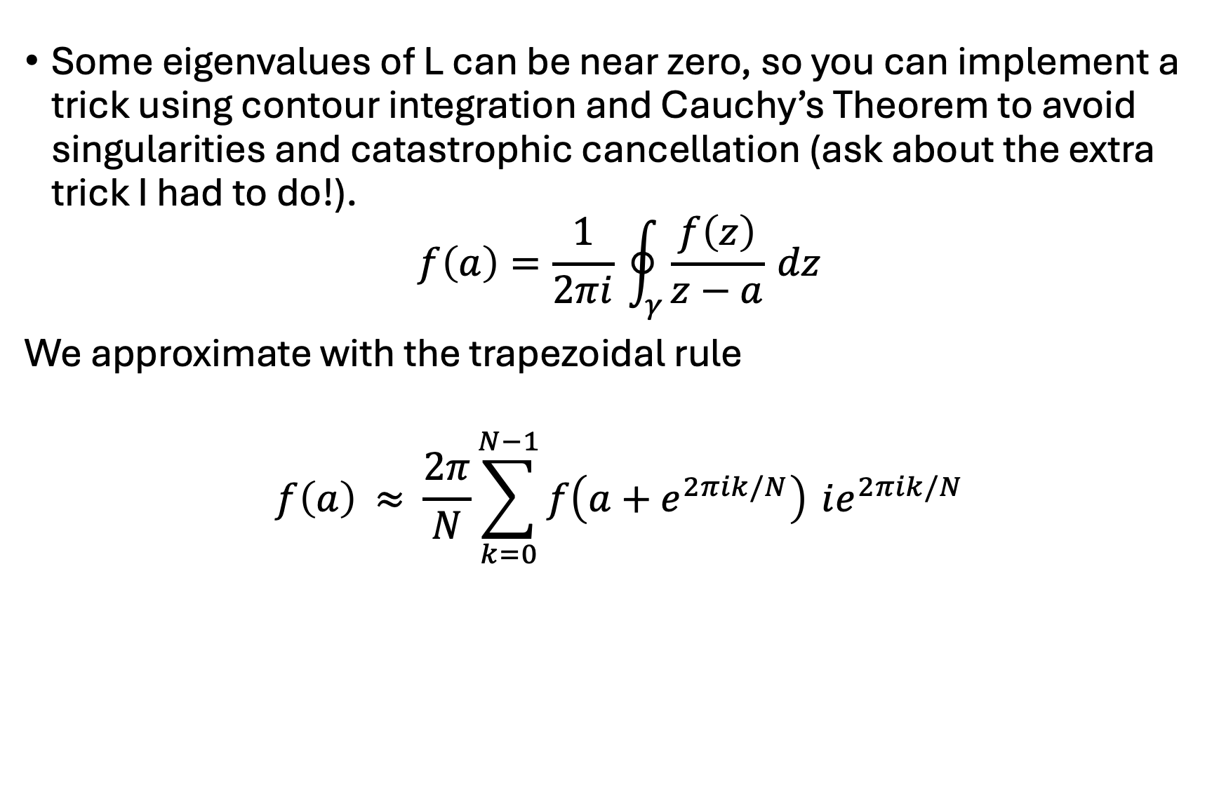
Some eigenvalues of L can be near zero, so you can implement a trick using contour integration and Cauchy’s Theorem to avoid singularities and catastrophic cancellation (ask about the extra trick I had to do!).
$$f\left(a\right)=\frac{1}{2πi} \oint_{γ}{\frac{f\left(z\right)}{z−a}} dz$$
We approximate with the trapezoidal rule
$$f\left(a\right) ≈ \frac{2π}{N}\sum_{k=0}^{N−1}{f​\left(a+e^{2πik/N}\right)} ie^{2πik/N}$$

Slide 22
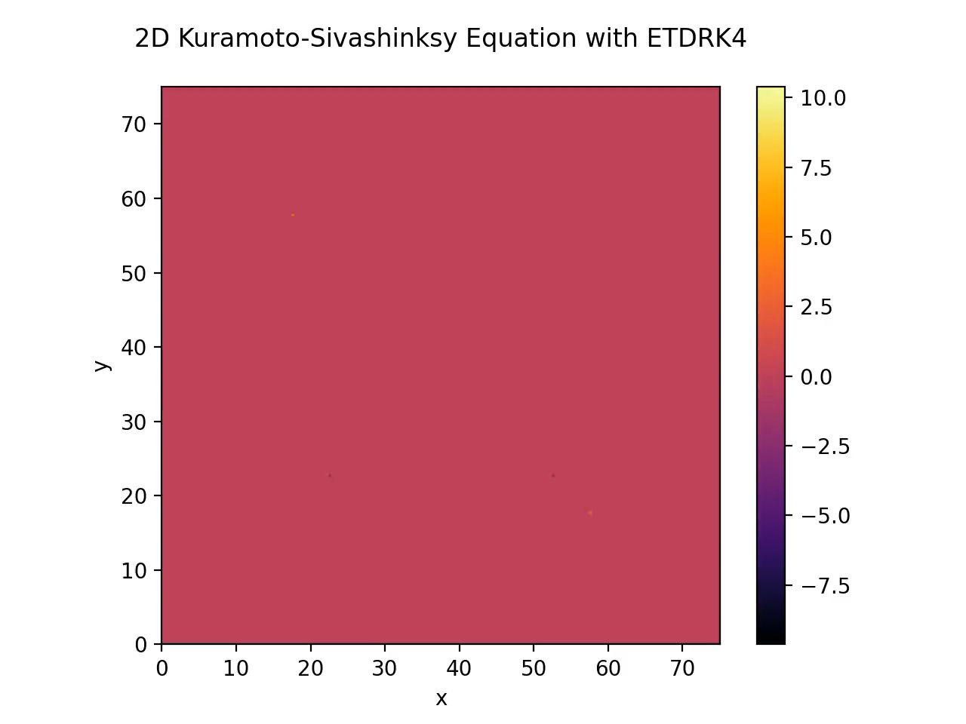

Slide 23
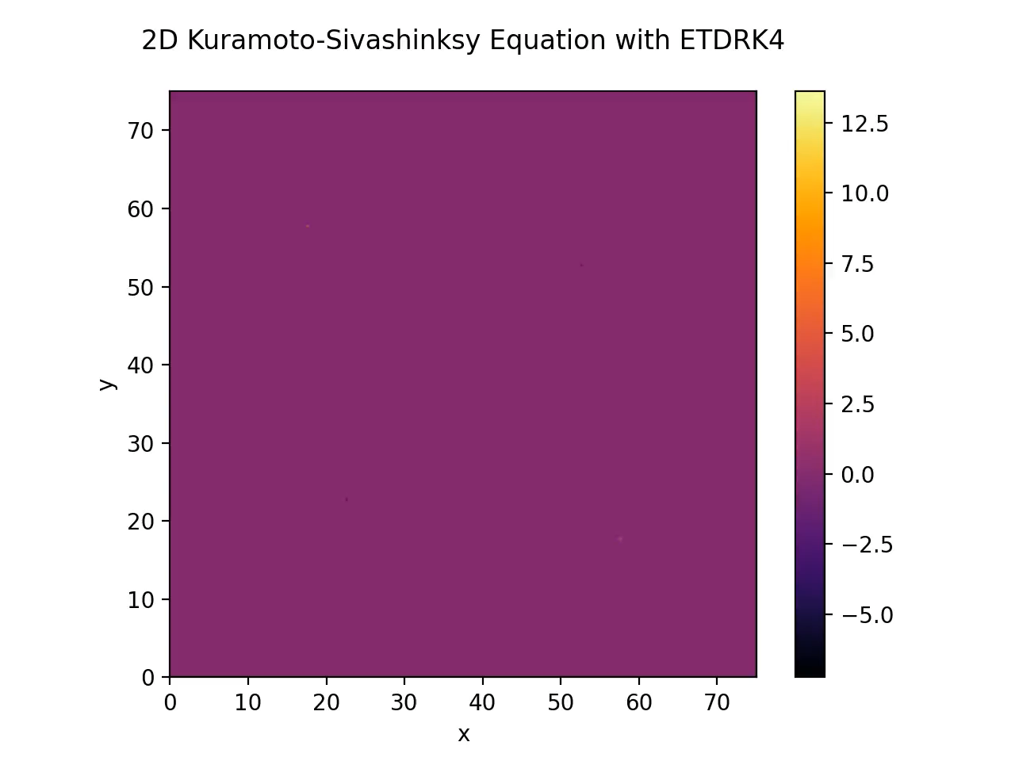

Slide 24
