Slide 1

TEAM 8
STUDENT PARTICIPATION
DATASET ANALYSIS
Week 4 · Final Program Insights Report
AI Data Internship · Excelerate
Notes:
Title slide. Introduce the team and the scope — 4 weeks of analysis culminating in actionable programme recommendations.

Slide 2
AGENDA
01
Overview & Methodology
04
Visualisations & Dashboard
Dataset, tools, and analytical approach
Charts, heatmaps, feature importance
02
Key Findings — Participation
05
Recommendations
Trends, demographics, and engagement patterns
6 prioritised strategies + deployment roadmap
03
Predictive Model Results
06
Reflection & Feedback
3 models, performance metrics, probabilities
Team insights and internship learnings

Slide 3
OVERVIEW & METHODOLOGY
8,558
3,026
22
2,089
Total Records
Unique Learners
Opportunities
Institutions
WEEK 1
WEEK 2
WEEK 3
WEEK 4
Data Understanding
& Documentation
Exploratory Data
Analysis (EDA)
Machine Learning
& Predictions
Final Report &
Recommendations
Tools Used:
Python · scikit-learn · pandas · matplotlib · seaborn · Microsoft Word · PowerPoint
Notes:
Week 1–4 project arc. Dataset: 8,558 records, 26 features, 3 ML models trained.

Slide 4
KEY FINDINGS — PARTICIPATION TRENDS
Application Status
Applications by Category
⚡ Internships = 63.3% of demand but only 21.5% Active rate — the core platform challenge
Notes:
Internships dominate demand but have lowest success rate. Rejection rate = 41.7%.

Slide 5
DEMOGRAPHIC & GEOGRAPHIC INSIGHTS
Gender Split
Age Group Distribution
By Region
64.5%
58.6%
80%
14.8%
of learners are aged 21–25
Male | 41.2% Female
from US + India combined
African learners — growing fast
Notes:
Demographics: dominant cohort 21–25. Africa is the third-largest and fastest-growing region.

Slide 6
PREDICTIVE MODEL RESULTS
Model Performance Comparison (%)
🏆 BEST MODEL
Gradient Boosting
AUC-ROC: 91.99%
Accuracy: 86.71%
CV AUC: 91.12% ± 0.87%
5-Fold CV AUC (training set)
RF: 91.46% · GB: 91.12% · LR: 89.58%
#1 Feature: Opportunity Category
54.9% of model information gain
⚡ All 3 models >86% accuracy & >90% AUC — predictions are reliable and deployment-ready
Notes:
Gradient Boosting wins on every metric. Category dominance = supply problem, not learner quality problem.

Slide 7
FEATURE IMPORTANCE & MODEL VISUALS
Feature Importance — RF vs GB (%)
54.9%
Opportunity
Category
Dominant predictor — category determines outcome
12.8%
Region
Geography = 2nd most important signal
11.8%
App. Quarter
Seasonal outreach patterns matter
2.5%
Gender
Lowest overall — but Africa shows gap
Notes:
Opportunity Category alone = 54.9% of predictive power. This confirms capacity is the issue.

Slide 8
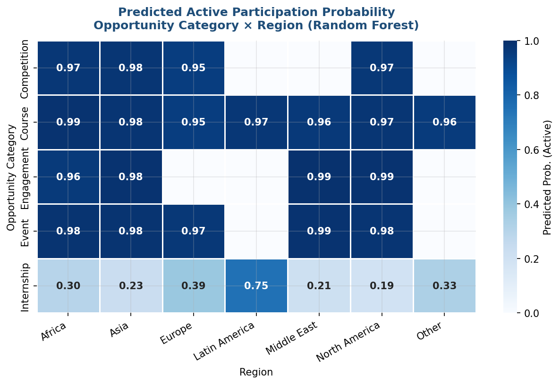
PREDICTED PARTICIPATION PROBABILITIES
Predicted Active Probability: Category × Region
Avg Predicted Active Prob. by Category (%)
⚡ Non-internship formats: 97–99% predicted Active rate · Internships: 30–56% — capacity bottleneck confirmed
Notes:
Heatmap confirms category × region interaction. Internship demand vs capacity = the key problem.

Slide 9
TEMPORAL TRENDS & PIPELINE ANALYSIS
2024 Monthly Application Volume
Q1
3,412
39.8% of total
Q2
1,371
16.0% of total
Q3
2,130
24.9% of total
Q4
1,641
19.2% of total
⚡ Q1 surge (Jan–Feb 2024) = 10× baseline. Recommendation: Launch Q4 outreach to fuel next Q1 intake
Notes:
Q4 outreach window (Oct–Nov) is the evidence-backed timing to prime Q1 applications.

Slide 10
ACTIONABLE RECOMMENDATIONS
CRITICAL
Expand Internship Capacity
MEDIUM
Drop-Out Prevention
Add associate-level feeder tracks; open slots before applications
Model scores trigger check-ins below 40% probability threshold
HIGH
Q4 Outreach Campaign
MEDIUM
Courses as Pipeline
Launch Oct–Nov to prime Q1 surge; Africa Q2 separate campaign
Make courses mandatory pre-qualifier for internship applications
HIGH
Africa & Gender Equity
LOW
Model Deployment (4 Phases)
Africa-specific opportunities; dedicated outreach for African women
Deploy GB scorer → automate alerts → add features → multi-class
Notes:
6 recommendations from critical to low priority. All grounded in model outputs.

Slide 11
KEY TAKEAWAYS
From Data to Impact
1. 8,558 records → 3 ML models → 91.99% AUC → 22 opportunity probability scores
2. Internship capacity is the #1 platform constraint — not learner quality
3. Africa & gender equity is the most underserved opportunity for growth
4. Q4 outreach + Course pipeline → highest ROI programme interventions
5. Gradient Boosting model is deployment-ready for live application scoring
Team 8 · AI Data Internship · Excelerate · June 2026
Notes:
Close with confidence. All 5 takeaways are evidence-backed. Model is ready to deploy.

