Slide 1
GitHub: github.com/ManmadhaKuttum/CornerStone_COP7001/final-presentation
Real-Time Speech Translation
Hindi → Telugu • Fully Offline • Edge-Deployable
COP7001 – CornerStone Project | Indian Institute of Technology Delhi | April 2026
Jithendra & Manmadha Kuttum
mcs252743@iitd.ac.in | mcs252101@iitd.ac.in

Slide 2
⬛ github.com/ManmadhaKuttum/CornerStone_COP7001
COP7001 — IIT Delhi
Problem Statement
India has 22 official languages — real-time cross-language communication is unsolved at scale.
< 2 s
01
Latency Target
Cloud solutions (Google, AWS) require internet and introduce 3–5 s latency with privacy risks.
100%
02
Offline
No fully offline, open-source, production-ready speech translation system exists for Indian languages.
Hi→Te
03
Language Pair
→ Goal: Build a fully offline, real-time Hindi→Telugu speech translation system with < 2 s end-to-end latency, no internet, no cloud.

Slide 3
⬛ github.com/ManmadhaKuttum/CornerStone_COP7001
COP7001 — IIT Delhi
System Architecture — Producer–Consumer Pipeline
MIC
VAD
ASR
Audio
Capture
audio_queue
Segmenter
(VAD)
asr_queue
ASR
(Whisper)
▶
▶
▶
src/audio.py
16 kHz · 32 ms
src/segmenter.py
Silero-VAD · Energy
src/asr.py
Faster-Whisper small
trans_text
_queue
src/tts.py
MMS-TTS-Telugu
src/translation.py
CTranslate2 int8
TTS
NMT
Legend:
▼
Data flow
TTS
(MMS-VITS)
◀
▶
Translation
(NLLB)
◀
tts_text_queue
State update
▼
🔊 Speaker Output
WebSocket
Broadcast (10 Hz)
Figure 1 (adapted from report): Solid arrows = data flow · Dashed arrows = state updates to dashboard · Queue names shown on connectors

Slide 4
⬛ github.com/ManmadhaKuttum/CornerStone_COP7001
COP7001 — IIT Delhi
Technology Stack
ML Models
Infrastructure
Faster-Whisper (CTranslate2 backend)
FastAPI + WebSockets (10 Hz broadcast)
NLLB-200-distilled-600M (int8 quantised)
sounddevice (mic capture & speaker output)
MMS-TTS-Telugu (VITS architecture)
Python threading (one thread per stage)
Silero-VAD (ONNX, 16 kHz, 32 ms)
HTML / CSS / JS real-time dashboard
100% Offline — zero API calls

Slide 5
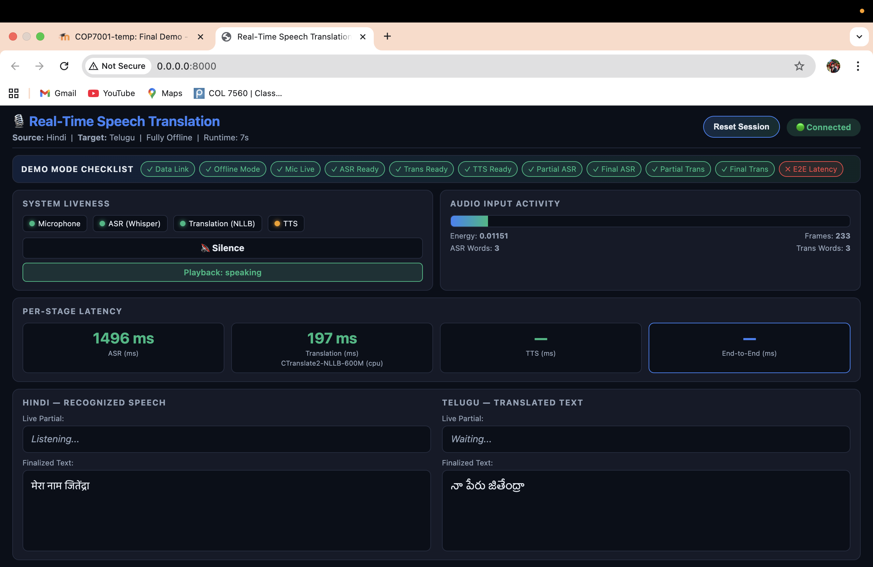
⬛ github.com/ManmadhaKuttum/CornerStone_COP7001
COP7001 — IIT Delhi
Live Demo — Hindi Speech Recognition
Hindi: 'मेरा नाम जिंदड़ा' → Telugu: 'నా పేరు జితేంద్ర' | ASR Latency: 1496 ms | Translation: 197 ms | Words: 3→3

Slide 6
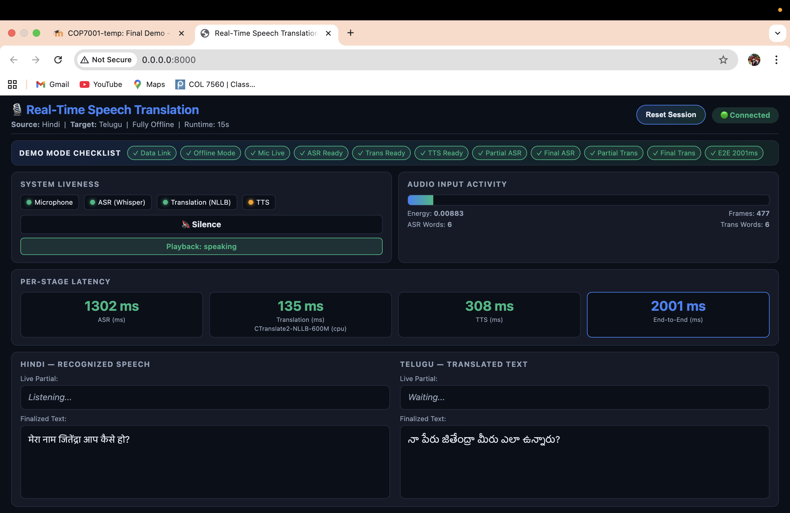
⬛ github.com/ManmadhaKuttum/CornerStone_COP7001
COP7001 — IIT Delhi
Live Demo — End-to-End Translation
'मेरा नाम जिंदड़ा आप कैसे हो?' → 'నా పేరు జితేంద్ర మీరు ఎలా ఉన్నారు?' | End-to-End: 2001 ms | RTF < 1.0 | Words: 6→6

Slide 7
⬛ github.com/ManmadhaKuttum/CornerStone_COP7001
COP7001 — IIT Delhi
Systems Challenges & Solutions
PROBLEM
HOW WE SOLVED IT
RESULT
~2001 ms
< 1.0
100%
Pipeline parallelism
+ bounded queues
End-to-End
RTF
Offline
Latency: 8+ s →
→
→
✓ 2001 ms
Hindi hallucinations
→
initial_prompt + Devanagari
character filter (≥25%)
→
✓ Clean output
Translation: 1.2 s →
→
CTranslate2 int8
+ all CPU cores (9×)
→
✓ 135–197 ms
TTS cold-start 2 s spike
→
Pre-warm VITS model
at server startup
→
✓ No spike

Slide 8
⬛ github.com/ManmadhaKuttum/CornerStone_COP7001
COP7001 — IIT Delhi
AI-Assisted Development
Tool: Claude Code (claude-sonnet-4-6) by Anthropic — used across all 4 project phases
Compared Whisper sizes; guided NLLB-200 over mBART; chose hin_Deva→tel_Telu tokens; recommended ONNX Silero VAD for cross-platform
Designed bounded-queue pipeline; suggested thread-per-stage model; recommended 10 Hz WebSocket broadcast rate
Model Selection
Architecture
Fixed 7 bugs: CTranslate2 __file__ path, MPS device crash, audio callback race condition, segmenter deadlock, TTS cold-start spike
Dual-beam ASR (beam=1 partial / beam=4 final); CT2 inter_threads=os.cpu_count(); greedy beam=2 for translation
Bug Fixes
Optimisation
Generated edge cases: silence, code-switching, whispered speech, fast speech, mic disconnect, reset mid-utterance
Co-authored README, platform requirements files, config inline comments; session reset verification checklist
Testing
Documentation

Slide 9
⬛ github.com/ManmadhaKuttum/CornerStone_COP7001
COP7001 — IIT Delhi
Team Contributions — Equal 50 / 50 Split
Jithendra (50%)
Manmadha (50%)
Phases 3 & 4 — Core ML Pipeline
Phases 1 & 2 — Foundation & Integration
ASR: Faster-Whisper, dual-path decode, Devanagari filter
Translation: CTranslate2 NLLB-200 int8, greedy, HF fallback
TTS: MMS-TTS-Telugu, sounddevice playback, pre-warming
VAD: Silero segmenter + energy fallback
Dashboard Phase 4: latency cards, RTF, partial streaming
Config: CT2 threads, beam sizes, silence thresholds
State management & E2E latency tracking
Cross-platform requirements + README
Project setup: repo, .gitignore, requirements
Phase 1: Audio ingress pipeline & dashboard v1
Phase 2: Hindi ASR base (Faster-Whisper)
Session reset: endpoint + queue drain + UI
Mac/MPS compatibility & CPU fallback chains
Translation responsiveness improvements
Latency reporting enhancements
Midterm PPT, video annotation & report
Jithendra
Manmadha

Slide 10
⬛ github.com/ManmadhaKuttum/CornerStone_COP7001
COP7001 — IIT Delhi
Conclusion & Future Work
✓ What We Achieved
→ Future Work
End-to-end latency ~2001 ms (target <3 s ✓)
100% offline — no internet, no cloud
Real-time dashboard at 10 Hz with live metrics
Runs on CPU, Apple Silicon MPS, NVIDIA CUDA
Dual-path ASR: live partial + accurate final
Clean modular 5-stage extensible architecture
More language pairs (Tamil, Kannada, Bengali)
Speaker diarization for 2-person conversations
Mobile deployment via ONNX (Android / iOS)
WER / BLEU formal evaluation on benchmarks
Noise-robust VAD for real-world environments
Streaming TTS for sub-1.5 s perceived latency

Slide 11
Thank You
Video is uploaded in below Google drive link: https://drive.google.com/drive/folders/14eaCsZe_iCxT_sAZBL98bBglNLywE4sh
GitHub: github.com/ManmadhaKuttum/CornerStone_COP7001/final-presentation
mcs252743@iitd.ac.in | mcs252101@iitd.ac.in
COP7001 CornerStone Project | IIT Delhi | 2026

