Slide 1
Real-Time Speech
Translation System
Project Status Presentation | Phase 2 & Phase 3 (Partial)
Course
COP7001 — CornerStone Project (Systems Programming major deliverable)
Language
Hindi (Source language, North India) → Telugu (Target language, South India)
Mode
Fully Offline — No internet connection, no Application Programming Interface (API) calls
Team
Manmadha (2025MCS2101) | Jithendra (2025MCS2743)
Repository
github.com/ManmadhaKuttum/CornerStone_COP7001
Real-Time Speech Translation | Hindi → Telugu | COP7001 CornerStone Project
1 / 10

Slide 2
What We Are Building
A streaming microphone-to-speaker translation pipeline — not a batch offline tool
THE PROBLEM
India has 22 official languages. When two people speak different languages — one Hindi, one Telugu — there is no real-time tool today that lets them communicate through spoken language, offline, on a laptop, without sending any audio to a cloud server.
OUR SOLUTION — THE TARGET PIPELINE
Hindi Speech → Transcription (ASR) → Translation → Telugu Speech (TTS)
Every arrow runs locally on your machine. No internet. No API (Application Programming Interface). Continuous and real-time.
KEY ABBREVIATIONS USED IN THIS PRESENTATION
ASR = Automatic Speech Recognition — converts spoken audio into written text
TTS = Text-to-Speech — converts written text into spoken audio
VAD = Voice Activity Detection — decides if a sound is speech or noise
RTF = Real-Time Factor — ratio of processing time to audio duration
API = Application Programming Interface — a service you call over the internet
E2E = End-to-End — from microphone input to speaker output, total system
NLP = Natural Language Processing — machine understanding of human language
CPU = Central Processing Unit — the main processor chip in your laptop
Real-Time Speech Translation | Hindi → Telugu | COP7001 CornerStone Project
2 / 10

Slide 3
How the System is Structured — Architecture
Five stages, four of which are live — each runs in its own thread connected by bounded queues
①
②
③
④
⑤
Audio
Capture
VAD
Segmenter
ASR
(Automatic Speech
Recognition)
Translation
TTS
(Text-to-Speech)
→
→
→
→
sounddevice
Silero-VAD
faster-whisper
NLLB-200
IndicTTS
16 kHz / 32ms
audio frames
Speech vs noise
neural model
Hindi text
int8 / offline
Hindi → Telugu
offline model
Telugu speech
Phase 4 planned
audio_queue — max 200 frames
asr_to_trans_queue — max 50 items
KEY TERMS ON THIS SLIDE
Queue = A conveyor belt — one stage puts data in, another takes it out
Bounded Queue = Queue with a size limit — if full, new data is dropped, not stored
Thread = An independent task running inside the same program simultaneously
Backpressure = When a slow stage causes the faster stage to drop data, not wait
int8 = 8-bit integer quantization — a compression technique making models 3× faster
16 kHz = 16,000 audio samples per second — standard rate for speech recognition
Real-Time Speech Translation | Hindi → Telugu | COP7001 CornerStone Project
3 / 10

Slide 4
Phase 1 & Phase 2 — Complete and Tested
Audio backbone and Hindi ASR are both working stably
PHASE 1 — AUDIO INGRESS AND DASHBOARD (DAY 20)
PHASE 2 — ASR INTEGRATION (DAY 40)
— Live microphone capture at 16 kHz (kilohertz = thousands of samples per second) using sounddevice library in callback mode
— Bounded audio_queue (maxsize=200) — non-blocking: if queue is full, frame is dropped, not buffered forever
— FastAPI web server + WebSocket (persistent browser connection) broadcasting state at 10 Hz (10 updates per second)
— Live browser dashboard: energy bar, frame count, runtime, liveness indicators
— Verified stable for 10+ minute continuous runs — no crashes, no memory growth
— Silero-VAD (Voice Activity Detection) neural model replaced energy threshold — near-zero false positives
— faster-whisper with int8 (8-bit integer) quantization — 3× faster inference than standard Whisper on CPU
— Hallucination suppression: three parameters eliminate repeated-token garbage output
— Zero hallucinations after fix — was consuming up to 5900ms (5.9 seconds) per event
— Consistent ASR (Automatic Speech Recognition) latency: 1300–1600ms per utterance
KEY TERMS ON THIS SLIDE
WebSocket = A persistent two-way connection between server and browser — server pushes updates without being asked
FastAPI = A Python web framework — the software that runs the web server and handles browser requests
Callback mode = Audio driver calls your function automatically every 32ms — you do not need to ask for data
Hallucination = When an AI model produces confident but completely wrong or nonsense output
Real-Time Speech Translation | Hindi → Telugu | COP7001 CornerStone Project
4 / 10

Slide 5
VAD (Voice Activity Detection) — Before and After
Replacing a naive energy threshold with a neural model — the most important systems improvement in Phase 2
BEFORE — Energy Threshold
AFTER — Silero-VAD Neural Model
RMS (Root Mean Square) energy is computed for each audio frame.
If energy > 0.02, the system assumes speech has started.
A neural network (machine learning model) trained on thousands of hours of speech AND noise runs on each 32ms frame and returns a confidence score between 0.0 and 1.0.
— Triggers on laptop fan noise, keyboard typing, air conditioning
— ASR receives garbage audio — produces wrong transcripts
— Requires manual threshold tuning for each environment
— Causes hallucinations (nonsense output) that block the pipeline for 5–6 seconds each
— Threshold of 0.6 — frames scoring above 0.6 are speech, below are noise
— Near-zero false positives in all testing environments
— No manual tuning needed — neural model is portable
— Only real speech reaches ASR — hallucinations eliminated
Before: up to 5900ms latency spikes
After: consistent 1300–1600ms ✓ Zero hallucinations
KEY TERMS ON THIS SLIDE
RMS = Root Mean Square — a mathematical way to measure the average power/volume of an audio signal
Neural Network = A machine learning model loosely inspired by the brain — trained on data to make decisions
Confidence Score = A number between 0 and 1 showing how certain the model is — 1 means completely certain
Threshold = A cutoff value — values above are treated one way, values below another way
Real-Time Speech Translation | Hindi → Telugu | COP7001 CornerStone Project
5 / 10

Slide 6
ASR (Automatic Speech Recognition) — Hallucination Problem and Fix
Whisper producing repeated nonsense output on silence — diagnosed and eliminated
WHAT WAS HAPPENING — ACTUAL TERMINAL LOG OUTPUT
Output: "तो तो तो तो तो तो तो..." — consumed 5901ms (5.9 seconds)
Output: "बच्च्च्च्च्च्च्च्च..." — consumed 5690ms (5.7 seconds)
ROOT CAUSE
Silero-VAD was not yet integrated. The old energy threshold allowed near-silence noise frames to reach Whisper. Whisper attempted to transcribe noise and produced repeated tokens — a known failure mode called hallucination. Each event blocked the entire pipeline for up to 6 seconds.
THREE-PARAMETER FIX APPLIED IN asr.py
Parameter Name | Value Set | What It Does — Full Explanation
no_speech_threshold | 0.6 | Discards ASR output if Whisper's own internal confidence that speech is present is below 60% — Whisper scores itself
compression_ratio_threshold | 2.4 | Discards output where the text is highly repetitive — repeated tokens compress very efficiently, so high compression ratio = hallucination signature
log_prob_threshold | -1.0 | Discards output where token log-probabilities (the model's confidence in each word choice) are very low — catches uncertain garbage output
KEY TERMS ON THIS SLIDE
Log-probability = The model's confidence score for choosing each word — very negative = uncertain
Compression ratio = How much a text can be compressed — highly repetitive text compresses much more than natural text
Token = The basic unit a language model works with — roughly one word or word fragment
Inference = Running a machine learning model on an input to get a prediction or output
Real-Time Speech Translation | Hindi → Telugu | COP7001 CornerStone Project
6 / 10

Slide 7
Phase 3 — Translation Integration: In Progress
NLLB-200 model integrated — pipeline wired — accuracy validation ongoing
WHAT HAS BEEN COMPLETED IN PHASE 3
WHAT IS STILL BEING WORKED ON
— NLLB-200-distilled-600M (No Language Left Behind, 600 million parameters) loads and runs fully offline
— Translation thread (separate concurrent process) wired — consumes from asr_to_trans_queue
— tok.src_lang = 'hin_Deva' — tokenizer source language set to Hindi Devanagari script before processing
— forced_bos_token_id = tok.convert_tokens_to_ids('tel_Telu') — forces output to begin in Telugu Telu script
— End-to-End latency timer: starts when VAD (Voice Activity Detection) detects speech, stops when translation finishes
— Dashboard extended with Telugu output panel and translation latency display
— Telugu translation output accuracy needs validation with real conversational Hindi sentences
— Translation latency on CPU (Central Processing Unit) is above target — needs optimization
— End-to-End latency ~3000ms currently — target is below 2000ms
— Partial translation during mid-utterance not yet implemented
MODEL SELECTION — WHY NLLB-200 WAS CHOSEN
Model Name | Size | Hindi→Telugu | Offline | Decision and Reason
IndicTrans2-1B (AI4Bharat, IIT Madras) | ~4 GB | Best accuracy | Yes | Too large — exceeds demo hardware memory
IndicTrans2-dist-200M (distilled = compressed) | ~800 MB | Good | Yes | Not listed on public HuggingFace model hub
NLLB-200-distilled-600M ← chosen | ~600 MB | Good | Yes | Best available offline option — selected
googletrans (Google Translate API) | API call | Good | No | Requires internet connection — rejected
Real-Time Speech Translation | Hindi → Telugu | COP7001 CornerStone Project
7 / 10

Slide 8
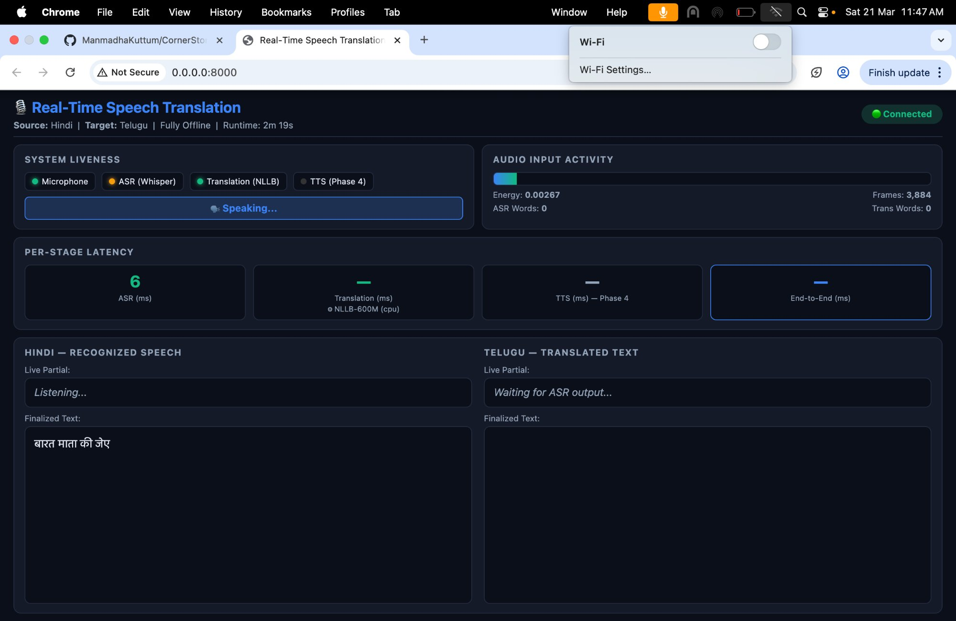
Live Dashboard — Demo Evidence
Browser-based observability panel — all pipeline stages visible simultaneously while the system runs
WHAT YOU SEE
🟢 Microphone
Audio capture is live and receiving frames
🟢 ASR (Whisper)
Automatic Speech Recognition is processing
🟢 Translation (NLLB)
Translation model is loaded and running
⚪ TTS (Phase 4)
Text-to-Speech — not yet implemented
1384 ms
ASR latency for last utterance — within 2000ms target
Hindi panel
Final recognized Hindi text displayed below
Telugu panel
KEY TERMS ON THIS SLIDE
Telugu translation output panel — wired
WebSocket = Persistent two-way connection — server pushes JSON (JavaScript Object Notation) data to browser every 100ms
DOM = Document Object Model — the browser's internal tree structure representing the webpage that JavaScript updates
JSON = JavaScript Object Notation — a standard text format for sending structured data (numbers, text, booleans) over a connection
10 Hz = 10 Hertz = 10 updates per second — how often the dashboard refreshes with new pipeline state
Real-Time Speech Translation | Hindi → Telugu | COP7001 CornerStone Project
8 / 10

Slide 9
Performance Observations
Measured on Apple M4 chip (ARM architecture) — CPU only for both ASR and Translation
1300–1600ms
0.72
~3000ms
< 2000ms
ASR Latency
(typical)
RTF — ASR Stage
(Real-Time Factor)
End-to-End Latency
(current)
End-to-End Target
(Phase 4 goal)
per utterance after fix
below 1.0 = real-time ✓
ASR + Translation combined
via pipeline stage overlap
RTF (REAL-TIME FACTOR) EXPLAINED
RTF = Processing Time ÷ Audio Duration. Example: a 2-second utterance that takes 1.44 seconds to process has RTF = 1.44 ÷ 2.0 = 0.72. RTF below 1.0 means the system processes audio FASTER than it arrives — this is the definition of real-time operation. Our ASR stage achieves RTF = 0.72 ✓ | Combined with Translation: RTF is slightly above 1.0 (Phase 4 target).
FULL PERFORMANCE TABLE
Metric | Observed Value | Target | Status
Audio frame size | 32ms / 512 samples | ≤ 32ms (Silero-VAD minimum) | ✓ Met
Dashboard (WebSocket) refresh rate | 10 Hz | 10 Hz | ✓ Met
ASR latency — typical | 1300–1600ms | < 2000ms | ✓ Met
ASR latency — before fix | Up to 5900ms spikes | Eliminated | ✓ Fixed
VAD overhead per frame | ~2ms on CPU | < 5ms | ✓ Met
Hallucinations | Zero after fix | Zero | ✓ Met
Real-Time Speech Translation | Hindi → Telugu | COP7001 CornerStone Project
9 / 10

Slide 10
GitHub Change Log and Next Steps
Git (version control system) commit history — one commit per file for clean, reviewable history
GIT COMMIT HISTORY — GITHUB REPOSITORY
CURRENT STATUS
Commit Hash | What Was Changed
bfd914b | segmenter.py — replaced energy threshold VAD with Silero-VAD neural model
2734c11 | script.js — fixed speech_active field, added auto-reconnect, latency color coding
0eeb998 | index.html — removed speaker panel, clean 3-row layout
9f50337 | style.css — fixed Telugu text color visibility on dark background
8a4f8f3 | main.py — fixed dashboard path, started translation thread
271573d | translation.py — added NLLB-200 offline Hindi-to-Telugu translation thread
4cad7da | asr.py — added three hallucination suppression parameters
ee2d003 | audio.py — increased frame size to 32ms for Silero-VAD compatibility
2182291 | state.py — added translation and End-to-End latency fields
8b193de | config.py — added MPS/CUDA device detection and parameters
a416e9e | Phase 2: Added Hindi ASR (Automatic Speech Recognition) using faster-whisper
05be995 | Phase 1: Audio ingress pipeline and real-time web dashboard
Phase 1 ✓ Complete
Audio capture + WebSocket dashboard
Phase 2 ✓ Complete
VAD + ASR + hallucination fix
Phase 3 ⚙ In Progress
Translation integrated — validating
Phase 4 ◻ Planned
TTS + speaker output — not started
PHASE 4 — REMAINING WORK
— Integrate IndicTTS (AI4Bharat, IIT Madras) for offline Telugu TTS (Text-to-Speech)
— Add TTS output queue between translation and speaker playback
— Measure TTS latency — display on dashboard as part of E2E (End-to-End) timing
— Overlap ASR and Translation stages to reduce E2E below 2000ms
— Target: RTF (Real-Time Factor) below 1.0 for full pipeline
The streaming backbone is working. ASR (Automatic Speech Recognition) produces Hindi text live. Translation is wired and loading. TTS (Text-to-Speech) integration is the final step to complete the microphone-to-speaker pipeline.
Real-Time Speech Translation | Hindi → Telugu | COP7001 CornerStone Project
10 / 10

