Slide 1
SHOPAHOLIC
SALESFORCE CRM(Customer Relationship Management)
CLOUD APPLICATION

Slide 2
SALESFORCE
INTRODUCTION TO SFDC:The company was founded in 1999 by former Oracle executive Marc Benioff, Parker Harris, Dave Moellenhoff, and Frank Dominguez as a company specializing in software as a service(SaaS).
Salesforce.com offers Force.com as its on-demand platform. Force.com features breakthrough Visualforce technology, which allows customers, developers, and ISVs to design any app, for any user, anywhere with the world’s first User Interface-as-a-Service. The Force.com platform offers global infrastructure and services for database, logic, workflow, integration, user interface, and application exchange.

Slide 3
CREATING AN APPLICATION,OBJECTS AND ITS FIELDS(SHOPAHOLIC)
An app is a set of tabs. In this step you'll create a Shopping app, including a Merchandise object and tab. Later, you'll add fields to the Merchandise object, as well as additional objects and tabs to the Shopaholic app.
Launch your browser and go to https://login.salesforce.com.
Enter your username (in the form of an email address) and password.
Click Setup in the upper right corner, and then click Create >Apps in the sidebar menu.
Click Quick Start
In the Force.com Quick Start overlay, enter the app and object details.
• For the App Label, type Warehouse
• For the Plural Label, type Merchandise.
• For the Singular Label, type Merchandise.
Click Create to finish creating your new object.
Click Go To My App to see your new app.

Slide 4
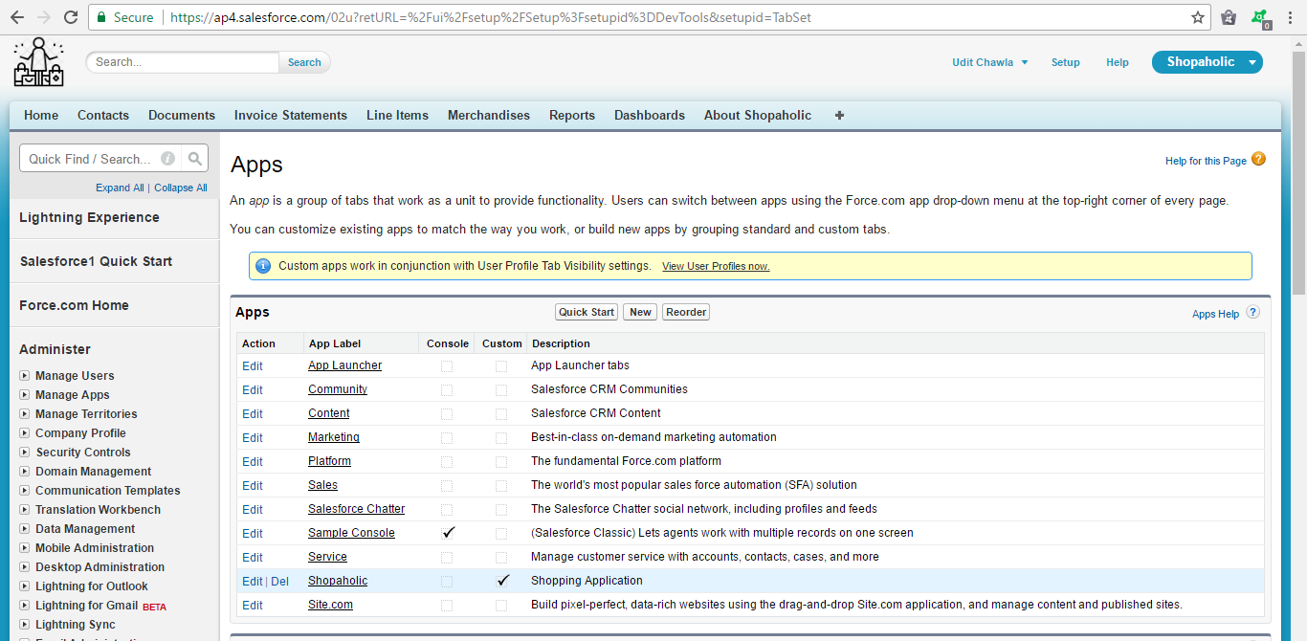
SCREENSHOT OF SHOPAHOLIC APPLICATION

Slide 5
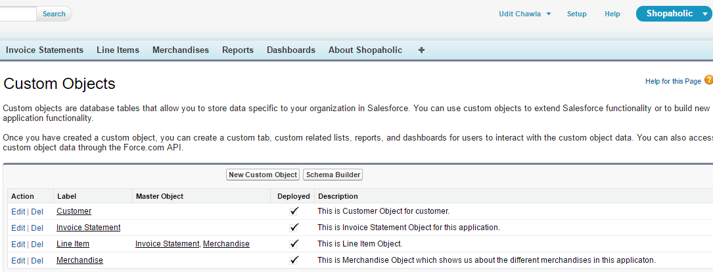
SCREENSHOT OF OBJECTS

Slide 6
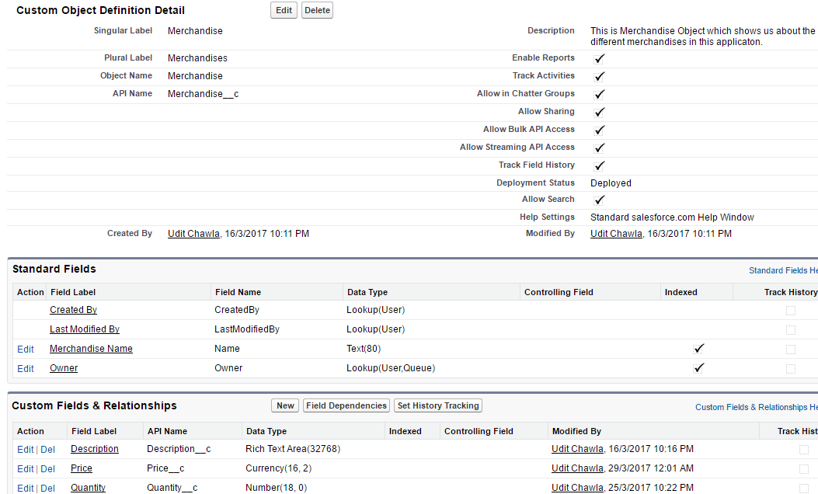
SCREENSHOT OF FIELDS IN OBJECTS

Slide 7
CREATING A RECORD
Select the Shopaholic app from the Force.com app menu.
Click the Merchandise tab and then click New to create a new product.
Fill in all the fields.
• In the Merchandise Name field enter any Merchandise Name
• For Description field enter description.
• In the Price field enter any price value.
• In the Quantity field enter quantity of merchandise.
Click Save.

Slide 8
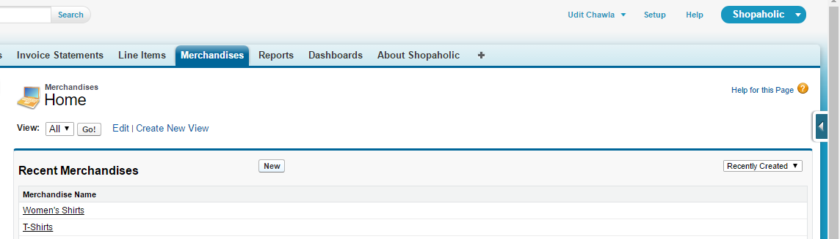
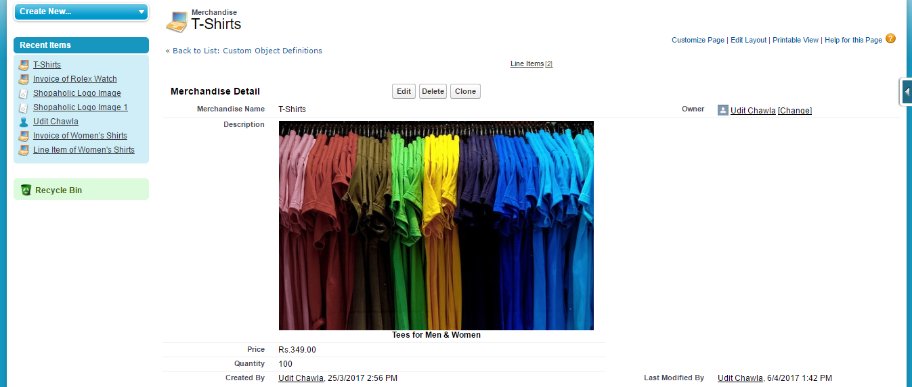
SCREENSHOT OF RECORDS IN MERCHANDISE OBJECT

Slide 9
OTHER OBJECTS AND THEIR FIELDS
Other than the Merchandise object there are some other objects and their corresponding fields which has to be created in Shopaholic Application.Those objects and fields are:
Invoice Statement having fields :
Invoice Statement Name
Contact(to whom that invoice belongs)
Description
Status(either it is open,close or pending for merchandise)
Line Item having fields:
Line Item Name
Unit Price
Unit Sold
Invoice Statement(Look up Relationship)
Merchandise(Look up Relationship)

Slide 10
RELATIONSHIPS BETWEEN OBJECTS
There are two main type of relationships in Salesforce
Master-detail Relationship: It is Parent-Child relationship that controls behaviour of detail object. They are tightly coupled. Maximum 2 Master-Detail relationship can be created in Salesforce for detail object
Lookup Relationship : It is type of relation which link two objects together, but has no effect on deletion or security. They are loosely coupled. Max 25 lookup relationship per child can be created.

Slide 11
USE OF FORMULA AND VALIDATION RULES
Check Quantity With a Validation Rule
Navigate back to the Line Item custom object page by clicking Your Name >Setup >Create >Objects >Line Item.
Scroll down to the Validation Rules related list, and click New.
In the Rule Name field, enter Order in stock.
In the Error Condition Formula area, click Insert Field to open the Insert Field popup window.
a. Select Line Item > in the first column.
b. Select Merchandise > in the second column.
c. Select Total Inventory in the third column.
d. Click Insert.
e. Type the less-than symbol < so that the formula looks like this:
Merchandise__r.Total_Inventory__c<

Slide 12
USE OF FORMULA AND VALIDATION RULES
f. Complete formula is
IF(
ISNEW(),
Merchandise__r.Quantity__c < Unit_Sold__c ,
IF(
Unit_Sold__c < PRIORVALUE( Unit_Sold__c ) ,
FALSE,
Merchandise__r.Quantity__c < ( Unit_Sold__c -PRIORVALUE( Unit_Sold__c ))
))
Click Check Syntax to make sure there are no errors. If you do find errors, fix them before proceeding.
In the Error Message field, enter this item is out of stock.
For the Error Location, select Field, then choose Units Sold from the drop-down list.
Click Save.

Slide 13
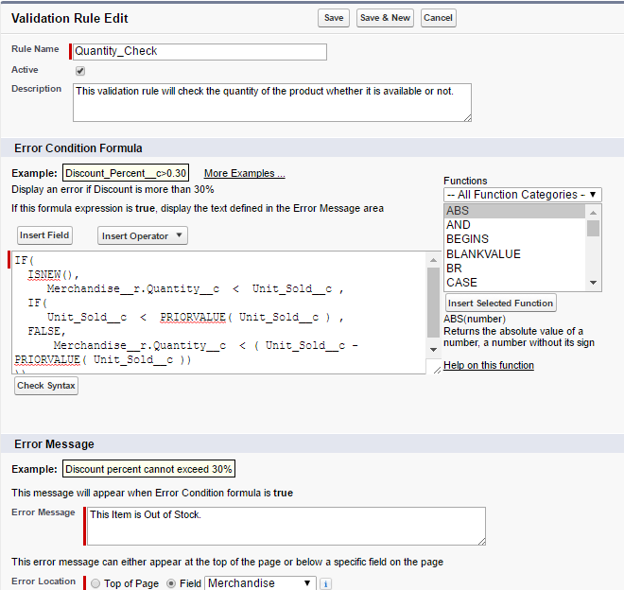
SCREENSHOT OF VALIDATION RULE

Slide 14
CREATING REPORTS AND DASHBOARDS
Reports : report is a list of records that meet the criteria you define. It’s displayed in Salesforce in rows and columns, and can be filtered, grouped, or displayed in a graphical chart.
Dashboards : A dashboard is a visual display of key metrics and trends for records in your org. The relationship between a dashboard component and report is 1:1; for each dashboard component, there is a single underlying report. However, you can use the same report in multiple dashboard components on a single dashboard (e.g., use the same report in both a bar chart and pie chart). Multiple dashboard components can be shown together on a single dashboard page layout, creating a powerful visual display and a way to consume multiple reports that often have a common theme, like sales performance, customer support, etc.

Slide 15
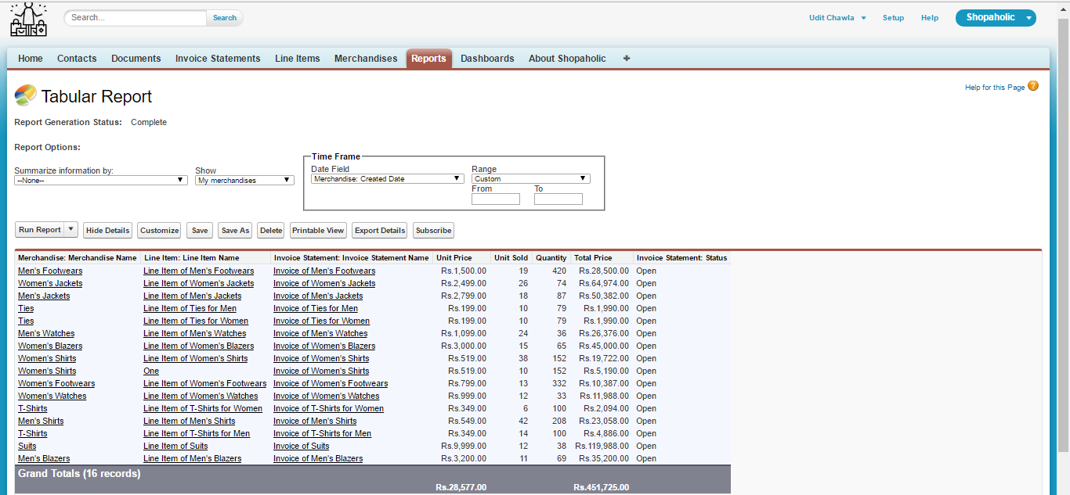
SCREENSHOTS OF REPORTS

Slide 16
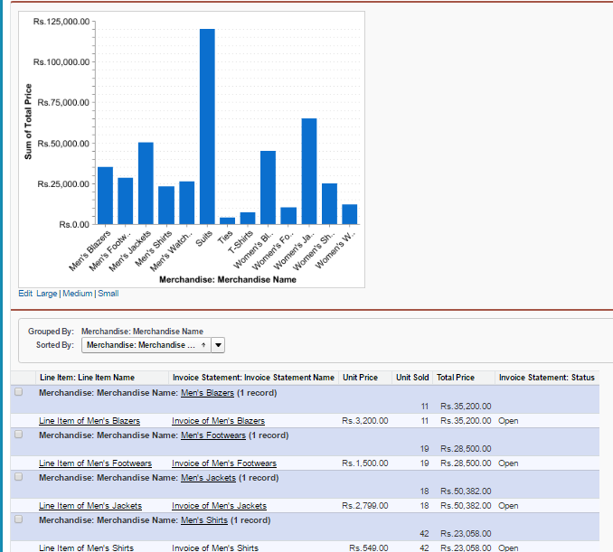
SCREENSHOTS OF REPORTS

Slide 17
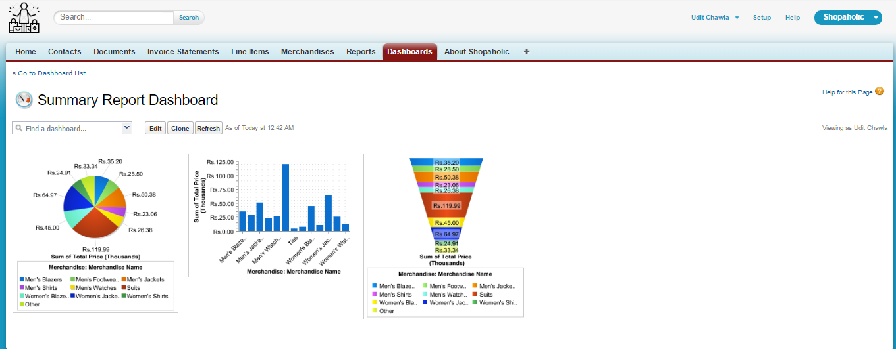
SCREENSHOTS OF DASHBOARDS

Slide 18
ADDING E-MAIL SERVICES
Select Setup
Then in Administer ,select Communication Templates and then e-mail templates.
Select new and select the type of email template you want to create.
Give name to the template and enter the text or merge fields in plain text area.
Select the available for use option to make the email template available.
After doing all the above steps ,save your template and test it by sending it to your mail.

Slide 19
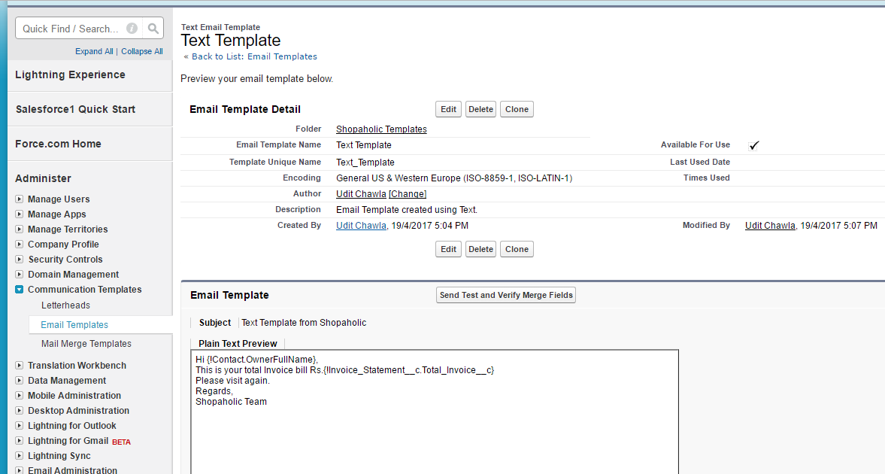
SCREENSHOT OF E-MAIL TEMPLATE

Slide 20
VISUAL FORCE PAGES
Visualforce is a web development framework that enables developers to build sophisticated, custom user interfaces for mobile and desktop apps that can be hosted on the Force.com platform.
Visualforce uses the traditional model–view–controller (MVC) paradigm. It includes sophisticated built-in controllers to handle standard actions and data access, providing simple and tight integration with the Force.com database. When using the standard controller, you don’t need to write the code for the controller. However, you can extend the standard controller to add new functionality or create custom controllers from scratch.

Slide 21
CREATING A VISUAL FORCE PAGE
In the upper right, click your name, and then click Developer Console from the menu.
In Developer Console, select File > New > Visualforce Page.
Name the page and then click OK. If you've never used the Source Code Editor before, click Start Tour and follow along.
In the new page, enter code inside the apex:page component
In the Developer Console, save the page by selecting File > Save.
Above the code line numbers, click Preview. You see a blank page with the text "Hello" that you added, but also notice the URL at the top.

Slide 22
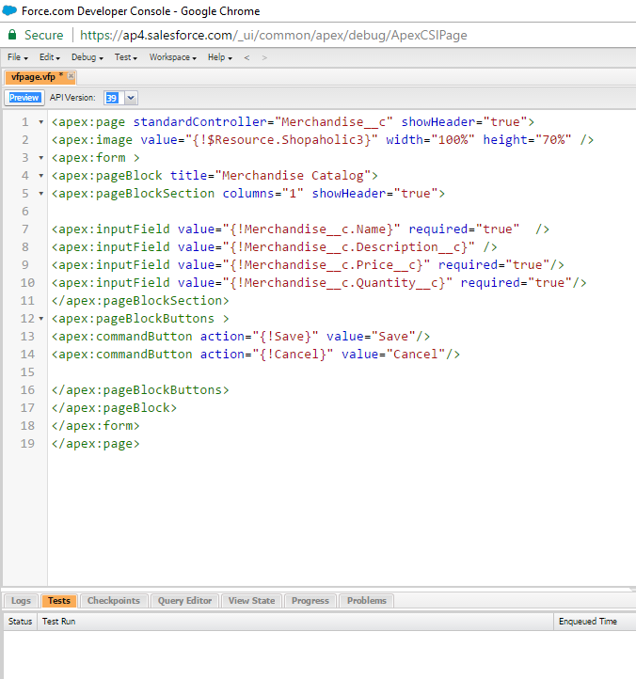
SCREENSHOT OF VISUAL FORCE PAGE

Slide 23
UPLOADING YOUR APPLICATION
Click on Setup and then create and then select package.
Create a new package for your application by clicking on new button.
Give name to your package and start adding components in the package.
After adding all the components click on upload button and from there give the version details of your application and then upload.
After that you will get a link and when any other salesforce user go to that link your application will be installed on that user’s system when he/she clicks install this application button.
LINK OF SHOPAHOLIC APPLICATION
https://login.salesforce.com/packaging/installPackage.apexp?p0=04t6F000001IMyE

Slide 24

THANK YOU ALL…..

