Slide 1
Project Presentation of CO-OP Project at Industry (Module-2) (22CS421)
On
AI Driven Automated Trading System
Manmeet Kaur ( 2210990554 )
Mann Sharma ( 2210990555 )
Mohd. Ishaan ( 2210990581 )
Sanya (2210992253)
Supervised By
Dr. Rajat Takkar
Department of Computer Science and Engineering,
Chitkara University, Punjab

Slide 2
Executive Summary
Integrating AI with stock trading has shifted paradigms from human-led execution to precise, high-frequency automated decision-making. This study analyzes the evolution from 1995 to 2024
‹#›

Slide 3
Market Dominance
67%
AI-Driven Market Volume
Trading volume managed by AI systems surged from just 14.3% in 2015 to over 67% in 2024. High-Frequency Trading (HFT) now accounts for nearly 60% of all market trades, utilizing millisecond execution speeds.

Slide 4
CONVERSATIONAL INTELLIGENCE
NLP Analysis Using Natural Language Processing to decode news headlines and social media trends (Twitter, Reddit).
Sentiment Scoring
Categorizing public mood. Positive sentiment correlates with average gains up to 3.5%.
Alpha Generation
Turning qualitative data into quantitative signals before prices fully reflect new information.

Slide 5
DEEP LEARNING ARCHITECTURES
LSTM & CNN Synergy
State-of-the-art systems utilize:
LSTM Networks: Excellent at capturing temporal dependencies and long-term time-series patterns.
CNN Layers: Used to learn features from price charts treated as visual data.
Gating Mechanisms: "Forget gates" and "Input gates" filter market noise effectively.

Slide 6
MODERN PORTFOLIO THEORY (MPT)
Risk-Return Trade-off
Based on the Markowitz model, maximizing returns for a given risk level via variance minimization.
AI Optimization
Utilizing Genetic Algorithms and Swarm Intelligence to navigate non-convex landscapes and transaction constraints.
Integration of CVaR (Conditional Value at Risk) helps manage extreme tail risks during market volatility.

Slide 7
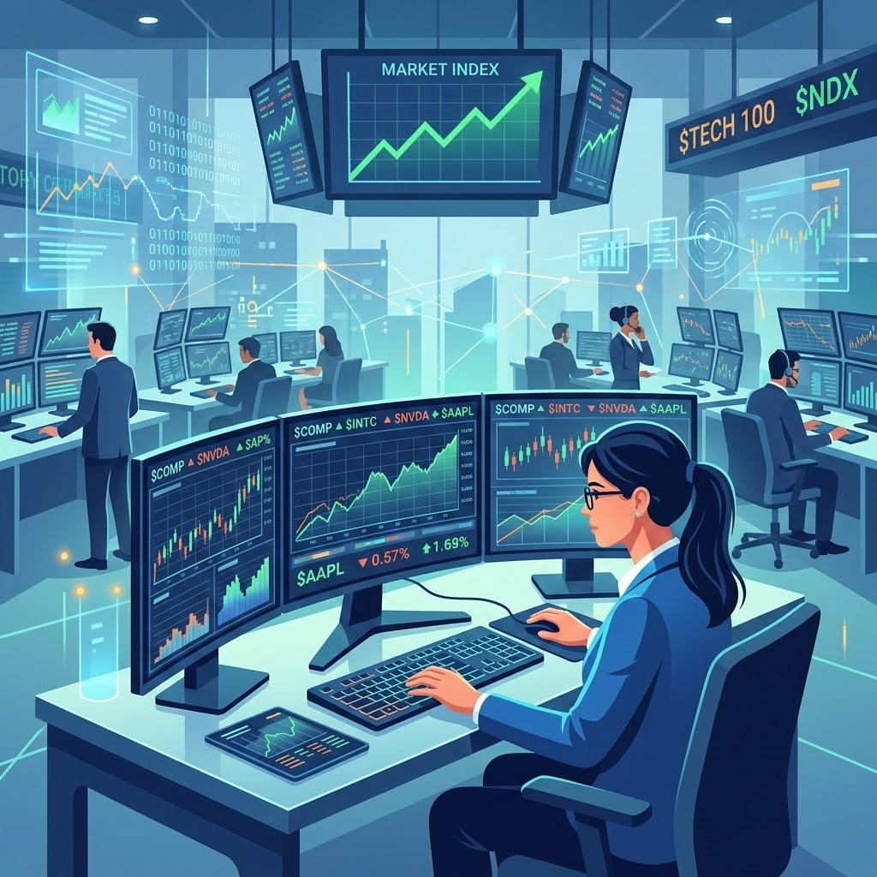
MARKET DYNAMICS
Efficiency & Fragility
AI improves market efficiency by narrowing spreads and ensuring instant price discovery. However, the rise of "Phantom Liquidity" and cascading risks can lead to events like the 2010 Flash Crash.
Employment is shifting from floor traders to specialists in algorithm development and data architecture.

Slide 8
ETHICS & REGULATION
Algorithmic Bias: Unintentional reinforcement of biases present in training data, leading to unfair advantages.
Market Manipulation: Risks of HFT deceptive practices such as "Spoofing" and "Layering" to push prices artificially.
Regulatory Push: EU AI Act (2026) and MiFID II are enforcing stricter transparency and auditing for "Black Box" models.
Systemic Risk: Interconnected systems creating dangerous feedback loops during periods of market stress.

Slide 9
Thank You
‹#›

