Slide 1
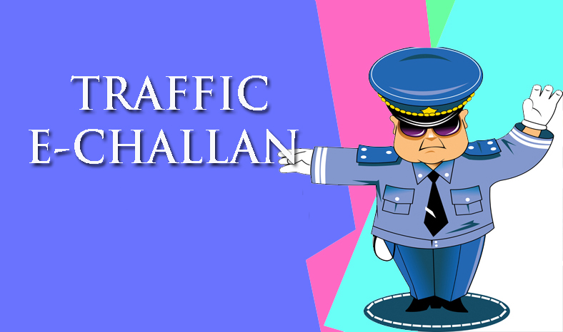
MI 17 Hackathon Chandigarh
Theme Name : Smart City App with Gamification
Solution Name : TMS Traffic Management System
Location :Chandigarh
Team Name : Chandigarh Rockers
Team lead Name : Simarjeet Singh Chera
<Manmohan, Kamal, Simarjeet, Manjeet, Sukhvinder>

Slide 2
Solution Summary
Problem statement
Digitize issuance of Traffic Challan in digital format. Supports addition of unique identification No. (Aadhar card).
Along with Driving license and vehicle registration certificate.
Brief Description
Issuance of Traffic Challan requests is still manual process. And takes a considerable amount of paper work to issue challan to a culprit.
First the police officer spots a possible violator. Asks for various documents like Driving license, Registration certificate. Fills challan form and issues the challan.
Here we are trying to digitize the challan issuance process using Aadhar card.
Gamification implemented on basis of challan count of police officers.
What is unique about my solution?
Solution get its uniqueness from the fact that here the officer only has to fill certain fields in form of user details and submit it to issue challan.
Some people are also proclaimed offenders. The app keeps the Challan history of a person and displays it after a challan is issued.

Slide 3
Solution Summary
Technologies used
Domains that can consume this solution
Java 1.8, Spring boot 1.3.3, Hibernate | Smart City
Swagger, Angular 2, Ionic 2, Node6.5
Cordova1.5, Android sdk 25
Postgresql-9.2.19-1

Slide 4
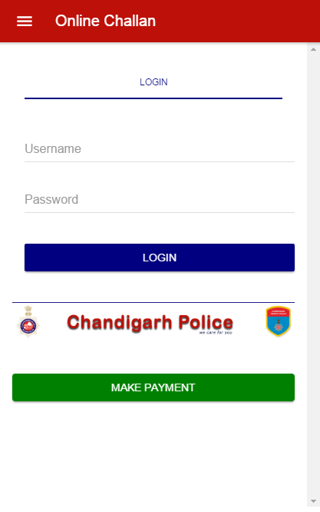
Application snapshots: Login to online challan

Slide 5
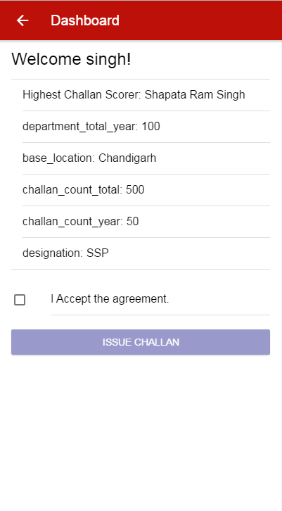
Application snapshots: Dashboard

Slide 6
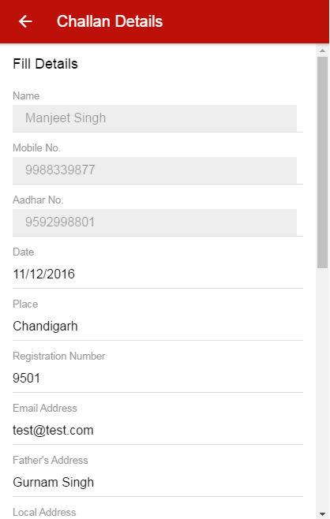
Application snapshots: Challan Details

Slide 7
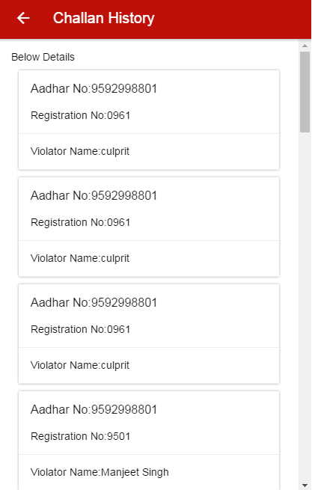
Application snapshots: Challan History

Slide 8
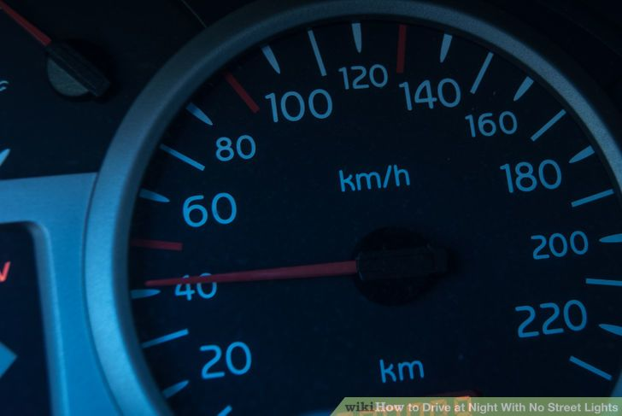
Thank You

