Slide 1
Graphs
Chapter 10

Slide 2
Chapter Summary
Graphs and Graph Models
Graph Terminology and Special Types of Graphs
Representing Graphs and Graph Isomorphism
Connectivity
Euler and Hamiltonian Graphs
Shortest-Path Problems (not currently included in overheads)
Planar Graphs (not currently included in overheads)
Graph Coloring (not currently included in overheads)

Slide 3
Graphs and Graph Models
Section 10.1

Slide 4
Section Summary
Introduction to Graphs
Graph Taxonomy
Graph Models

Slide 5
Graphs
Definition: A graph G = (V, E) consists of a nonempty set V of vertices (or nodes) and a set E of edges. Each edge has either one or two vertices associated with it, called its endpoints. An edge is said to connect its endpoints.
Remarks:
The graphs we study here are unrelated to graphs of functions studied in Chapter 2.
We have a lot of freedom when we draw a picture of a graph. All that matters is the connections made by the edges, not the particular geometry depicted. For example, the lengths of edges, whether edges cross, how vertices are depicted, and so on, do not matter
A graph with an infinite vertex set is called an infinite graph. A graph with a finite vertex set is called a finite graph. We (following the text) restrict our attention to finite graphs.
Example:
a
b
This is a graph with four vertices and five edges.
d
c

Slide 6
Some Terminology
In a simple graph each edge connects two different vertices and no two edges connect the same pair of vertices.
Multigraphs may have multiple edges connecting the same two vertices. When m different edges connect the vertices u and v, we say that {u,v} is an edge of multiplicity m.
An edge that connects a vertex to itself is called a loop.
A pseudograph may include loops, as well as multiple edges connecting the same pair of vertices.
Example:
This pseudograph has both multiple edges and a loop.
a
b
Remark: There is no standard terminology for graph theory. So, it is crucial that you understand the terminology being used whenever you read material about graphs.
c

Slide 7
Directed Graphs
Definition: A directed graph (or digraph) G = (V, E) consists of a nonempty set V of vertices (or nodes) and a set E of directed edges (or arcs). Each edge is associated with an ordered pair of vertices. The directed edge associated with the ordered pair (u,v) is said to start at u and end at v.
Remark:
Graphs where the end points of an edge are not ordered are said to be undirected graphs.

Slide 8
Some Terminology (continued)
A simple directed graph has no loops and no multiple edges.
A directed multigraph may have multiple directed edges. When there are m directed edges from the vertex u to the vertex v, we say that (u,v) is an edge of multiplicity m.
Example:
a
b
This is a directed graph with three vertices and four edges.
c
Example:
In this directed multigraph the multiplicity of (a,b) is 1 and the multiplicity of (b,c) is 2.
a
b
c

Slide 9
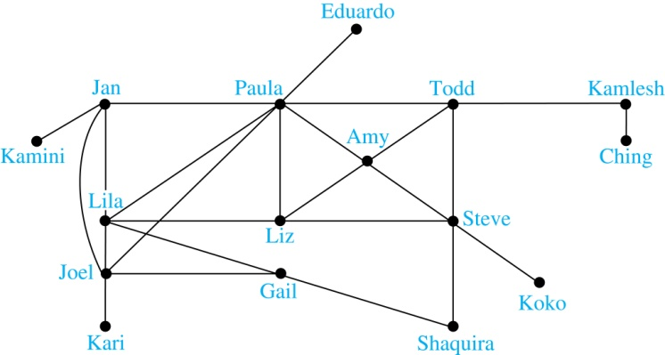
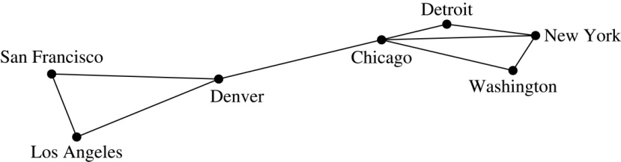
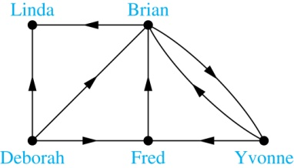
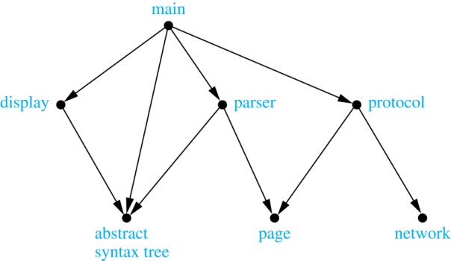
Graphs are Everywhere!
Computer Networks
Social Networks
Influence Networks
SW Module Dependency Graphs

Slide 10
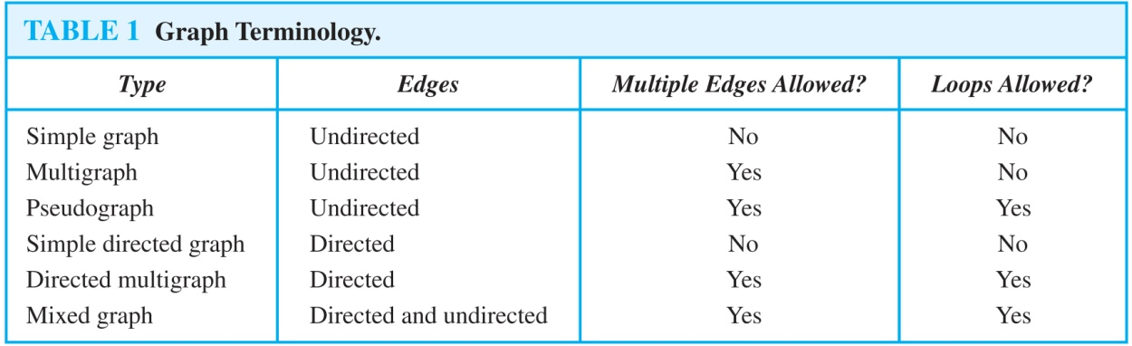
Graph Terminology: Summary
To understand the structure of a graph and to build a graph model, we ask these questions:
Are the edges of the graph undirected or directed (or both)?
If the edges are undirected, are multiple edges present that connect the same pair of vertices? If the edges are directed, are multiple directed edges present?
Are loops present?

Slide 11
Graph Terminology and Special Types of Graphs
Section 10.2

Slide 12
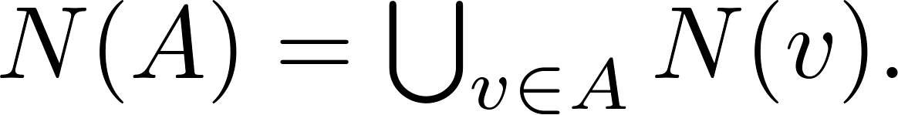
Basic Terminology
Definition 1. Two vertices u, v in an undirected graph G are called adjacent (or neighbors) in G if there is an edge e between u and v. Such an edge e is called incident with the vertices u and v and e is said to connect u and v.
Definition 2. The set of all neighbors of a vertex v of G = (V, E), denoted by N(v), is called the neighborhood of v. If A is a subset of V, we denote by N(A) the set of all vertices in G that are adjacent to at least one vertex in A. So,
Definition 3. The degree of a vertex in an undirected graph is the number of edges incident with it, except that a loop at a vertex contributes two to the degree of that vertex. The degree of the vertex v is denoted by deg(v).

Slide 13
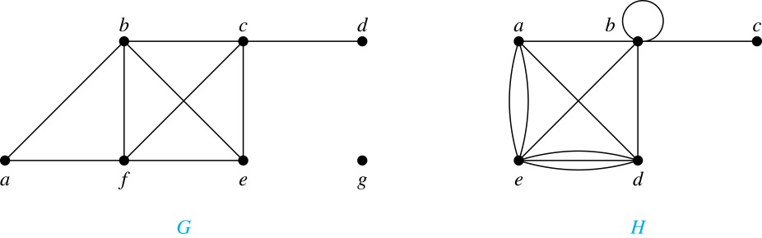
Degrees & Neighborhoods of Vertices
Example: What are the degrees and neighborhoods of the vertices in the graphs G and H?
Solution:
G: deg(a) = 2, deg(b) = deg(c) = deg(f ) = 4, deg(d ) = 1,
deg(e) = 3, deg(g) = 0.
N(a) = {b, f }, N(b) = {a, c, e, f }, N(c) = {b, d, e, f }, N(d) = {c},
N(e) = {b, c , f }, N(f) = {a, b, c, e}, N(g) = ∅ .
H: deg(a) = 4, deg(b) = deg(e) = 6, deg(c) = 1, deg(d) = 5.
N(a) = {b, d, e}, N(b) = {a, b, c, d, e}, N(c) = {b},
N(d) = {a, b, e}, N(e) = {a, b ,d}.

Slide 14
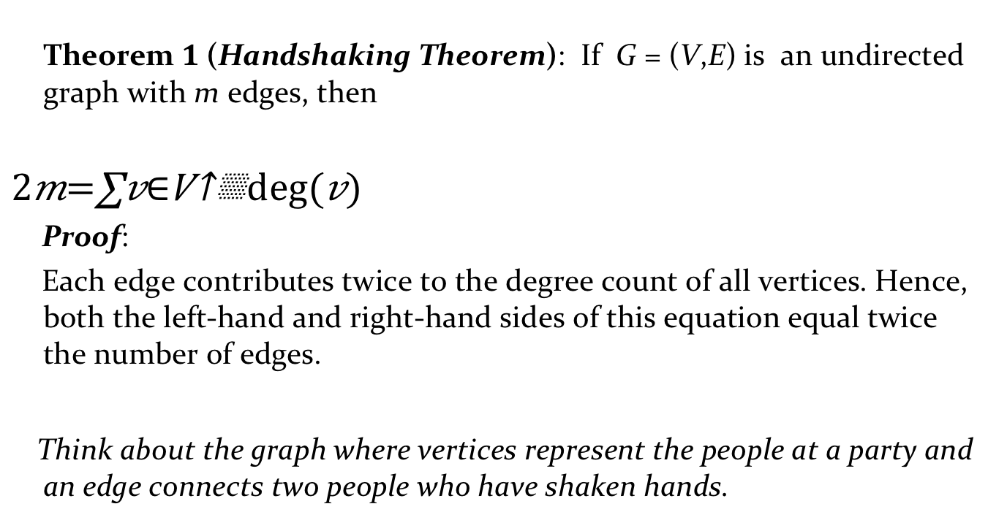
Degrees of Vertices
Theorem 1 (Handshaking Theorem): If G = (V,E) is an undirected graph with m edges, then
$$2m=\sum_{v∈V}{deg⁡(v)}$$
Proof:
Each edge contributes twice to the degree count of all vertices. Hence, both the left-hand and right-hand sides of this equation equal twice the number of edges.
Think about the graph where vertices represent the people at a party and an edge connects two people who have shaken hands.

Slide 15
Handshaking Theorem
We now give two examples illustrating the usefulness of the handshaking theorem.
Example: How many edges are there in a graph with 10 vertices of degree six?
Solution: Because the sum of the degrees of the vertices is 6 ⋅ 10 = 60, the handshaking theorem tells us that 2m = 60. So the number of edges m = 30.
Example: If a graph has 5 vertices, can each vertex have degree 3?
Solution: This is not possible by the handshaking theorem, because the sum of the degrees of the vertices 3 ⋅ 5 = 15 is odd.

Slide 16
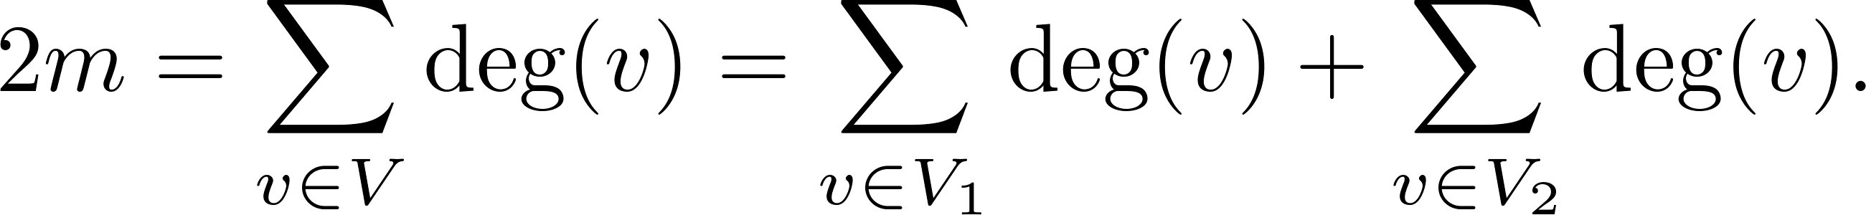
Degree of Vertices (continued)
Theorem 2: An undirected graph has an even number of vertices of odd degree.
Proof: Let V₁ be the vertices of even degree and V₂ be the vertices of odd degree in an undirected graph G = (V, E) with m edges. Then
even
This sum must be even because 2m is even and the sum of the degrees of the vertices of even degrees is also even. Because this is the sum of the degrees of all vertices of odd degree in the graph, there must be an even number of such vertices.
must be even since deg(v) is even for each v ∈ V₁

Slide 17
Directed Graphs
Recall the definition of a directed graph.
Definition: A directed graph G = (V, E) consists of V, a nonempty set of vertices (or nodes), and E, a set of directed edges or arcs. Each edge is an ordered pair of vertices. The directed edge (u,v) is said to start at u and end at v.
Definition: Let (u,v) be an edge in G. Then u is the initial vertex of this edge and is adjacent to v and v is the terminal (or end) vertex of this edge and is adjacent from u. The initial and terminal vertices of a loop are the same.

Slide 18
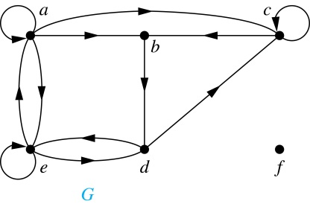
Directed Graphs (continued)
Definition: The in-degree of a vertex v, denoted deg⁻(v), is the number of edges which terminate at v. The out-degree of v, denoted deg⁺(v), is the number of edges with v as their initial vertex. Note that a loop at a vertex contributes 1 to both the in-degree and the out-degree of the vertex.
Example: In the graph G we have
deg⁻(a) = 2, deg⁻(b) = 2, deg⁻(c) = 3, deg⁻(d) = 2,
deg⁻(e) = 3, deg⁻(f) = 0.
deg⁺(a) = 4, deg⁺(b) = 1, deg⁺(c) = 2, deg⁺(d) = 2,
deg⁺ (e) = 3, deg⁺(f) = 0.

Slide 19
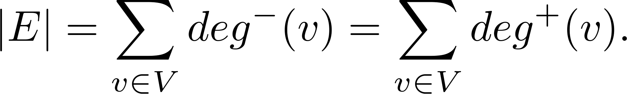
Directed Graphs (continued)
Theorem 3: Let G = (V, E) be a graph with directed edges. Then:
Proof: The first sum counts the number of incoming edges over all vertices and the second sum counts the number of outgoing edges over all vertices. It follows that both sums equal the number of edges in the graph.

Slide 20
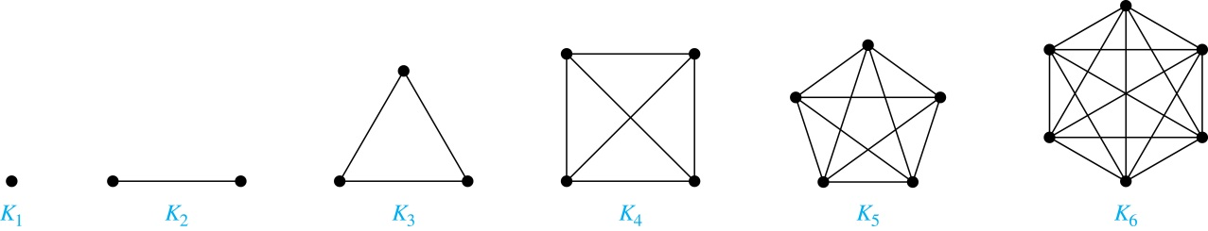
Special Types of Simple Graphs: Complete Graphs
A complete graph on n vertices, denoted by K_{n}, is the simple graph that contains exactly one edge between each pair of distinct vertices.

Slide 21
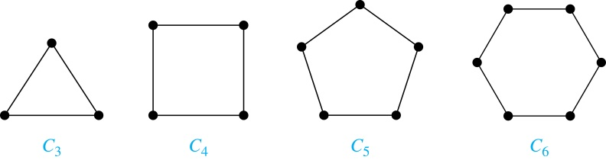
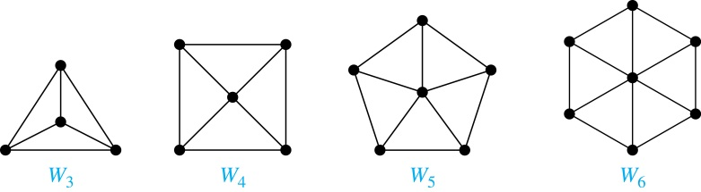
Special Types of Simple Graphs: Cycles and Wheels
A cycle C_{n} for n ≥ 3 consists of n vertices v₁, v₂ ,⋯ , v_{n}, and edges {v₁, v₂}, {v₂, v₃} ,⋯ , {v_{n-1}, v_{n}}, {v_{n}, v₁}.
A wheel W_{n} is obtained by adding an additional vertex to a cycle C_{n} for n ≥ 3 and connecting this new vertex to each of the n vertices in C_{n} by new edges.

Slide 22
Representing Graphs
Section 10.3

Slide 23
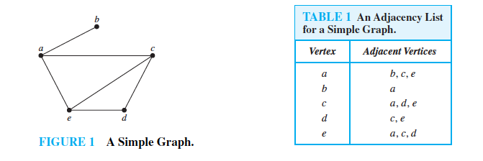
Adjacency List Representation

Slide 24
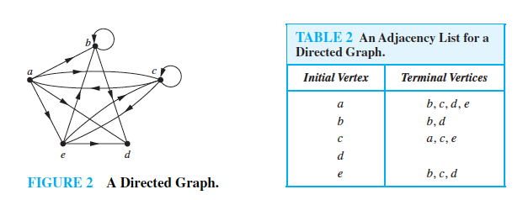
Adjacency List Representation

Slide 25
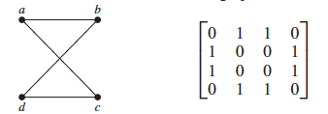
Adjacency Matrices

Slide 26
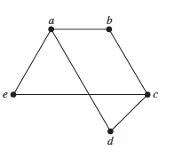
Depth-First Traversal/Search
1 procedure DFS(G:graph, v:vertex in G):
2 label v as discovered /* or display v */
3 for vertices w in adjacency list for v do
4 if vertex w is not labeled as visited then
5 DFS(G,w)
In which order will DFS visit the nodes starting with a:

Slide 27
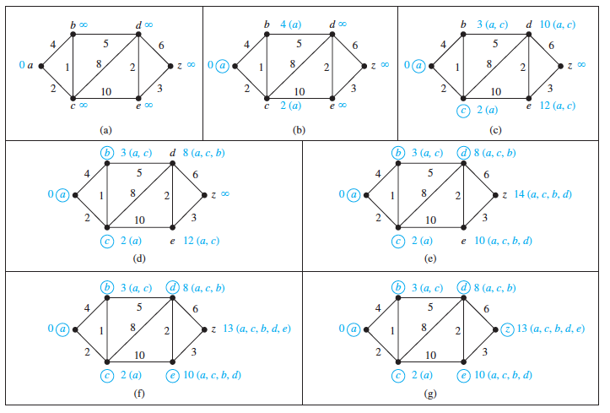
Dijkstra’s Shortest Paths Algorithm

Slide 28
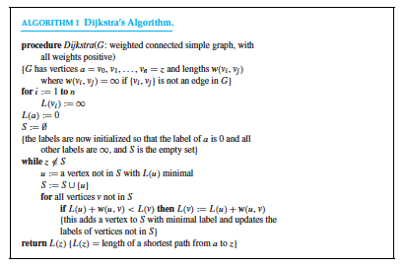
Dijkstra’s Shortest Paths Algorithm

