Slide 1
Number Theory
Text book: Discrete Mathematics and its Applications, 7th Edition

Slide 2
Introduction to Number Theory
Number theory is about integers and their properties.
We will start with the basic principles of
divisibility,
greatest common divisors,
least common multiples, and
modular arithmetic
and look at some relevant algorithms.

Slide 3
Division
If a and b are integers with a ≠ 0, we say that a divides b if there is an integer c so that b = ac.
When a divides b we say that a is a factor of b and that b is a multiple of a.
The notation a | b means that a divides b.
We write a X b when a does not divide b
(see book for correct symbol).

Slide 4
Example
Example: Determine whether 3 | 7 and whether 3 | 12.

Slide 5
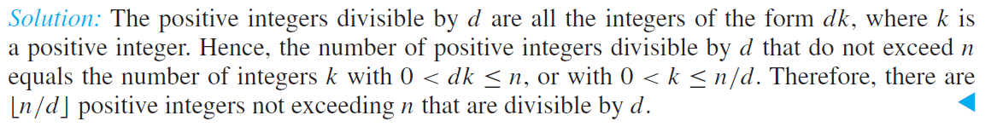
Example
Let n and d be positive integers. How many positive integers not exceeding n are divisible by d?

Slide 6
Divisibility Theorems
For integers a, b, and c it is true that
if a | b and a | c, then a | (b + c)
Example: 3 | 6 and 3 | 9, so 3 | 15.
if a | b, then a | bc for all integers c
Example: 5 | 10, so 5 | 20, 5 | 30, 5 | 40, …
if a | b and b | c, then a | c
Example: 4 | 8 and 8 | 24, so 4 | 24.

Slide 7
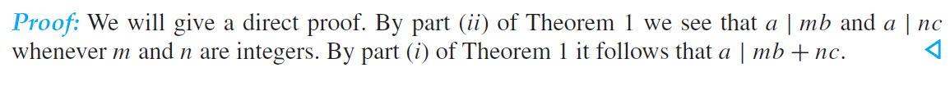
Properties of Divisibility
Proof: (i) Suppose a | b and a | c, then it follows that there are integers s and t with b = as and c = at. Hence,
b + c = as + at = a(s + t). Hence, a | (b + c)
Corollary: If a, b, and c be integers, where a ≠0, such that a | b and a | c, then a | mb + nc whenever m and n are integers.

Slide 8
Primes
A positive integer p greater than 1 is called prime if the only positive factors of p are 1 and p.
A positive integer that is greater than 1 and is not prime is called composite.
The fundamental theorem of arithmetic:
Every positive integer can be written uniquely as the product of primes, where the prime factors are written in order of increasing size.

Slide 9
Primes
Examples:
15 =
3·5
48 =
2·2·2·2·3 = 2⁴·3
17 =
17
100 =
2·2·5·5 = 2²·5²
512 =
2·2·2·2·2·2·2·2·2 = 2⁹
515 =
5·103
28 =
2·2·7

Slide 10
Primes
If n is a composite integer, then n has a prime divisor less than or equal .
This is easy to see: if n is a composite integer, it must have two prime divisors p₁ and p₂ such that p₁⋅p₂ = n.
p₁ and p₂ cannot both be greater than
, because then p₁⋅p₂ > n.

Slide 11
The Division Algorithm
Let a be an integer and d a positive integer.
Then there are unique integers q and r, with 0 ≤ r < d, such that a = dq + r.
In the above equation,
d is called the divisor,
a is called the dividend,
q is called the quotient, and
r is called the remainder.

Slide 12
The Division Algorithm
Example:
When we divide 17 by 5, we have
17 = 5⋅3 + 2.
17 is the dividend,
5 is the divisor,
3 is called the quotient, and
2 is called the remainder.

Slide 13
The Division Algorithm
Another example:
What happens when we divide -11 by 3 ?
Note that the remainder cannot be negative.
-11 = 3⋅(-4) + 1.
-11 is the dividend,
3 is the divisor,
-4 is called the quotient, and
1 is called the remainder.

Slide 14
Greatest Common Divisors
Let a and b be integers, not both zero.
The largest integer d such that d | a and d | b is called the greatest common divisor of a and b.
The greatest common divisor of a and b is denoted by gcd(a, b).
Example 1: What is gcd(48, 72) ?
The positive common divisors of 48 and 72 are 1, 2, 3, 4, 6, 8, 12, 16, and 24, so gcd(48, 72) = 24.
Example 2: What is gcd(19, 72) ?
The only positive common divisor of 19 and 72 is 1, so gcd(19, 72) = 1.

Slide 15
Greatest Common Divisors
Using prime factorizations:
a = p₁ª1 p₂ª2 … p_{n}ªn , b = p₁^{b}1 p₂^{b}2 … p_{n}^{b}n ,
where p₁ < p₂ < … < p_{n} and a_{i}, b_{i} ∈ N for 1 ≤ i ≤ n
gcd(a, b) = p₁^{min(a}1^{, b}1 ⁾ p₂^{min(a}2^{, b}2 ⁾ … p_{n}^{min(a}n^{, b}n ⁾
Example:
a = 60 =
2² 3¹ 5¹
b = 54 =
2¹ 3³ 5⁰
gcd(a, b) =
2¹ 3¹ 5⁰ = 6

Slide 16
Relatively Prime Integers
Definition:
Two integers a and b are relatively prime if gcd(a, b) = 1.
Examples:
Are 15 and 28 relatively prime?
Yes, gcd(15, 28) = 1.
Are 55 and 28 relatively prime?
Yes, gcd(55, 28) = 1.
Are 35 and 28 relatively prime?
No, gcd(35, 28) = 7.

Slide 17
Relatively Prime Integers
Definition:
The integers a₁, a₂, …, a_{n} are pairwise relatively prime if gcd(a_{i}, a_{j}) = 1 whenever 1 ≤ i < j ≤ n.
Examples:
Are 15, 17, and 27 pairwise relatively prime?
No, because gcd(15, 27) = 3.
Are 15, 17, and 28 pairwise relatively prime?
Yes, because gcd(15, 17) = 1, gcd(15, 28) = 1 and gcd(17, 28) = 1.

Slide 18
Least Common Multiples
Definition:
The least common multiple of the positive integers a and b is the smallest positive integer that is divisible by both a and b.
We denote the least common multiple of a and b by lcm(a, b).
Examples:
lcm(3, 7) =
21
lcm(4, 6) =
12
lcm(5, 10) =
10

Slide 19
Least Common Multiples
Using prime factorizations:
a = p₁ª1 p₂ª2 … p_{n}ªn , b = p₁^{b}1 p₂^{b}2 … p_{n}^{b}n ,
where p₁ < p₂ < … < p_{n} and a_{i}, b_{i} ∈ N for 1 ≤ i ≤ n
lcm(a, b) = p₁^{max(a}1^{, b}1 ⁾ p₂^{max(a}2^{, b}2 ⁾ … p_{n}^{max(a}n^{, b}n ⁾
Example:
a = 60 =
2² 3¹ 5¹
b = 54 =
2¹ 3³ 5⁰
lcm(a, b) =
2² 3³ 5¹ = 4275 = 540

Slide 20
GCD and LCM
a = 60 =
2² 3¹ 5¹
b = 54 =
2¹ 3³ 5⁰
gcd(a, b) =
2¹ 3¹ 5⁰ = 6
lcm(a, b) =
2² 3³ 5¹ = 540
Theorem: ab =
gcd(a,b)lcm(a,b)

Slide 21
Modular Arithmetic
Let a be an integer and m be a positive integer. We denote by a mod m the remainder when a is divided by m.
Examples:
9 mod 4 =
1
9 mod 3 =
0
9 mod 10 =
9
-13 mod 4 =
3

Slide 22
Congruences
Let a and b be integers and m be a positive integer. We say that a is congruent to b modulo m if m divides a – b.
We use the notation a ≡ b (mod m) to indicate that a is congruent to b modulo m.
In other words: a ≡ b (mod m) if and only if a mod m = b mod m.

Slide 23
Congruences
Examples:
Is it true that 46 ≡ 68 (mod 11) ?
Yes, because 11 | (46 – 68).
Is it true that 46 ≡ 68 (mod 22)?
Yes, because 22 | (46 – 68).
For which integers z is it true that z ≡ 12 (mod 10)?
It is true for any z∈{…,-28, -18, -8, 2, 12, 22, 32, …}
Theorem: Let m be a positive integer. The integers a and b are congruent modulo m if and only if there is an integer k such that a = b + km.

Slide 24
Congruences
Theorem: Let m be a positive integer. If a ≡ b (mod m) and c ≡ d (mod m), then a + c ≡ b + d (mod m) and ac ≡ bd (mod m).
Proof:
We know that a ≡ b (mod m) and c ≡ d (mod m) implies that there are integers s and t with b = a + sm and d = c + tm.
Therefore,
b + d = (a + sm) + (c + tm) = (a + c) + m(s + t) and
bd = (a + sm)(c + tm) = ac + m(at + cs + stm).
Hence, a + c ≡ b + d (mod m) and ac ≡ bd (mod m).

Slide 25
The Euclidean Algorithm
The Euclidean Algorithm finds the greatest common divisor of two integers a and b.
For example, if we want to find gcd(287, 91), we divide 287 by 91:
287 = 91⋅3 + 14
We know that for integers a, b and c, if a | b and a | c, then a | (b + c).
Therefore, any divisor of 287 and 91 must also be a divisor of 287 - 91⋅3 = 14.
Consequently, gcd(287, 91) = gcd(14, 91).

Slide 26
The Euclidean Algorithm
In the next step, we divide 91 by 14:
91 = 14⋅6 + 7
This means that gcd(14, 91) = gcd(14, 7).
So we divide 14 by 7:
14 = 7⋅2 + 0
We find that 7 | 14, and thus gcd(14, 7) = 7.
Therefore, gcd(287, 91) = 7.

Slide 27
The Euclidean Algorithm
In pseudocode, the algorithm can be implemented as follows:
procedure gcd(a, b: positive integers)
x := a
y := b
while y ≠ 0
begin
r := x mod y
x := y
y := r
end {x is gcd(a, b)}

Slide 28
Representations of Integers
Let b be a positive integer greater than 1. Then if n is a positive integer, it can be expressed uniquely in the form:
n = a_{k}b^{k} + a_{k-1}b^{k-1} + … + a₁b + a₀,
where k is a nonnegative integer,
a₀, a₁, …, a_{k} are nonnegative integers less than b,
and a_{k} ≠ 0.
Example for b=10:
859 = 8⋅10² + 5⋅10¹ + 9⋅10⁰

Slide 29
Representations of Integers
Example for b=2 (binary expansion):
(10110)₂ = 1⋅2⁴ + 1⋅2² + 1⋅2¹ = (22)₁₀
Example for b=16 (hexadecimal expansion):
(we use letters A to F to indicate numbers 10 to 15)
(3A0F)₁₆ = 3⋅16³ + 10⋅16² + 15⋅16⁰ = (14863)₁₀

Slide 30
Example
What is the decimal expansion of the integer that has (1 0101 1111)₂ as its binary expansion?
Solution:
(1 0101 1111)₂ = 1∙2⁸ + 0∙2⁷ + 1∙2⁶ + 0∙2⁵ + 1∙2⁴ + 1∙2³ + 1∙2² + 1∙2¹ + 1∙2⁰ =351.
What is the decimal expansion of the number with octal expansion (7016)₈ ?
Solution: 7∙8³ + 0∙8² + 1∙8¹ + 6∙8⁰ =3598

Slide 31
Example
Example: What is the decimal expansion of the number with hexadecimal expansion (2AE0B)₁₆ ?
Solution:
2∙16⁴ + 10∙16³ + 14∙16² + 0∙16¹ + 11∙16⁰ =175627
Example: What is the decimal expansion of the number with hexadecimal expansion (E5)₁₆ ?
Solution: 1∙16² + 14∙16¹ + 5∙16⁰ = 256 + 224 + 5 = 485

Slide 32
Representations of Integers
How can we construct the base b expansion of an integer n?
First, divide n by b to obtain a quotient q₀ and remainder a₀, that is,
n = bq₀ + a₀, where 0 ≤ a₀ < b.
The remainder a₀ is the rightmost digit in the base b expansion of n.
Next, divide q₀ by b to obtain:
q₀ = bq₁ + a₁, where 0 ≤ a₁ < b.
a₁ is the second digit from the right in the base b expansion of n. Continue this process until you obtain a quotient equal to zero.

Slide 33
Algorithm: Constructing Base b Expansions
q represents the quotient obtained by successive divisions by b, starting with q = n.
The digits in the base b expansion are the remainders of the division given by q mod b.
The algorithm terminates when q = 0 is reached.
procedure base b expansion(n, b: positive integers with b > 1)
q := n
k := 0
while (q ≠ 0)
a_{k} := q mod b
q := q div b
k := k + 1
return(a_{k-1} ,…, a₁,a₀){(a_{k-1} … a₁a₀)_{b} is base b expansion of n}

Slide 34
Representations of Integers
Example: What is the base 8 expansion of (12345)₁₀ ?
First, divide 12345 by 8:
12345 = 8⋅1543 + 1
1543 = 8⋅192 + 7
192 = 8⋅24 + 0
24 = 8⋅3 + 0
3 = 8⋅0 + 3
The result is: (12345)₁₀ = (30071)₈.

Slide 35
Representations of Integers
procedure base_b_expansion(n, b: positive integers)
q := n
k := 0
while q ≠ 0
begin
a_{k} := q mod b
q := ⎣q/b⎦
k := k + 1
end
{the base b expansion of n is (a_{k-1} … a₁a₀)_{b} }

Slide 36
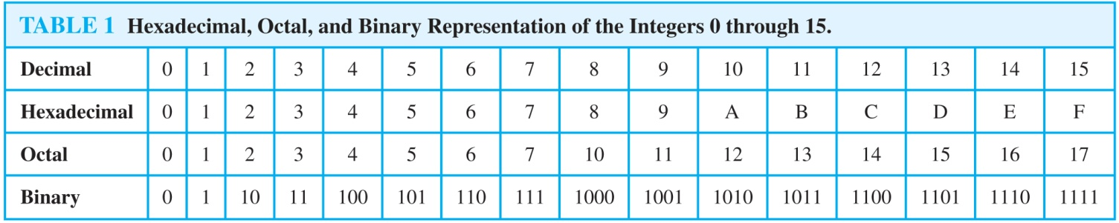
Comparison of Hexadecimal, Octal, and Binary Representations
Initial 0s are not shown
Each octal digit corresponds to a block of 3 binary digits.
Each hexadecimal digit corresponds to a block of 4 binary digits.
So, conversion between binary, octal, and hexadecimal is easy.

Slide 37
Conversion Between Binary, Octal, and Hexadecimal Expansions
Example: Find the octal and hexadecimal expansions of (11 1110 1011 1100)₂.
Solution:
To convert to octal, we group the digits into blocks of three (011 111 010 111 100)₂, adding initial 0s as needed. The blocks from left to right correspond to the digits 3,7,2,7, and 4. Hence, the solution is (37274)₈.
To convert to hexadecimal, we group the digits into blocks of four (0011 1110 1011 1100)₂, adding initial 0s as needed. The blocks from left to right correspond to the digits 3,E,B, and C. Hence, the solution is (3EBC)₁₆.

Slide 38
Addition of Integers
Let a = (a_{n-1}a_{n-2}…a₁a₀)₂, b = (b_{n-1}b_{n-2}…b₁b₀)_{2.}
How can we add these two binary numbers?
First, add their rightmost bits:
a₀ + b₀ = c₀⋅2 + s₀,
where s₀ is the rightmost bit in the binary expansion of a + b, and c₀ is the carry.
Then, add the next pair of bits and the carry:
a₁ + b₁ + c₀ = c₁⋅2 + s₁,
where s₁ is the next bit in the binary expansion of a + b, and c₁ is the carry.

Slide 39
Addition of Integers
Continue this process until you obtain c_{n-1}.
The leading bit of the sum is s_{n} = c_{n-1}.
The result is:
a + b = (s_{n}s_{n-1}…s₁s₀)₂

Slide 40
Addition of Integers
Example:
Add a = (1110)₂ and b = (1011)₂.
a₀ + b₀ = 0 + 1 = 0⋅2 + 1, so that c₀ = 0 and s₀ = 1.
a₁ + b₁ + c₀ = 1 + 1 + 0 = 1⋅2 + 0, so c₁ = 1 and s₁ = 0.
a₂ + b₂ + c₁ = 1 + 0 + 1 = 1⋅2 + 0, so c₂ = 1 and s₂ = 0.
a₃ + b₃ + c₂ = 1 + 1 + 1 = 1⋅2 + 1, so c₃ = 1 and s₃ = 1.
s₄ = c₃ = 1.
Therefore, s = a + b = (11001)₂.

Slide 41
Addition of Integers
How do we (humans) add two integers?
Example: 7583 + 4932
1
1
carry
1
1
2
5
1
5
1
1
carry
Binary expansions: (1011)₂ + (1010)₂
(
1
0
1
0
1
)₂

Slide 42
Addition of Integers
Let a = (a_{n-1}a_{n-2}…a₁a₀)₂, b = (b_{n-1}b_{n-2}…b₁b₀)_{2.}
How can we algorithmically add these two binary numbers?
First, add their rightmost bits:
a₀ + b₀ = c₀⋅2 + s₀,
where s₀ is the rightmost bit in the binary expansion of a + b, and c₀ is the carry.
Then, add the next pair of bits and the carry:
a₁ + b₁ + c₀ = c₁⋅2 + s₁,
where s₁ is the next bit in the binary expansion of a + b, and c₁ is the carry.

Slide 43
Addition of Integers
Continue this process until you obtain c_{n-1}.
The leading bit of the sum is s_{n} = c_{n-1}.
The result is:
a + b = (s_{n}s_{n-1}…s₁s₀)₂

Slide 44
Addition of Integers
Example:
Add a = (1110)₂ and b = (1011)₂.
a₀ + b₀ = 0 + 1 = 0⋅2 + 1, so that c₀ = 0 and s₀ = 1.
a₁ + b₁ + c₀ = 1 + 1 + 0 = 1⋅2 + 0, so c₁ = 1 and s₁ = 0.
a₂ + b₂ + c₁ = 1 + 0 + 1 = 1⋅2 + 0, so c₂ = 1 and s₂ = 0.
a₃ + b₃ + c₂ = 1 + 1 + 1 = 1⋅2 + 1, so c₃ = 1 and s₃ = 1.
s₄ = c₃ = 1.
Therefore, s = a + b = (11001)₂.

Slide 45
Addition of Integers
procedure add(a, b: positive integers)
c := 0
for j := 0 to n-1
begin
d := ⎣(a_{j} + b_{j} + c)/2⎦
s_{j} := a_{j} + b_{j} + c – 2d
c := d
end
s_{n} := c
{the binary expansion of the sum is (s_{n}s_{n-1}…s₁s₀)₂}

Slide 46
Binary Multiplication of Integers
Algorithm for computing the product of two n bit integers.
The number of additions of bits used by the algorithm to multiply two n-bit integers is O(n²).
procedure multiply(a, b: positive integers)
{the binary expansions of a and b are (a_{n-1},a_{n-2},…,a₀)₂ and (b_{n-1},b_{n-2},…,b₀)₂, respectively}
for j := 0 to n − 1
if b_{j} = 1 then c_{j} = a shifted j places
else c_{j} := 0
{c_{o},c₁,…, c_{n-1} are the partial products}
p := 0
for j := 0 to n − 1
p := p + c_{j}
return p {p is the value of ab}

Slide 47
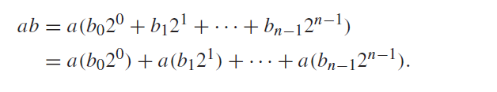
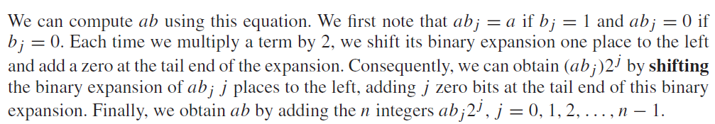
MULTIPLICATION ALGORITHM

Slide 48
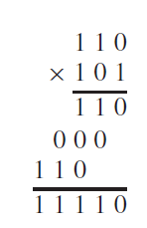
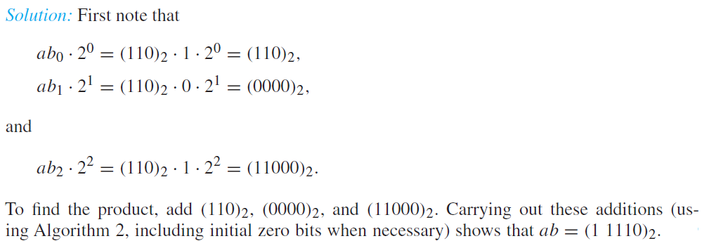
Example
Find the product of a = (110)2 and b = (101)2.

Slide 49
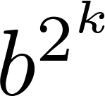
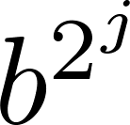
Binary Modular Exponentiation
In cryptography, it is important to be able to find b^{n} mod m efficiently, where b, n, and m are large integers.
Use the binary expansion of n, n = (a_{k-1},…,a₁,a_{o})₂ , to compute b^{n} .
Note that:
Therefore, to compute b^{n}, we need only compute the values of b, b², (b²)² = b⁴, (b⁴)² = b⁸ , …, and the multiply the terms in this list, where a_{j} = 1.
Example: Compute 3¹¹ using this method.
Solution: Note that 11 = (1011)₂ so that 3¹¹ = 3⁸ 3² 3¹ =
((3²)² )² 3² 3¹ = (9² )² ∙ 9 ∙3 = (81)² ∙ 9 ∙3 =6561 ∙ 9 ∙3 =117,147.
continued →

Slide 50
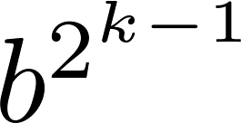
Binary Modular Exponentiation Algorithm
The algorithm successively finds b mod m, b² mod m, b⁴ mod m, …, mod m, and multiplies together the terms where a_{j} = 1.
O((log m )² log n) bit operations are used to find b^{n} mod m.
procedure modular exponentiation(b: integer, n = (a_{k-1}a_{k-2}…a₁a₀)₂ , m: positive integers)
x := 1
power := b mod m
for i := 0 to k − 1
if a_{i}= 1 then x := (x∙ power ) mod m
power := (power∙ power ) mod m
return x {x equals b^{n} mod m
}

Slide 51

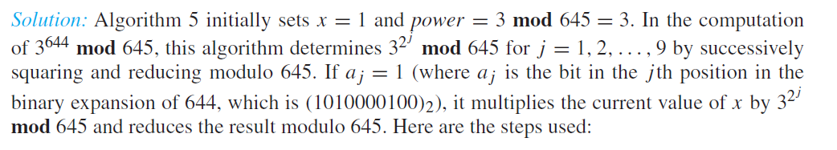
Example

Slide 52
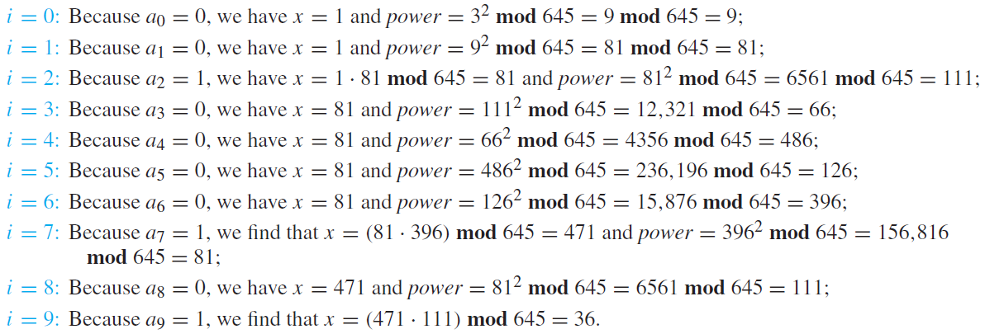
Steps

