Slide 1


B.Tech Project Presentation
Predicting Pneumonia using CNN
BTP Supervisor:
Dr. Susham Biswas

Slide 2
Table of content
Problem Statement
Motivation For Project
Methodology
Result
Conclusion

Slide 3

Problem Statement
The problem statement for our project is Predicting Pneumonia using CNN. We will employ CNN to make the classification between a normal X-ray image and a Pneumonic X-ray image. Also we will deploy our model in an web based application so that any normal person having a lung X-ray can tell if the image is Pneumonic or not

Slide 4
Motivation for this
Pneumonia is a respiratory infection / lung illness caused by a number of bacteria, fungi, or viruses; it is more frequent in developing and impoverished countries due to high levels of pollution, unsanitary living conditions, and overpopulation, as well as limited medical infrastructure.
The main aim of this project is to identify Pneumonia just by using the X-Ray images of the patients. As doctors must do a lot of certain tests to identify if the patient has Pneumonia or not because there might be some cases in which identifying infection in lungs by naked eye is difficult so to achieve remarkable efficiency and accuracy deep learning models is developed.
Pneumonia detection on CXR is hectic, to improve the efficiency and accuracy and to make the work of the doctors simpler by making the diagnosis process quicker and cheaper with a reduced reliance on the intervention of human experts.
Automated methods to detect and classify human diseases from medical images.

Slide 5
Methodology
We will be using Convolutional Neural Networks in our project since we are trying to a solve an image classification problem where we need to select features and CNN is good in feature extraction .
The convolutional neural network is formed by building a layered neural network called convolutional layers. Convolutional layers use a filter of defined size to extract various features.
What is CNN ?
A convolutional neural network (CNN) is a type of artificial neural network used in image recognition and processing that is specifically designed to process pixel data.
CNN does not require much pre-processing. The CNN image classifier takes an input, evaluates it, and categorizes it.
Images are fed into convolutional neural networks (CNNs), which prioritize different parts of the image.
CNN’s are equipped with an input layer, an output layer, and hidden layers, all of which help process and classify images. The hidden layers comprise convolutional layers, ReLU layers, pooling layers

Slide 6
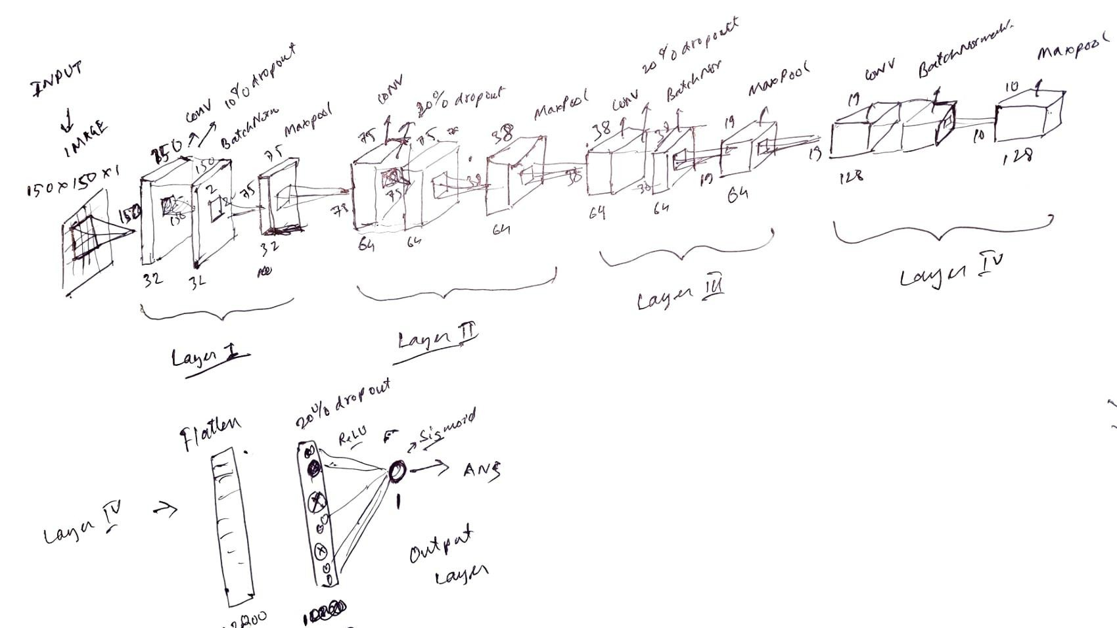
How CNN used in My project
In our input layer we are taking images of dimension 150x150x1 (grayscale) image. The filter (3x3) convolutes over the image and gives a feature map after that a activation map is produced . Now the different activation function is used and hence we extract features that is required in our project.
Similarly many layer are added to extract features of the image

Slide 7
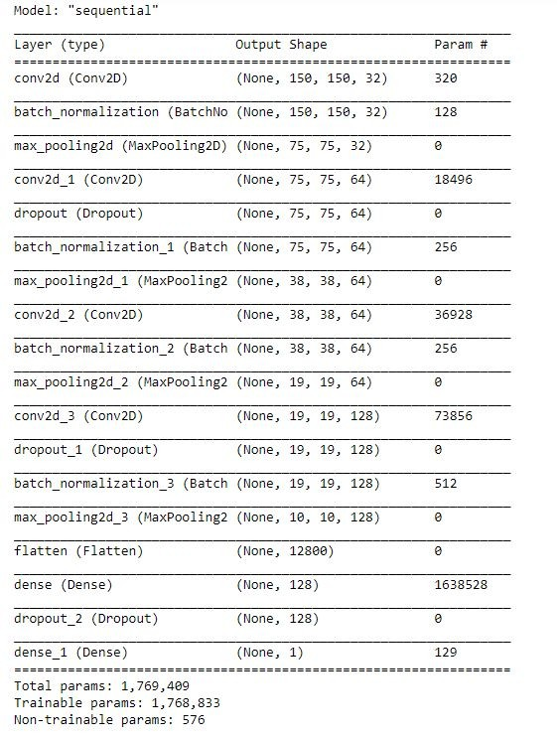
Methodology
We have a training dataset of 5216 x-ray images in jpg format divided into Pneumonic and Normal images.
Before we fit our dataset into our model we have normalized our dataset and have used data augmentation to diversify our dataset and enhance the performance of the model. The techniques used are:
Rotating image by upto 30 degrees
A zoom of 20%
Horizontal and vertical shifting by 10%
Thus by doing this we can ensure randomness in the data in our dataset so that our model does not over fit and is not vulnerable to real world data.
We have also used a variable reduce_lr. It reduces the loss when we find cases where the gradient is constant at the increase of epochs in the loss v/s epoch graph
Model Summary:
Implementation of 4 layer CNN with 2 dense layers.
Activation function used is ReLU and in the output layer Sigmoid activation function is used
We have used 50 epochs
Optimizer used is Adam

Slide 8
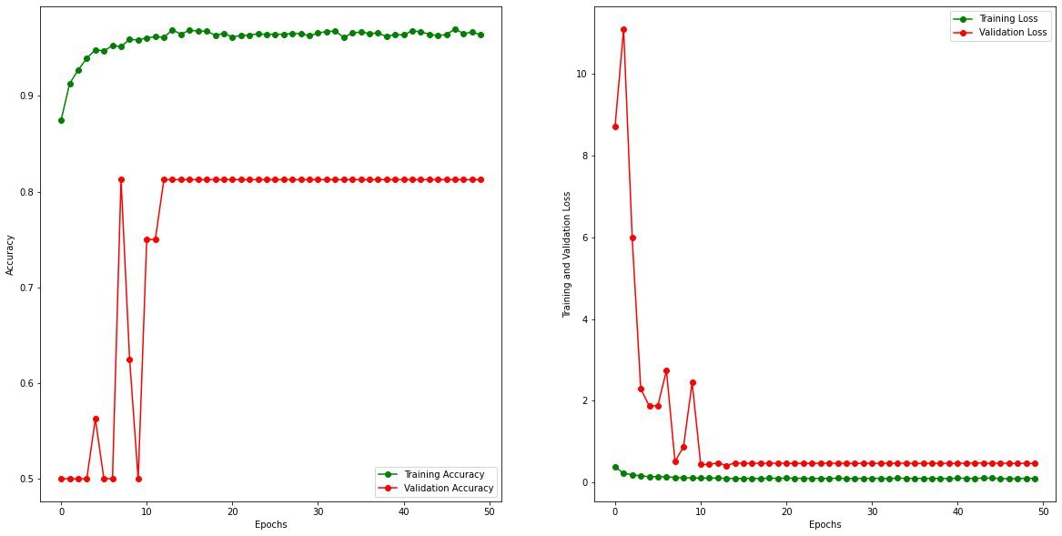
Result
We have seen a gradual increase in our validation accuracy and a gradual decrease in validation loss with the increase in number of epochs.

Slide 9
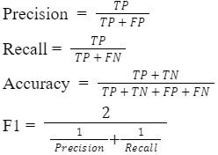
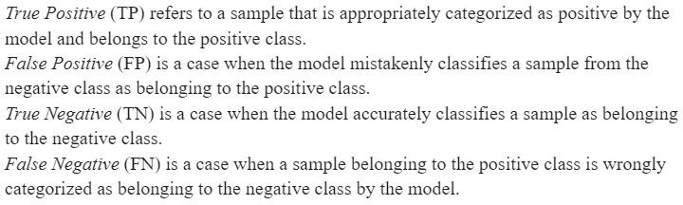

Result
We have achieved an accuracy of 91.66% and loss of 0.24 however it is not the only criteria to check the validity of our model
We also have explored different evaluation metrics. Like precision, recall, F1-score
Formula:
We have obtained the following results

Slide 10
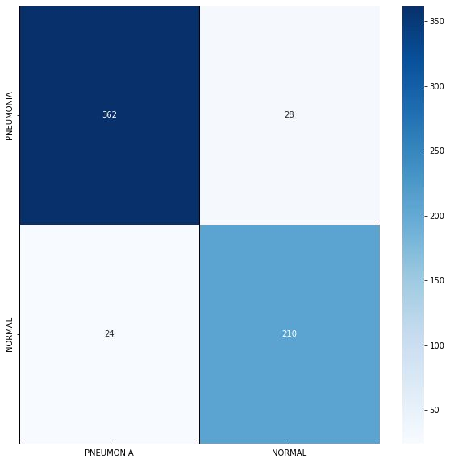
Result
A Confusion matrix is an N x N matrix used for evaluating the performance of a classification model, where N is the number of target classes. The matrix compares the actual target values with those predicted by the machine learning model.
Since in our project we are predicting an image is pneumonic or normal, or we are doing binary classification we will be having a 2 x 2 matrix
The Confusion Matrix obtained is given beside:

Slide 11
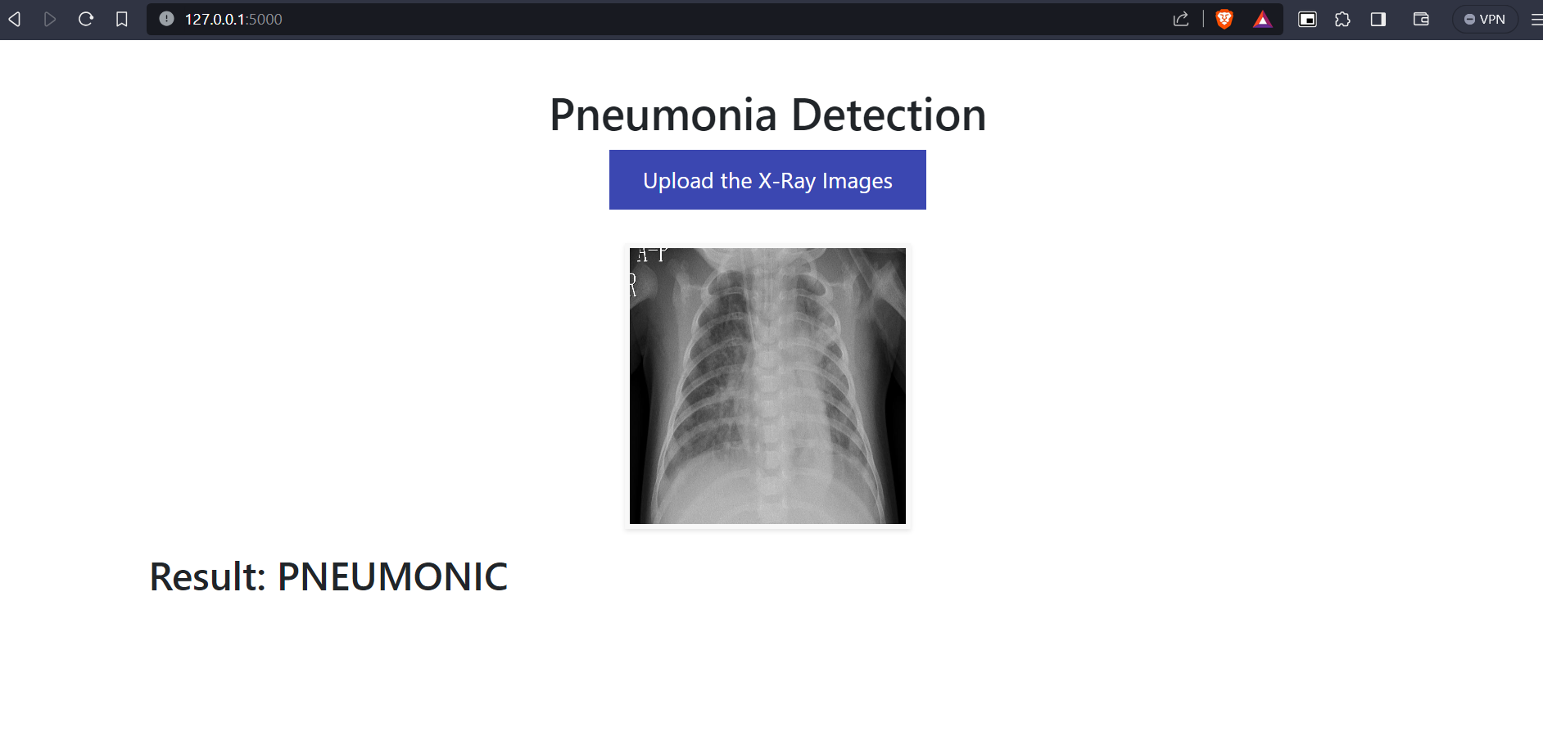
Conclusion
We have created a web-based application to help medical practitioners to systematize chest X-ray images into “Pneumonia” and “Normal” two different classes using categorization based on deep learning.

Slide 12

Thank You
Present By:
Mann Gupta
21IT3018

