Slide 1

Campus Recruitment Data Analysis
Presented by: ( Group 8 )
Manjusha Ghanwat
Vrushali Lohkare
Guided by:
Prof. Kushal Sharma

Slide 2

Problem Statement:
Can we predict that a candiate was placed on a role after their MBA studies? If so, which factors helped the most (ie. work experience, degree, school results, gender, etc)?

Slide 3
Introduction
This data set consists of Placement data of students in our campus. It includes secondary and higher secondary school percentage and specialization. It also includes degree specialization, type and Work experience and salary offers to the placed students. In Placement Prediction system predicts the probability of an undergraduate students getting placed in a company by applying classification algorithms such as KNN, SVM and Logistics Regression

Slide 4
DATA DESCRIPTION : sl_no - Serial Number gender - Gender- Male='M’, Female='F' ssc_p - Secondary Education percentage- 10th Grade ssc_b - Board of Education- Central/ Others hsc_p - Higher Secondary Education percentage- 12th Grade hsc_b - Board of Education- Central/ Others hsc_s - Specialization in Higher Secondary Education degree_p - Degree Percentage degree_t - Under Graduation(Degree type)- Field of degree education workex - Work Experience etest_p - Employability test percentage ( conducted by college) specialisation - Post Graduation(MBA)- Specialization mba_p - MBA percentage status - Status of placement- Placed/Not placed salary - Salary offered by corporate to candidates

Slide 5

Question:
Which factor influenced a candidate in getting placed?
Does percentage matters for one to get placed?
Which degree specialization is much demanded by corporate?
Play with the data conducting all statistical tests.

Slide 6
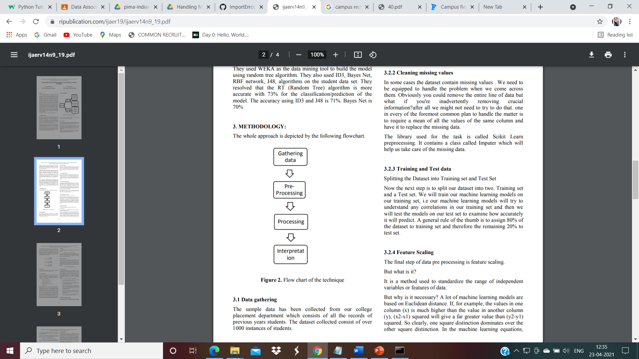
METHODOLOGY:
Fig. Flow chart of the technique

Slide 7
Machine Learning Algorithm Used for better Accuracy
KNN Algorithm
SVM Algorithm
Logistics Regression

Slide 8
Learning from the Project
The campus placement activity is incredibly a lot of vital as institution point of view as well as student point of view. In this regard to improve the student’s performance, a work has been analysed and predicted using the classification algorithms KNN, SVM and the Logistics Regression algorithm to validate the approaches. The algorithms are applied on the data set and attributes used to build the model. The accuracy obtained after analysis for KNN is 74.41%, for the SVM is 79.06% and for the Logistics Regression is 88.37%. Hence, from the above said analysis and prediction it’s better if the Logistics Regression algorithm is used to predict the placement results

